Slide 1
God Loves You

Slide 2
True story. World War II. Rome. Colonel Kepler.
Notes:
2

Slide 3
In 3-4 sentences, describe Colonel Kepler. What kind of person is he? What does he do for a living? What city is he in charge of? What time (in earth’s history) is it?

Slide 4
A few years later . . .
Notes:
4

Slide 5
In 3-4 sentences, describe what is happening (or just happened). Who was the man being chased? Why was he being chased? Why did he try to run away? Where was he going?

Slide 6
A few hours later . . .
Notes:
6

Slide 7
In 3-4 sentences, describe Colonel Kepler from what you know now. Describe Hugh O’Flaherty (the priest). What kind of person is the priest? Does he (the priest) model what Jesus would do? How do you feel about Colonel Kepler’s plea? What would you have done?

Slide 8
Let’s rewind the clock a year or so . . . and see MORE of the picture . . .
Notes:
8

Slide 9
In 3-4 sentences, describe Colonel Kepler. What do you think of him now? Did your perspective change? Imagine what else he does for a living? How does knowing more of the situation change our ideas?

Slide 10
What is the basic story of the great battle between God and satan?
Who are the main characters in the cosmic conflict? Who are the supporting cast? Who is the audience?
What stories from the Bible seem to clearly tell of the war between Christ and satan for supremacy?
What makes a hero? Why do we “root” for them? What makes a villain? What makes us cheer to see the villain foiled?
What will YOUR legacy be?
Notes:
10

Slide 11
“All the world's a stage, and all the men and women merely players; they have their exits and their entrances, and one man in his time plays many parts”
William Shakespeare

Slide 12
For I think that God hath set forth us the apostles last, as it were appointed to death: for we are made a spectacle unto the world, and to angels, and to men.
I Corinthians 4:9 (KJV)

Slide 13
For it seems to me that God has put us apostles on display at the end of the procession, like men condemned to die in the arena. We have been made a spectacle to the whole universe, to angels as well as to men.
I Corinthians 4:9 (NIV)

Slide 14
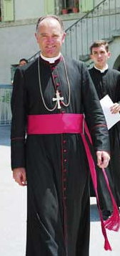
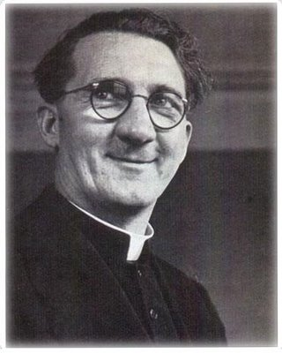
Swastika
Herbert Kappler
a monsignor
Hugh O’Flaherty
Notes:
14

Slide 15
The Scarlet and the Black
24:00
Notes:
15

Slide 16
Notes:
16

Slide 17
God Loves You

Slide 18
“The world is a stage, but the play is badly cast.”
Oscar Wilde

Slide 19
What occupation is Hugh O’Flaherty?
a) He is a boxing trainer
b) English Ambassador
c) Monsignor
What does Colonel Kappler do for a living?
a) Newspaper Reporter
b) Military Commander
c) Historical Artifact collector
Why “scarlet” and “black” in the title?
a) Because both Hugh & Herbert wear scarlet/black
b) The German Swastika is scarlet and black
c) The Vatican flag is scarlet and black

Slide 20
The Scarlet and the Black
24:00
Notes:
20

Slide 21
Journaling
Colonel Kappler promises “freedom” for the Jewish people in Rome for the price in 100lb of gold. He then breaks his promise. Did he ever really intend to keep this promise? Why did he offer the promise in the first place? Notice his demeanour—his attitude and facial expressions—while talking with the Rabbis. Yet he goes back on his word. What does this tell you about Colonel Kappler?
Prince Patao offers a warning to Hugh O’Flaherty about Colonel Kappler. He also offers 300,000 lira. What does this tell you about the prince? Describe several people in the movie so far.
Notes:
21

Slide 22
Notes:
22

Slide 23
God Loves You

Slide 24
“If all the world’s a stage, I want to operate the trap door.”
Paul Beatty

Slide 25
What is the price Colonel Kappler demands for the Jewish freedom?
a) Unswerving allegiance to the Füror
b) 100 Pounds of Gold
c) A signed declaration of intent to leave Rome
What sport does Hugh O’Flaherty like to play?
a) Golf
b) Gin rummy
c) Boxing
Why does Hugh O’Flaherty go to see the British consulate?
a) To ask for money
b) To turn the “operation” over to him
c) To have his servant, Jeeves, help

Slide 26
The Scarlet and the Black
32:00
Notes:
26

Slide 27
Notes:
27

Slide 28
God Loves You

Slide 29
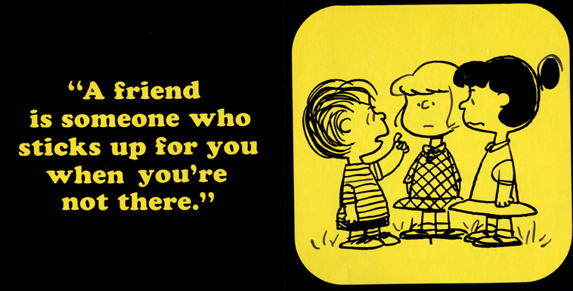

Slide 30
What warning does the Pope give the Monsignor?
a) He (the Pope) cannot help him (O’Flaherty)
b) They are in a war so be careful
c) Colonel Kappler is on to him (O’Flaherty) and spying on him
How does Hugh O’Flaherty rescue Jack?
a) Forging Colonel Kappler’s signature
b) Goes in disguise to rescue him
c) Asks the pope to help him
Colonel Kappler scores some victories by . . .?
a) Infiltrating the trusted friends of Hugh O’Flaherty with a spy
b) Capturing a code book
c) Tricking Hugh O’Flaherty at a party.

Slide 31
The Scarlet and the Black
30:00
Notes:
31

Slide 32
Journaling
Colonel Kappler invites Hugh O’Flaherty to a party to do what . . . ? What does Hugh O’Flaherty do in response? (give me a brief description of what’s going on so far)
How many people is Hugh O’Flaherty hiding and responsible for? What if it were you? What would you do If you were responsible for all of them but you could very well die in the process?
Hugh O’Flaherty isn’t just endangering his own life, but the life of all that are in the Vatican (his activities could give the Germans cause to invade). What if you were also a priest who worked in another part of the compound and YOUR life could be forfeit because of his actions? What would you do? Would you talk to him?
Notes:
32

Slide 33
Notes:
33

Slide 34
God Loves You
Notes:
34

Slide 35
Notes:
35

