Slide 1
God Loves You

Slide 2
And when he was gone forth into the way, there came one running, and kneeled to him, and asked him, Good Master, what shall I do that I may inherit eternal life? . . . Then Jesus beholding him loved him, and said unto him, One thing thou lackest: go thy way, sell whatsoever thou hast, and give to the poor, and thou shalt have treasure in heaven: and come, take up the cross, and follow me.
Mark 10: 17, 21 (KJV)

Slide 3
“As Jesus started on his way, a man ran up to him and fell on his knees before him. “Good teacher,” he asked, “what must I do to inherit eternal life?” Jesus looked at him and loved him. “One thing you lack,” he said. “Go, sell everything you have and give to the poor, and you will have treasure in heaven. Then come, follow me.”
Mark 10: 17, 21 (NIV)

Slide 4
What makes Hugh O’Flaherty a “hero”?
Why do we “boo” Colonel Kepler?
What books are the sources of truth for a Christian?
What does Jesus call us to?
What will YOUR legacy be?
What is Christ’s attitude towards us NO MATTER what we choose?
Notes:
4

Slide 5
How does O’Flaherty escape the first time in disguise?
a) He pretends to be a mailman
b) He pretends to be a street sweeper
c) He pretends to be a coalman
Why does Colonel Kappler invite O’Flaherty to the party?
a) To give him a warning
b) To capture him
c) To get his signature
Colonel Kappler is under pressure from?
a) The Vatican to leave
b) The German high command
c) The Monsignor has threatened him

Slide 6
The Scarlet and the Black
25:00
Notes:
6

Slide 7
Notes:
7

Slide 8
God Loves You

Slide 9
Following the path of least resistance is what makes rivers and men crooked.
Unknown

Slide 10
Hugh O’Flaherty’s most dangerous disguise was?
a) Impersonating a nun
b) Impersonating an italian soldier
c) Impersonating a German officer
Colonel Kappler calls a private meeting with O’Flaherty for . . . ?
a) The purpose of killing him in person
b) The purpose of having O’Flaherty do him a favor
c) The purpose of saying he (Kappler) was sorry for what he’d done
O’Flaherty storms off after their discussion because . . . ?
a) He doesn’t want to help the Colonel
b) He has to get back to the Vatican before curfew
c) He has plans to arrange safe passage for the Colonel’s family

Slide 11
The Scarlet and the Black
end
Notes:
11

Slide 12
Journaling
Colonel Kappler promised “freedom” for the Jewish people but reneged on his promise. Hugh O’Flaherty said he wouldn’t help Kappler but did. Which one would you rather aspire to be? (to try to live like)
O’Flaherty really struggled throughout doing what was right, but in the end he went beyond what most would deem “the call of duty” to the higher ideal of Christian ethics. Why do you think Kappler was eventually baptized by O’Flaherty? What can we learn about how to live?
Notes:
12

Slide 13
Read & Discuss
Mark 10:17 – 31
Mark 10:13-16 (keyword: children)
Luke 22:31-34
Mark 16:6-7
John 21:1-19
John 18:15-18 (keyword: fire)
Notes:
13

Slide 14
Notes:
14

Slide 15
I Timothy
II Timothy
Titus
a) Major Prophet
b) Apocalypse
c) Gospel
d) Book of the Law
e) Minor Prophet
f) Letter by ... (author)
g) History
h) Poetry
i) Letter by Paul

Slide 16
Jude
Revelation
none
a) Major Prophet
b) Apocalypse
c) Gospel
d) Book of the Law
e) Minor Prophet
f) Letter by ... (author)
g) History
h) Poetry
i) Letter by Paul

Slide 17
Ephesians
Philippians
Colossians
a) Letter by ... (author)
b) Letter by Paul
c) Minor Prophet
d) Apocalypse
e) Poetry
f) Book of the Law
g) History
h) Major Prophet
i) Gospel

Slide 18
Matthew
Mark
Luke
a) Letter by ... (author)
b) Letter by Paul
c) Minor Prophet
d) Apocalypse
e) Poetry
f) Book of the Law
g) History
h) Major Prophet
i) Gospel

Slide 19
Hebrews
James
I Peter
a) Letter by ... (author)
b) Letter by Paul
c) Minor Prophet
d) Apocalypse
e) Poetry
f) Book of the Law
g) History
h) Major Prophet
i) Gospel

Slide 20
Galatians
Ephesians
Philippians
a) Letter by ... (author)
b) Letter by Paul
c) Minor Prophet
d) Apocalypse
e) Poetry
f) Book of the Law
g) History
h) Major Prophet
i) Gospel

Slide 21
John
Acts
Romans
a) Letter by ... (author)
b) Letter by Paul
c) Minor Prophet
d) Apocalypse
e) Poetry
f) Book of the Law
g) History
h) Major Prophet
i) Gospel

Slide 22
James
I Peter
II Peter
a) Letter by ... (author)
b) Letter by Paul
c) Minor Prophet
d) Apocalypse
e) Poetry
f) Book of the Law
g) History
h) Major Prophet
i) Gospel

Slide 23
III John
Jude
Revelation
a) Letter by ... (author)
b) Letter by Paul
c) Minor Prophet
d) Apocalypse
e) Poetry
f) Book of the Law
g) History
h) Major Prophet
i) Gospel

Slide 24
none
Matthew
Mark
a) Letter by ... (author)
b) Letter by Paul
c) Minor Prophet
d) Apocalypse
e) Poetry
f) Book of the Law
g) History
h) Major Prophet
i) Gospel

Slide 25
I John
II John
III John
a) Letter by ... (author)
b) Letter by Paul
c) Minor Prophet
d) Apocalypse
e) Poetry
f) Book of the Law
g) History
h) Major Prophet
i) Gospel

Slide 26
Luke
John
Acts
a) Major Prophet
b) Apocalypse
c) Gospel
d) Book of the Law
e) Minor Prophet
f) Letter by ... (author)
g) History
h) Poetry
i) Letter by Paul

Slide 27
Acts
Romans
I Corinthians
a) Major Prophet
b) Apocalypse
c) Gospel
d) Book of the Law
e) Minor Prophet
f) Letter by ... (author)
g) History
h) Poetry
i) Letter by Paul

Slide 28
Philemon
Hebrews
James
a) Major Prophet
b) Apocalypse
c) Gospel
d) Book of the Law
e) Minor Prophet
f) Letter by ... (author)
g) History
h) Poetry
i) Letter by Paul

Slide 29
Notes:
29

Slide 30
God Loves You

Slide 31
Whenever you find that you are on the side of the majority, it is time to pause and reflect.
Mark Twain

Slide 32
Notes:
32

Slide 33
Notes:
33

Slide 34
Do you want me
To become an
Atheist?
Notes:
34

Slide 35
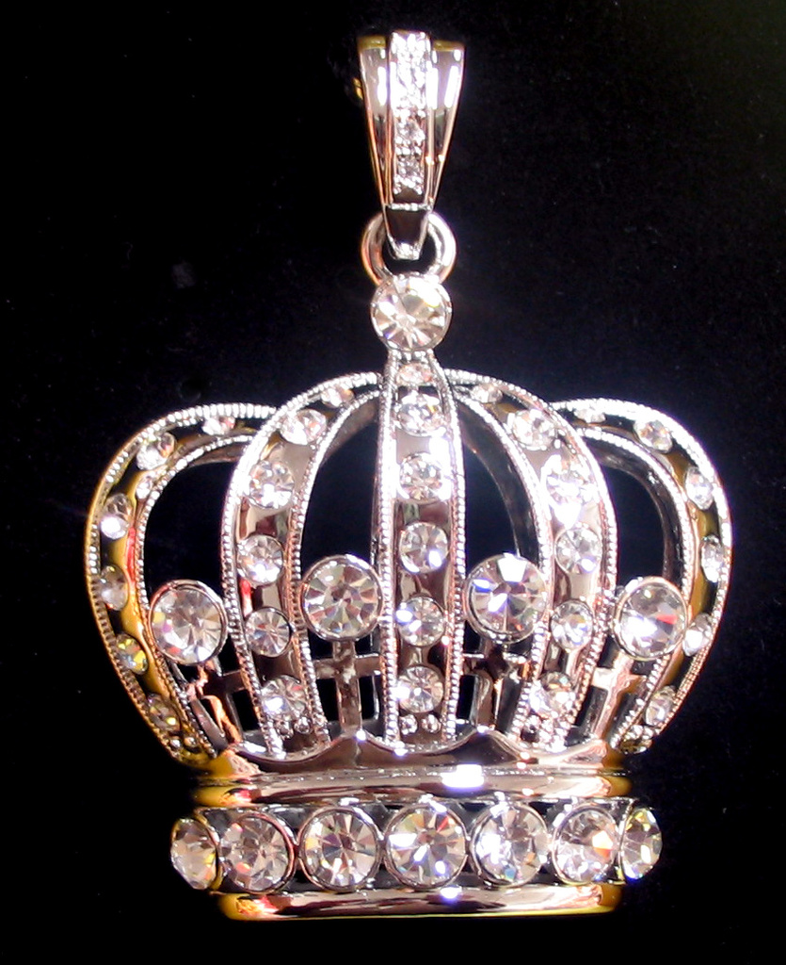
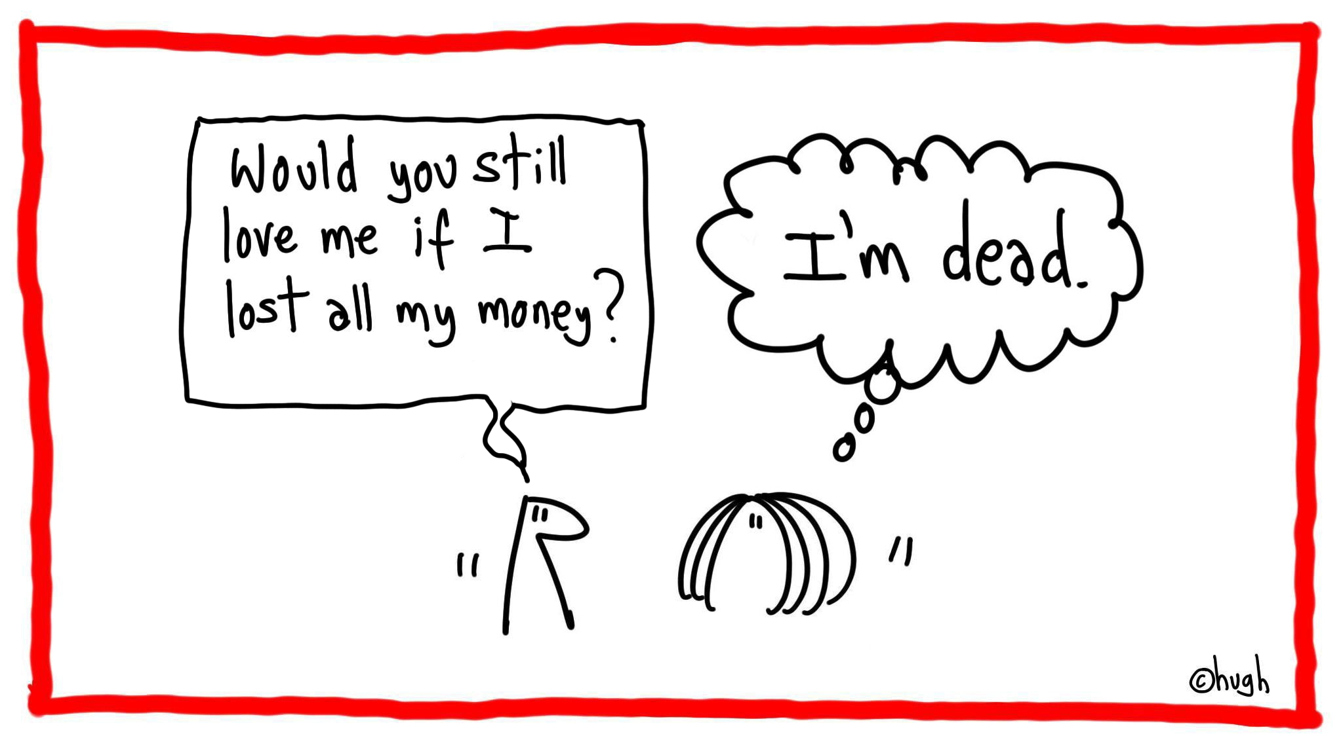
Why do some people “convert”?
Could it be for self-ish reasons?
Do you want me
To become an
Atheist?
Why do some people “un-convert”?
Could it be for self-ish reasons?
What was God trying to say with the 10 Commandments about a relationship with Him?
Notes:
35

Slide 36
Notes:
36

Slide 37
Jude
Revelation
none
a) Major Prophet
b) Apocalypse
c) Gospel
d) Book of the Law
e) Minor Prophet
f) Letter by ... (author)
g) History
h) Poetry
i) Letter by Paul

Slide 38
Matthew
Mark
Luke
a) Letter by ... (author)
b) Letter by Paul
c) Minor Prophet
d) Apocalypse
e) Poetry
f) Book of the Law
g) History
h) Major Prophet
i) Gospel

Slide 39
Hebrews
James
I Peter
a) Letter by ... (author)
b) Letter by Paul
c) Minor Prophet
d) Apocalypse
e) Poetry
f) Book of the Law
g) History
h) Major Prophet
i) Gospel

Slide 40
John
Acts
Romans
a) Letter by ... (author)
b) Letter by Paul
c) Minor Prophet
d) Apocalypse
e) Poetry
f) Book of the Law
g) History
h) Major Prophet
i) Gospel

Slide 41
James
I Peter
II Peter
a) Letter by ... (author)
b) Letter by Paul
c) Minor Prophet
d) Apocalypse
e) Poetry
f) Book of the Law
g) History
h) Major Prophet
i) Gospel

Slide 42
Philemon
Hebrews
James
a) Major Prophet
b) Apocalypse
c) Gospel
d) Book of the Law
e) Minor Prophet
f) Letter by ... (author)
g) History
h) Poetry
i) Letter by Paul

Slide 43
I Timothy
II Timothy
Titus
a) Major Prophet
b) Apocalypse
c) Gospel
d) Book of the Law
e) Minor Prophet
f) Letter by ... (author)
g) History
h) Poetry
i) Letter by Paul

Slide 44
none
Matthew
Mark
a) Letter by ... (author)
b) Letter by Paul
c) Minor Prophet
d) Apocalypse
e) Poetry
f) Book of the Law
g) History
h) Major Prophet
i) Gospel

Slide 45
Galatians
Ephesians
Philippians
a) Letter by ... (author)
b) Letter by Paul
c) Minor Prophet
d) Apocalypse
e) Poetry
f) Book of the Law
g) History
h) Major Prophet
i) Gospel

Slide 46
I John
II John
III John
a) Letter by ... (author)
b) Letter by Paul
c) Minor Prophet
d) Apocalypse
e) Poetry
f) Book of the Law
g) History
h) Major Prophet
i) Gospel

Slide 47
III John
Jude
Revelation
a) Letter by ... (author)
b) Letter by Paul
c) Minor Prophet
d) Apocalypse
e) Poetry
f) Book of the Law
g) History
h) Major Prophet
i) Gospel

Slide 48
Luke
John
Acts
a) Major Prophet
b) Apocalypse
c) Gospel
d) Book of the Law
e) Minor Prophet
f) Letter by ... (author)
g) History
h) Poetry
i) Letter by Paul

Slide 49
Acts
Romans
I Corinthians
a) Major Prophet
b) Apocalypse
c) Gospel
d) Book of the Law
e) Minor Prophet
f) Letter by ... (author)
g) History
h) Poetry
i) Letter by Paul

Slide 50
Ephesians
Philippians
Colossians
a) Letter by ... (author)
b) Letter by Paul
c) Minor Prophet
d) Apocalypse
e) Poetry
f) Book of the Law
g) History
h) Major Prophet
i) Gospel

Slide 51
Titus
Philemon
Hebrews
a) Letter by ... (author)
b) Letter by Paul
c) Minor Prophet
d) Apocalypse
e) Poetry
f) Book of the Law
g) History
h) Major Prophet
i) Gospel

Slide 52
Notes:
52

Slide 53
God Loves You

Slide 54
Notes:
54

Slide 55
God Loves You
Notes:
55

Slide 56
Notes:
56

