Slide 1
God Loves You

Slide 2
Every man is a missionary, now and forever, for good or for evil, whether he intends or designs it or not. He may be a blot radiating his dark influence outward to the very circumference of society, or he may be a blessing spreading benediction over the length and breadth of the world. But a blank he cannot be: there are no moral blanks; there are no neutral characters.
Thomas Chalmers

Slide 3
Go ye therefore, and teach all nations, baptizing them in the name of the Father, and of the Son, and of the Holy Ghost: teaching them to observe all things whatsoever I have commanded you: and, lo, I am with you always, even unto the end of the world. Amen.
Matthew 28:19-20 (KJV)

Slide 4
Therefore go and make disciples of all nations, baptizing them in the name of the Father and of the Son and of the Holy Spirit, and teaching them to obey everything I have commanded you. And surely I am with you always, to the very end of the age."
Matthew 28:19-20 (NIV)

Slide 5
What is evangelism?
What is the “forbidden chapter” in the OT to a Jew?
What books are the sources of truth for a Christian?
What does Jesus call us to?
What will YOUR legacy be?
What plan does Jesus outlay as a plan to reach the world?
Notes:
5

Slide 6
Evangelism is communicating clearly
Notes:
6

Slide 7
What is evangelism?
Notes:
7

Slide 8
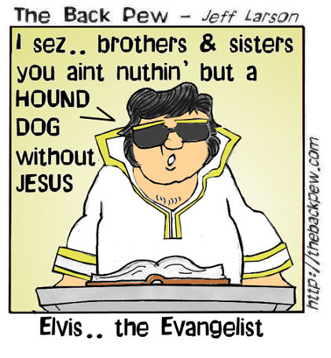
While it is true that people will be better off with Jesus in their life, insulting them along the way usually doesn’t work.
Notes:
8

Slide 9
Read & Discuss
Matthew 28:19-20
Luke 24:13-35
Acts 1:6-8
Notes:
9

Slide 10
Why was/is reaching the Jews difficult?
Notes:
10

Slide 11
Acts in 3 minutes

Slide 12
Notes:
12

Slide 13
God Loves You

Slide 14
Evangelism is just one beggar telling another beggar where to get bread
Lou Venden

Slide 15
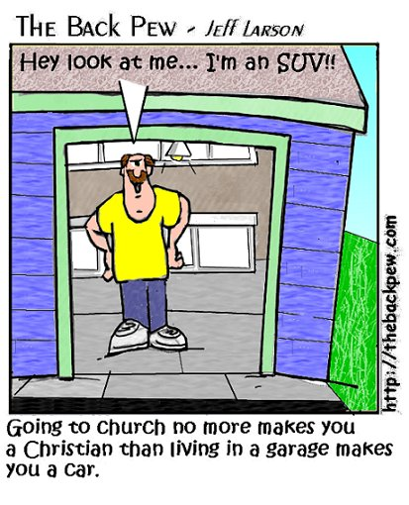
Evangelism is not just getting people to go to church. It might be a step in the right direction, but it won’t save anyone.
Notes:
15

Slide 16
What do you think of when you hear the word “evangelism”?
Notes:
16

Slide 17
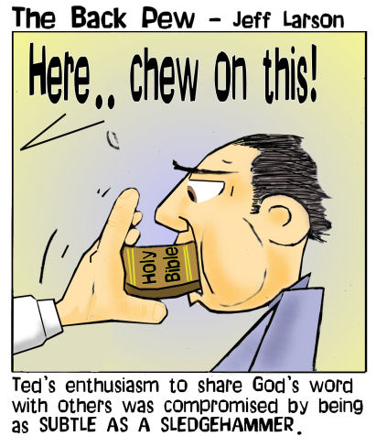
Evangelism is not just getting people to read the Bible. It is a step in the right direction, but no one likes being force fed!
Notes:
17

Slide 18
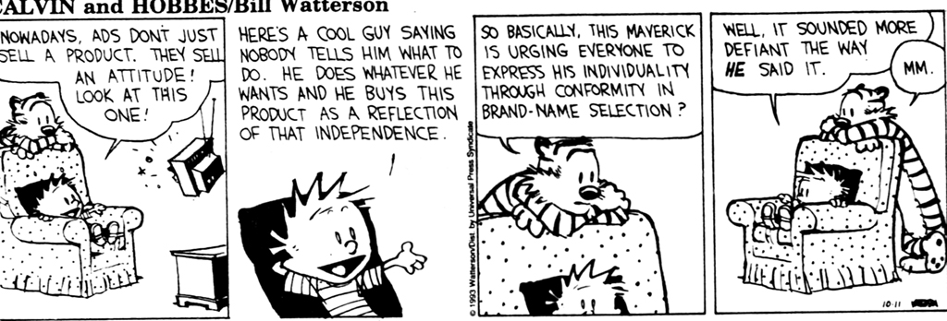
Notes:
18

Slide 19
Isaiah 53 is unread. It is the story of Christ
Notes:
19

Slide 20
Notes:
20

Slide 21
Amos
Obadiah
Jonah
a) Letter by ... (author)
b) Letter by Paul
c) Minor Prophet
d) Apocalypse
e) Poetry
f) Book of the Law
g) History
h) Major Prophet
i) Gospel

Slide 22
Nehemiah
Esther
Job
a) Letter by ... (author)
b) Letter by Paul
c) Minor Prophet
d) Apocalypse
e) Poetry
f) Book of the Law
g) History
h) Major Prophet
i) Gospel

Slide 23
Ezekiel
Daniel
Hosea
a) Letter by ... (author)
b) Letter by Paul
c) Minor Prophet
d) Apocalypse
e) Poetry
f) Book of the Law
g) History
h) Major Prophet
i) Gospel

Slide 24
Leviticus
Numbers
Deuteronomy
a) Letter by ... (author)
b) Letter by Paul
c) Minor Prophet
d) Apocalypse
e) Poetry
f) Book of the Law
g) History
h) Major Prophet
i) Gospel

Slide 25
none
Genesis
Exodus
a) Letter by ... (author)
b) Letter by Paul
c) Minor Prophet
d) Apocalypse
e) Poetry
f) Book of the Law
g) History
h) Major Prophet
i) Gospel

Slide 26
Esther
Job
Psalms
a) Letter by ... (author)
b) Letter by Paul
c) Minor Prophet
d) Apocalypse
e) Poetry
f) Book of the Law
g) History
h) Major Prophet
i) Gospel

Slide 27
Proverbs
Ecclesiastes
Song of Songs
a) Major Prophet
b) Apocalypse
c) Gospel
d) Book of the Law
e) Minor Prophet
f) Letter by ... (author)
g) History
h) Poetry
i) Letter by Paul

Slide 28
Zechariah
Malachi
none
a) Major Prophet
b) Apocalypse
c) Gospel
d) Book of the Law
e) Minor Prophet
f) Letter by ... (author)
g) History
h) Poetry
i) Letter by Paul

Slide 29
Jeremiah
Lamentations
Ezekiel
a) Letter by ... (author)
b) Letter by Paul
c) Minor Prophet
d) Apocalypse
e) Poetry
f) Book of the Law
g) History
h) Major Prophet
i) Gospel

Slide 30
Daniel
Hosea
Joel
a) Letter by ... (author)
b) Letter by Paul
c) Minor Prophet
d) Apocalypse
e) Poetry
f) Book of the Law
g) History
h) Major Prophet
i) Gospel

Slide 31
Judges
Ruth
I Samuel
a) Letter by ... (author)
b) Letter by Paul
c) Minor Prophet
d) Apocalypse
e) Poetry
f) Book of the Law
g) History
h) Major Prophet
i) Gospel

Slide 32
I Kings
II Kings
I Chronicles
a) Major Prophet
b) Apocalypse
c) Gospel
d) Book of the Law
e) Minor Prophet
f) Letter by ... (author)
g) History
h) Poetry
i) Letter by Paul

Slide 33
Habakkuk
Zephaniah
Haggai
a) Major Prophet
b) Apocalypse
c) Gospel
d) Book of the Law
e) Minor Prophet
f) Letter by ... (author)
g) History
h) Poetry
i) Letter by Paul

Slide 34
Song of Songs
Isaiah
Jeremiah
a) Major Prophet
b) Apocalypse
c) Gospel
d) Book of the Law
e) Minor Prophet
f) Letter by ... (author)
g) History
h) Poetry
i) Letter by Paul

Slide 35
II Kings
I Chronicles
II Chronicles
a) Letter by ... (author)
b) Letter by Paul
c) Minor Prophet
d) Apocalypse
e) Poetry
f) Book of the Law
g) History
h) Major Prophet
i) Gospel

Slide 36
Notes:
36

Slide 37
God Loves You

Slide 38
It is the duty of every Christian to be Christ to his neighbor.
Martin Luther

Slide 39
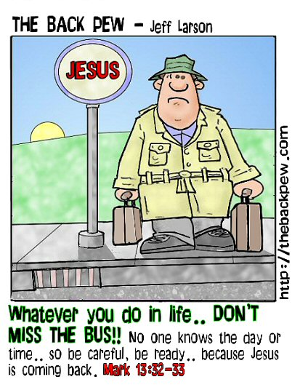
Evangelism is getting people to connect with CHRIST. That’s what a CHRISTian is—a follower of CHRIST.
Notes:
39

Slide 40
Testimony from the Mount
Notes:
40

Slide 41
Christianity spreads
Notes:
41

Slide 42
Zechariah
Malachi
none
a) Major Prophet
b) Apocalypse
c) Gospel
d) Book of the Law
e) Minor Prophet
f) Letter by ... (author)
g) History
h) Poetry
i) Letter by Paul

Slide 43
Daniel
Hosea
Joel
a) Letter by ... (author)
b) Letter by Paul
c) Minor Prophet
d) Apocalypse
e) Poetry
f) Book of the Law
g) History
h) Major Prophet
i) Gospel

Slide 44
Nehemiah
Esther
Job
a) Letter by ... (author)
b) Letter by Paul
c) Minor Prophet
d) Apocalypse
e) Poetry
f) Book of the Law
g) History
h) Major Prophet
i) Gospel

Slide 45
I Kings
II Kings
I Chronicles
a) Major Prophet
b) Apocalypse
c) Gospel
d) Book of the Law
e) Minor Prophet
f) Letter by ... (author)
g) History
h) Poetry
i) Letter by Paul

Slide 46
none
Genesis
Exodus
a) Letter by ... (author)
b) Letter by Paul
c) Minor Prophet
d) Apocalypse
e) Poetry
f) Book of the Law
g) History
h) Major Prophet
i) Gospel

Slide 47
Esther
Job
Psalms
a) Letter by ... (author)
b) Letter by Paul
c) Minor Prophet
d) Apocalypse
e) Poetry
f) Book of the Law
g) History
h) Major Prophet
i) Gospel

Slide 48
Proverbs
Ecclesiastes
Song of Songs
a) Major Prophet
b) Apocalypse
c) Gospel
d) Book of the Law
e) Minor Prophet
f) Letter by ... (author)
g) History
h) Poetry
i) Letter by Paul

Slide 49
Leviticus
Numbers
Deuteronomy
a) Letter by ... (author)
b) Letter by Paul
c) Minor Prophet
d) Apocalypse
e) Poetry
f) Book of the Law
g) History
h) Major Prophet
i) Gospel

Slide 50
Jeremiah
Lamentations
Ezekiel
a) Letter by ... (author)
b) Letter by Paul
c) Minor Prophet
d) Apocalypse
e) Poetry
f) Book of the Law
g) History
h) Major Prophet
i) Gospel

Slide 51
Judges
Ruth
I Samuel
a) Letter by ... (author)
b) Letter by Paul
c) Minor Prophet
d) Apocalypse
e) Poetry
f) Book of the Law
g) History
h) Major Prophet
i) Gospel

Slide 52
II Kings
I Chronicles
II Chronicles
a) Letter by ... (author)
b) Letter by Paul
c) Minor Prophet
d) Apocalypse
e) Poetry
f) Book of the Law
g) History
h) Major Prophet
i) Gospel

Slide 53
Habakkuk
Zephaniah
Haggai
a) Major Prophet
b) Apocalypse
c) Gospel
d) Book of the Law
e) Minor Prophet
f) Letter by ... (author)
g) History
h) Poetry
i) Letter by Paul

Slide 54
Song of Songs
Isaiah
Jeremiah
a) Major Prophet
b) Apocalypse
c) Gospel
d) Book of the Law
e) Minor Prophet
f) Letter by ... (author)
g) History
h) Poetry
i) Letter by Paul

Slide 55
Amos
Obadiah
Jonah
a) Letter by ... (author)
b) Letter by Paul
c) Minor Prophet
d) Apocalypse
e) Poetry
f) Book of the Law
g) History
h) Major Prophet
i) Gospel

Slide 56
Ezekiel
Daniel
Hosea
a) Letter by ... (author)
b) Letter by Paul
c) Minor Prophet
d) Apocalypse
e) Poetry
f) Book of the Law
g) History
h) Major Prophet
i) Gospel

Slide 57
What is God doing to save us?
Notes:
57

Slide 58
Notes:
58

Slide 59
God Loves You

Slide 60
Notes:
60

Slide 61
The gift of water to Mozambique

Slide 62
Journaling
What are some ways you can make a difference following the Biblical model of near to far outreach that you can do this coming week. Make a list. Do some of them. Report on it.
Mission trips are good and we often celebrate them with “fanfare” about those that go. But why do you think that Jesus said “Jerusalem” first, then others? What are the plus and minuses (pros/cons) of mission trips to foreign countries?
Notes:
62

Slide 63
Notes:
63

Slide 64
God Loves You
Notes:
64

Slide 65
Notes:
65

