Slide 1
God Loves You

Slide 2
What makes evangelism possible?
What are some jobs of the Holy Spirit?
What is your favorite passage of Scripture?
What are some attributes/jobs the Holy Spirit gives?
How does Jesus model the value of Scripture?
Jesus is calling YOU to . . . ?
What will YOUR legacy be?
Notes:
2

Slide 3
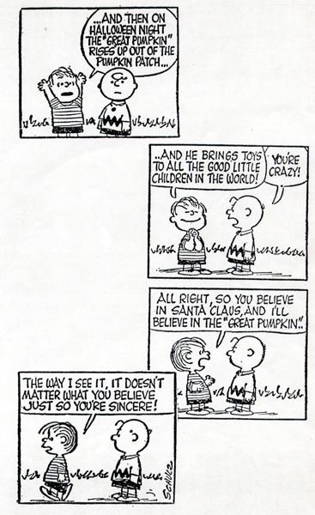
Notes:
3

Slide 4
The importance of knowing the book
Notes:
4

Slide 5
Read & Discuss
Matthew 28:19-20
Luke 24:13-35
Acts 1:6-8
John 14:15-18; 26
John 16:7-15
I Corinthians 12:7-11
Notes:
5

Slide 6
Notes:
6

Slide 7
God Loves You

Slide 8
MAP Testing
Notes:
8

Slide 9
Notes:
9

Slide 10
God Loves You

Slide 11
Notes:
11

Slide 12
God Loves You

Slide 13
Notes:
13

Slide 14
God Loves You
Notes:
14

Slide 15
Notes:
15

