Slide 1
God Loves You

Slide 2
What events shaped the early church?
What major events have transpired in the history of the Christian church?
What is the basic outline of the book of Acts?
What might be a better title for the book of Acts?
What will YOUR legacy be?
Jesus is calling YOU to . . . ?
Notes:
2

Slide 3
And because iniquity shall abound, the love of many shall wax cold. But he that shall endure unto the end, the same shall be saved. And this gospel of the kingdom shall be preached in all the world for a witness unto all nations; and then shall the end come.
Matthew 24:12-14 (KJV)

Slide 4
Because of the increase of wickedness, the love of most will grow cold, but the one who stands firm to the end will be saved. And this gospel of the kingdom will be preached in the whole world as a testimony to all nations, and then the end will come.
Matthew 24:12-14 (NIV)

Slide 5
Word choices
Wax
Cold
Endure
Saved
Notes:
5

Slide 6
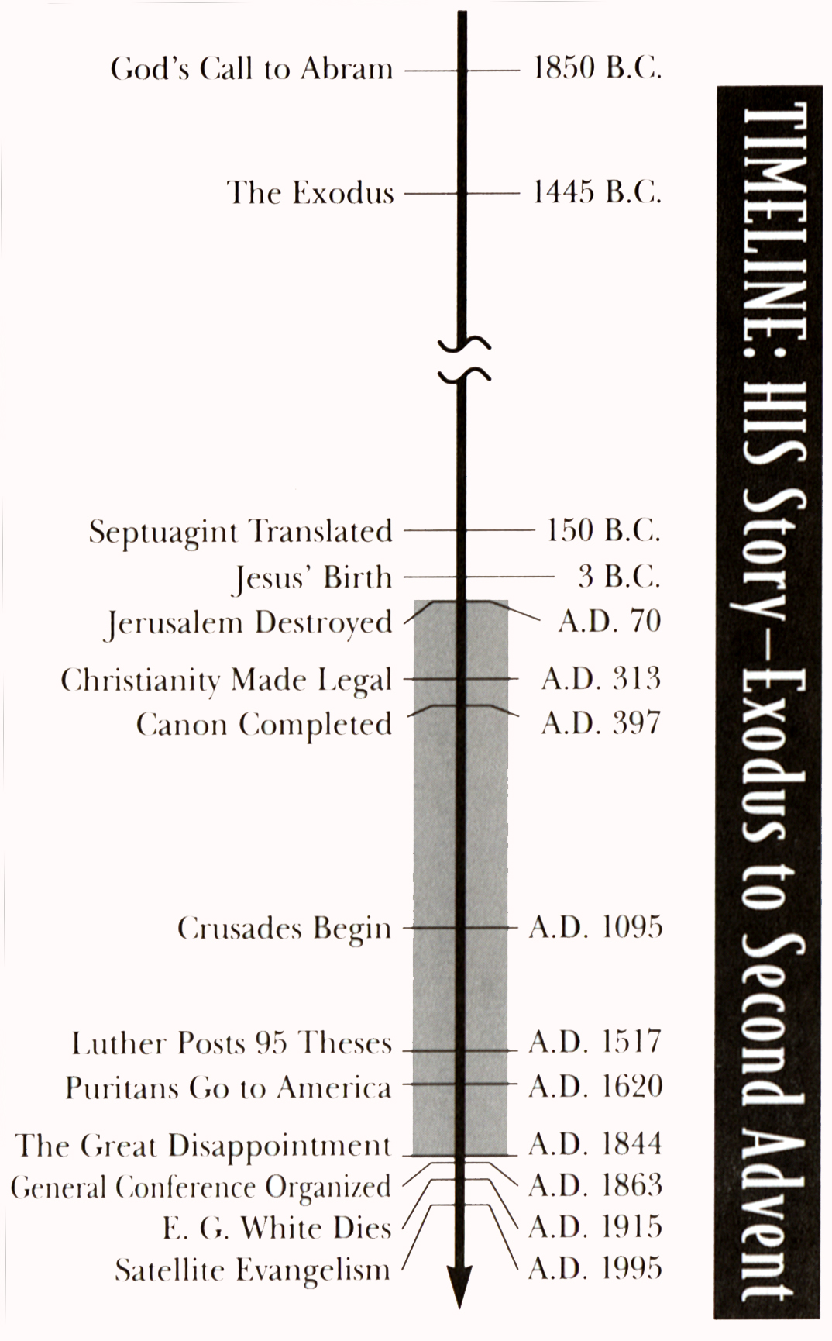
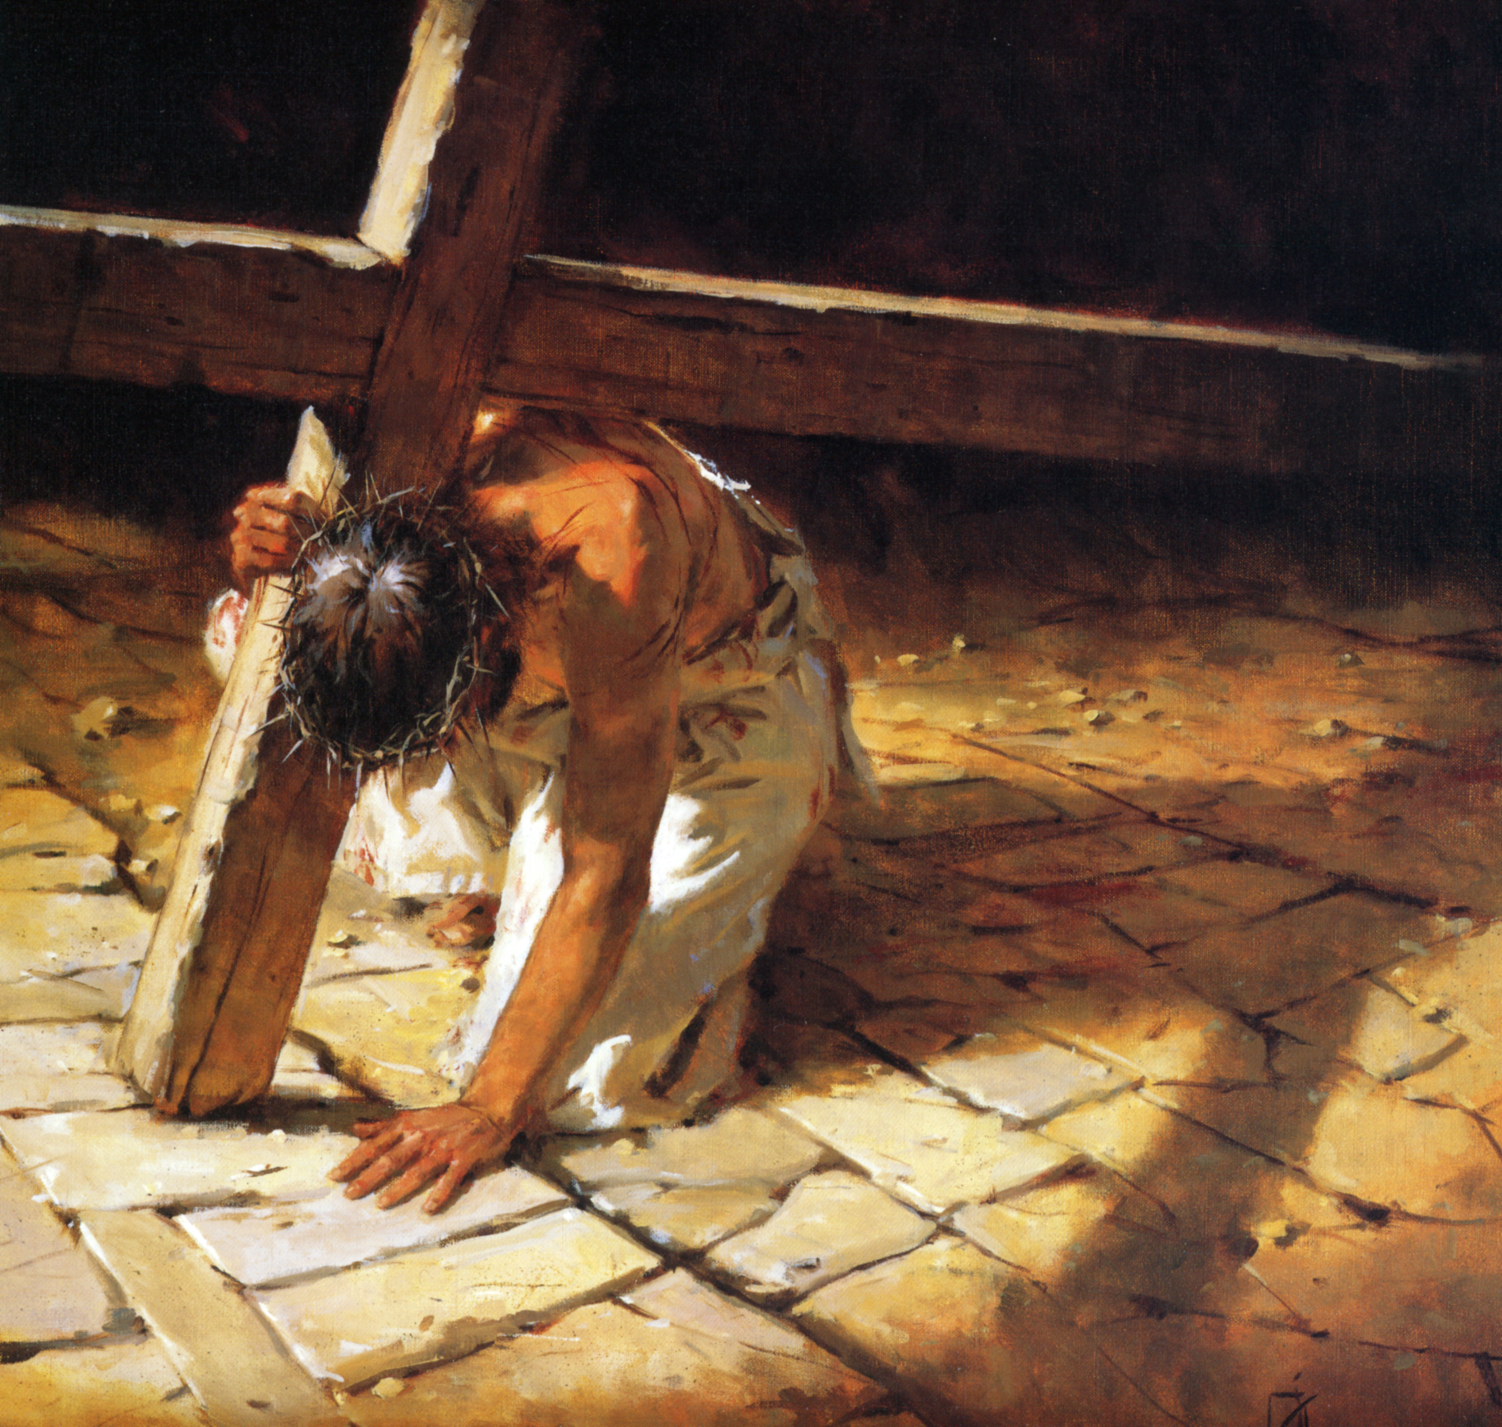
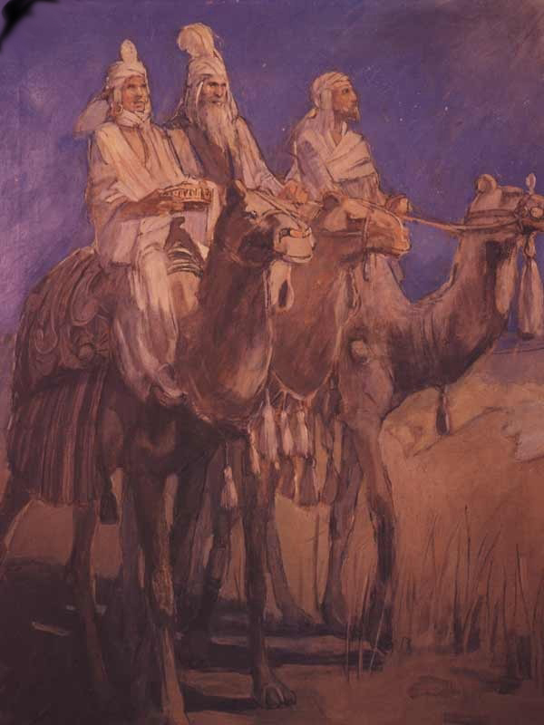
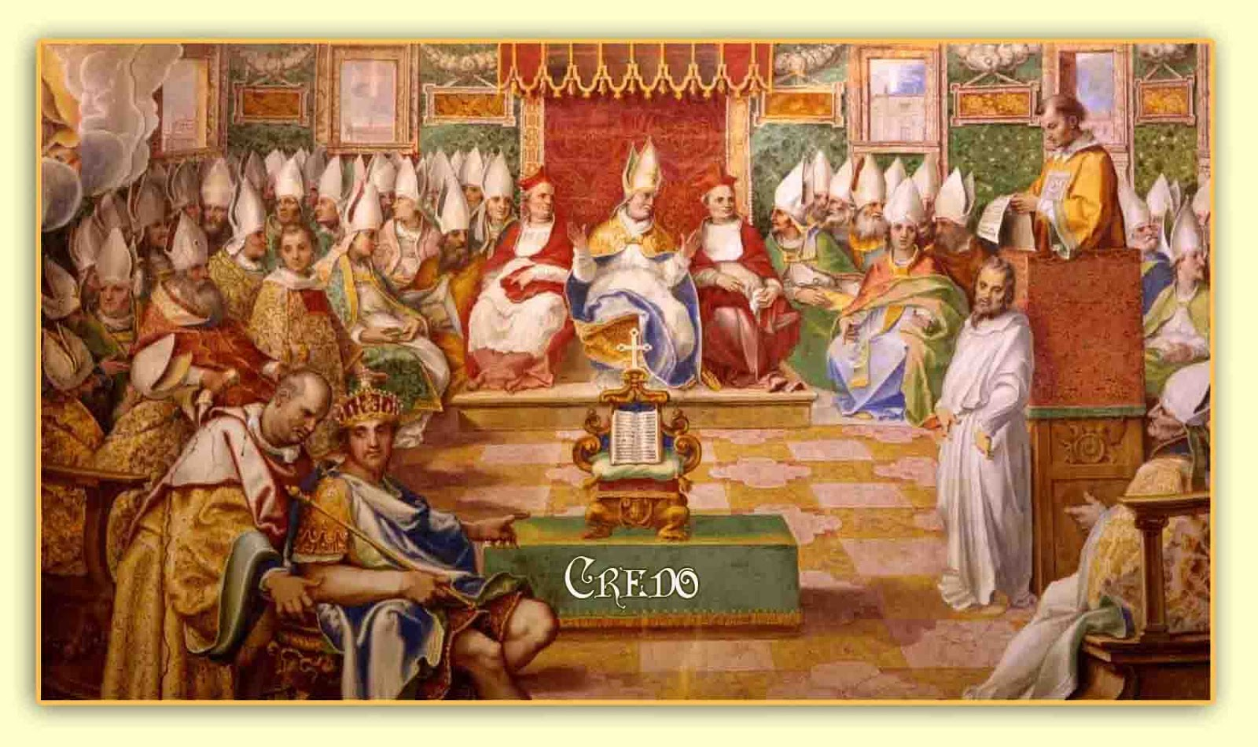
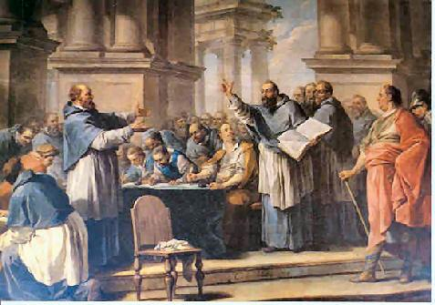
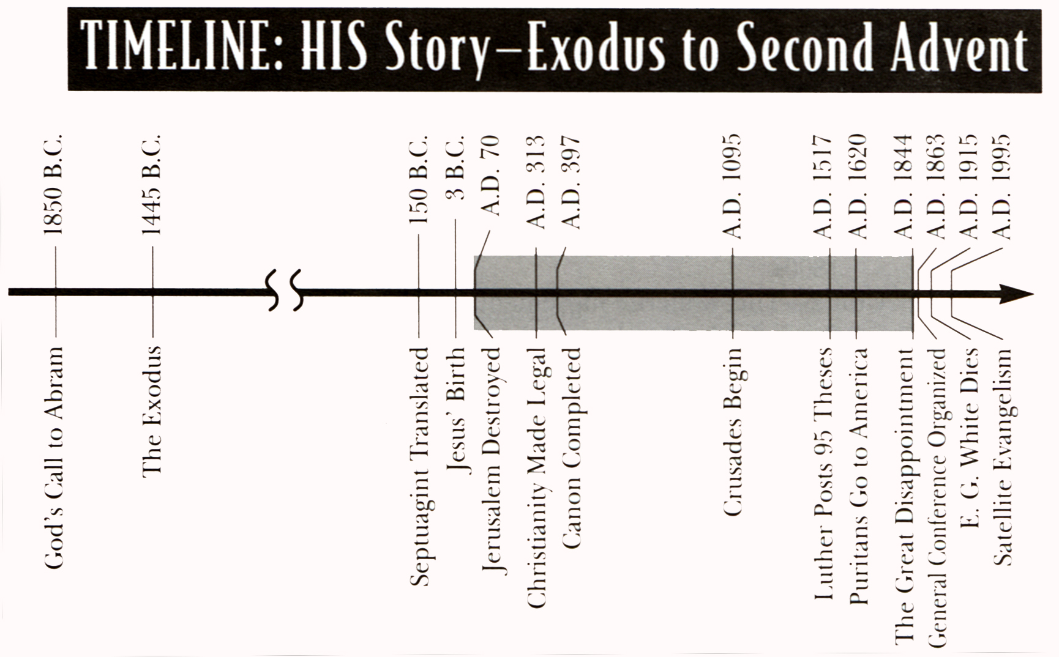
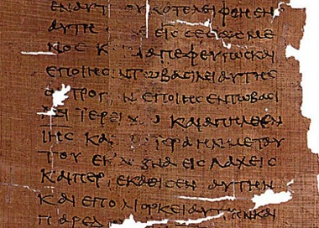
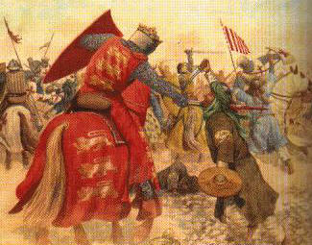
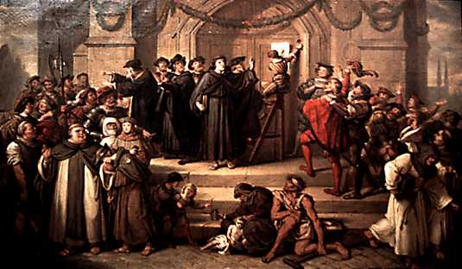
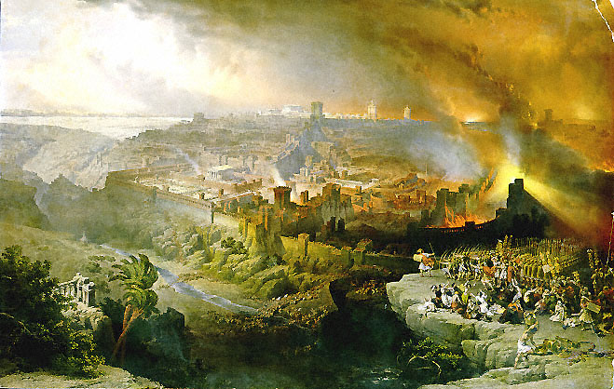
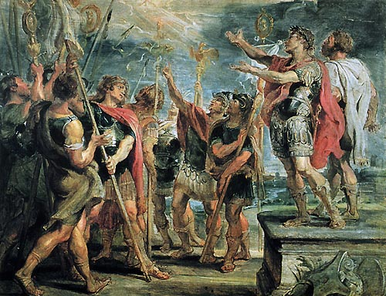
AD 31
AD 325
Notes:
6

Slide 7
Acts in 3 minutes

Slide 8
Acts Part 1 in more detail

Slide 9
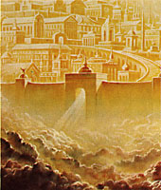
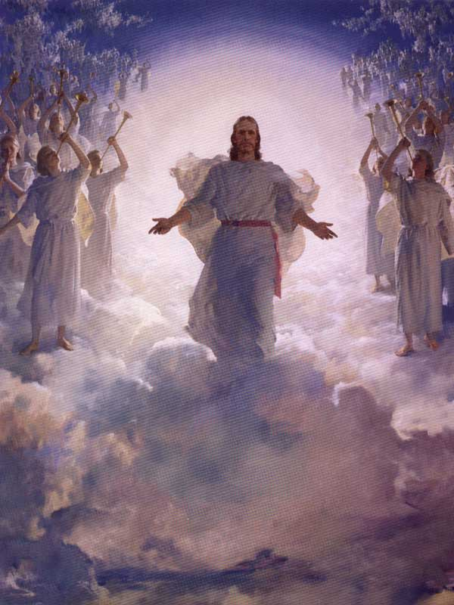
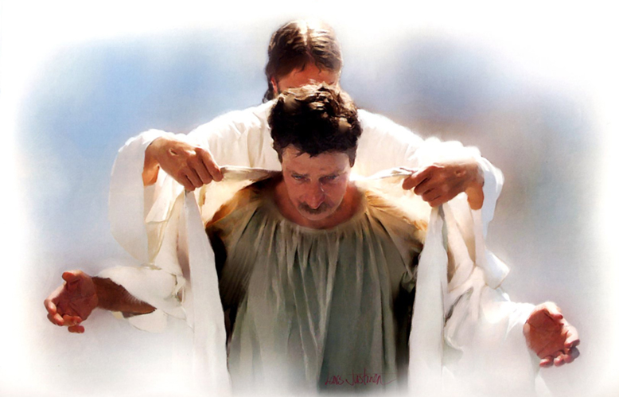
John 14:1-3
Acts 1:9-11
Hebrews 9:28
Matthew 24:23-27
Revelation 1:7
I Thessalonians 4:16-17
Matthew 24:30-31
I Corinthians 15:51-53
Revelation 6:15-17
Isaiah 25:9
Notes:
9

Slide 10
Notes:
10

Slide 11
God Loves You

Slide 12
Septuagint Translated
a) 150 BC
b) 3 BC
c) AD 31
d) AD 70
e) AD 313
f) AD 325
g) AD 397
h) AD 1095
i) AD 1517

Slide 13
Council of Nicea
a) 150 BC
b) 3 BC
c) AD 31
d) AD 70
e) AD 313
f) AD 325
g) AD 397
h) AD 1095
i) AD 1517

Slide 14
Death of Christ
a) 150 BC
b) 3 BC
c) AD 31
d) AD 70
e) AD 313
f) AD 325
g) AD 397
h) AD 1095
i) AD 1517

Slide 15
Crusades begin
a) 150 BC
b) 3 BC
c) AD 31
d) AD 70
e) AD 313
f) AD 325
g) AD 397
h) AD 1095
i) AD 1517

Slide 16
95 Theses
a) 150 BC
b) 3 BC
c) AD 31
d) AD 70
e) AD 313
f) AD 325
g) AD 397
h) AD 1095
i) AD 1517

Slide 17
Destruction of Jerusalem
a) 150 BC
b) 3 BC
c) AD 31
d) AD 70
e) AD 313
f) AD 325
g) AD 397
h) AD 1095
i) AD 1517

Slide 18
Birth of Christ
a) 150 BC
b) 3 BC
c) AD 31
d) AD 70
e) AD 313
f) AD 325
g) AD 397
h) AD 1095
i) AD 1517

Slide 19
Council of Carthage
a) 150 BC
b) 3 BC
c) AD 31
d) AD 70
e) AD 313
f) AD 325
g) AD 397
h) AD 1095
i) AD 1517

Slide 20
Acts Part 2 in more detail

Slide 21
Notes:
21

Slide 22
God Loves You

Slide 23
Bonus Journaling
If you have been a missionary (local or foreign mission trip) report on it.
If you have not been on one, please interview 3 missionaries and record why they did it, what they learned, and why they might suggest you go. Include signatures.
Notes:
23

Slide 24
Notes:
24

Slide 25
God Loves You

Slide 26
The story of the cost of discipleship

Slide 27
Notes:
27

Slide 28
God Loves You
Notes:
28

Slide 29
Notes:
29

