Slide 1
God Loves You

Slide 2
Your talent is God’s gift to you. What you do with it is your gift back to God.
Leo Buscaglia

Slide 3

What makes evangelism possible?
What are some jobs of the Holy Spirit?
What is your favorite passage of Scripture?
What are some attributes/jobs the Holy Spirit gives?
How does Jesus model the value of Scripture?
Jesus is calling YOU to . . . ?
What will YOUR legacy be?
Notes:
3

Slide 4
Spiritual gifts testing
Notes:
4

Slide 5
Online Learning modality assessment
Notes:
5

Slide 6
Notes:
6

Slide 7
God Loves You

Slide 8
The body is a unit, though it is made up of many parts; and though all its parts are many, they form one body. So it is with Christ. For we were all baptized by one Spirit into one body—whether Jews or Greeks, slave or free—and we were all given the one Spirit to drink. Now the body is not made up of one part but of many. If the foot should say, "Because I am not a hand, I do not belong to the body," it would not for that reason cease to be part of the body. And if the ear should say, "Because I am not an eye, I do not belong to the body," it would not for that reason cease to be part of the body. . .
Apostle Paul

Slide 9
Spiritual gifts testing
Notes:
9

Slide 10
Notes:
10

Slide 11
God Loves You

Slide 12
. . . If the whole body were an eye, where would the sense of hearing be? If the whole body were an ear, where would the sense of smell be? But in fact God has arranged the parts in the body, every one of them, just as he wanted them to be. If they were all one part, where would the body be? As it is, there are many parts, but one body. The eye cannot say to the hand, "I don't need you!" And the head cannot say to the feet, "I don't need you!"
Apostle Paul

Slide 13
3
4
4
5
Written Eval 2
1
3
4
…
3
4
4
11
Notes:
13

Slide 14

3
1’s = Linguistic
5
2’s = Logical-Mathematical
Panda Test
4
3’s = INTRApersonal
5
4’s = Spatial
Add up all the values OF a number. For example: add up how MANY 1’s you got, then how MANY 2’s you got, etc
4
5’s = Musical
1
6’s = Bodily-Kinesthetic
2
7’s = INTERpersonal
There are no values for Naturalist
Notes:
14

Slide 15
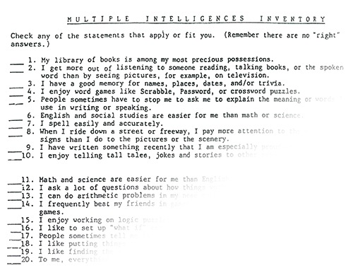
4
Section 1 = Linguistic
4
Section 2 = Logical-Mathematical
Written Eval 1
6
Section 3 = Spatial
1
Section 4 = Bodily-Kinesthetic
Total up all the values in EACH section separately. For example: add up how MANY √’s you got and put that number on the side
5
Section 5 = Musical
2
Section 6 = INTERpersonal
3
Section 7 = INTRApersonal
There are no values for Naturalist
Notes:
15

Slide 16








Online test
Section 1 = Linguistic
Find the number that you got with a particular category, then double it, then round it to the nearest whole number. FOR EXAMPLE: say you got a 3.52 on the Logical-Mathematical score. Double that would be 7.04. The nearest whole number is 7. Do that for each category.
Section 2 = Logical-Mathematical
Section 3 = Spatial
Section 4 = Bodily-Kinesthetic
Section 5 = Musical
Section 6 = INTERpersonal
Section 7 = INTRApersonal
Section 8 = Naturalist
Notes:
16

Slide 17
Panda
test
Written eval 1
Written eval 2
Online test
Total
Linguistic
3
4
15
5
27
Logical-Mathematical
5
4
8
7
24
Spatial
5
6
10
8
29
Musical
4
5
9
9
27
Bodily-Kinesthetic
1
1
7
1
10
Interpersonal
2
2
6
3
13
Intrapersonal
4
3
8
7
22
Naturalist
--
--
8
9
17

Slide 18
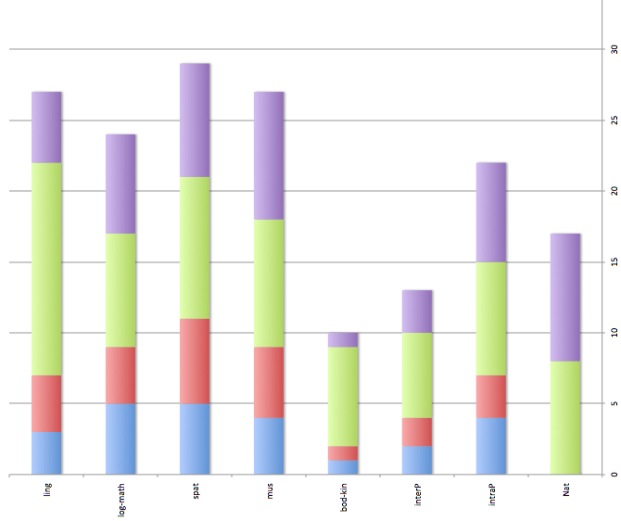
Interest/aptitude

Slide 19
Notes:
19

Slide 20
God Loves You

Slide 21

Journaling
Compare your chart with at least 2 other people. What are the differences? What are the similarities?
Imagine the personality of your favorite Bible character. What were they (guess)? The point here is that they (all the writers or characters) were just like you with similar/divergent interests and temperaments. Describe someone you think might have been like you.
How might understanding learning modalities help us understand the Bible (and moreover) and characters and stories from the Bible?
Notes:
21

Slide 22

Read & Discuss
MI types, insights, lessons learned
5LL categories, insights, lessons learned
Spiritual gifts, insights, lessons learned
Insights into the Bible or its characters
“My Story” project description
Notes:
22

Slide 23
Notes:
23

Slide 24
God Loves You
Notes:
24

Slide 25
Notes:
25

