Slide 1
God Loves You

Slide 2
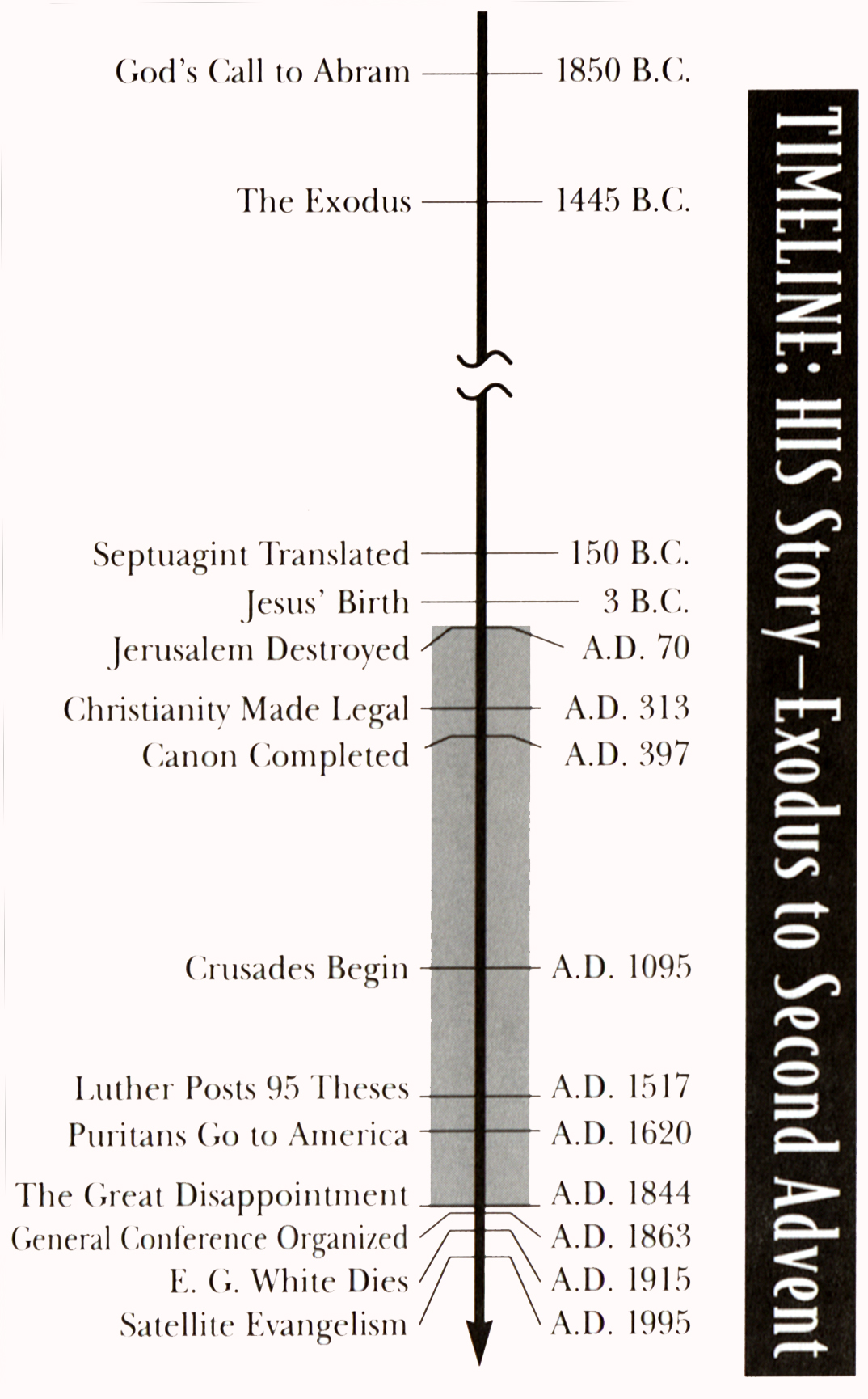
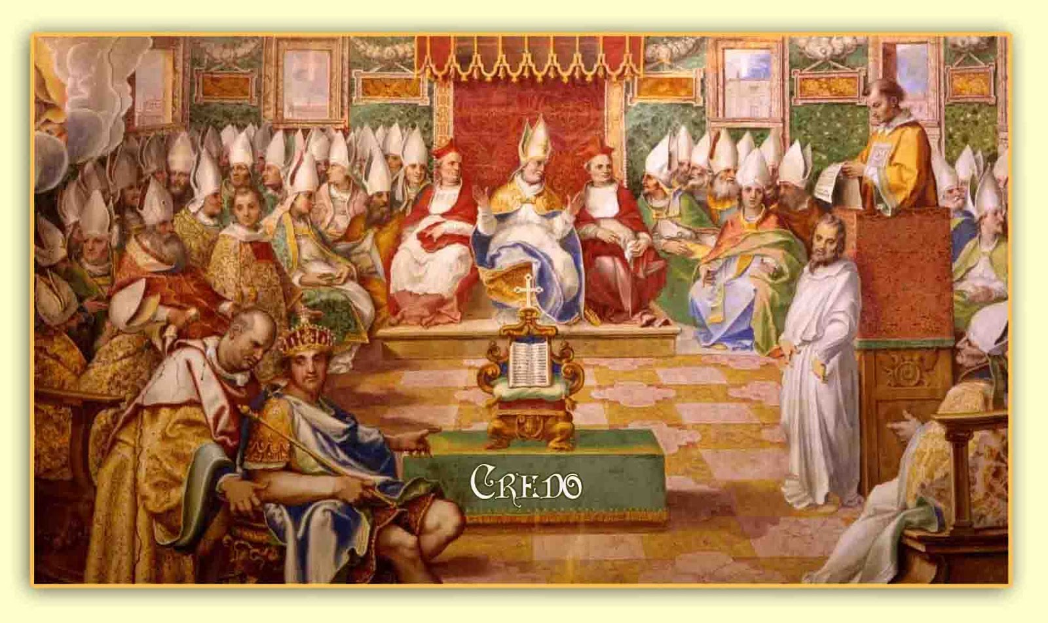
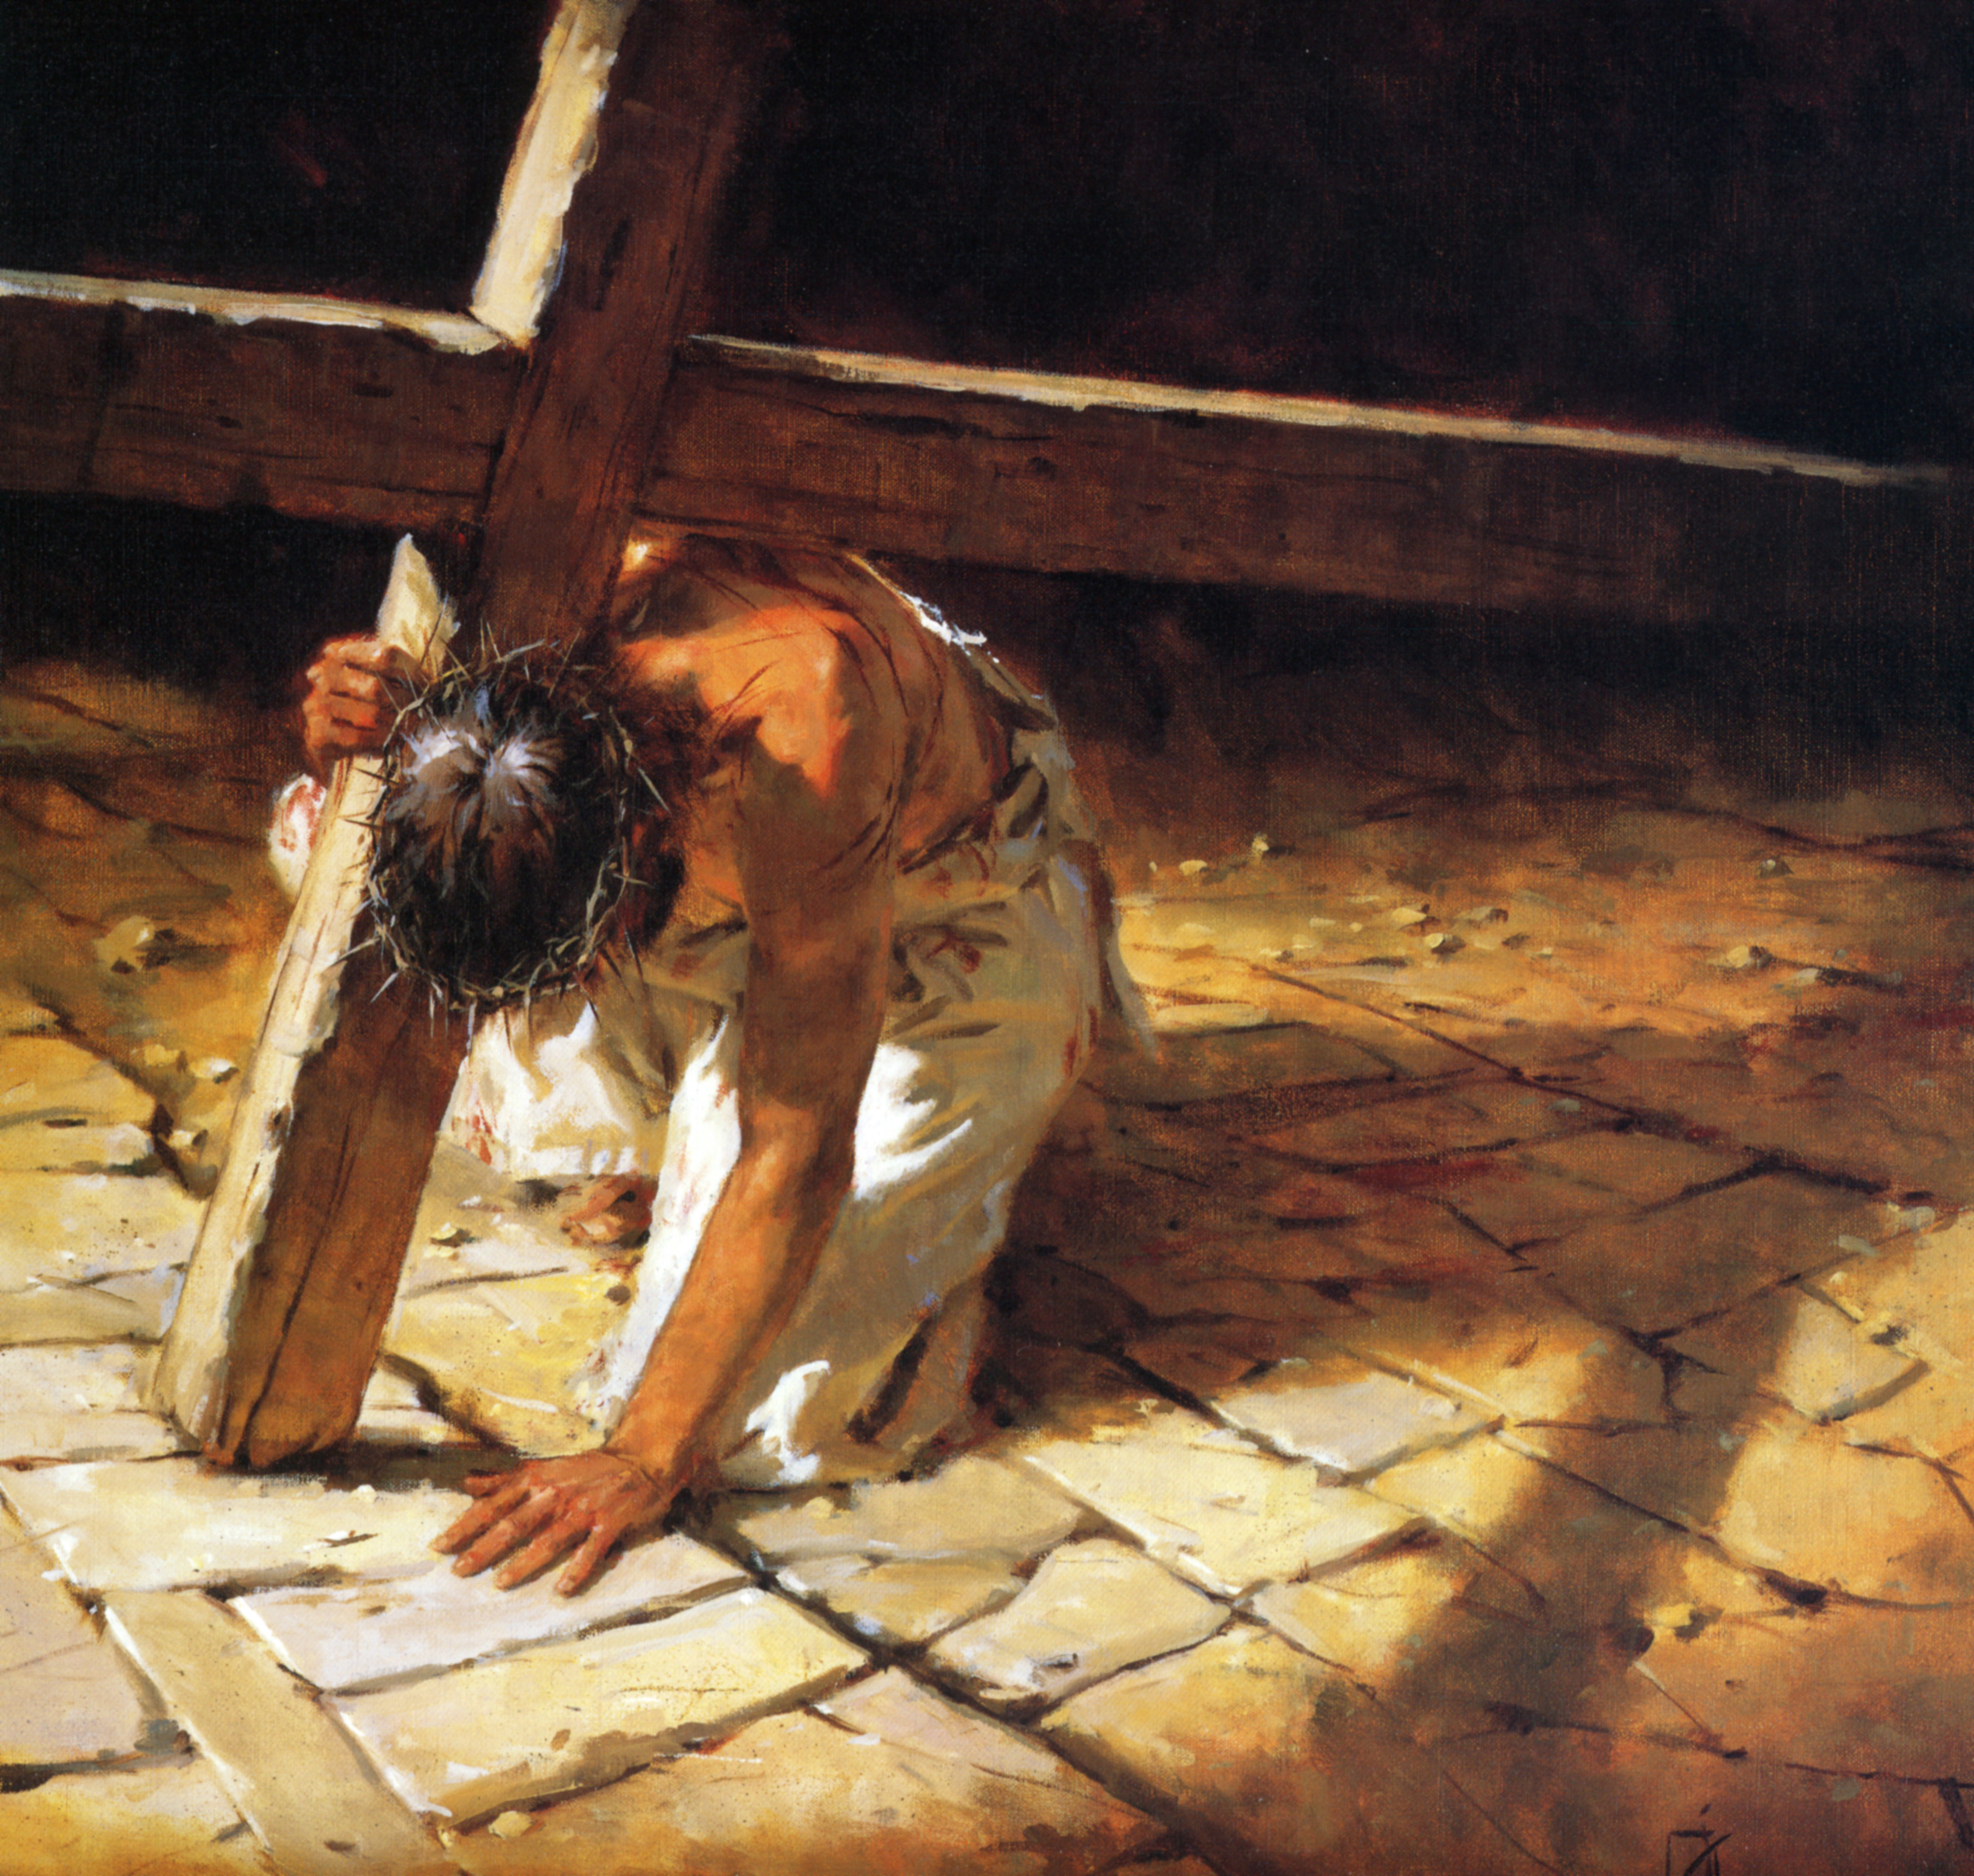
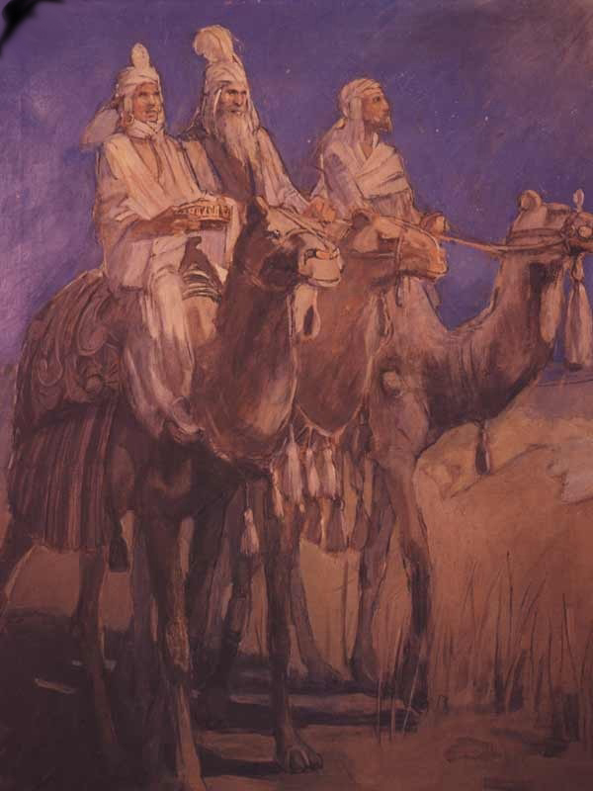
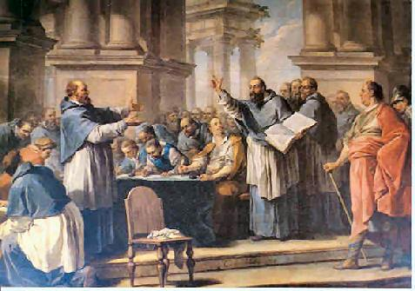
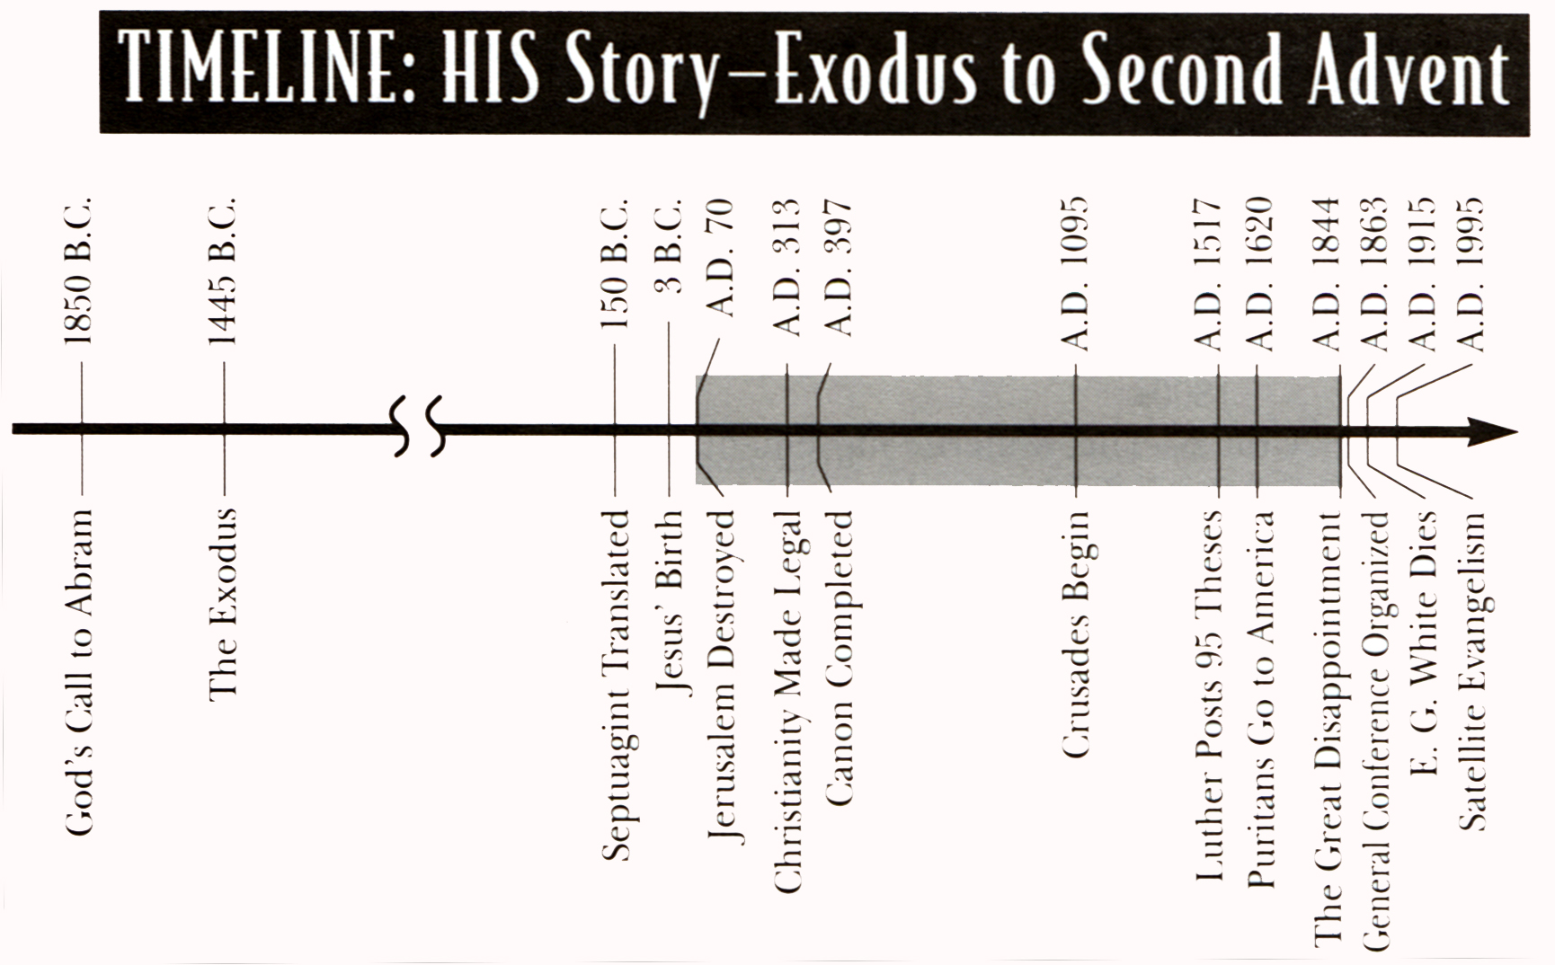
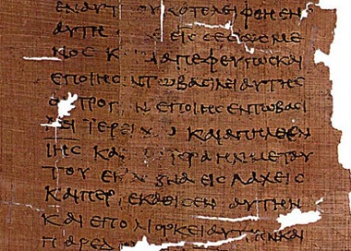
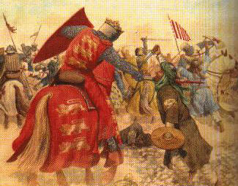
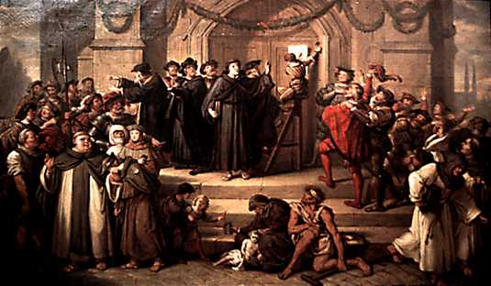
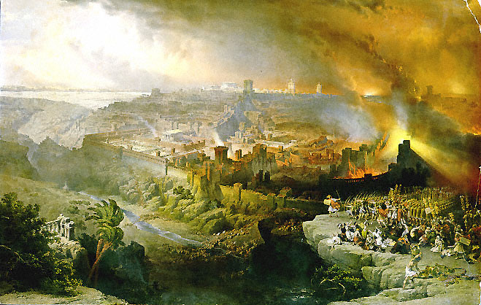
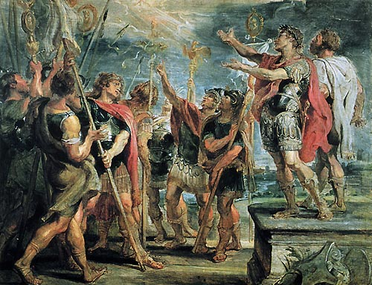
AD 31
AD 325
Notes:
2

Slide 3
What is your story?
Notes:
3

Slide 4
Council of Nicea
a) 1850 BC
b) 1445 BC
c) 150 BC
d) 3 BC
e) AD 31
f) AD 70
g) AD 313
h) AD 325
i) AD 397
j) AD 1095
k) AD 1517
l) AD 1620
m) AD 1844
n) AD 1863

Slide 5
Birth of Christ
a) 1850 BC
b) 1445 BC
c) 150 BC
d) 3 BC
e) AD 31
f) AD 70
g) AD 313
h) AD 325
i) AD 397
j) AD 1095
k) AD 1517
l) AD 1620
m) AD 1844
n) AD 1863

Slide 6
Septuagint Translated
a) 1850 BC
b) 1445 BC
c) 150 BC
d) 3 BC
e) AD 31
f) AD 70
g) AD 313
h) AD 325
i) AD 397
j) AD 1095
k) AD 1517
l) AD 1620
m) AD 1844
n) AD 1863

Slide 7
Council of Carthage
a) 1850 BC
b) 1445 BC
c) 150 BC
d) 3 BC
e) AD 31
f) AD 70
g) AD 313
h) AD 325
i) AD 397
j) AD 1095
k) AD 1517
l) AD 1620
m) AD 1844
n) AD 1863

Slide 8
Moses leads Exodus
a) 1850 BC
b) 1445 BC
c) 150 BC
d) 3 BC
e) AD 31
f) AD 70
g) AD 313
h) AD 325
i) AD 397
j) AD 1095
k) AD 1517
l) AD 1620
m) AD 1844
n) AD 1863

Slide 9
Abram leaves Ur
a) 1850 BC
b) 1445 BC
c) 150 BC
d) 3 BC
e) AD 31
f) AD 70
g) AD 313
h) AD 325
i) AD 397
j) AD 1095
k) AD 1517
l) AD 1620
m) AD 1844
n) AD 1863

Slide 10
Death of Christ
a) 1850 BC
b) 1445 BC
c) 150 BC
d) 3 BC
e) AD 31
f) AD 70
g) AD 313
h) AD 325
i) AD 397
j) AD 1095
k) AD 1517
l) AD 1620
m) AD 1844
n) AD 1863

Slide 11
Great Disappointment
a) 1850 BC
b) 1445 BC
c) 150 BC
d) 3 BC
e) AD 31
f) AD 70
g) AD 313
h) AD 325
i) AD 397
j) AD 1095
k) AD 1517
l) AD 1620
m) AD 1844
n) AD 1863

Slide 12
First Puritans arrive in America
a) 1850 BC
b) 1445 BC
c) 150 BC
d) 3 BC
e) AD 31
f) AD 70
g) AD 313
h) AD 325
i) AD 397
j) AD 1095
k) AD 1517
l) AD 1620
m) AD 1844
n) AD 1863

Slide 13
Crusades begin
a) 1850 BC
b) 1445 BC
c) 150 BC
d) 3 BC
e) AD 31
f) AD 70
g) AD 313
h) AD 325
i) AD 397
j) AD 1095
k) AD 1517
l) AD 1620
m) AD 1844
n) AD 1863

Slide 14
Destruction of Jerusalem
a) 1850 BC
b) 1445 BC
c) 150 BC
d) 3 BC
e) AD 31
f) AD 70
g) AD 313
h) AD 325
i) AD 397
j) AD 1095
k) AD 1517
l) AD 1620
m) AD 1844
n) AD 1863

Slide 15
95 Theses
a) 1850 BC
b) 1445 BC
c) 150 BC
d) 3 BC
e) AD 31
f) AD 70
g) AD 313
h) AD 325
i) AD 397
j) AD 1095
k) AD 1517
l) AD 1620
m) AD 1844
n) AD 1863

Slide 16
SDA Church formed
a) 1850 BC
b) 1445 BC
c) 150 BC
d) 3 BC
e) AD 31
f) AD 70
g) AD 313
h) AD 325
i) AD 397
j) AD 1095
k) AD 1517
l) AD 1620
m) AD 1844
n) AD 1863

Slide 17
Notes:
17

Slide 18
James
I Peter
II Peter
a) Letter by ... (author)
b) Letter by Paul
c) Minor Prophet
d) Apocalypse
e) Poetry
f) Book of the Law
g) History
h) Major Prophet
i) Gospel

Slide 19
Daniel
Hosea
Joel
a) Letter by ... (author)
b) Letter by Paul
c) Minor Prophet
d) Apocalypse
e) Poetry
f) Book of the Law
g) History
h) Major Prophet
i) Gospel

Slide 20
Malachi
Matthew
Mark
a) Letter by ... (author)
b) Letter by Paul
c) Minor Prophet
d) Apocalypse
e) Poetry
f) Book of the Law
g) History
h) Major Prophet
i) Gospel

Slide 21
Obadiah
Jonah
Micah
a) Major Prophet
b) Apocalypse
c) Gospel
d) Book of the Law
e) Minor Prophet
f) Letter by ... (author)
g) History
h) Poetry
i) Letter by Paul

Slide 22
I Thessalonians
II Thessalonians
I Timothy
a) Major Prophet
b) Apocalypse
c) Gospel
d) Book of the Law
e) Minor Prophet
f) Letter by ... (author)
g) History
h) Poetry
i) Letter by Paul

Slide 23
Proverbs
Ecclesiastes
Song of Songs
a) Major Prophet
b) Apocalypse
c) Gospel
d) Book of the Law
e) Minor Prophet
f) Letter by ... (author)
g) History
h) Poetry
i) Letter by Paul

Slide 24
James
I Peter
II Peter
a) Letter by ... (author)
b) Letter by Paul
c) Minor Prophet
d) Apocalypse
e) Poetry
f) Book of the Law
g) History
h) Major Prophet
i) Gospel

Slide 25
Song of Songs
Isaiah
Jeremiah
a) Major Prophet
b) Apocalypse
c) Gospel
d) Book of the Law
e) Minor Prophet
f) Letter by ... (author)
g) History
h) Poetry
i) Letter by Paul

Slide 26
III John
Jude
Revelation
a) Letter by ... (author)
b) Letter by Paul
c) Minor Prophet
d) Apocalypse
e) Poetry
f) Book of the Law
g) History
h) Major Prophet
i) Gospel

Slide 27
Titus
Philemon
Hebrews
a) Letter by ... (author)
b) Letter by Paul
c) Minor Prophet
d) Apocalypse
e) Poetry
f) Book of the Law
g) History
h) Major Prophet
i) Gospel

Slide 28
Acts
Romans
I Corinthians
a) Major Prophet
b) Apocalypse
c) Gospel
d) Book of the Law
e) Minor Prophet
f) Letter by ... (author)
g) History
h) Poetry
i) Letter by Paul

Slide 29
Zechariah
Malachi
Matthew
a) Major Prophet
b) Apocalypse
c) Gospel
d) Book of the Law
e) Minor Prophet
f) Letter by ... (author)
g) History
h) Poetry
i) Letter by Paul

Slide 30
Leviticus
Numbers
Deuteronomy
a) Letter by ... (author)
b) Letter by Paul
c) Minor Prophet
d) Apocalypse
e) Poetry
f) Book of the Law
g) History
h) Major Prophet
i) Gospel

Slide 31
Philemon
Hebrews
James
a) Major Prophet
b) Apocalypse
c) Gospel
d) Book of the Law
e) Minor Prophet
f) Letter by ... (author)
g) History
h) Poetry
i) Letter by Paul

Slide 32
Galatians
Ephesians
Philippians
a) Letter by ... (author)
b) Letter by Paul
c) Minor Prophet
d) Apocalypse
e) Poetry
f) Book of the Law
g) History
h) Major Prophet
i) Gospel

Slide 33
Joel
Amos
Obadiah
a) Letter by ... (author)
b) Letter by Paul
c) Minor Prophet
d) Apocalypse
e) Poetry
f) Book of the Law
g) History
h) Major Prophet
i) Gospel

Slide 34
I John
II John
III John
a) Letter by ... (author)
b) Letter by Paul
c) Minor Prophet
d) Apocalypse
e) Poetry
f) Book of the Law
g) History
h) Major Prophet
i) Gospel

Slide 35
Ephesians
Philippians
Colossians
a) Letter by ... (author)
b) Letter by Paul
c) Minor Prophet
d) Apocalypse
e) Poetry
f) Book of the Law
g) History
h) Major Prophet
i) Gospel

Slide 36
John
Acts
Romans
a) Letter by ... (author)
b) Letter by Paul
c) Minor Prophet
d) Apocalypse
e) Poetry
f) Book of the Law
g) History
h) Major Prophet
i) Gospel

Slide 37
Mark
Luke
John
a) Letter by ... (author)
b) Letter by Paul
c) Minor Prophet
d) Apocalypse
e) Poetry
f) Book of the Law
g) History
h) Major Prophet
i) Gospel

Slide 38
Jude
Revelation
none
a) Major Prophet
b) Apocalypse
c) Gospel
d) Book of the Law
e) Minor Prophet
f) Letter by ... (author)
g) History
h) Poetry
i) Letter by Paul

Slide 39
Matthew
Mark
Luke
a) Letter by ... (author)
b) Letter by Paul
c) Minor Prophet
d) Apocalypse
e) Poetry
f) Book of the Law
g) History
h) Major Prophet
i) Gospel

Slide 40
Nehemiah
Esther
Job
a) Letter by ... (author)
b) Letter by Paul
c) Minor Prophet
d) Apocalypse
e) Poetry
f) Book of the Law
g) History
h) Major Prophet
i) Gospel

Slide 41
Esther
Job
Psalms
a) Major Prophet
b) Apocalypse
c) Gospel
d) Book of the Law
e) Minor Prophet
f) Letter by ... (author)
g) History
h) Poetry
i) Letter by Paul

Slide 42
I Timothy
II Timothy
Titus
a) Major Prophet
b) Apocalypse
c) Gospel
d) Book of the Law
e) Minor Prophet
f) Letter by ... (author)
g) History
h) Poetry
i) Letter by Paul

Slide 43
Luke
John
Acts
a) Major Prophet
b) Apocalypse
c) Gospel
d) Book of the Law
e) Minor Prophet
f) Letter by ... (author)
g) History
h) Poetry
i) Letter by Paul

Slide 44
none
Genesis
Exodus
a) Letter by ... (author)
b) Letter by Paul
c) Minor Prophet
d) Apocalypse
e) Poetry
f) Book of the Law
g) History
h) Major Prophet
i) Gospel

Slide 45
Colossians
I Thessalonians
II Thessalonians
a) Major Prophet
b) Apocalypse
c) Gospel
d) Book of the Law
e) Minor Prophet
f) Letter by ... (author)
g) History
h) Poetry
i) Letter by Paul

Slide 46
Titus
Philemon
Hebrews
a) Letter by ... (author)
b) Letter by Paul
c) Minor Prophet
d) Apocalypse
e) Poetry
f) Book of the Law
g) History
h) Major Prophet
i) Gospel

Slide 47
Jeremiah
Lamentations
Ezekiel
a) Letter by ... (author)
b) Letter by Paul
c) Minor Prophet
d) Apocalypse
e) Poetry
f) Book of the Law
g) History
h) Major Prophet
i) Gospel

Slide 48
I Chronicles
II Chronicles
Ezra
a) Letter by ... (author)
b) Letter by Paul
c) Minor Prophet
d) Apocalypse
e) Poetry
f) Book of the Law
g) History
h) Major Prophet
i) Gospel

Slide 49
Hebrews
James
I Peter
a) Letter by ... (author)
b) Letter by Paul
c) Minor Prophet
d) Apocalypse
e) Poetry
f) Book of the Law
g) History
h) Major Prophet
i) Gospel

Slide 50
Notes:
50

Slide 51
God Loves You

Slide 52
Notes:
52

Slide 53
God Loves You

Slide 54
Notes:
54

Slide 55
God Loves You

Slide 56
Notes:
56

Slide 57
God Loves You
Notes:
57

Slide 58
Notes:
58

