Slide 1
God Loves You

Slide 2
For I think that God hath set forth us the apostles last, as it were appointed to death: for we are made a spectacle unto the world, and to angels, and to men.
I Corinthians 4:9 (KJV)

Slide 3
For it seems to me that God has put us apostles on display at the end of the procession, like men condemned to die in the arena. We have been made a spectacle to the whole universe, to angels as well as to men.
I Corinthians 4:9 (NIV)

Slide 4
What is the big fight (great controversy) about?
Where do you fit into the cosmic conflict (gc)?
What is “at stake” in this good vs evil struggle?
How can the choices you make change history?
What is worship?
Jesus is calling YOU to . . . ?
What will YOUR legacy be?
Notes:
4

Slide 6
Project
Read JOB Project texts (step 1)
Answer Questions (step 4)
Do creative work (step 5)
Hand in!
Notes:
6

Slide 7
Notes:
7

Slide 8
God Loves You

Slide 9
Telling the GC in your own words
Notes:
9

Slide 10
Notes:
10

Slide 11
God Loves You

Slide 12
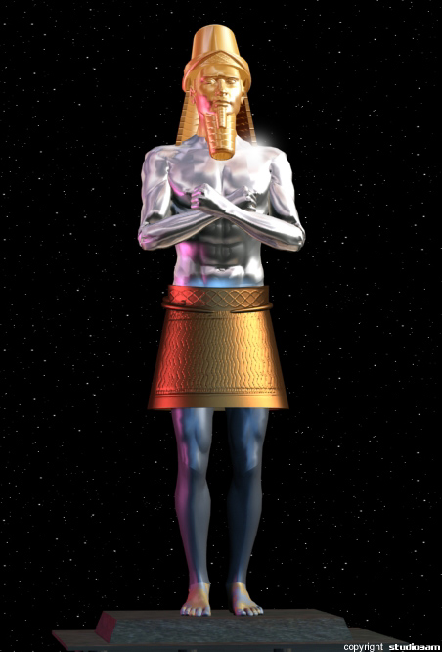
WAR OF WORSHIP IN REVELATION
The Issue: Worship
Away with you, Satan! For it is written, ‘You shall worship the Lord your God, and Him only you shall serve.’ Matt 4:10
A King’s Seal is determined by three things: 1) Name 2) Title & 3) Dominion. These three elements are found in the Fourth Commandment. 1) Name: The LORD, 2) Title: Made (or Creator), 3: Dominion: Heaven & Earth, The Sea and all that in them is.

Slide 13
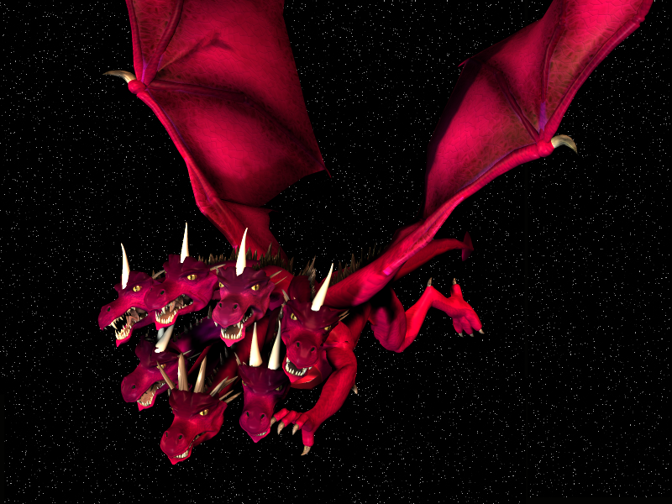
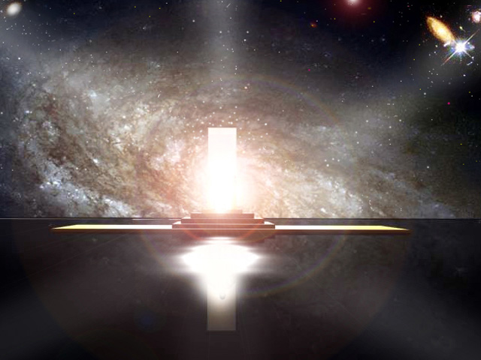
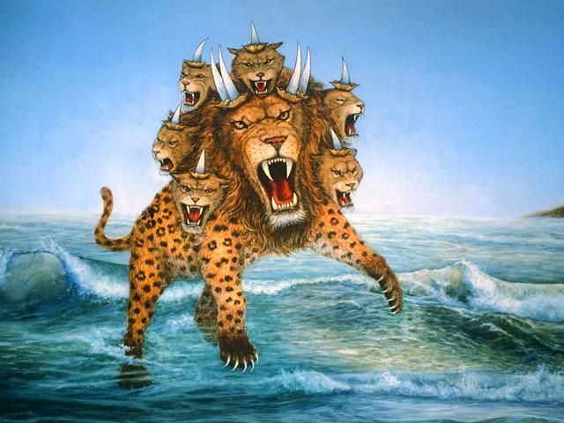
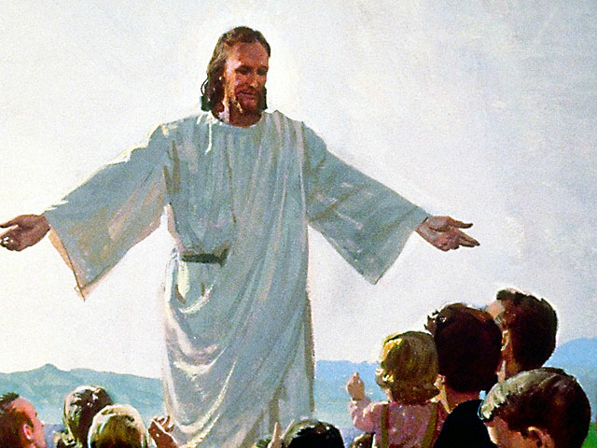
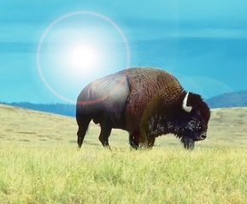
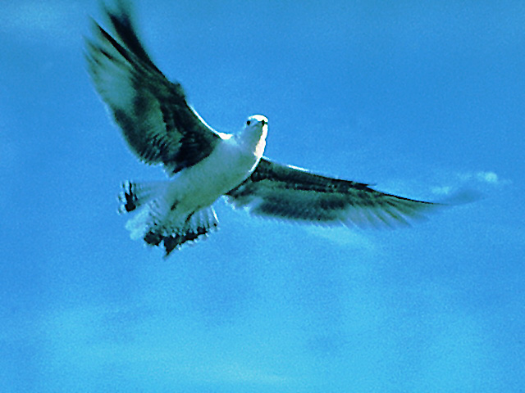
WAR OF WORSHIP IN REVELATION
The Contenders for Worship: The True & False Godhead
Counterfeit of the Father:
1. Like the Most High
(Isa 14:12-14)
2. Receives worship (Rev 13:3)
3. Works through other beasts
Work of the Father:
1. IS THE Most High (Rev 4:11)
2. Receives worship (Rev 4:9)
3. Works through Son & Spirit
Dragon - Satan
Father
Sea Beast Counterfeit of the Son:
1. Looks like Dragon (Rev 12:3; 13:1)
2. Receives authority from Dragon (Rev 13:2)
3. Receives fatal wound (Rev 13:3)
4. Receives life again (Rev 13:3)
5. Has a work for 42 months (Rev 13:5)
6. Is worshipped by the world (Rev 13:4)
Work of the Son:
1. Looks like Father (John 14:9; Dan 7; Rev 1)
2. Receives authority from Father (Matt 28:18)
3. Receives fatal wound (Rev 5:6)
4. Receives life again (Rev 5:9)
5. Has a work for 42 months (Dan 9:27)
6. Is worshipped by the world (Rev 5:12-14)
Sea Beast – Organized Religious State
Son
Land Beast Counterfeit of the Holy Spirit:
1. Takes up work of the Sea Beast (Rev 13:12)
2. Points people to Sea Beast (Rev 13:12)
3. Calls fire down from heaven (Rev 13:13)
Work of the Holy Spirit:
1. Takes up work of Christ (John 16:7)
2. Points people to Christ (John 16:13)
3. Calls fire down from heaven (Acts 2:1-3)
Land Beast – Political State with “religiousity”
Holy Spirit

Slide 14
Notes:
14

Slide 15
God Loves You

Slide 16
Notes:
16

Slide 17
God Loves You

Slide 18
Then Job arose, and rent his mantle, and shaved his head, and fell down upon the ground, and worshipped, And said, Naked came I out of my mother's womb, and naked shall I return thither: the Lord gave, and the Lord hath taken away; blessed be the name of the Lord. In all this Job sinned not, nor charged God foolishly.
Job 1:20-22 (KJV)

Slide 19
At this, Job got up and tore his robe and shaved his head. Then he fell to the ground in worship and said: “Naked I came from my mother’s womb, and naked I will depart. The Lord gave and the Lord has taken away; may the name of the Lord be praised.” In all this, Job did not sin by charging God with wrongdoing.
Job 1:20-22 (NIV)

Slide 20
Notes:
20

Slide 21
God Loves You

Slide 22
Observations
What have you noticed?
Anything bother you?
Anything intrigue you?
Anything you do not understand?
Anything connect to your life now?
Notes:
22

Slide 23
Notes:
23

Slide 24
God Loves You

Slide 25
Notes:
25

Slide 26
God Loves You
Notes:
26

Slide 27
Notes:
27

