Slide 1
God Loves You

Slide 2
And there was war in heaven: Michael and his angels fought against the dragon; and the dragon fought and his angels, and prevailed not; neither was their place found any more in heaven. And the great dragon was cast out, that old serpent, called the Devil, and Satan, which deceiveth the whole world: he was cast out into the earth, and his angels were cast out with him. And I heard a loud voice saying in heaven, Now is come salvation, and strength, and the kingdom of our God, and the power of his Christ: for the accuser of our brethren is cast down, which accused them before our God day and night.
Revelation 12:7-10 (KJV)

Slide 3
Then war broke out in heaven. Michael and his angels fought against the dragon, and the dragon and his angels fought back. But he was not strong enough, and they lost their place in heaven. The great dragon was hurled down—that ancient serpent called the devil, or Satan, who leads the whole world astray. He was hurled to the earth, and his angels with him. Then I heard a loud voice in heaven say: Now have come the salvation and the power and the kingdom of our God, and the authority of his Messiah. For the accuser of our brothers and sisters, who accuses them before our God day and night, has been hurled down.
Revelation 12:7-10 (NIV)

Slide 4
How do you hear God talking to you?
How much time do you spend reading the Bible in a given week?
How much time do you spend in prayer with God during the week?
Do you understand what is at stake in the Cosmic Conflict?
How are you preparing yourself to “fight”?
Why is worship SOOOO important?
What will YOUR legacy be?
Notes:
4

Slide 5
What is the “big fight” about?
Notes:
5

Slide 6
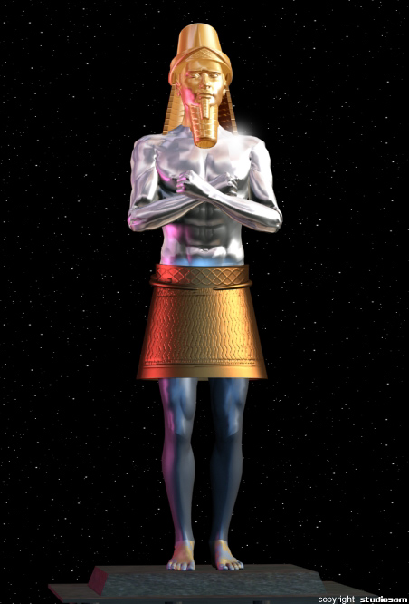
WAR OF WORSHIP IN REVELATION
The Issue: Worship
Away with you, Satan! For it is written, ‘You shall worship the Lord your God, and Him only you shall serve.’ Matt 4:10
A King’s Seal is determined by three things: 1) Name 2) Title & 3) Dominion. These three elements are found in the Fourth Commandment. 1) Name: The LORD, 2) Title: Made (or Creator), 3: Dominion: Heaven & Earth, The Sea and all that in them is.

Slide 7
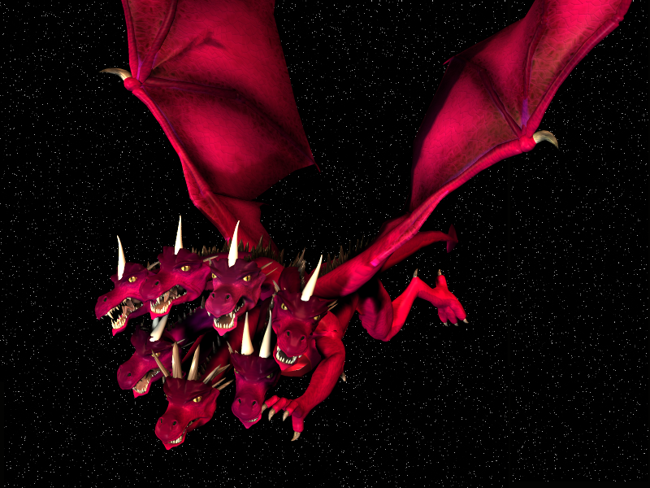
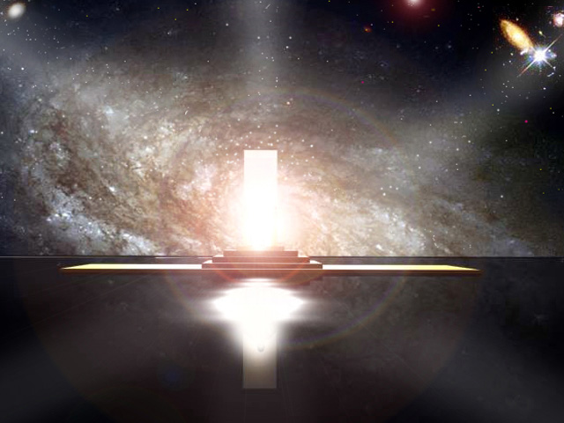
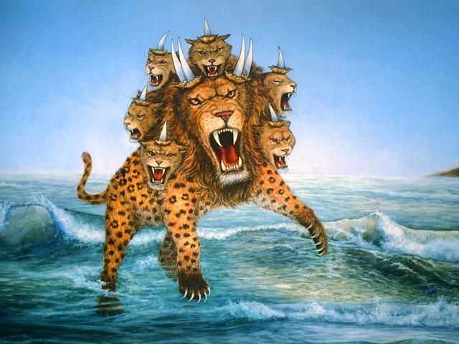
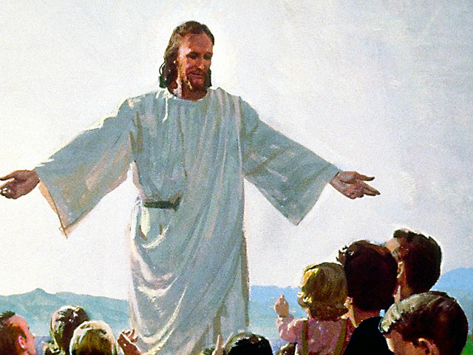
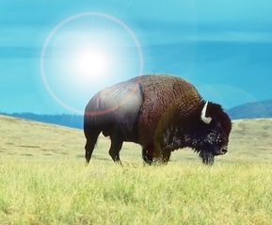
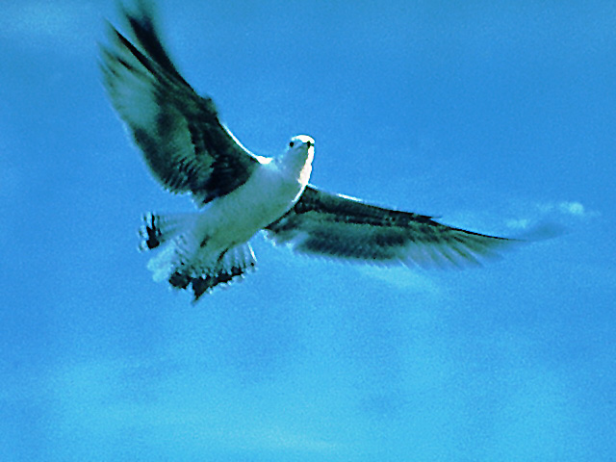
WAR OF WORSHIP IN REVELATION
The Contenders for Worship: The True & False Godhead
Counterfeit of the Father:
1. Like the Most High
(Isa 14:12-14)
2. Receives worship (Rev 13:3)
3. Works through other beasts
Work of the Father:
1. IS THE Most High (Rev 4:11)
2. Receives worship (Rev 4:9)
3. Works through Son & Spirit
Dragon - Satan
Father
Sea Beast Counterfeit of the Son:
1. Looks like Dragon (Rev 12:3; 13:1)
2. Receives authority from Dragon (Rev 13:2)
3. Receives fatal wound (Rev 13:3)
4. Receives life again (Rev 13:3)
5. Has a work for 42 months (Rev 13:5)
6. Is worshipped by the world (Rev 13:4)
Work of the Son:
1. Looks like Father (John 14:9; Dan 7; Rev 1)
2. Receives authority from Father (Matt 28:18)
3. Receives fatal wound (Rev 5:6)
4. Receives life again (Rev 5:9)
5. Has a work for 42 months (Dan 9:27)
6. Is worshipped by the world (Rev 5:12-14)
Sea Beast – Organized Religious State
Son
Land Beast Counterfeit of the Holy Spirit:
1. Takes up work of the Sea Beast (Rev 13:12)
2. Points people to Sea Beast (Rev 13:12)
3. Calls fire down from heaven (Rev 13:13)
Work of the Holy Spirit:
1. Takes up work of Christ (John 16:7)
2. Points people to Christ (John 16:13)
3. Calls fire down from heaven (Acts 2:1-3)
Land Beast – Political State with “religiousity”
Holy Spirit

Slide 8
Only some are listening . . .
Notes:
8

Slide 9
Living out the Great Controversy every day
Notes:
9

Slide 10
Trouble on the Blue Planet
Notes:
10

Slide 11
Project
Read JOB Project texts (step 1)
Answer Questions (step 4)
Do creative work (step 5)
Hand in!
Notes:
11

Slide 12
Notes:
12

Slide 13
God Loves You

Slide 14
Living out the Great Controversy every day
Notes:
14

Slide 15
Notes:
15

Slide 16
God Loves You

Slide 17
Notes:
17

Slide 18
God Loves You

Slide 19
Notes:
19

Slide 20
God Loves You
Notes:
20

Slide 21
Notes:
21

