Slide 1
God Loves You

Slide 2
God creates out of nothing. Wonderful you say. Yes, to be sure, but he does what is still more wonderful: he makes saints out of sinners.
Soren Kierkegaard

Slide 3
By the word of the Lord were the heavens made; and all the host of them by the breath of his mouth.
Psalm 33:6 (KJV)

Slide 4
By the word of the Lord the heavens were made, their starry host by the breath of his mouth.
Psalm 33:6 (NIV)

Slide 5
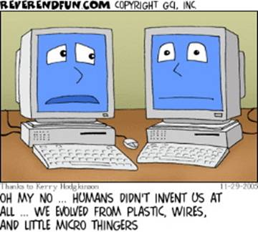
Notes:
5

Slide 6
Earth: A Young Planet?
25:00
Notes:
6

Slide 7
What are some of the arguments for a young earth?
What are some of the problems with the fossil record (as regards evolution)?
What wonders of the heaven/earth might God have put for your enjoyment?
What impact, if any, does believing in evolution/creation have on your self-image?
What are “transitional life-forms” and why are so many missing?
How does part of the theory of evolution contradict itself?
Notes:
7

Slide 8
Journaling
Detail some of the arguments for a young earth. Detail some of the arguments against the earth being so young. Why is important to know all the issues? What are some thoughts that arose for you that you had not thought of before?
Notes:
8

Slide 9
Notes:
9

Slide 10
God Loves You

Slide 11
Imagination is the beginning of creation. You imagine what you desire, you will what you imagine and at last you create what you will.
George Bernard Shaw

Slide 12
Could there be more than “tooth & claw” and survival of the fittest?
Notes:
12

Slide 13
If the earth were 4.5 billion years old, what should show up in our atmosphere?
a) Lots of Hydrogen
b) Lots of Helium
c) Lots of Carbon 14
What is “carbon-dating”?
a) Measuring the radioactivity of a given sample
b) Using graphite to filter out the water samples
c) Dating only someone who wears diamonds
The surface of the moon indicates . . . ?
a) An age of approximately 700,000-1.5 million years
b) An age of approximately 700,000-150,000 years
c) An age of approximately 7000-15,000 years

Slide 14
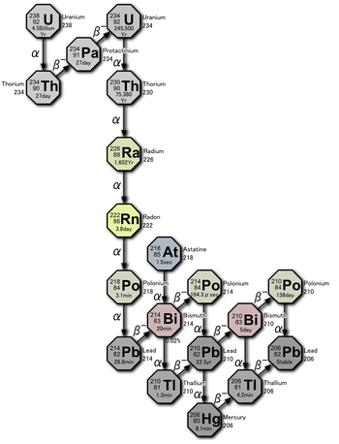
Uranium 238 decay
Notes:
14

Slide 15
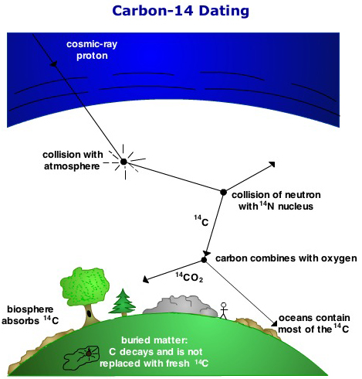
Notes:
15

Slide 16
The Fossil Record
25:00
Notes:
16

Slide 17
Journaling
What are some of the problems with the evolutionary idea in regards to the current fossil record? Given that some strata do appear very old, what arguments might a creationist present against that? Describe your thoughts and reactions to the videos so far.
Notes:
17

Slide 18
Notes:
18

Slide 19
God Loves You

Slide 20
While I know myself as a creation of God, I am also obligated to realize and remember that everyone else and everything else are also God's creation.
Maya Angelou

Slide 21
Affection of species points to a Creator
Notes:
21

Slide 22
The geological layer-strata map illustrates . . . ?
a) An analysis of dinosaur digs
b) The mudslide/strata analysis of the Grand Canyon
c) Evolutionary dating method using buried layers
What are “transitional types” of fossils . . . ?
a) Animal types that blend two genus
b) Intermediary animals between life-forms
c) The basic animal stages (ex: between kitten and cat)
Coal seams provide what kind of information. . . ?
a) Buried plant material
b) Buried fossil records
c) An insight into the long time needed to make coal

Slide 23
Genetic drift and Natural Selection
Notes:
23

Slide 24
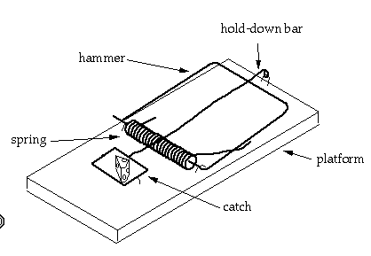
A mousetrap: irreducible complexity
Notes:
24

Slide 25
What was Darwin actually saying?
Notes:
25

Slide 26
So then, how did life begin?
Notes:
26

Slide 27
Journaling
What impact does a creationist view have on one’s self-image and esteem if any? What might be some of the conclusions and impact on one’s personal belief structure if you adopt an evolutionists’ ideology?
Notes:
27

Slide 28
Notes:
28

Slide 29
God Loves You

Slide 30
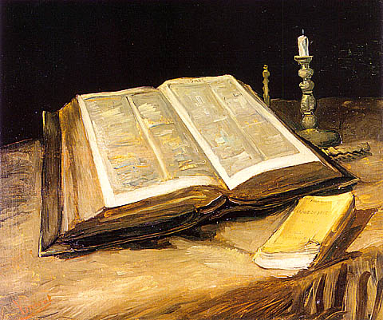
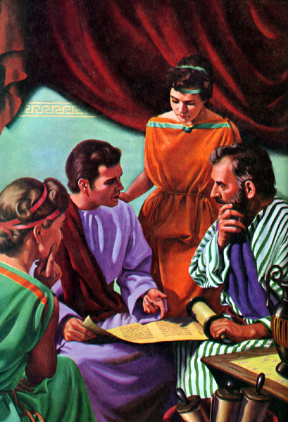
II Peter 1:20-21
II Samuel 23:2
Hebrews 1:1
II Timothy 3:15-16
Psalm 119:105
II Peter 1:19
Psalm 33:6, 9
Psalm 119:11
Acts 17:11
Isaiah 28:9-10
Notes:
30

Slide 31
Notes:
31

