Slide 1
God Loves You

Slide 2
God makes the world not out of necessity but by a divine Whim, and the world he makes is a whimsically romantic place. We're all crazy about each other because we're made in the image of Someone who's been crazy about us
Robert Farrer Capon

Slide 3
To whom then will ye liken me, or shall I be equal? saith the Holy One. Lift up your eyes on high, and behold who hath created these things, that bringeth out their host by number: he calleth them all by names by the greatness of his might, for that he is strong in power; not one faileth.
Isaiah 40:25-26 (KJV)

Slide 4
“To whom will you compare me? Or who is my equal?” says the Holy One. Lift up your eyes and look to the heavens: Who created all these? He who brings out the starry host one by one and calls forth each of them by name. Because of his great power and mighty strength, not one of them is missing.
Isaiah 40:25-26 (NIV)

Slide 5
What are some of the arguments for a young earth?
What are some of the problems with the fossil record (as regards evolution)?
What wonders of the heaven/earth might God have put for your enjoyment?
What impact, if any, does believing in evolution/creation have on your self-image?
What are “transitional life-forms” and why are so many missing?
How does part of the theory of evolution contradict itself?
Notes:
5

Slide 6
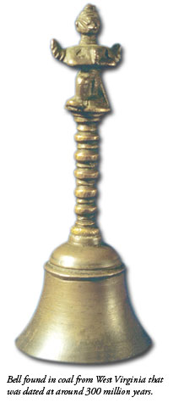
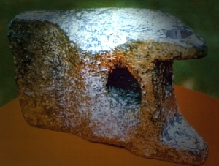
Artifacts found “out of place”
A Chain in Coal. Mrs. S. W. Culp, of Morrisonville, Illinois, was breaking coal into smaller lumps for her scuttle, one day in 1891, when she noticed a chain in the midst of the coal. When she reached down to pick it up, she saw that the two ends of the chain were firmly embedded in two separate pieces of coal that had clearly been a single lump only moments before. (The Morrosonville Times, June 11, 1891)
Milled aluminum found with Mastodon bones
Acts & Facts magazine, Feb 2010
Notes:
6

Slide 7
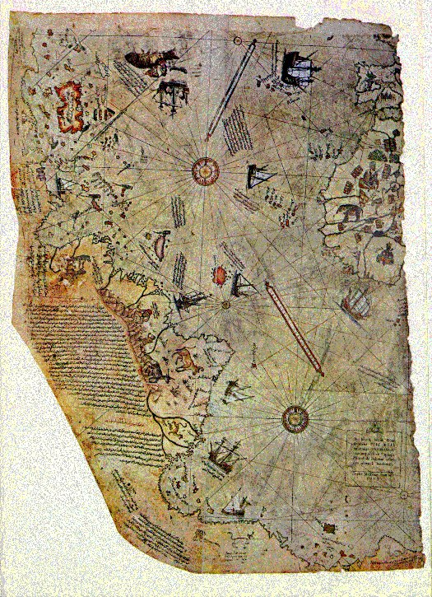
A map dated from the Ottoman era (1513)
Piri Re’is (or the Piri Reis) annotated the map in Turkish saying that he had copied the map from earlier maps dated in the 4th Century BC
Modern cartographers are amazed because the longitude and latitude are EXACT as today
in order to draw such maps, the authors had to know about the spheroid trigonometry, the curvature of the earth, & methods of projection.
The map shows the coastline of Antarctica exactly as we know it exists—UNDER the ice
Notes:
7

Slide 8
Dawkins, avowed atheist, speaks
Notes:
8

Slide 9
Unforseen complexity of the cell
Notes:
9

Slide 10
More objects out of place
Notes:
10

Slide 11
Notes:
11

Slide 12
God Loves You

Slide 13
I grew up believing in this (evolution) Myth and I have felt—I still feel—its almost perfect grandeur. Let no one say we are an unimaginative age: neither the Greeks nor the Norsemen ever invented a better story. But the Myth asks me to believe that reason is simply the unforeseen and unintended byproduct of a mindless process at one stage of its endless and aimless becoming. The content of the Myth thus knocks from under me the only ground on which I could possibly believe the Myth to be true. If my own mind is a product of the irrational, how shall I trust my mind when it tells me about evolution?
C. S. Lewis

Slide 14
The importance of knowing the ONE
Notes:
14

Slide 15
Journaling
What difference does it make whether you believe in a god at all? How does it change the meaning of Scripture to understand that it is claiming to be THE God without peers giving us the Bible?
Elohim is plural in Scripture, so how does the meaning of Genesis 1:1 change? It ties in with Genesis 1:26 as a plural unit, and what does the phrasing of Genesis 1:26-27 tell us about God, ourselves (as a reflection of the Divine) and subsequently, the created earth?
Notes:
15

Slide 16
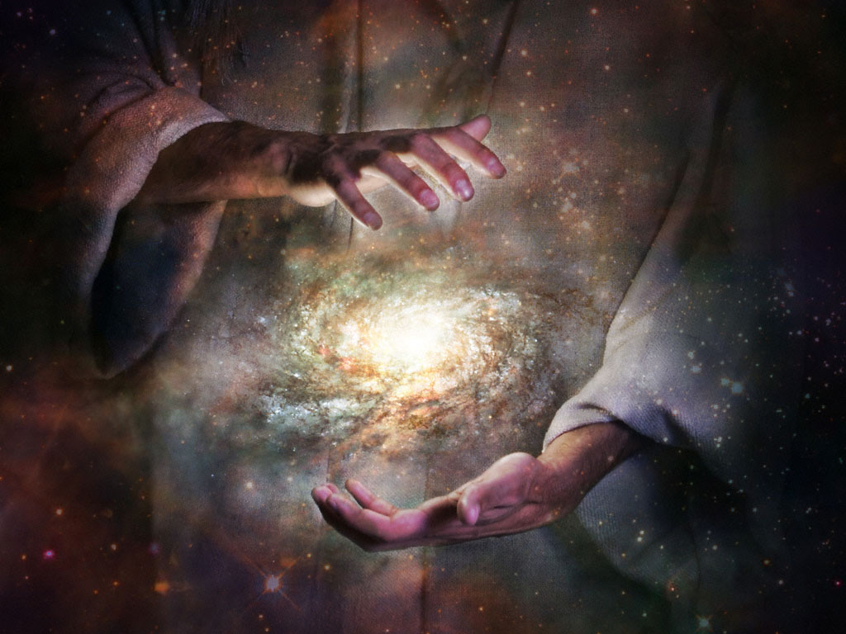
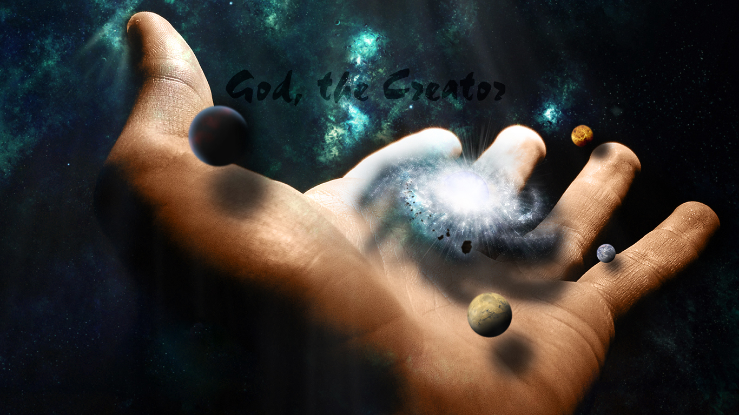
Genesis 1:1
Psalm 33:6, 9
John 1:1-3
Acts 17:24-25
Isaiah 40:25-28
Job 38:1, 4
Revelation 14:6-7
Nehemiah 9:6
Psalm 139:14
Revelation 4:10-11
Notes:
16

Slide 17
Notes:
17

Slide 18
God Loves You

Slide 19
Notes:
19

Slide 20
God Loves You
Notes:
20

Slide 21
Notes:
21

