Slide 1
God Loves You

Slide 2
What? know ye not that your body is the temple of the Holy Ghost which is in you, which ye have of God, and ye are not your own? For ye are bought with a price: therefore glorify God in your body, and in your spirit, which are God's.
I Corinthians 6:19-20 (KJV)

Slide 3
Do you not know that your bodies are temples of the Holy Spirit, who is in you, whom you have received from God? You are not your own; you were bought at a price. Therefore honor God with your bodies.
I Corinthians 6:19-20 (NIV)

Slide 4
Word choices
Temple
Bought
Glorify
Notes:
4

Slide 5
People are complex, layered
Notes:
5

Slide 6
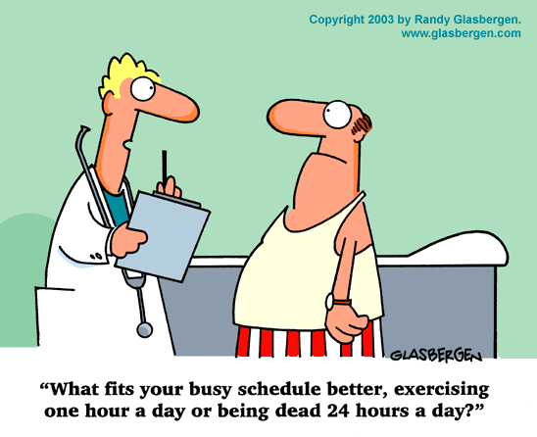
Notes:
6

Slide 7
Mental Health
Spiritual Health
Physical Health
Social Health
Notes:
7

Slide 8
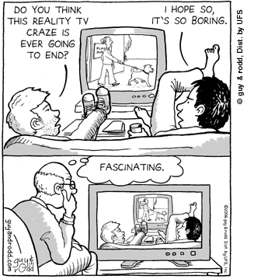
What are you putting into your mind?
Notes:
8

Slide 9
The value of exercise
Notes:
9

Slide 10
What are the links between body/mind (if any)?
Why does God care what we eat?
Are there optimum plans for health?
Is there a “one size fits all” strategy?
Are there things that EVERYONE should know in regards to health?
What is “salvific” about exercise?
What is the diet for the mind?
What does the Bible suggest about our mental diet?
Notes:
10

Slide 11
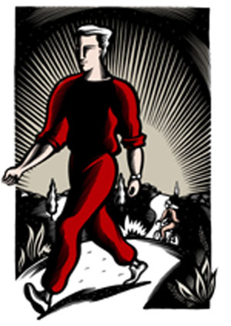
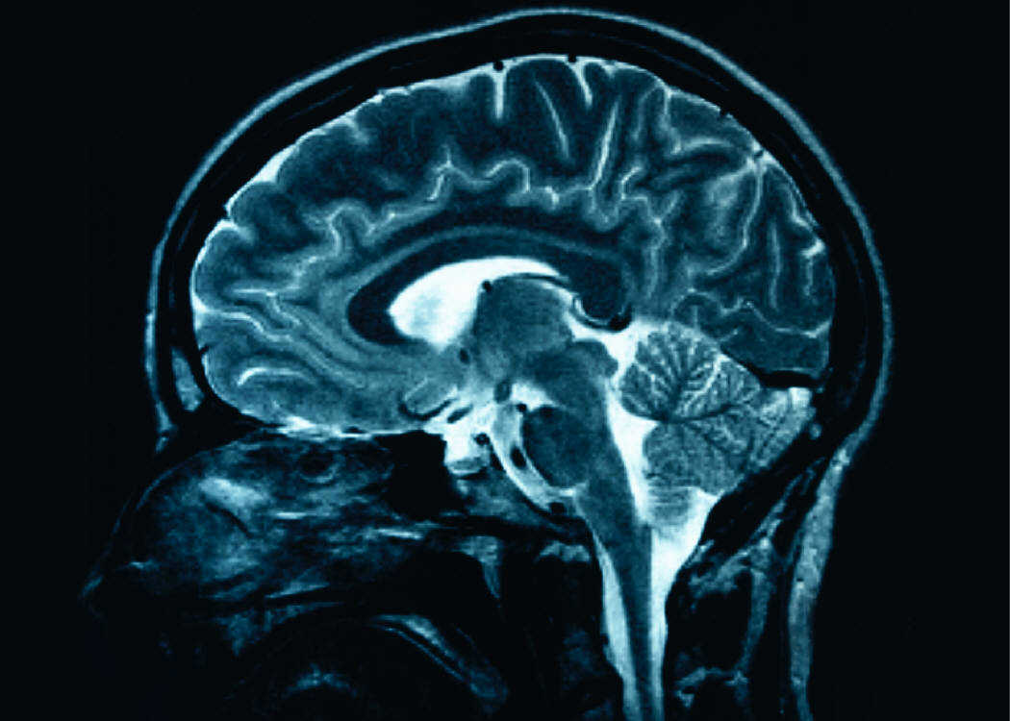
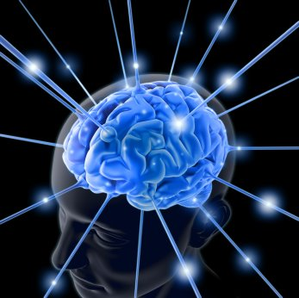
I Corinthians 6:19-20
II Corinthians 6:16-18
Romans 12:1-2
Genesis 1:29
Genesis 3:18
Genesis 9:3-4 (Lev 11)
Daniel 1:8-16
Ephesians 5:18-19
I Corinthians 10:23-33
Romans 14:1-4
James 4:17
Notes:
11

Slide 12
Notes:
12

Slide 13
God Loves You

Slide 14
Mental health and social media
Notes:
14

Slide 15
Manipulation through media
Notes:
15

Slide 16
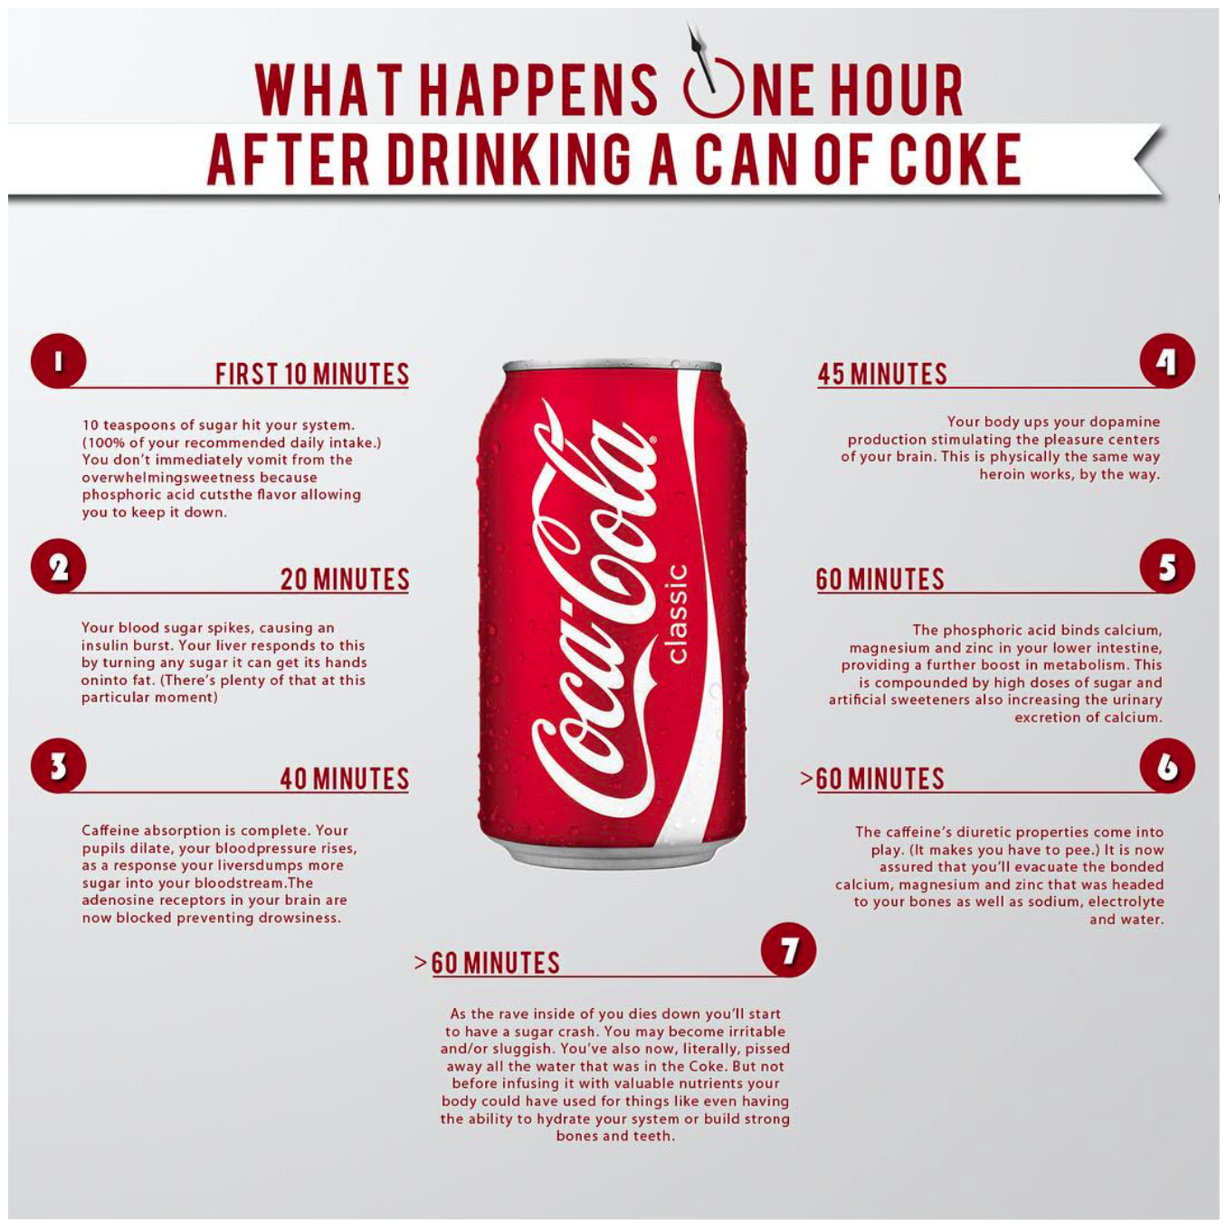
Notes:
16

Slide 17
Matthew 7:12
Luke 10:25-37
Matthew 5:44
Proverbs 25:21-22
John 13:34-35
Ecclesiastes 5:2
Malachi 2:10
Proverbs 26:18-19
Hebrews 13:1-2
Proverbs 15:1
Romans 13:8-10
Galatians 6:2
Notes:
17

Slide 18
Notes:
18

Slide 19
God Loves You

Slide 20
Notes:
20

