Slide 1
God Loves You
Notes:
1

Slide 2
Jesus said unto her, I am the resurrection, and the life: he that believeth in Me, though he were dead, yet shall he live. And whosoever liveth and believeth in Me shall never die. Believest thou this?
John 11:25-26 (KJV)

Slide 3
Jesus said to her, "I am the resurrection and the life. He who believes in Me will live, even though he dies; and whoever lives and believes in Me will never die. Do you believe this?"
John 11:25-26 (NIV)

Slide 4
Word choices
Rise
Resurrection
Life
Christ
Notes:
4

Slide 5
He not busy being born is busy dying.
Bob Dylan

Slide 6
John 11
Notes:
6

Slide 7

Chapter Reflections
What does this chapter say about Jesus?
Who He is
Fulfillment of Messiahship
Empathy with humanity
What can we learn about who God is?
What insights into the GC are there here?
What message can we take to others?
Notes:
7

Slide 8

God promised His followers He’d come back for them. What is taking so long?
If you had a message from God to give the world, but it might cost you everything to give it, would you?
What is the point of living on this earth now if we are going to live somewhere else?
Is heaven meant to be our home? Why then come back to earth (REV 21) later?
What are you looking forward to most at the end of time?
What are you dreading as you may think about “last day events”?
Notes:
8

Slide 9
Bible Study
State of the Dead
take
one
Notes:
9

Slide 10
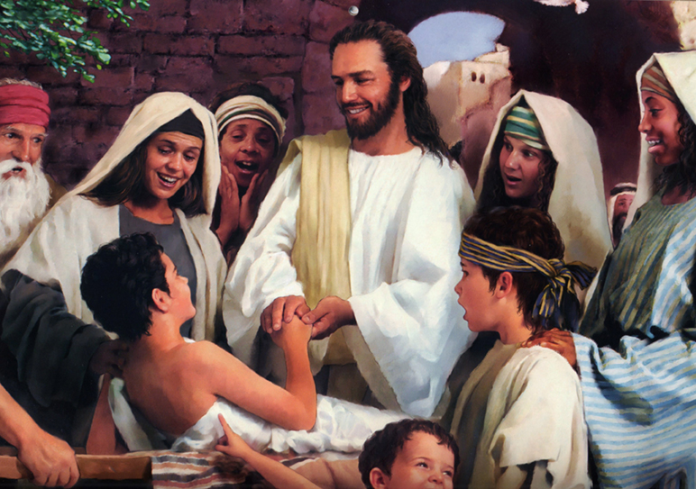
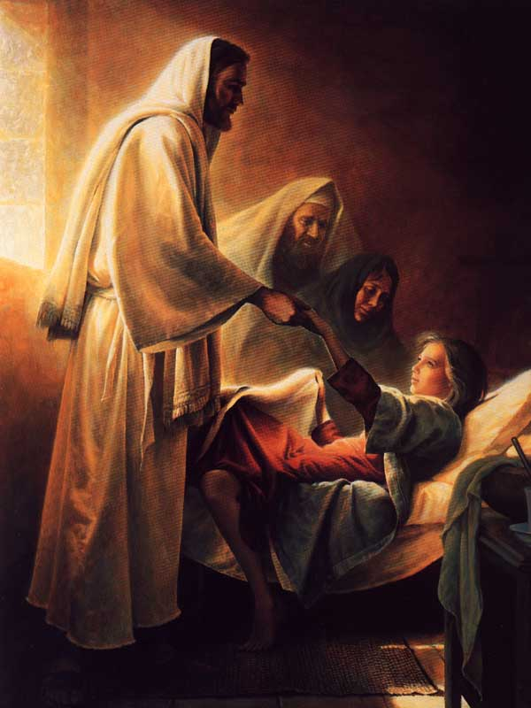
Ecclesiastes 9:5-6
Hebrews 9:27
Genesis 2:7
Ecclesiastes 12:7
Job 27:3
Psalms 146:2-4
John 11:11-14
I Thessalonians 4:14-17
John 5:28-29
I Corinthians 15:20, 35-38, 51-57
Revelation 20:4-6
Notes:
10

Slide 11
Notes:
11

Slide 12
God Loves You
Notes:
12

Slide 13
And in the end, it’s not the years in your life that count. It’s the life in your years.
Abraham Lincoln

Slide 14
John 11
Notes:
14

Slide 15
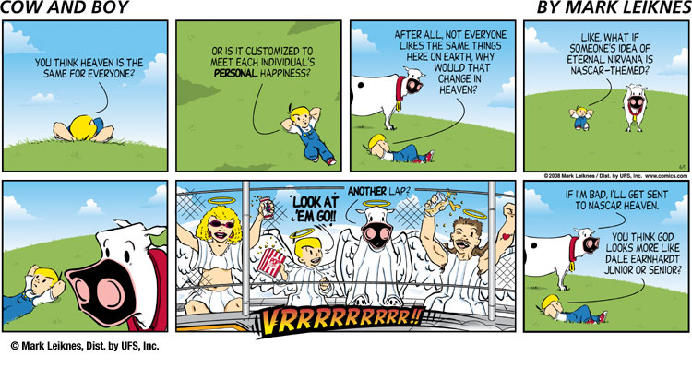

Slide 17
What of the afterlife (eastwood interview)?

Slide 18
“As regards this earth, Scripture declares the work of creation to have been finished from the foundation of the world. Hebrews 4:3. But the power of God is still exercised in upholding the objects of His creation. It is not because the mechanism once set in motion continues to act by its own inherent energy that the pulse beats, and breath follows breath. Every breath, every pulsation of the heart, is an evidence of the care of Him in whom we live and move and have our being.”
—pg 130-131, Ed., pub. 1903

Slide 19
“God is the fountain of life; and when one chooses the service of sin he separates from God, and thus cuts himself off from life. He is ‘alienated from the life of God.’ Christ says, ‘All they that hate Me love death.’ Eph. 4:18; Prov. 8:36. God gives [us] existence for a time that . . . [we may] receive the results of [our] own choice. By a life of rebellion, satan and all who unite with him place themselves so out of harmony with God that His very presence is to them a consuming fire. The glory of Him who is love will destroy them.”
—pg 764, DA., pub. 1890

Slide 20
“At the beginning of the great controversy, the angels did not understand this. Had Satan and his host then been left to reap the full result of their sin, they would have perished; but it would not have been apparent to heavenly beings that this was the inevitable result of sin. A doubt of God’s goodness would have remained in their minds as evil seed, to produce its deadly fruit of sin and woe. But not so when the great controversy shall be ended . . .

Slide 21
“ . . . Then, the plan of redemption having been completed, the character of God is revealed to all created intelligences. The precepts of His law are seen to be perfect and immutable. Then the extermination of sin will vindicate God’s love and establish His honor before a universe of beings who delight to do His will, and in whose heart is His law.”
—pg 764, DA., pub. 1890

Slide 22
“The youth need to understand the deep truth underlying the Bible statement that with God ‘is the fountain of life.’ Psalm 36:8. Not only is He the originator of all, but He is the life of everything that lives . . . It is His life that we receive in the sunshine, In the pure, sweet air, in the food which builds up our bodies and sustains our strength. It is by His life that we exist, hour by hour, moment by moment. Except as perverted by sin, all His gifts tend to life, to health and joy.”
—pg 198, Ed., pub. 1903

Slide 23
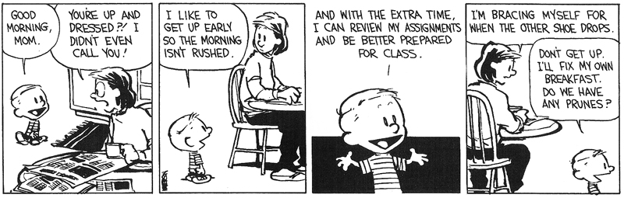
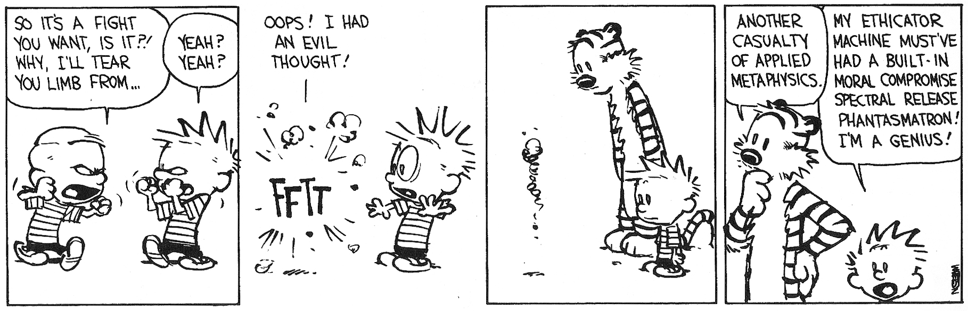
kind of like this . . .
Notes:
23

Slide 24
What does the Bible mean when it talks about eternal “death”?
To what does Jesus liken “death” in JN 11?
How is CHRIST the “life”?
What is the significance of Jesus weeping?
What does Thomas/Philip’s attitudes tell us about the disciples?
What meaning could there possibly be to the fact that Jesus waits to come heal Lazarus?
What meaning might there be to the fact that Martha comes first and then Mary?
Notes:
24

Slide 25
Notes:
25

Slide 26
God Loves You
Notes:
26

Slide 27
PSAT
Notes:
27

Slide 28
Ecclesiastes 9:5-6
Hebrews 9:27
Genesis 2:7
Ecclesiastes 12:7
Job 27:3
Psalms 146:2-4
John 11:11-14
I Thessalonians 4:14-17
John 5:28-29
I Corinthians 15:20, 35-38, 51-57
Revelation 20:4-6
Notes:
28

Slide 29
Notes:
29

Slide 30
God Loves You

Slide 31
No one else holds or has held the place in the heart of the world which Jesus holds. Other gods have been as devoutly worshipped; no other man has been so devoutly loved.
John Knox

Slide 32
To love at all is to be vulnerable.
C.S. Lewis

Slide 33
John 12
Notes:
33

Slide 34
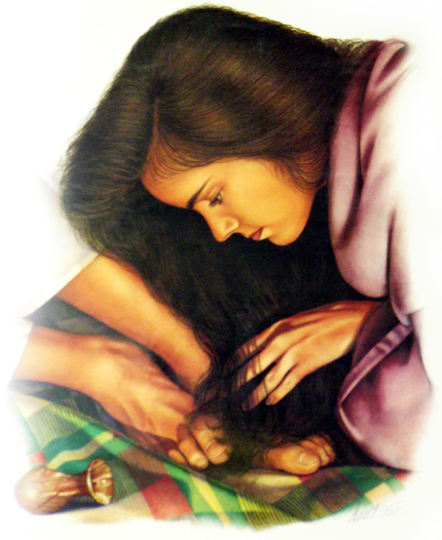
The anointing of the Messiah
Messiah = the Anointed One

Slide 35
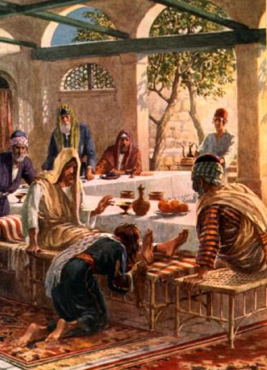
John 12
Notes:
35

Slide 36
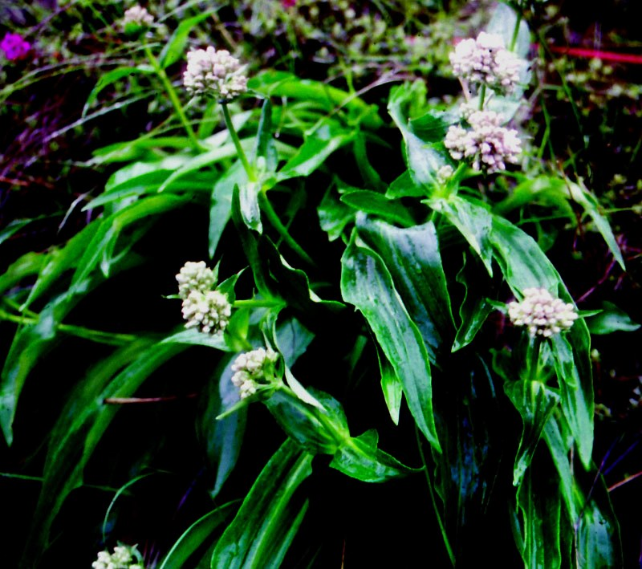

John 12
Spikenard plant
Notes:
36

Slide 37
What was the setting of the Anointing?
What details does John give us as compared to others?
Why did she do this (according to Jesus’ words)?
Have you ever done anything embarrassing that you wish you could “take back”?
How did the disciples react?
When in His life ministry was this done?
What significance might there be in John writing down this act when he did?
Notes:
37

Slide 38



Slide 39
Notes:
39

Slide 40
Word Study
Notes:
40

Slide 41

John 12:32

Slide 42
And I, if I be lifted up from the earth, will draw all men unto me.

Slide 43
WORD = ufow
ufow
“hoo-psah-oh”

Slide 44
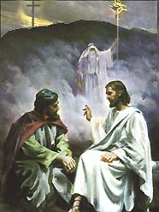
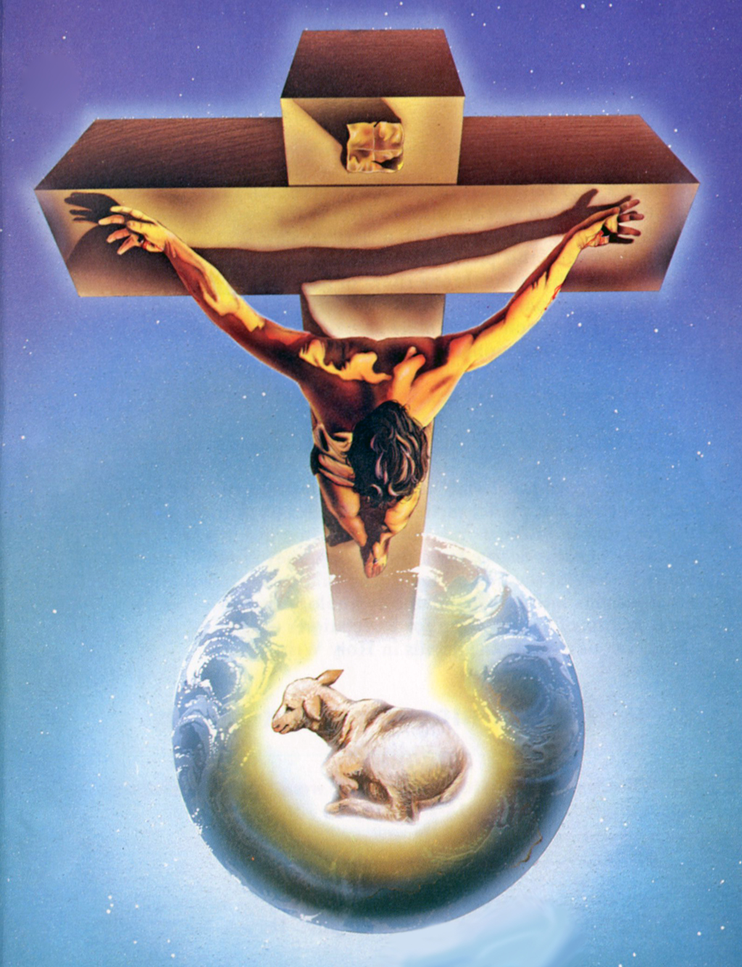
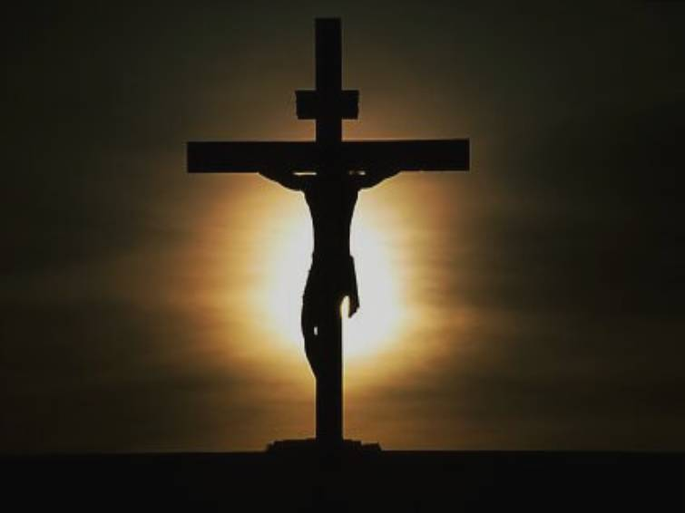
passages in John:
John 3:14
John 8:28
John 12:32

Slide 45
And as Moses lifted up the serpent in the wilderness, even so must the Son of man be lifted up
John 3:14
So Jesus said, “When you have lifted up the Son of Man, then you will know that I am the one . . .”
John 8:28
But I, when I am lifted up from the earth, will draw all men unto me.”
John 12:32

Slide 46
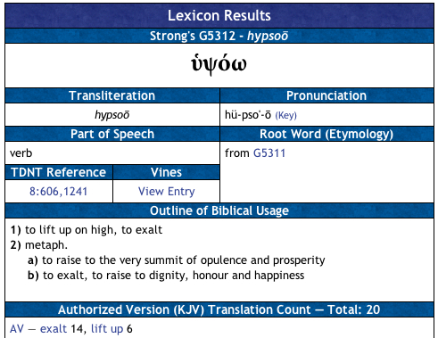
http://www.studylight.org/isb/
http://www.eliyah.com/lexicon.html
Notes:
46

Slide 47
Evangelism is simply letting Jesus be exalted. He will draw people to Himself when they see Him for who He is.
Notes:
47

Slide 48
God Loves You
Notes:
48

Slide 49
Great persons are able to do great kindnesses.
Miguel de Cervantes

Slide 50
Life’s most urgent question is: What are you doing for others?
Martin Luther King, Jr.

Slide 51
John 11
John 12
Notes:
51

Slide 52
Chapter Reflections
What does this chapter say about Jesus?
Who He is
Fulfillment of Messiahship
Empathy with humanity
What can we learn about who God is?
What insights into the GC are there here?
What message can we take to others?
Notes:
52

Slide 53
Notes:
53

