Slide 1
God Loves You
Notes:
1

Slide 2
A new commandment I give unto you, that ye love one another; as I have loved you, that ye also love one another. By this shall all men know that ye are my disciples, if ye have love one to another
John 13:34-35 (KJV)

Slide 3
A new command I give you: Love one another. As I have loved you, so you must love on another. By this everyone will know that you are my disciples, if you love one another.
John 13:34-35 (NIV)

Slide 4
Let not your heart be troubled: ye believe in God, believe also in me. In my Father's house are many mansions: if it were not so, I would have told you. I go to prepare a place for you And if I go and prepare a place for you, I will come again, and receive you unto myself; that where I am, there ye may be also. And whither I go ye know, and the way ye know . . . Jesus saith unto him, I am the way, the truth, and the life: no man cometh unto the Father, but by me. If ye had known me, ye should have known my Father also: and from henceforth ye know him, and have seen him.
John 14:1-4, 6-7 (KJV)

Slide 5
Do not let your hearts be troubled. Trust in God; trust also in me. In my Father's house are many rooms; if it were not so, I would have told you. I am going there to prepare a place for you. And if I go and prepare a place for you, I will come back and take you to be with me that you also may be where I am. You know the way to the place where I am going . . . Jesus answered, "I am the way and the truth and the life. No one comes to the Father except through me. If you really knew me, you would know my Father as well. From now on, you do know him and have seen him.”
John 14:1-4, 6-7 (NIV)

Slide 6
We come to love not by finding a perfect person, but by learning to see an imperfect person perfectly.
Anonymous

Slide 7
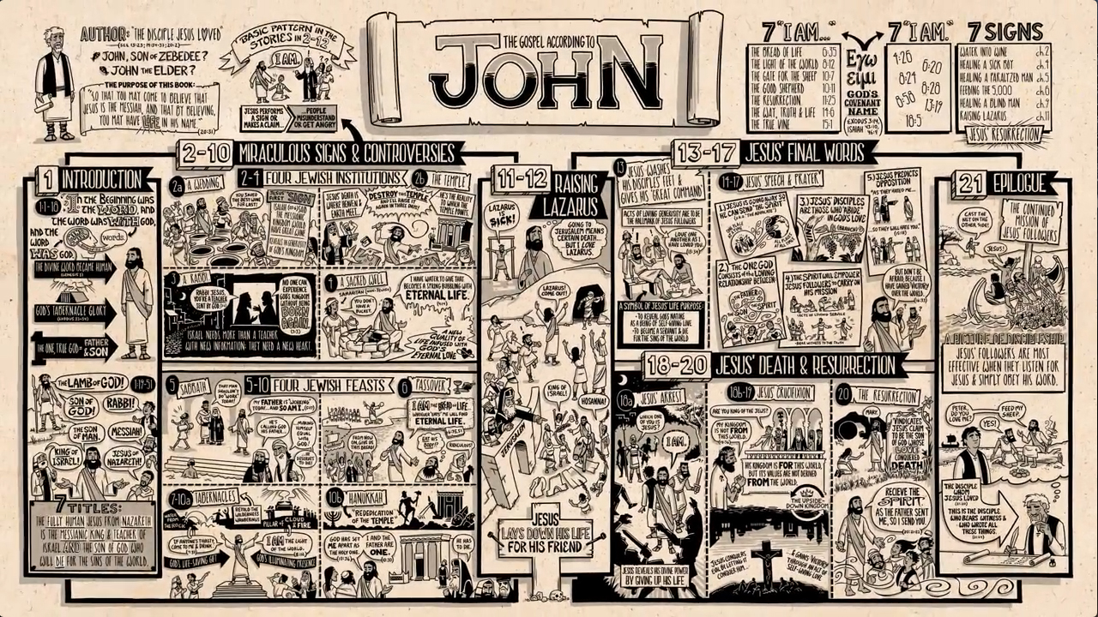
HOMEWORK OVER WEEKEND
Watch video on John 13-21; link on website
Notes:
7

Slide 8
John review
Chapter 1:
Chapter 2:
Chapter 3:
Chapter 4:
Chapter 5:
Chapter 6:
Chapter 7:
Chapter 8:
Chapter 9:
Chapter 10:
Chapter 11:
Chapter 12:
Notes:
8

Slide 9
John 13
John 14
Notes:
9

Slide 10
Notes:
10

Slide 11
God Loves You
Notes:
11

Slide 12
It is not how much you do, but how much love you put into the doing that matters.
Mother Teresa

Slide 13

Chapter Reflections
What does this chapter say about Jesus?
Who He is
Fulfillment of Messiahship
Empathy with humanity
What can we learn about who God is?
What insights into the GC are there here?
What message can we take to others?
Notes:
13

Slide 14
“It is not the fear of punishment, or the hope of everlasting reward, that leads the disciples of Christ to follow Him. They behold the Saviour’s matchless love, revealed throughout His pilgrimage on earth, from the manger of Bethlehem to Calvary’s cross, and the sight of Him attracts, it softens and subdues the soul. Love awakens in the heart of the beholders. They hear His voice, and they follow Him”
pg480, DA, pub.1890

Slide 15
Notes:
15

Slide 16
God Loves You
Notes:
16

Slide 17
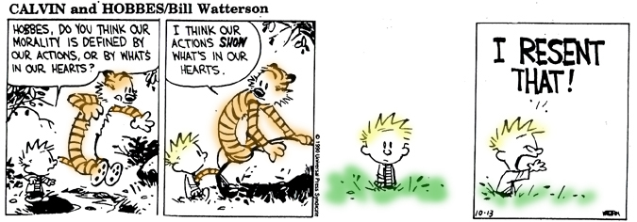

Slide 18
Love grows by giving. The love we give away is the only love we keep.
Elbert Hubbard

Slide 19
A Wonderful Life is one lived for others

Slide 20
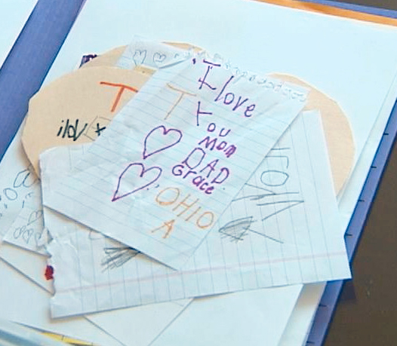
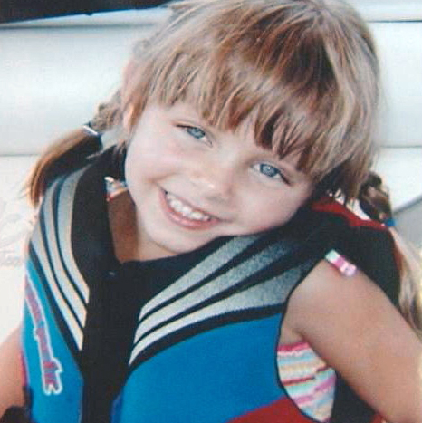
What if you only had a short time to live? How would you love?

Slide 21

Journaling
Read the story of the two sons found in Matthew 21:28-32. Note your thoughts and reactions to it.
Compare and contrast the idea of life/death/resurrection with our discussion of being born again and learning to do what’s right.
Notes:
21

Slide 22
“No truth does the Bible more clearly teach than that what we do is the result of what we are. To a great degree the experiences of life are the fruition of our own thoughts and deeds.
. . . [Proverbs 26:2. Isaiah 3: 10, 11. Jeremiah 6:19.]
Terrible is this truth, and deeply should it be impressed. Every deed reacts upon the doer. Never a human being but may recognize, in the evils that curse his life, fruitage of his own sowing. Yet even thus we are not without hope.”
pg 146, Ed, pub. 1903

Slide 23
“We are not to regard God as waiting to punish the sinner for his sin. The sinner brings the punishment upon himself. His own actions start a train of circumstances that bring the sure result. Every act of transgression reacts upon the sinner, works in him a change of character, and makes it more easy for him to transgress again. By choosing to sin, men separate themselves from God, cut themselves off from the channel of blessing, and the sure result is ruin and death.”
—letter 96, 1896

Slide 24
Notes:
24

Slide 25
God Loves You

Slide 26
The greatest spiritual practice is to transform love into service
Sai Baba

Slide 27
Love is unselfishly choosing for another's highest good.
C. S. Lewis

Slide 28
Desmond Doss

Slide 29
How long did Desmond Doss risk his life for others?
a) 12 minutes
b) 12 hours
c) 12 seconds
How did God protect Desmond from satan?
a) An angel appeared to help him
b) Desmond became bullet-proof
c) Enemy rifles jammed when aimed at him
Why might God have protected Desmond?

Slide 30
An unlikely relationship!

Slide 31
The gift of water to Mozambique

Slide 32
Little children, let no one deceive you. Whoever practices righteousness is righteous, as he is righteous
I John 3:7 (ESV)

Slide 33
Journaling
Write on your thoughts (questions raised, emotional reactions, observations) to one of the video clips
What are some practical ways in which you can practice righteousness? Do a service project and write it up for this JQ
Thinking about the little girl who knew her time was short and left messages for others to find. Become a “secret” pen-pal to someone for a week and leave them encouraging notes. Write up your thoughts/feelings/reactions.
Notes:
33

Slide 34
Notes:
34

Slide 35
God Loves You
Notes:
35

Slide 36
A Christian should always remember that the value of his good works is not based on their number and excellence, but on the love of God which prompts him to do these things.
John of the Cross

Slide 37
Notes:
37

