Slide 1
God Loves You
Notes:
1

Slide 2
For I think that God hath set forth us the apostles last, as it were appointed to death: for we are made a spectacle unto the world, and to angels, and to men.
I Corinthians 4:9 (KJV)

Slide 3
For it seems to me that God has put us apostles on display at the end of the procession, like those condemned to die in the arena. We have been made a spectacle to the whole universe, to angels as well as to human beings.
I Corinthians 4:9 (NIV)

Slide 4
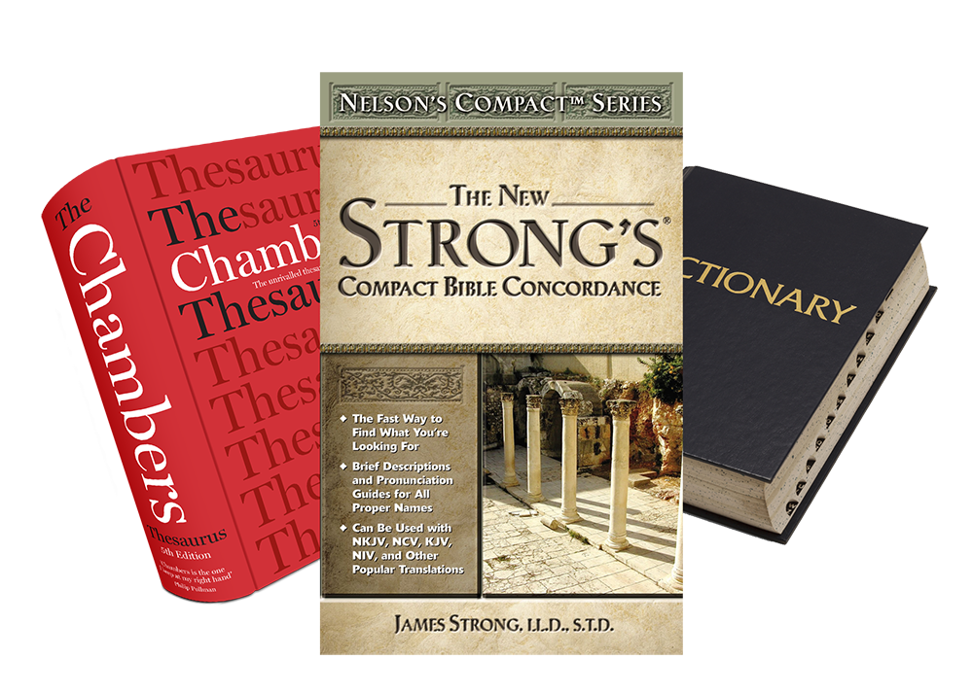
Word Study
spectacle
Notes:
4

Slide 5
Outlining the Quarter
How does it all fit together?
What is (a) Revelation?
What is an allusion?
What is chiastic structure (chiasmus)?
How does this matter to me today?
How can word studies shed light on the Bible?
Questions ???
Notes:
5

Slide 6
Reflection
What is the role of prophet?
What is the purpose of prophecy?
Notes:
6

Slide 7
Some verses to consider
Prophets & their jobs
Matthew 11:7-11
II Samuel 12:1-10
I Chronicles 29:26-30
Exodus 15:18-20
I Kings 18:27-39
Ezekiel 12:1-11
Exodus 7:1-2
Amos 3:3-7
Daniel 2:45-47
Revelation 1:1-3
Prophets are called to lead people to God, by writing, acting, singing, preaching, praying, and by suffering. That’s the job
Notes:
7

Slide 8
Reflection
The point of knowing the future isn’t to be able to “time” our repentance, but rather to get us to trust the GOD of time and then change how we live in the now.
Notes:
8

Slide 9
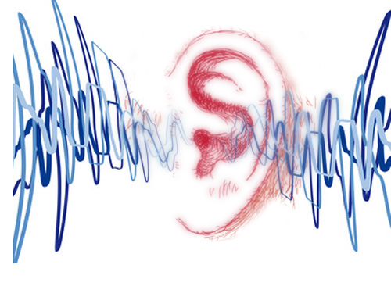
Listening
Revelation 1
Revelation 2
Revelation 3
Revelation 4
Revelation 5
As it was delivered to them
Class listen and note 2 “ideas” per chapter
Notes:
9

Slide 10
God Loves You
Notes:
10

Slide 11
For I think that God hath set forth us the apostles last, as it were appointed to death: for we are made a spectacle unto the world, and to angels, and to men.
I Corinthians 4:9 (KJV)

Slide 12
For it seems to me that God has put us apostles on display at the end of the procession, like those condemned to die in the arena. We have been made a spectacle to the whole universe, to angels as well as to human beings.
I Corinthians 4:9 (NIV)

Slide 13
Listening
Revelation 6
Revelation 7
Revelation 8
Revelation 9
Revelation 10
Revelation 11
As it was delivered to them
Notes:
13

Slide 14
Word Study
spectacle
Notes:
14

Slide 15
Notes:
15

Slide 16
God Loves You
Notes:
16

Slide 17
For I think that God hath set forth us the apostles last, as it were appointed to death: for we are made a spectacle unto the world, and to angels, and to men.
I Corinthians 4:9 (KJV)

Slide 18
For it seems to me that God has put us apostles on display at the end of the procession, like those condemned to die in the arena. We have been made a spectacle to the whole universe, to angels as well as to human beings.
I Corinthians 4:9 (NIV)

Slide 19
Listening
Revelation 12
As it was delivered to them
Class listen and note 2 “ideas” per chapter
Notes:
19

Slide 20
Word Study
spectacle
Notes:
20

Slide 21
Questions,
Observations
&
Discussion
Notes:
21

Slide 22
Notes:
22

Slide 23
God Loves You

Slide 24
For I think that God hath set forth us the apostles last, as it were appointed to death: for we are made a spectacle unto the world, and to angels, and to men.
I Corinthians 4:9 (KJV)

Slide 25
For it seems to me that God has put us apostles on display at the end of the procession, like those condemned to die in the arena. We have been made a spectacle to the whole universe, to angels as well as to human beings.
I Corinthians 4:9 (NIV)

Slide 26
Questions,
Observations
&
Discussion
Notes:
26

Slide 27
Weekly Reflections
& Time to work
Catch up on any homework you have
Do you have a WS due?
Work on extra-credit if you can
Don’t forget to post comments!
Do something creative this week
Notes:
27

Slide 28
Notes:
28

Slide 29
God Loves You
Notes:
29

Slide 30
Good Morning
Guided Learning Exercise
Finish Notes for Week
Notes:
30

Slide 31
Notes:
31

