Slide 1
God Loves You
Notes:
1

Slide 2
Daniel answered and said, Blessed be the name of God for ever and ever: for wisdom and might are his: And he changeth the times and the seasons: he removeth kings, and setteth up kings: he giveth wisdom unto the wise, and knowledge to them that know understanding: He revealeth the deep and secret things: he knoweth what is in the darkness, and the light dwelleth with him.
Daniel 2:20-22 (KJV)

Slide 3
and said: “Praise be to the name of God for ever and ever; wisdom and power are his. He changes times and seasons; he deposes kings and raises up others. He gives wisdom to the wise and knowledge to the discerning. He reveals deep and hidden things; he knows what lies in darkness, and light dwells with him.
Daniel 2:20-22 (NIV)

Slide 4
An overview of Daniel (note chapters 2-7!)
Notes:
4

Slide 5
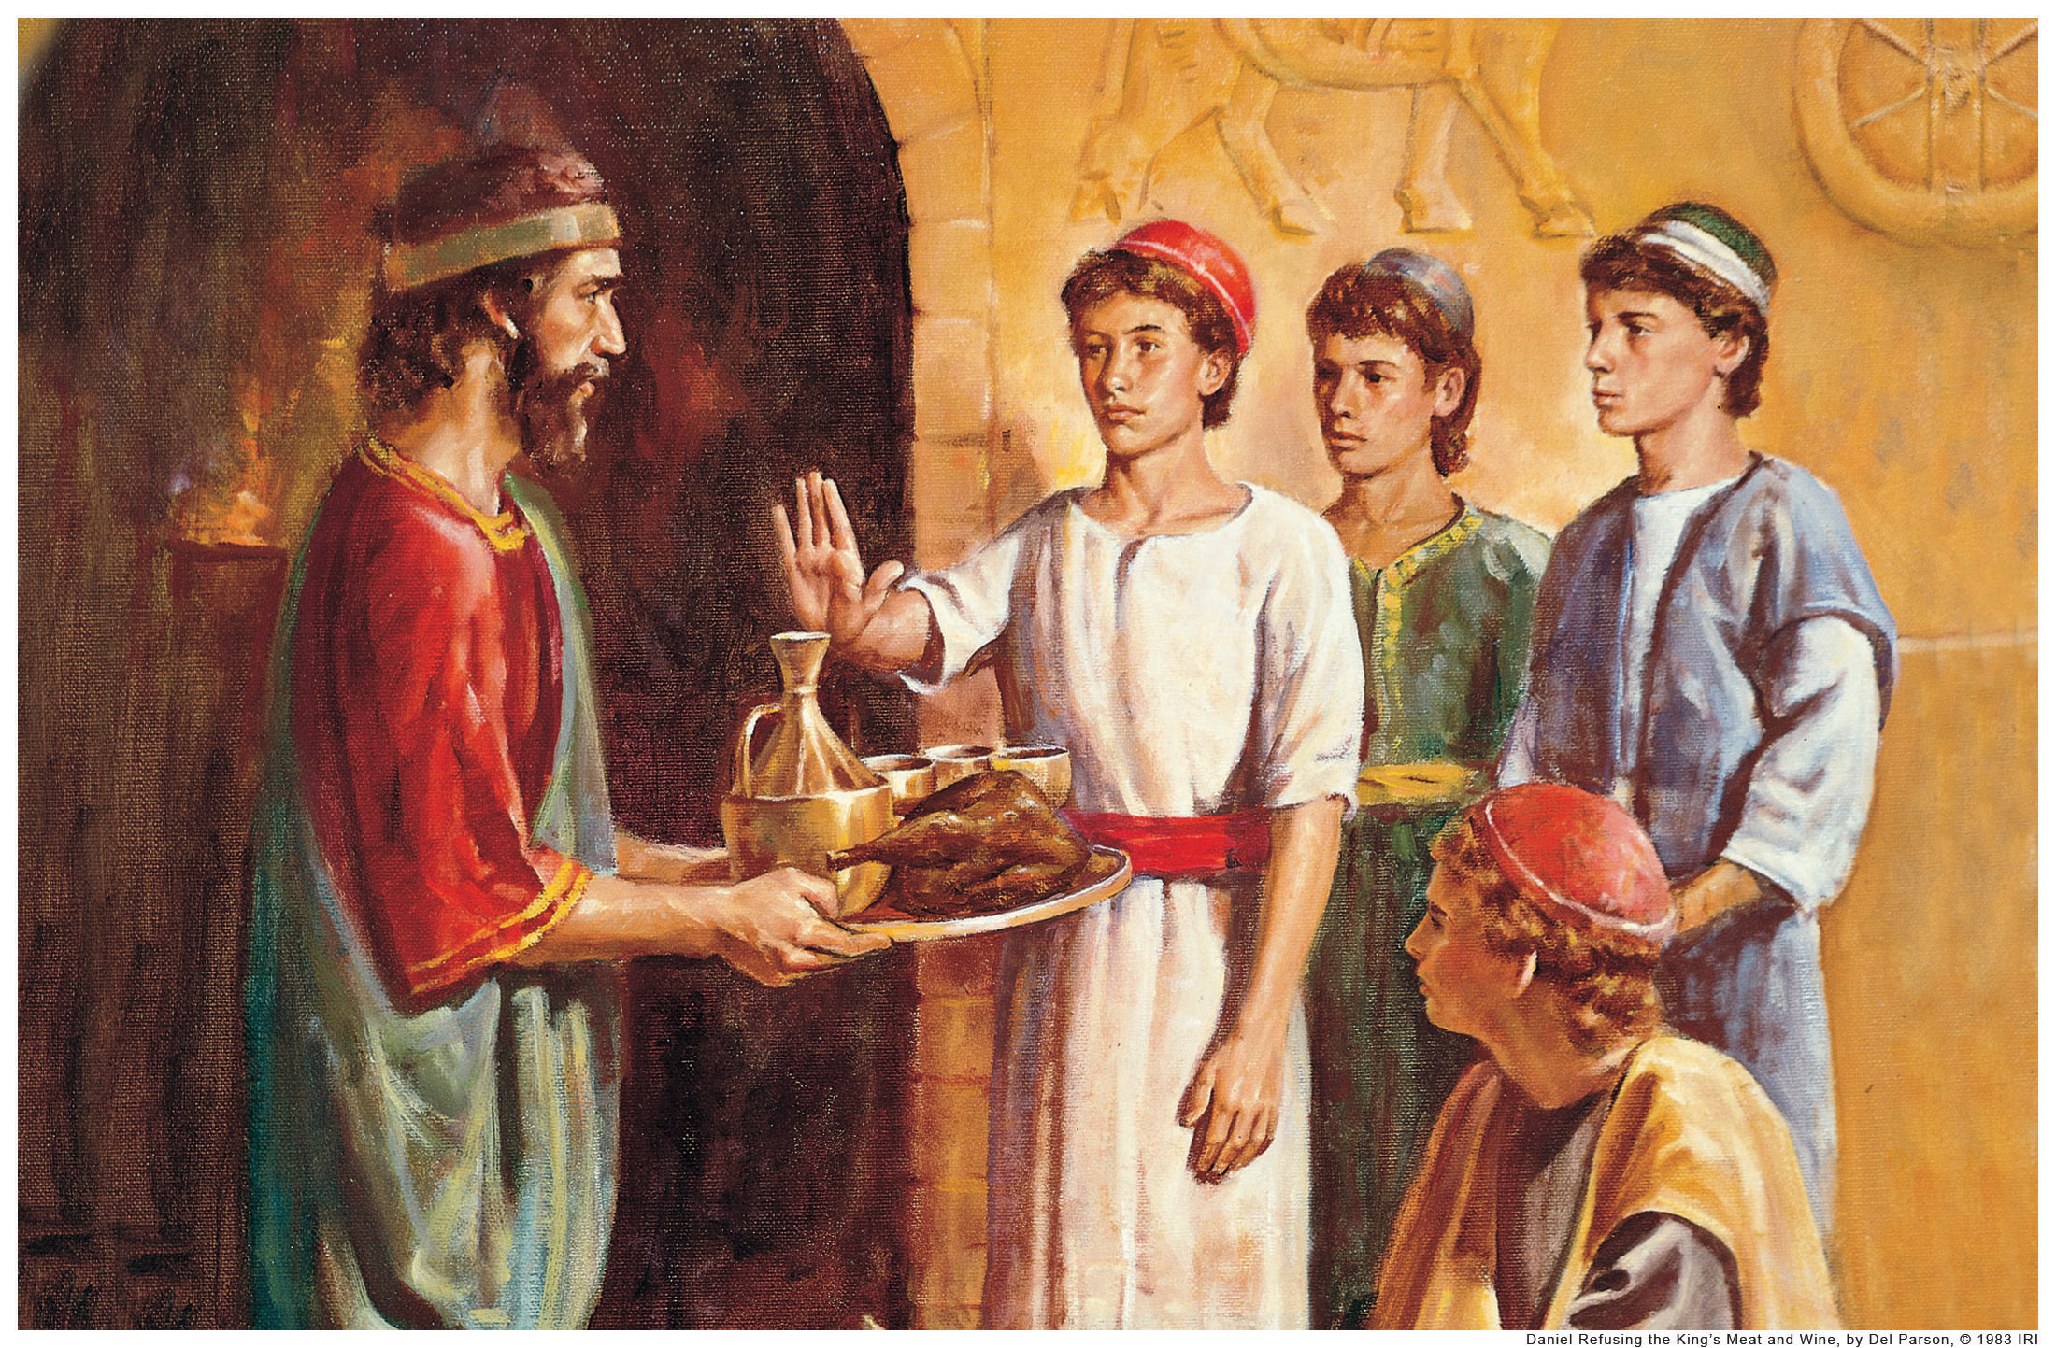
Notes:
5

Slide 6
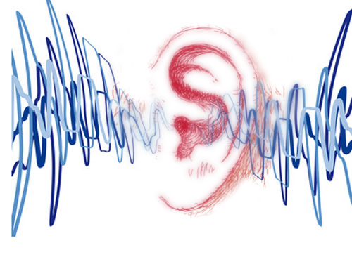
Listening
Daniel 1
Daniel 2
Daniel 3
As it was delivered to them
Notes:
6

Slide 7
Notes:
7

Slide 8
God Loves You
Notes:
8

Slide 9
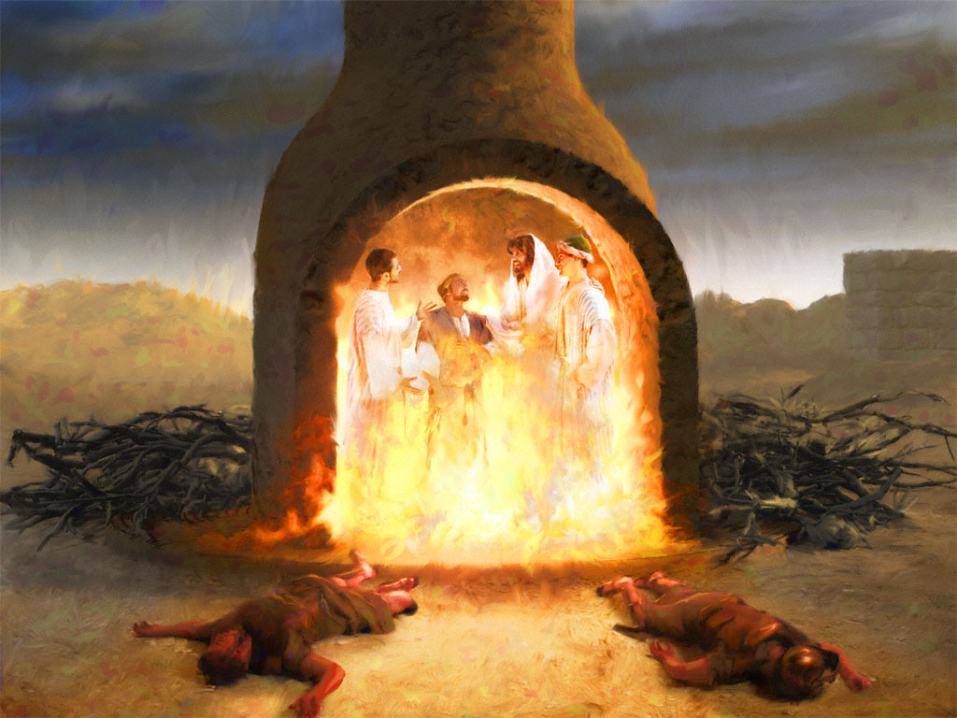
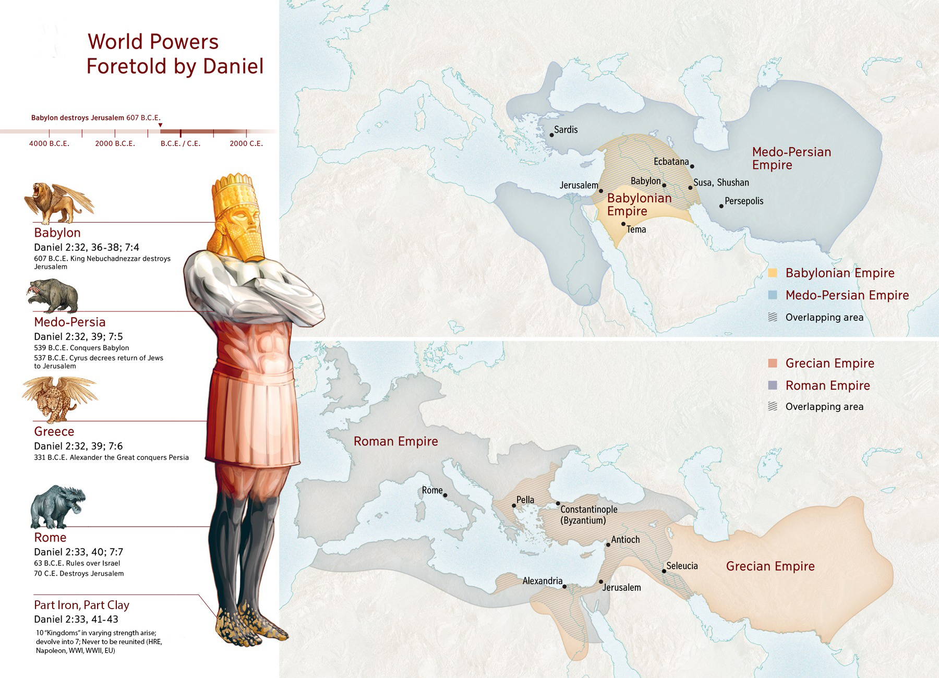
Notes:
9

Slide 10
Listening
Daniel 4
Daniel 5
Daniel 6
As it was delivered to them
Notes:
10

Slide 11
Notes:
11

Slide 12
Notes:
12

Slide 13
Notes:
13

Slide 14
Notes:
14

Slide 15
Notes:
15

Slide 16
God Loves You
Notes:
16

Slide 17
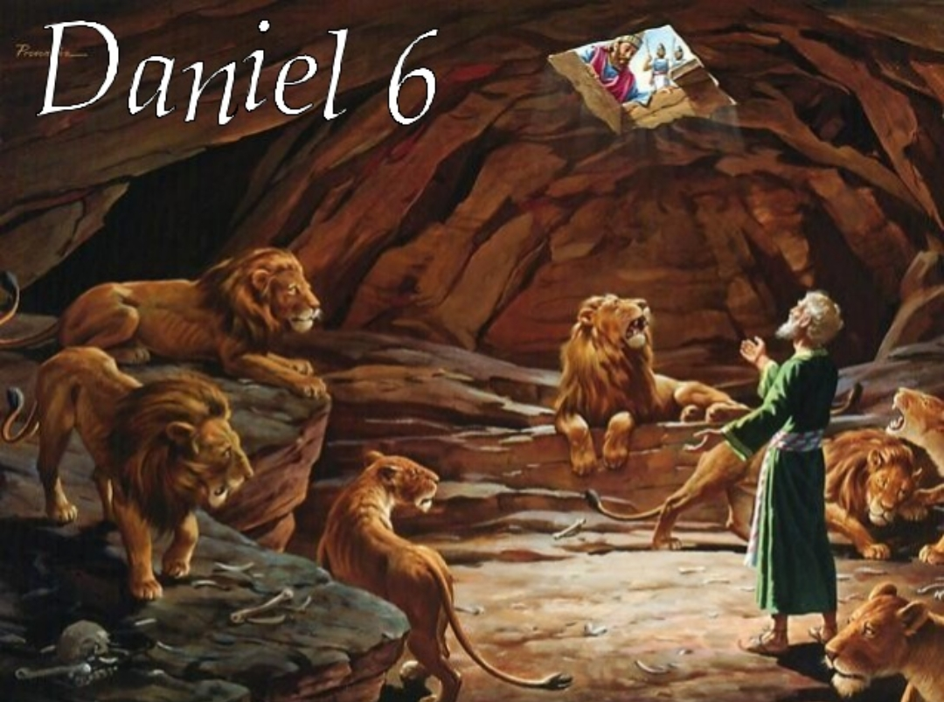
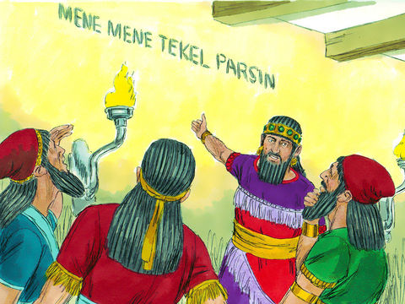
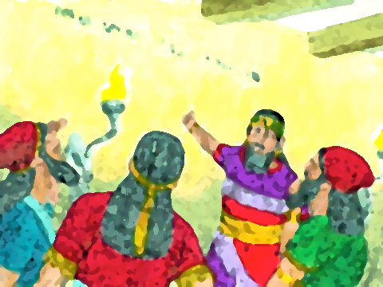
Notes:
17

Slide 18
Listening
Daniel 7
Daniel 8
As it was delivered to them
Notes:
18

Slide 19
Who is Michael?
Michael leads army
Revelation 12:7-9
—
Luke 1:19
Daniel 10:13, 21
Revelation 22:8-9
—
Daniel 12:1
Joshua 5:13-15
Exodus 3:5
—
Jude 9
I Thessalonians 4:16
John 5:25-29
Gabriel is privileged angel
(angels are NOT worshipped)
Respect due Michael
Resurrection power
Notes:
19

Slide 20
Notes:
20

Slide 21
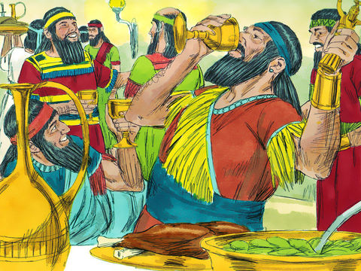
Notes:
21

Slide 22
Notes:
22

Slide 23
God Loves You

Slide 24
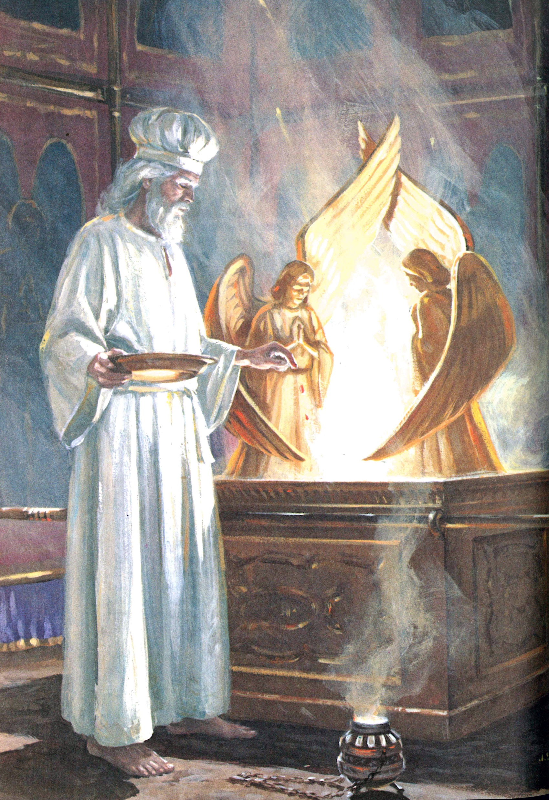
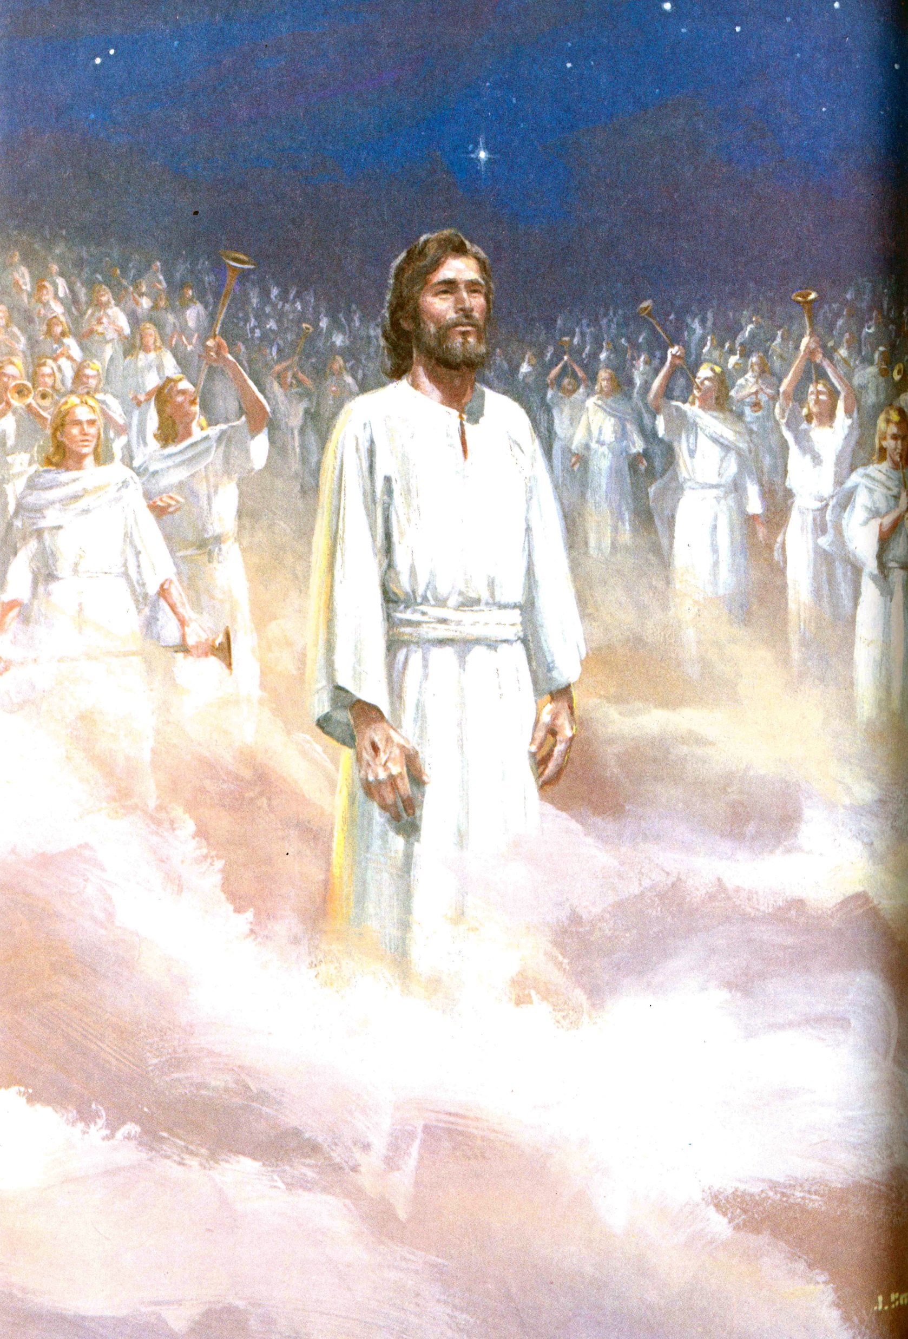
Notes:
24

Slide 25
Listening
Daniel 10
Daniel 12
As it was delivered to them
Notes:
25

Slide 26
Notes:
26

Slide 27
Notes:
27

Slide 28
Questions,
Observations
&
Discussion
Notes:
28

Slide 29
Weekly Reflections
& Time to work
Catch up on any homework you have
Do you have a WS due?
Work on extra-credit if you can
Don’t forget to post comments!
Do something creative this week
Notes:
29

Slide 30
Notes:
30

Slide 31
God Loves You
Notes:
31

Slide 32
Notes:
32

