Slide 1
God Loves You
Notes:
1

Slide 2
Listening
Daniel 2
Daniel 3
Daniel 4
As it was delivered to them
Notes:
2

Slide 3
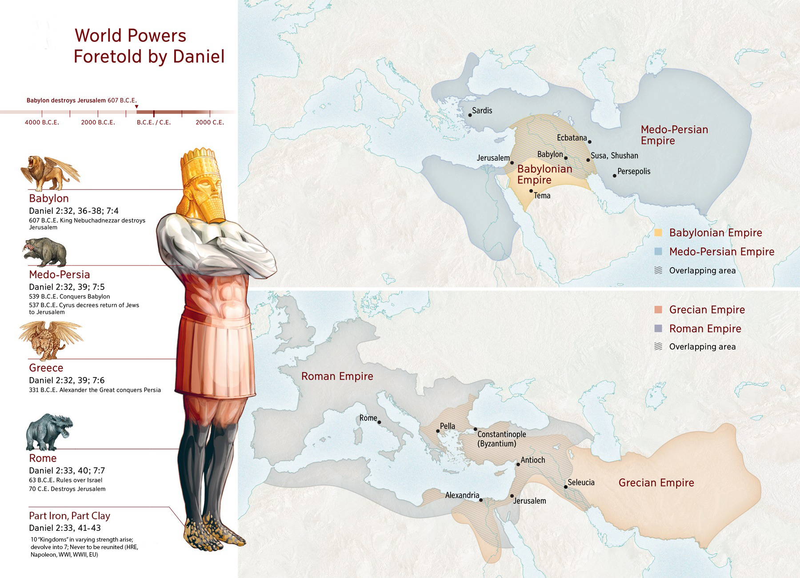
Notes:
3

Slide 4
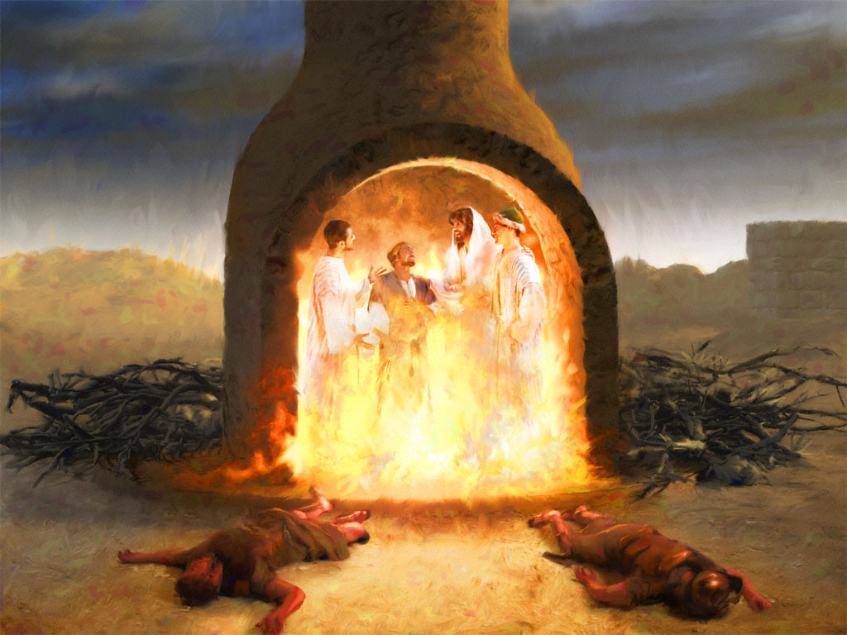
Notes:
4

Slide 5
Notes:
5

Slide 6
Notes:
6

Slide 7
An overview of Daniel 2 vision
Notes:
7

Slide 8
Daniel 8-9
Day for a year in prophetic time
Numbers 14:34
Ezekiel 4:6
Notes:
8

Slide 9
Daniel 7-12; Rev 13-17
Day for a year in prophetic time
Numbers 14:34
Ezekiel 4:6
Notes:
9

Slide 10
Notes:
10

Slide 11
God Loves You

Slide 12
Notes:
12

Slide 13
Visions for the Endtimes
Daniel 2, 7-8, 9-12

Slide 14
Harmonizing Apocalyptic Visions in Daniel & Revelation
Daniel 2
Daniel 7
Daniel 10-12

Slide 15
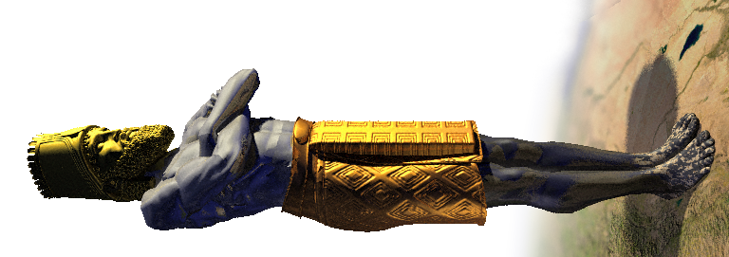
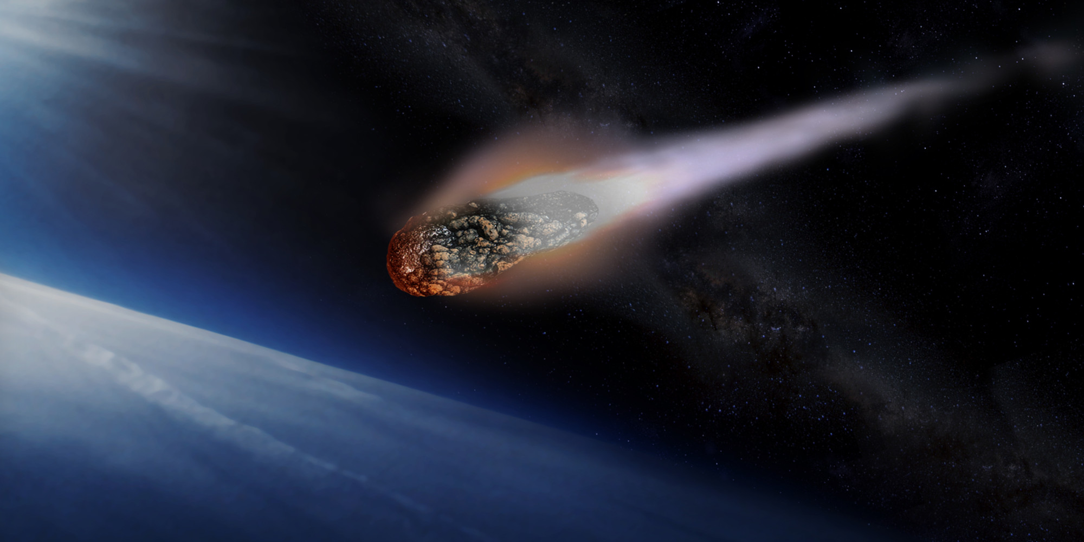
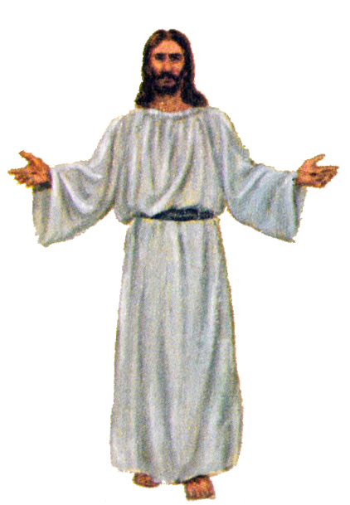
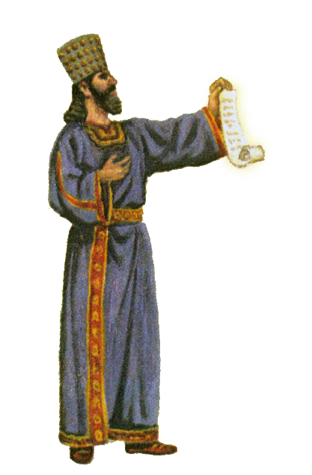
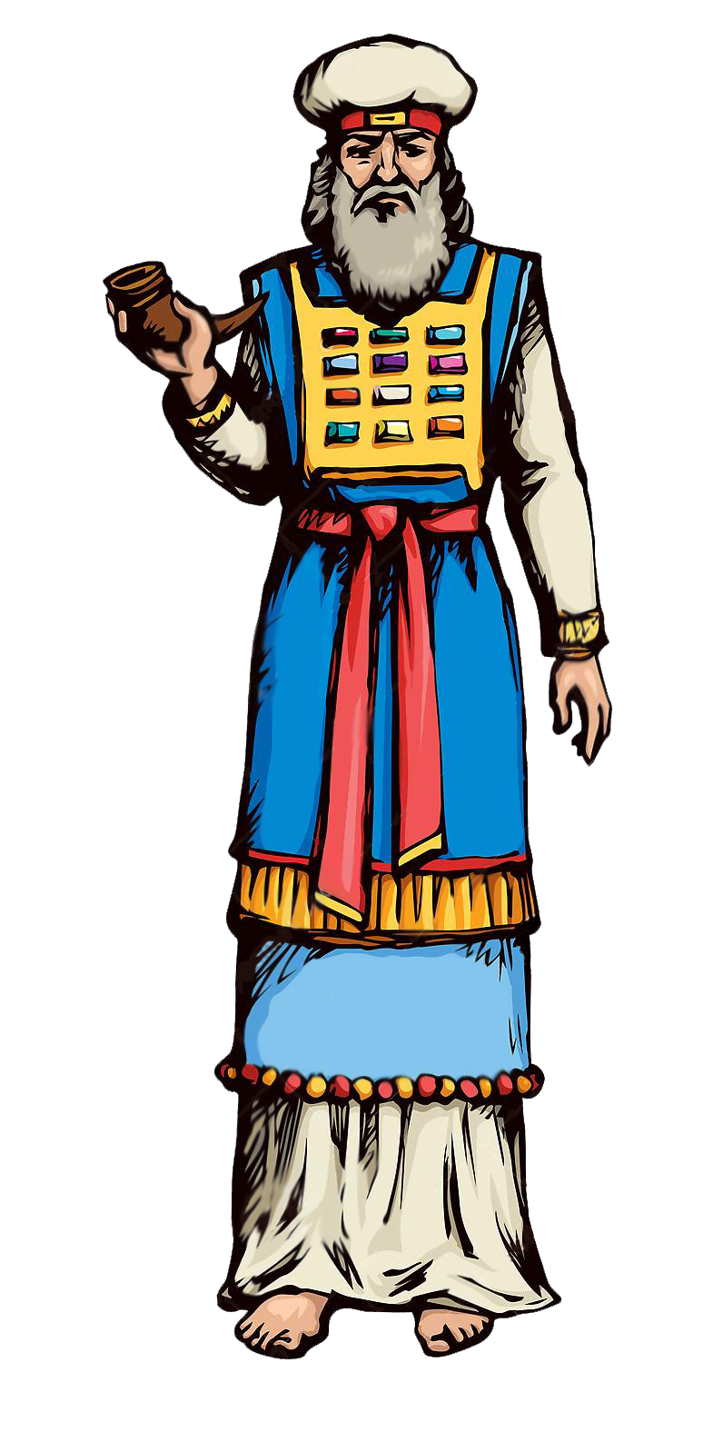
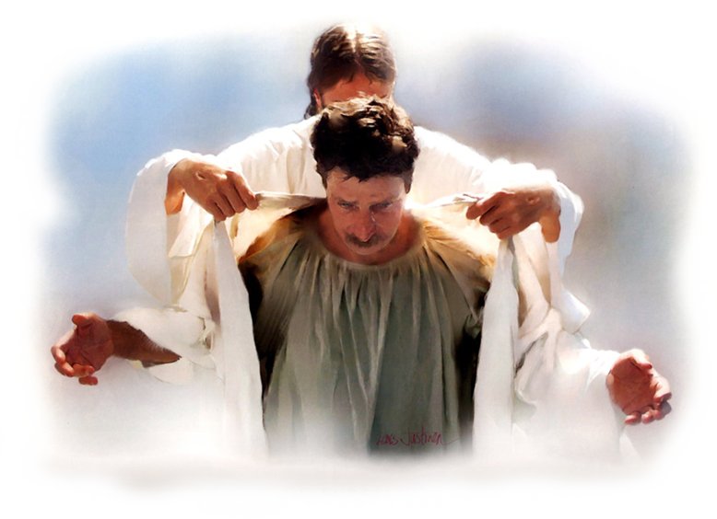
Political powers
Religious-Political powers
armageddon
What Jesus is doing
~1200 years
Exactly 1260 years
unspecified time
judgment

Slide 16
Unified Religious World power
Unified Political World power
Exactly 1290 years
Exactly 1260 years
Exactly 1335 years
What Jesus is doing
~1200 years
Exactly 1260 years
unspecified time
judgment

Slide 17
Questions,
Observations
&
Discussion
Notes:
17

Slide 18
Weekly Reflections
& Time to work
Catch up on any homework you have
Do you have a WS due?
Work on extra-credit if you can
Don’t forget to post comments!
Do something creative this week
Notes:
18

Slide 19
Notes:
19

Slide 20
God Loves You
Notes:
20

Slide 21
Journal Due
Notes:
21

Slide 22
Notes:
22

