Slide 1
God Loves You
Notes:
1

Slide 2
Notes:
2

Slide 3
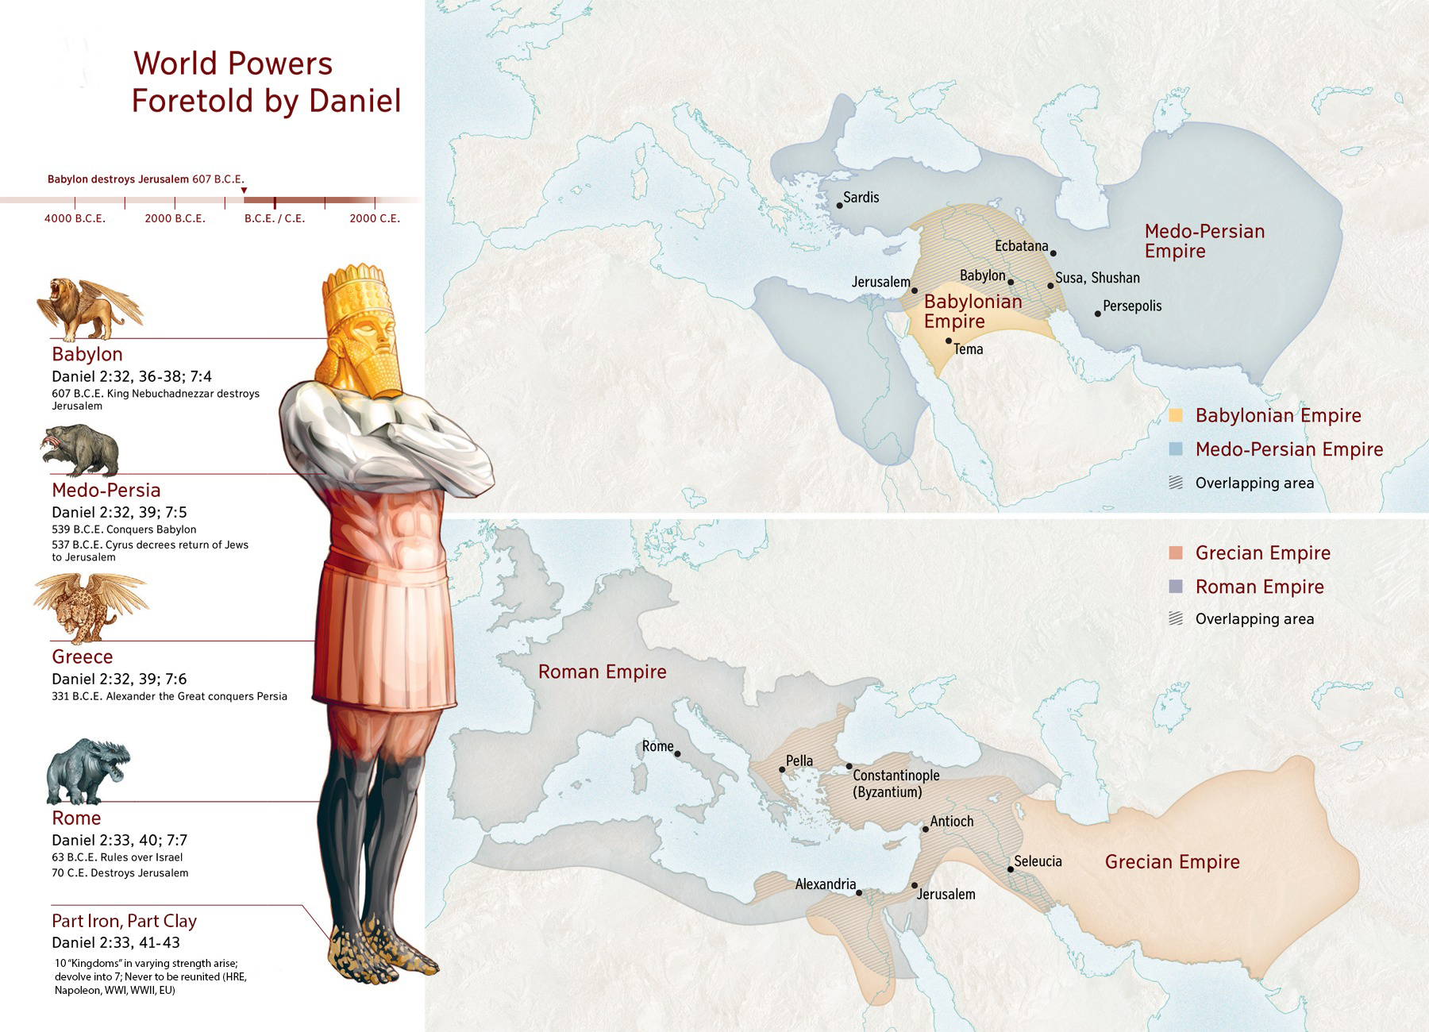
Notes:
3

Slide 4
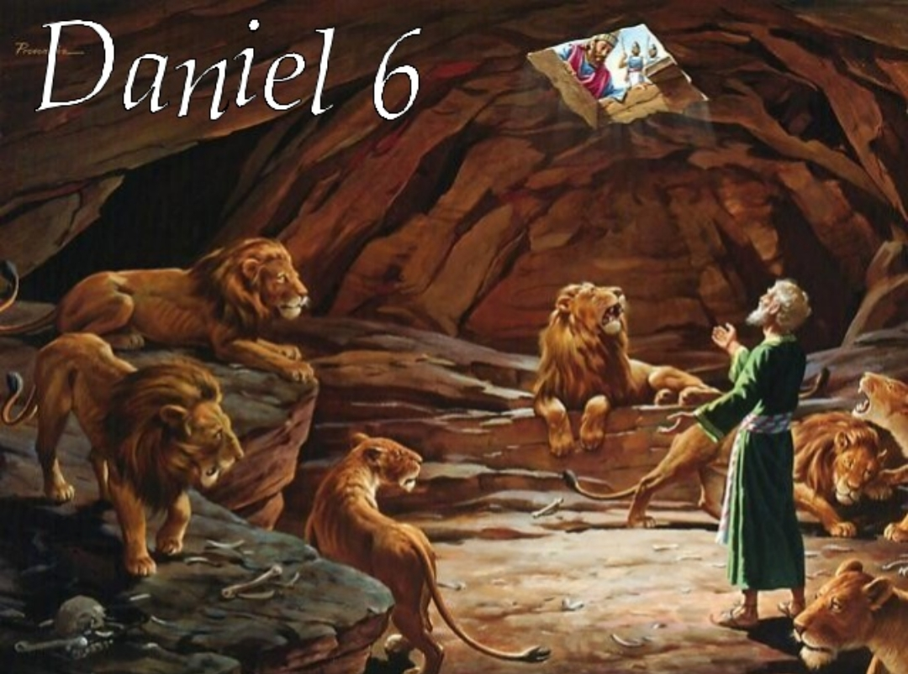
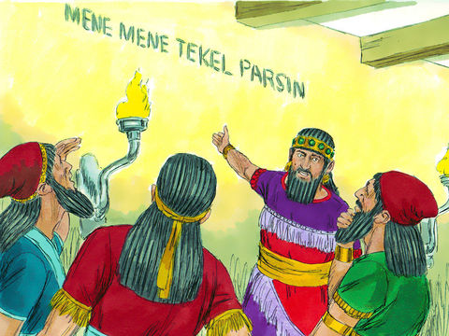
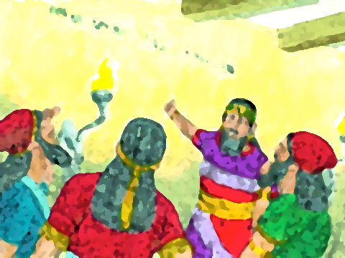
Notes:
4

Slide 5
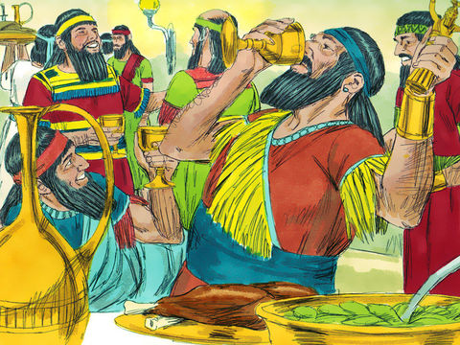
Notes:
5

Slide 6
Horton Hears a Who
35 min
Notes:
6

Slide 7
Journaling
Horton the elephant is a friendly elephant suddenly burdened with the task of saving an entire “planet.” Horton compares to Christ trying to save earth in the face of constant aggression and misunderstanding. Find more parallels.
Mayor McDodd (Whoville) is comparable to a prophet given a message that few believe. Like Jonah or Jeremiah, what would you do if no one believed?
Notes:
7

Slide 8
Notes:
8

Slide 9
God Loves You
Notes:
9

Slide 10
Horton Hears a Who
35 min
Notes:
10

Slide 11
Journaling
Horton’s struggles are becoming more real—in the sense that there are personal attacks on his life and beliefs. Compare this to God in Revelation.
Mayor McDodd (Whoville) keeps noticing and pointing out evidence to non-believers to no avail. How is that like the Gospel or particularly like the story in revelation?
Notes:
11

Slide 12
Notes:
12

Slide 13
God Loves You
Notes:
13

Slide 14
Questions,
Observations
&
Discussion
Notes:
14

Slide 15
Horton Hears a Who
35 min
Notes:
15

Slide 16
Journaling
The great show down at the end is much like the Armageddon in Revelation. List similarities and differences. How are the triumphs in both parallel?
What is the role of the people of Whoville in helping end the siege on their world? How is this similar to the redeemed in Revelation?
Other lessons learned or insights gained?
Notes:
16

Slide 17
Notes:
17

Slide 18
God Loves You

Slide 19
Weekly Reflections
& Time to work
Catch up on any homework you have
Do you have a WS due?
Work on extra-credit if you can
Don’t forget to post comments!
Do something creative this week
Notes:
19

Slide 20
Notes:
20

Slide 21
God Loves You
Notes:
21

Slide 22
Notes:
22

