Slide 1
God Loves You
Notes:
1

Slide 2
Wherefore seeing we also are compassed about with so great a cloud of witnesses, let us lay aside every weight, and the sin which doth so easily beset us, and let us run with patience the race that is set before us, looking unto Jesus the author and finisher of our faith; who for the joy that was set before him endured the cross, despising the shame, and is set down at the right hand of the throne of God. For consider him that endured such contradiction of sinners against himself, lest ye be wearied and faint in your minds.
Hebrews 12:1-3 (KJV)

Slide 3
Therefore, since we are surrounded by such a great cloud of witnesses, let us throw off everything that hinders and the sin that so easily entangles. And let us run with perseverance the race marked out for us, fixing our eyes on Jesus, the pioneer and perfecter of faith. For the joy set before him he endured the cross, scorning its shame, and sat down at the right hand of the throne of God. Consider him who endured such opposition from sinners, so that you will not grow weary and lose heart.
Hebrews 12:1-3 (NIV)

Slide 4
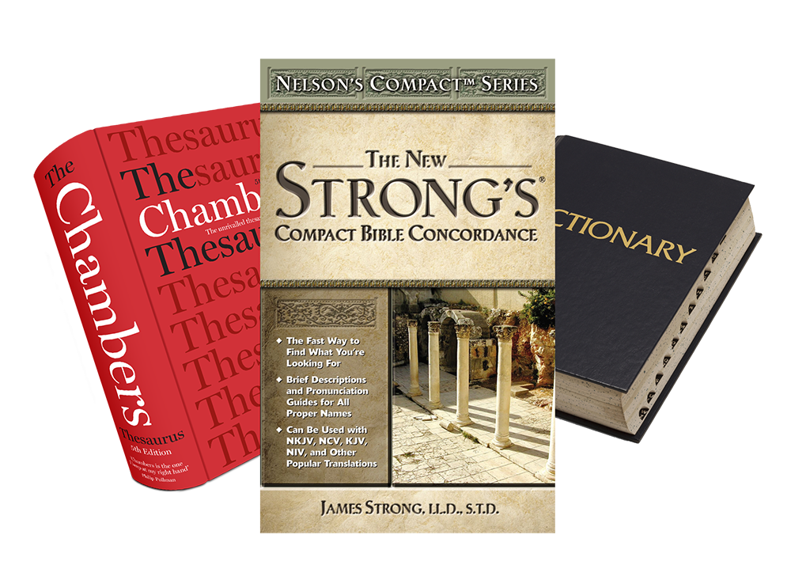
Word Study
compassed
Notes:
4

Slide 5
The Lion, the Witch, and the Wardrobe
24:00
Notes:
5

Slide 6
Journaling
Write a half page detailing the events of the movie so far.
What parallels do you see already between the world of Narnia and our Universe here? What might it be like to visit other worlds in God’s Universe. Why might it be important to be beings who are patient, kind and understanding before God allowing humans to visit other places (think about the meeting between Tumnus and Lucy).
Notes:
6

Slide 7
Notes:
7

Slide 8
God Loves You
Notes:
8

Slide 9
The Lion, the Witch, and the Wardrobe
24:00
Notes:
9

Slide 10
Journaling
Write a half page describing what you know of the main characters so far (White Witch, Aslan). What stories/rumors are there? What do you actually know of Aslan at this point?
Notice the change in the White Witch’s tiara. How does she wield power? What does she do with Edmund? What does that tell you about how she “rewards” her followers? What does Santa Claus say about (or demonstrate) about the gifts Aslan gives to his followers?
Notes:
10

Slide 11
Notes:
11

Slide 12
God Loves You
Notes:
12

Slide 13
What mythical land are the children taken to?
a) Brikabrak
b) England
c) Narnia
What is the name of the main protagonist?
a) Saint Nicholas
b) Aslan
c) The White Witch
What is the name of the main antagonist?
a) Saint Nicholas
b) Aslan
c) The White Witch

Slide 14
The Lion, the Witch, and the Wardrobe
24:00
Notes:
14

Slide 15
Journaling
Write a half page detailing how the environment is changing in Narnia and how that reflects on the White Witch’s power vs Aslan’s power.
What lessons are we to learn about relating to others in the fox/wolf comparison? Why does Aslan have Peter and Susan practicing for warfare? What does the “warfare practice” represent for us?
Why does Aslan roar? Why does the WW sit in response? What does the WW hope to accomplish by killing Aslan (notice her crown now)? What does she ACTUALLY do?
Notes:
15

Slide 16
Notes:
16

Slide 17
God Loves You

Slide 18
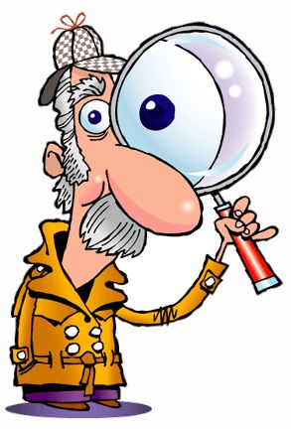
Questions,
Observations
&
Discussion
Notes:
18

Slide 19
The Lion, the Witch, and the Wardrobe
24:00
Notes:
19

Slide 20
Journaling
Write a half page giving insights into how TLTWTW compares to our reality and what is described in Revelation.
Why did the director “silence” almost all sounds for the battle start (clue: what could you still hear?)
How did the revival scene at the WW Castle parallel the resurrection of the just in Matthew/John/Revelation?
Though Aslan is the one who ends the WW, why was it important that P/S/E/L do their part in the battle? What is the spiritual lesson?
Notes:
20

Slide 21
Notes:
21

Slide 22
God Loves You
Notes:
22

Slide 23
Notes:
23

