Slide 1
God Loves You
Notes:
1

Slide 2
The Revelation of Jesus Christ, which God gave unto him, to shew unto his servants things which must shortly come to pass; and he sent and signified it by his angel unto his servant John . . . And from Jesus Christ, who is the faithful witness, and the first begotten of the dead, and the prince of the kings of the earth. Unto him that loved us, and washed us from our sins in his own blood
Revelation 1:1, 5 (KJV)

Slide 3
The revelation from Jesus Christ, which God gave him to show his servants what must soon take place. He made it known by sending his angel to his servant John . . . and from Jesus Christ, who is the faithful witness, the firstborn from the dead, and the ruler of the kings of the earth. To him who loves us and has freed us from our sins by his blood.
Revelation 1:1, 5 (NIV)

Slide 4
Word Study
revelation
Notes:
4

Slide 5
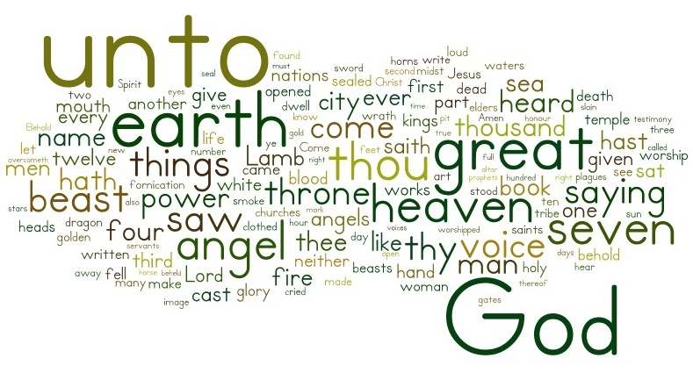
Artful interpretation
Revelation synopsis
Notes:
5

Slide 6
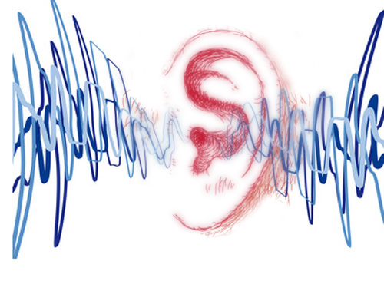
Listening
Revelation 1
Revelation 2
Revelation 3
As it was delivered to them
Listen and note every mention of Sanctuary
Notes:
6

Slide 7
Journaling
Note all the descriptions given of Jesus throughout these 3 chapters (physical features, names, appellations, characteristics). Why might the book begin this way? What might be the point of all the different aspects or characteristics of Jesus?
Don’t forget to get your Journal up to date!
Notes:
7

Slide 8
An overview of Revelation 1-11
Notes:
8

Slide 9
Notes:
9

Slide 10
God Loves You
Notes:
10

Slide 11
What is an allusion?
Notes:
11

Slide 12
Notes:
12

Slide 13
Allusions happen in movies all the time for comedic or broader reasons: to bring another character in with much less work than full development.
Notes:
13

Slide 14
Allusions rely on an audience’s intelligence as well as their familiarity with the extant material
Notes:
14

Slide 15
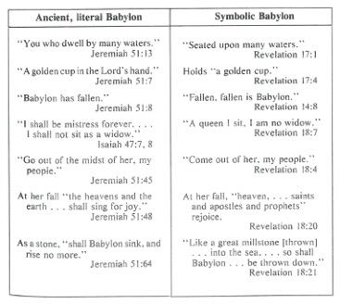
Some of our own to check out . . .
Rev 12:9 with Genesis 3:1
Rev 21:1 with Isaiah 66:22
Rev 21:4 with Isaiah 25:8
Notes:
15

Slide 16
Book of life
Digging deeper
Notes:
16

Slide 17
BOL project
Notes:
17

Slide 18
Notes:
18

Slide 19
God Loves You
Notes:
19

Slide 20
Dream big when thinking about what satan is actually trying to keep you from and what you stand to lose
Notes:
20

Slide 21
An idea about heaven . . .
Notes:
21

Slide 22
An idea about heaven . . .
Notes:
22

Slide 23
An idea about heaven . . .
Notes:
23

Slide 24
An idea about heaven . . .
Notes:
24

Slide 25
Journaling
Dream . . . Write a description of what you think you’ll do within the first week of being in heaven . . .
Don’t forget to get your Journal up to date!
Notes:
25

Slide 26
God Loves You

Slide 27
The Revelation of Jesus Christ, which God gave unto him, to shew unto his servants things which must shortly come to pass; and he sent and signified it by his angel unto his servant John . . . And from Jesus Christ, who is the faithful witness, and the first begotten of the dead, and the prince of the kings of the earth. Unto him that loved us, and washed us from our sins in his own blood
Revelation 1:1, 5 (KJV)

Slide 28
The revelation from Jesus Christ, which God gave him to show his servants what must soon take place. He made it known by sending his angel to his servant John . . . and from Jesus Christ, who is the faithful witness, the firstborn from the dead, and the ruler of the kings of the earth. To him who loves us and has freed us from our sins by his blood.
Revelation 1:1, 5 (NIV)

Slide 29
What is the “big fight” about?
Notes:
29

Slide 30
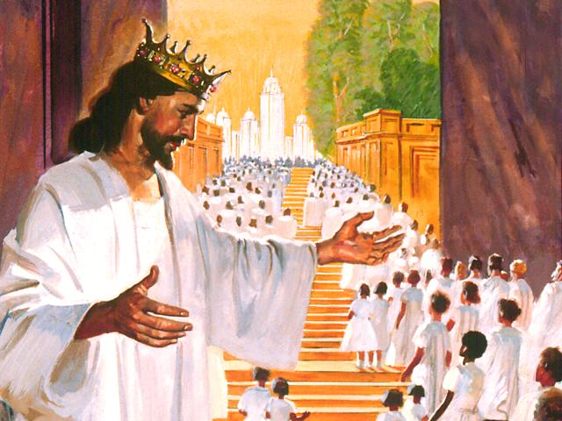
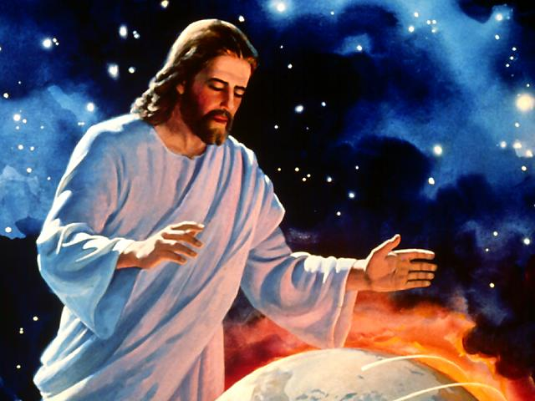
It all starts here . . .

Slide 31
Questions,
Observations
&
Discussion
Notes:
31

Slide 32
Notes:
32

Slide 33
God Loves You
Notes:
33

Slide 34
Notes:
34

