Slide 1
God Loves You
Notes:
1

Slide 2
He that hath an ear, let him hear what the Spirit saith unto the churches; To him that overcometh will I give to eat of the hidden manna, and will give him a white stone, and in the stone a new name written, which no man knoweth saving he that receiveth it.
Revelation 2:17 (KJV)

Slide 3
Whoever has ears, let them hear what the Spirit says to the churches. To the one who is victorious, I will give some of the hidden manna. I will also give that person a white stone with a new name written on it, known only to the one who receives it.
Revelation 2:17 (NIV)

Slide 4
Word Study
stone
Notes:
4

Slide 5
What is the “big fight” about?
Notes:
5

Slide 6
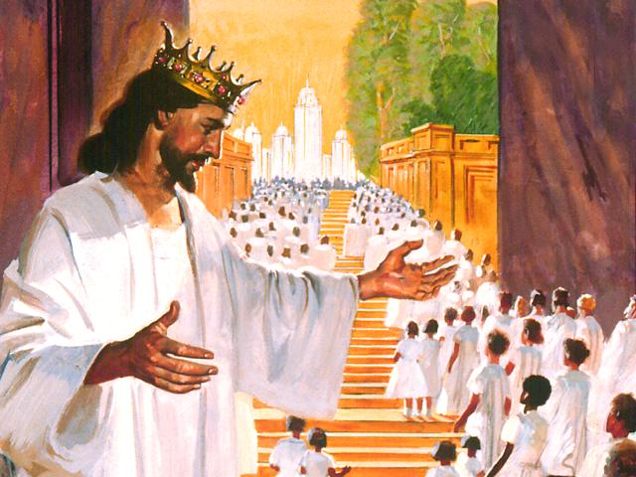
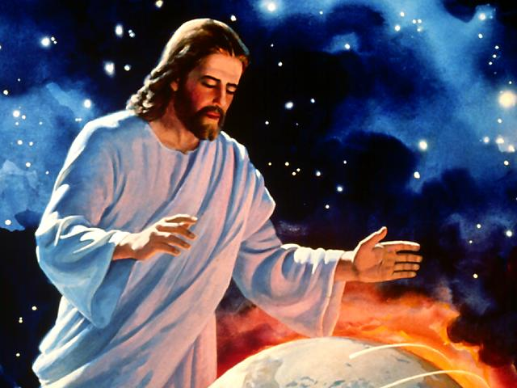
It all starts here . . .

Slide 7
Book of life
Digging deeper
Notes:
7

Slide 8
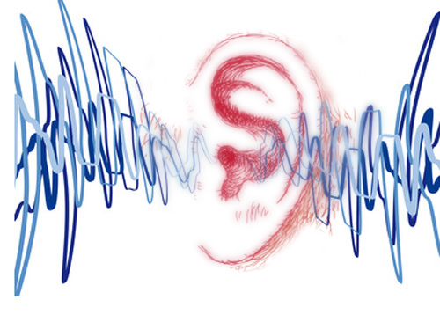
Listening
Revelation 4
Revelation 5
Revelation 6
Revelation 7
Revelation 8
Revelation 9
Revelation 10
Revelation 11
Revelation 12
As it was delivered to them
Listen and note every mention of Sanctuary
Notes:
8

Slide 9
Notes:
9

Slide 10
God Loves You
Notes:
10

Slide 11
Notes:
11

Slide 12
God Loves You
Notes:
12

Slide 13
Notes:
13

Slide 14
God Loves You

Slide 15
Questions,
Observations
&
Discussion
Notes:
15

Slide 16
Weekly Reflections
& Time to work
Catch up on any homework you have
Do you have a WS due?
Work on extra-credit if you can
Don’t forget to post comments!
Do something creative this week
Notes:
16

Slide 17
Notes:
17

Slide 18
God Loves You
Notes:
18

Slide 19
Notes:
19

