Slide 1
God Loves You
Notes:
1

Slide 2
And I saw another angel fly in the midst of heaven, having the everlasting gospel to preach unto them that dwell on the earth, and to every nation, and kindred, and tongue, and people, saying with a loud voice, Fear God, and give glory to him; for the hour of his judgment is come: and worship him that made heaven, and earth, and the sea, and the fountains of waters.
Revelation 14:6-7 (KJV)

Slide 3
Then I saw another angel flying in midair, and he had the eternal gospel to proclaim to those who live on the earth—to every nation, tribe, language and people. He said in a loud voice, “Fear God and give him glory, because the hour of his judgment has come. Worship him who made the heavens, the earth, the sea and the springs of water.”
Revelation 14:6-7 (NIV)

Slide 4
Word Study
worship
Notes:
4

Slide 5
BOL project
Due this week
Notes:
5

Slide 6
What is the “big fight” about?
Notes:
6

Slide 7
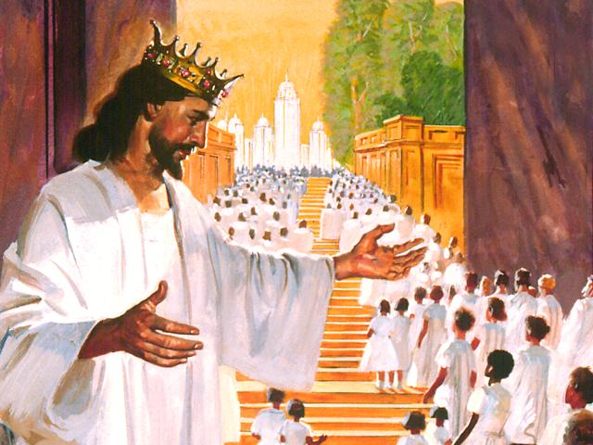
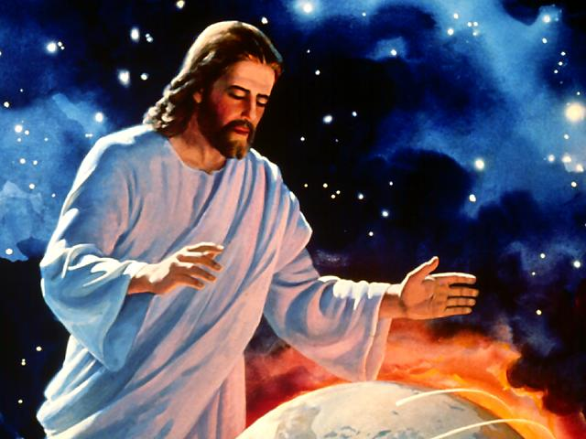
It all starts here . . .

Slide 8
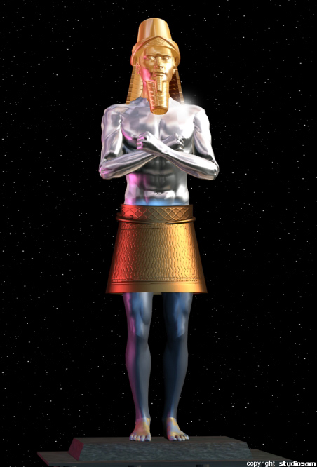
WAR OF WORSHIP IN REVELATION
The Issue: Worship
Away with you, Satan! For it is written, ‘You shall worship the Lord your God, and Him only you shall serve.’ Matt 4:10
A King’s Seal is determined by three things: 1) Name 2) Title & 3) Dominion. These three elements are found in the Fourth Commandment. 1) Name: The LORD, 2) Title: Made (or Creator), 3: Dominion: Heaven & Earth, The Sea and all that in them is.

Slide 9
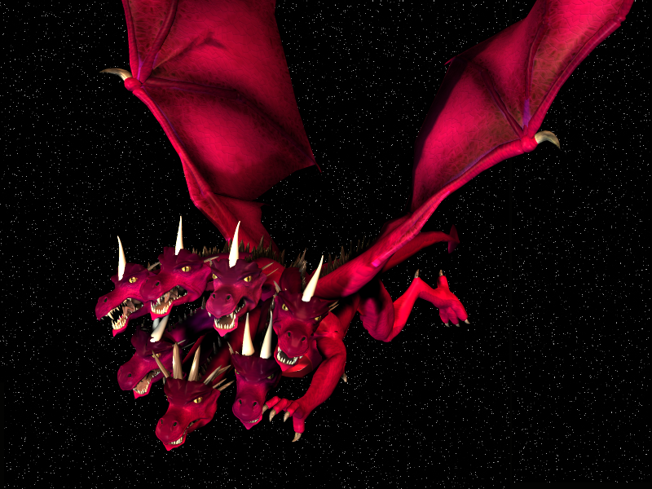
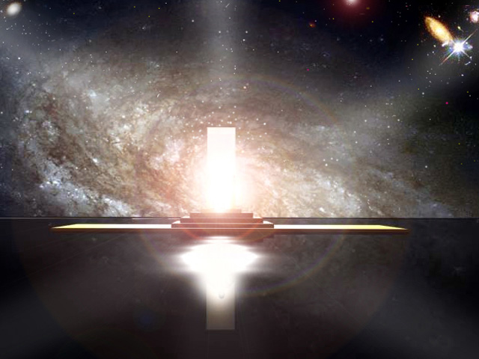
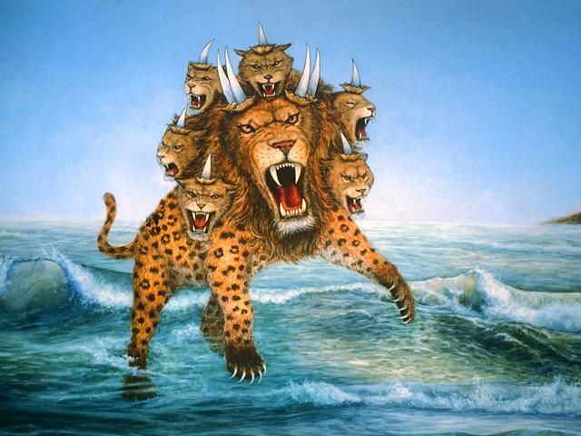
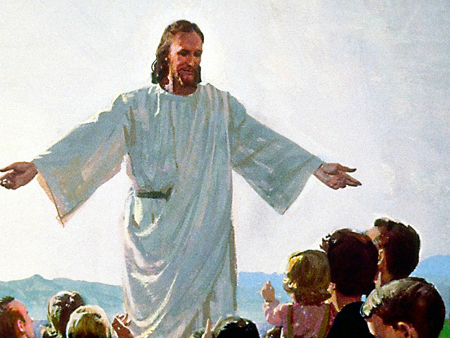
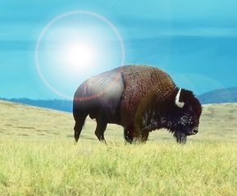
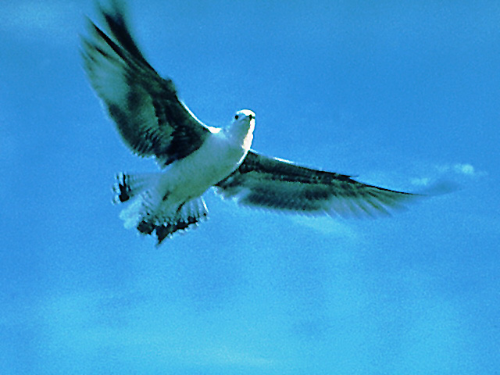
WAR OF WORSHIP IN REVELATION
The Contenders for Worship: The True & False Godhead
Counterfeit of the Father:
1. Like the Most High
(Isa 14:12-14)
2. Receives worship (Rev 13:3)
3. Works through other beasts
Work of the Father:
1. IS THE Most High (Rev 4:11)
2. Receives worship (Rev 4:9)
3. Works through Son & Spirit
Dragon - Satan
Father
Sea Beast Counterfeit of the Son:
1. Looks like Dragon (Rev 12:3; 13:1)
2. Receives authority from Dragon (Rev 13:2)
3. Receives fatal wound (Rev 13:3)
4. Receives life again (Rev 13:3)
5. Has a work for 42 months (Rev 13:5)
6. Is worshipped by the world (Rev 13:4)
Work of the Son:
1. Looks like Father (John 14:9; Dan 7; Rev 1)
2. Receives authority from Father (Matt 28:18)
3. Receives fatal wound (Rev 5:6)
4. Receives life again (Rev 5:9)
5. Has a work for 42 months (Dan 9:27)
6. Is worshipped by the world (Rev 5:12-14)
Sea Beast – Organized Religious State
Son
Land Beast Counterfeit of the Holy Spirit:
1. Takes up work of the Sea Beast (Rev 13:12)
2. Points people to Sea Beast (Rev 13:12)
3. Calls fire down from heaven (Rev 13:13)
Work of the Holy Spirit:
1. Takes up work of Christ (John 16:7)
2. Points people to Christ (John 16:13)
3. Calls fire down from heaven (Acts 2:1-3)
Land Beast – Political State with “religiousity”
Holy Spirit

Slide 10
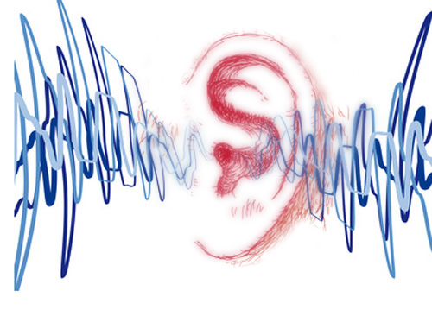
Listening
Revelation 13
Revelation 14
Revelation 15
Revelation 16
Revelation 17
Revelation 18
Revelation 19
Revelation 20
Revelation 21
Revelation 22
As it was delivered to them
Listen and note every mention of Sanctuary
Notes:
10

Slide 11
Notes:
11

Slide 12
God Loves You
Notes:
12

Slide 13
Notes:
13

Slide 14
God Loves You
Notes:
14

Slide 15
An overview of Revelation 12-22
Notes:
15

Slide 16
Questions,
Observations
&
Discussion
Notes:
16

Slide 17
Notes:
17

Slide 18
God Loves You

Slide 19
Weekly Reflections
& Time to work
Catch up on any homework you have
Do you have a WS due?
Work on extra-credit if you can
Don’t forget to post comments!
Do something creative this week
Notes:
19

Slide 20
Notes:
20

Slide 21
God Loves You
Notes:
21

Slide 22
Notes:
22

