Slide 1
God Loves You
Notes:
1

Slide 2
And I beheld, and, lo, in the midst of the throne and of the four beasts, and in the midst of the elders, stood a Lamb as it had been slain, having seven horns and seven eyes, which are the seven Spirits of God sent forth into all the earth.
Revelation 5:6 (KJV)

Slide 3
Then I saw a Lamb, looking as if it had been slain, standing at the center of the throne, encircled by the four living creatures and the elders. The Lamb had seven horns and seven eyes, which are the seven spirits of God sent out into all the earth.
Revelation 5:6 (NIV)

Slide 4
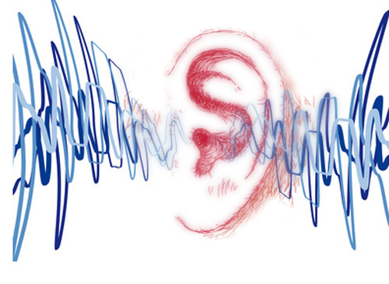
Listening
Revelation 4
Revelation 5
As it was delivered to them
Notes:
4

Slide 5

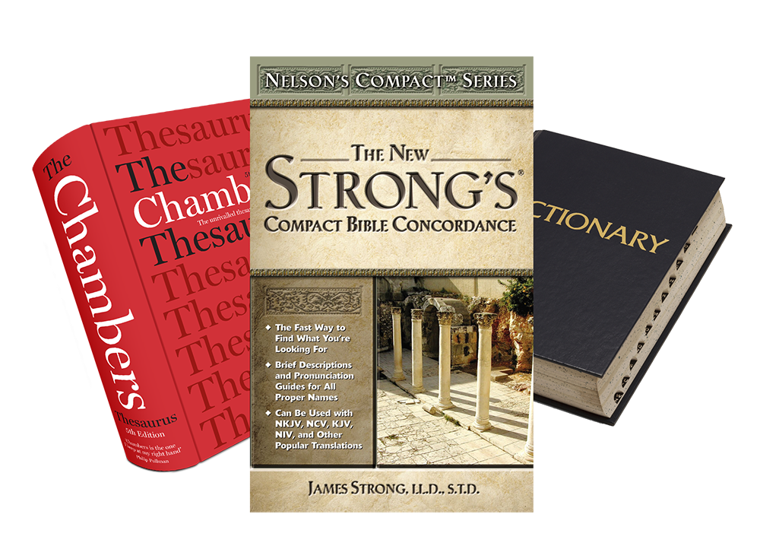
Word Study
slain (Rev 5:6)
blot (Rev 3:5)
Notes:
5

Slide 6
a close look at the main characters and their character traits
Notes:
6

Slide 7
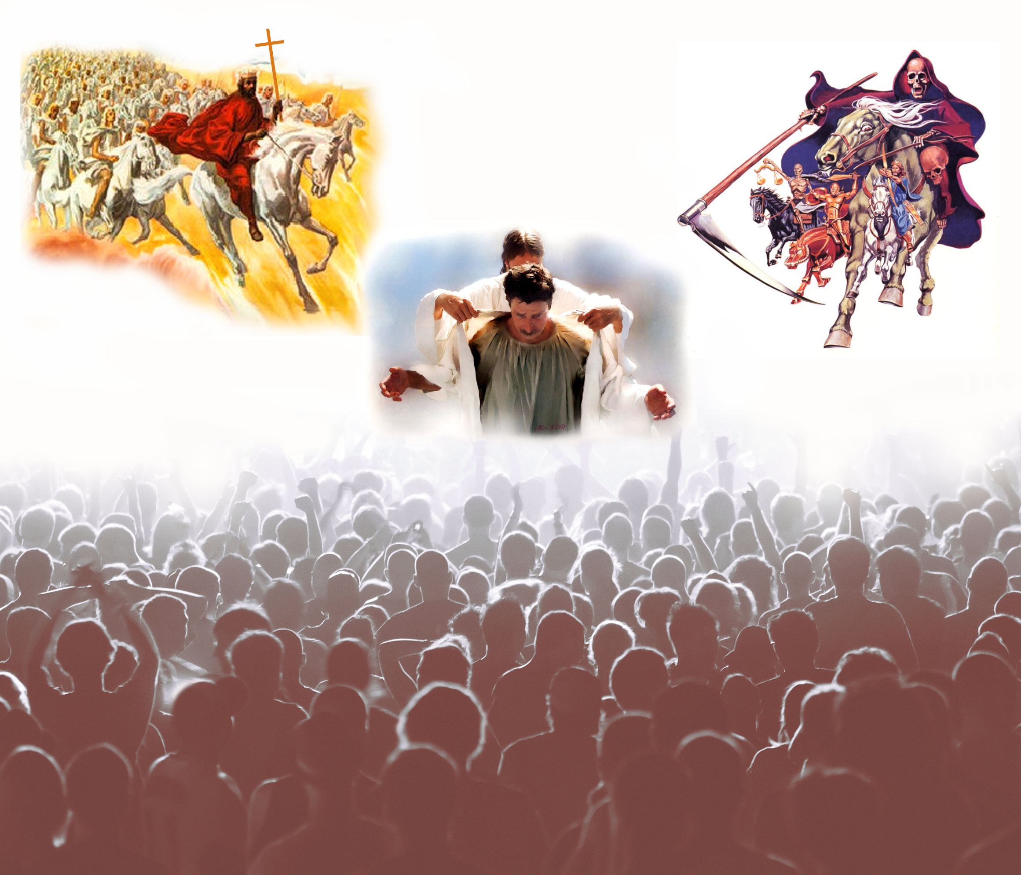
Good VS Evil
Notes:
7

Slide 8
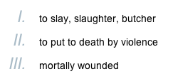
slain = sfazw
sfazw
“sfazo”
This connects with Rev 5 and Christ being the Lamb slain who could open the scroll

Slide 9

Revelation 1, 5
Revelation 12, 20
Revelation 13, 14

Slide 10
Notes:
10

Slide 11
God Loves You
Notes:
11

Slide 12

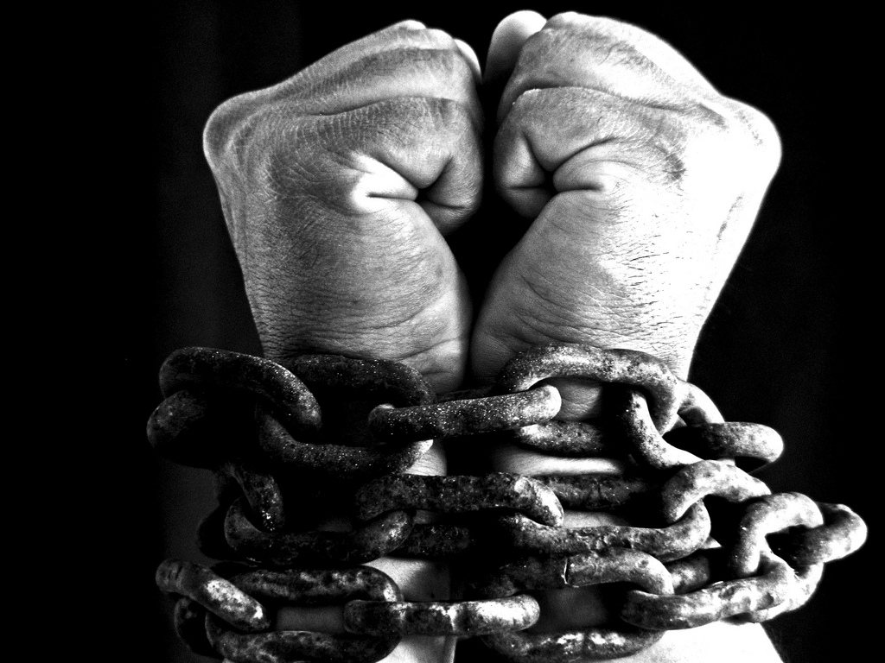
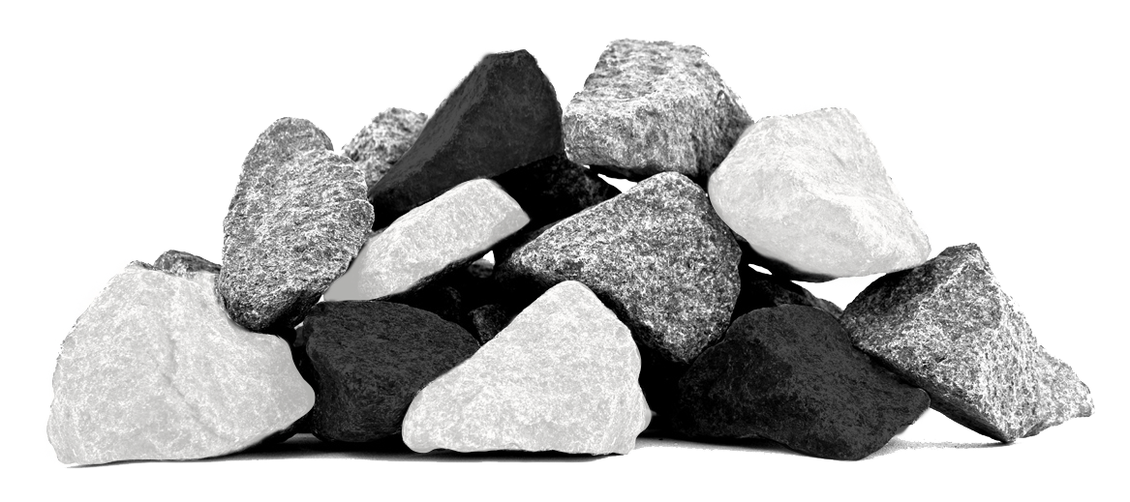
Beginning to tie things together . . .
Notes:
12

Slide 13
Revelation 13:8
Revelation 17:8
Revelation 3:5
Revelation 2:17
Revelation 12:10

Slide 14
All inhabitants of the earth will worship the beast—all whose names have not been written in the Lamb’s book of life, the Lamb slain from the foundation of the world.
Revelation 13:8
The beast that you saw was, and is not, and will ascend out of the bottomless pit and go to perdition. And those who dwell on the earth will marvel, whose names are not written in the book of life from the foundation of the world, when they see the beast that was, and is not, and yet will come.
Revelation 17:8

Slide 15
All inhabitants of the earth will worship the beast—all whose names have not been written in the Lamb’s book of life, the Lamb slain from the foundation of the world.
Revelation 13:8
The beast that you saw was, and is not, and will ascend out of the bottomless pit and go to perdition. And those who dwell on the earth will marvel, whose names are not written in the book of life from the foundation of the world, when they see the beast that was, and is not, and yet will come.
Revelation 17:8

Slide 16
He who overcomes shall be clothed in white garments, and I will not blot out his name from the Book of Life; but I will confess his name before My Father and before His angels.
Revelation 3:5

Slide 17
He who overcomes shall be clothed in white garments, and I will not blot out his name from the Book of Life; but I will confess his name before My Father and before His angels.
Revelation 3:5

Slide 18
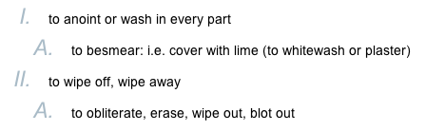
Blot = ecaleifw
ecaleifw
“eksalafo”
This connects with Rev 7 & Rev 21 where Christ “wipes away” (BLOTS) out the tears

Slide 19
Notes:
19

Slide 20
God Loves You
Notes:
20

Slide 21


Questions,
Observations
&
Discussion
Notes:
21

Slide 22

Weekly Reflections
& Time to work
Catch up on any homework you have
  Do you have a WS due?
Work on extra-credit if you can
Don’t forget to post comments!
Do something creative this week
Notes:
22

Slide 23
Notes:
23

Slide 24
God Loves You

Slide 25
Beginning to tie things together . . .
Original Questions in Job (1, 2)
Nobody really loves (wants to worship) God.
  Bribery
  Fear
Notes:
25

Slide 26
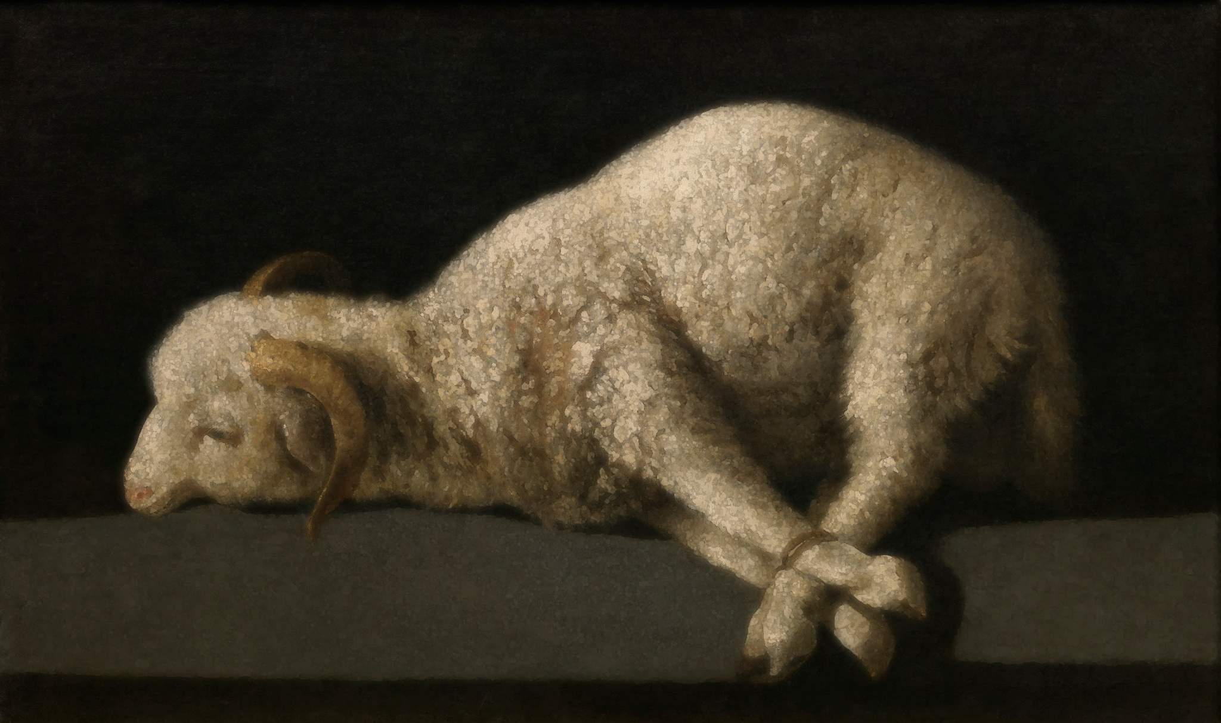

Beginning to tie things together . . .
Notes:
26

Slide 27
Beginning to tie things together . . .
The outcome of the cross gives Jesus (was Michael now Yoshua) the RIGHT to speak about the character of God and what is really going on. It unmasks satan (the slandering complainer) as the one NOT to be trusted in the “court of public opinion” such that his tirade against God falls on deaf ears to the Universe (I cor 4:9) and the redeemed overcome by their TESTIMONY to the fact that Jesus is telling the truth about what God is really like (Rev 1:5; Luke 15; John 14:6-9; 18:37).
Notes:
27

Slide 28
Notes:
28

Slide 29
God Loves You
Notes:
29

Slide 30
Notes:
30

