Slide 1
God Loves You
Notes:
1

Slide 2
“I wonder if this is how people always get close: They heal each other's wounds; they repair the broken skin.”
Lauren Oliver

Slide 3
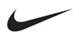
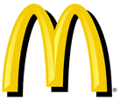


Interpreting the signs
Nike
McDonalds
Toyota
yield
Notes:
3

Slide 4
Visual Exercise — glasses
( put them on )
What will you see?
What can you see?
What do you see?
What is possible to see?
What have you seen?
What are you seeing?
This paragraph will contain a collection of words that must make a sentence with different colors and will all colors. But each meaning associated with various colors will have different meanings. That would demonstrate lots of ideas and will be a metaphor for shared perspectives—especially in contrast to solo perspectives.

Slide 5
If you could ask a question of anyone, say your neighbor for example, what exactly would you ask? Would you try to procure an eating utensil or maybe persuade them to vote in an election—or maybe for the death penalty. Maybe you would ask them to come support gay rights like demonstrating against california prop 8. Exactly, what would you do?

Slide 6
If you could ask a question of anyone, say your neighbor for example, what exactly would you ask? Would you try to procure an eating utensil or maybe persuade them to vote in an election—or maybe for the death penalty. Maybe you would ask them to come support gay rights like demonstrating against california prop 8. Exactly, what would you do?

Slide 7
If you could ask a question of anyone, say your neighbor for example, what exactly would you ask? Would you try to procure an eating utensil or maybe persuade them to vote in an election—or maybe for the death penalty. Maybe you would ask them to come support gay rights like demonstrating against california prop 8. Exactly, what would you do?

Slide 8
If you could ask a question of anyone, say your neighbor for example, what exactly would you ask? Would you try to procure an eating utensil or maybe persuade them to vote in an election—or maybe for the death penalty. Maybe you would ask them to come support gay rights like demonstrating against california prop 8. Exactly, what would you do?

Slide 9
If you could ask a question of anyone, say your neighbor for example, what exactly would you ask? Would you try to procure an eating utensil or maybe persuade them to vote in an election—or maybe for the death penalty. Maybe you would ask them to come support gay rights like demonstrating against california prop 8. Exactly, what would you do?

Slide 10

What are your “glasses”?
What is your “song”?
What is your “story”?
Relationships (and facets of: intimacy, estrangement, etc) are key in life. Does the Bible have suggestions, and if so what can we learn?
Are some logos culturally significant only? Do they become identifiers of a people? Can you think of any?
Notes:
10

Slide 11
Owe no man anything, but to love one another: for he that loveth another hath fulfilled the law. For this, Thou shalt not commit adultery, Thou shalt not kill, Thou shalt not steal, Thou shalt not bear false witness, Thou shalt not covet; and if there be any other commandment, it is briefly comprehended in this saying, namely, Thou shalt love thy neighbour as thyself. Love worketh no ill to his neighbour: therefore love is the fulfilling of the law
Romans 13:8-10 (KJV)

Slide 12
Let no debt remain outstanding, except the continuing debt to love one another, for whoever loves others has fulfilled the law. The commandments, “You shall not commit adultery,” “You shall not murder,” “You shall not steal,” “You shall not covet,” and whatever other command there may be, are summed up in this one command: “Love your neighbor as yourself.” Love does no harm to a neighbor. Therefore love is the fulfillment of the law.
Romans 13:8-10 (NIV)

Slide 13
This week MV submission: Paraphrase

Slide 14
How can i get
HELP?!
daniel e gregory site
http://www.danielegregory.info
Notes:
14

Slide 15
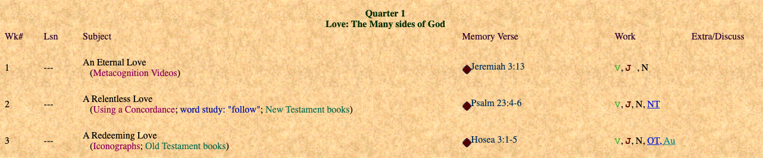
What we’re covering
Week of semester
Lesson from textbook
Quiz material
Homework for week
Extra credit options for the week (if any)
Memory verse for the week
Notes:
15

Slide 16
Notes:
16

Slide 17
God Loves You
Notes:
17

Slide 18
What did we learn about signs?
a) Create community & bond
b) Are always culturally specific
c) They don’t contain words
What can we learn from the glasses?
a) The glasses change the message
b) Some have “glasses” and some do not
c) We see different things depending on what we’re wearing
What are important relationship issues we’ll cover?
a) Importance of understanding temperments
b) Importance of knowing your own learning style
c) What jobs/occupations might work well for me

Slide 19
Perspective makes a difference
Notes:
19

Slide 20
The origin of a word and the development and inter-relatedness of people & ideas
Notes:
20

Slide 21
What can we learn from ”tracking” language development?
a) How fast people are supposed to learn
b) How caregivers “come down” to the level of the learner
c) How language development mirrors physical development
Language development can teach us . . . ?
a) How parents enforce developmental ideas
b) Which ideas are most important for society
c) How cultures spread ideas
“Word-scapes” show us the important influence of a word?
a) This idea was not talked about
b) False
c) True

Slide 22
Online testing
Keep working and save / print your work
Put into binder

Slide 23
Notes:
23

Slide 24
God Loves You
Notes:
24

Slide 25
“Love, it will not betray you, dismay you, or enslave you. It will set you free.”
Mumford & Sons

Slide 26

Notes:
26

Slide 27

Journaling
Write a short paragraph detailing an experience in your life where you felt really loved/secure/good. What was going on? What was the setting? Why do you think that was such a memorable/pleasurable/enduring experience?
Remember: personal & 2+ interviews
Notes:
27

Slide 28
Notes:
28

Slide 29
God Loves You

Slide 30
Good Afternoon
Guided Learning Exercise
Finish Notes for Week
Notes:
30

Slide 31
“Love, it will not betray you, dismay you, or enslave you. It will set you free.”
Mumford & Sons

Slide 32

Notes:
32

Slide 33
Notes:
33

Slide 34
Notes:
34

