Slide 1
God Loves You
Notes:
1

Slide 2
“There's nothing more intimate in life than simply being understood. And understanding someone else.”
Brad Meltzer

Slide 3
Bear ye one another’s burdens, and so fulfil the law of Christ. For if a man think himself to be something, when he is nothing, he deceiveth himself. But let every man prove his own work, and then shall he have rejoicing in himself alone, and not in another. For every man shall bear his own burden.
Galatians 6:2-5 (KJV)

Slide 4
Carry each other’s burdens, and in this way you will fulfill the law of Christ. If anyone thinks they are something when they are not, they deceive themselves. Each one should test their own actions. They they can take pride in themselves alone, without comparing themselves to someone else, for each one should carry their own load.
Galatians 6:2-5 (NIV)

Slide 5
This week MV submission: Iconographs
3~5 images to explain a verse with 1 “bumper sticker” phrase to highlight the main point

Slide 6
Examples
Notes:
6

Slide 7
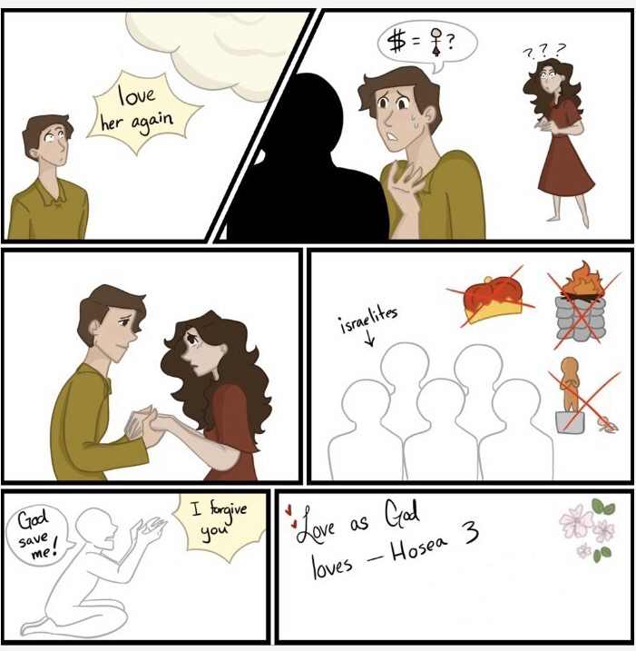
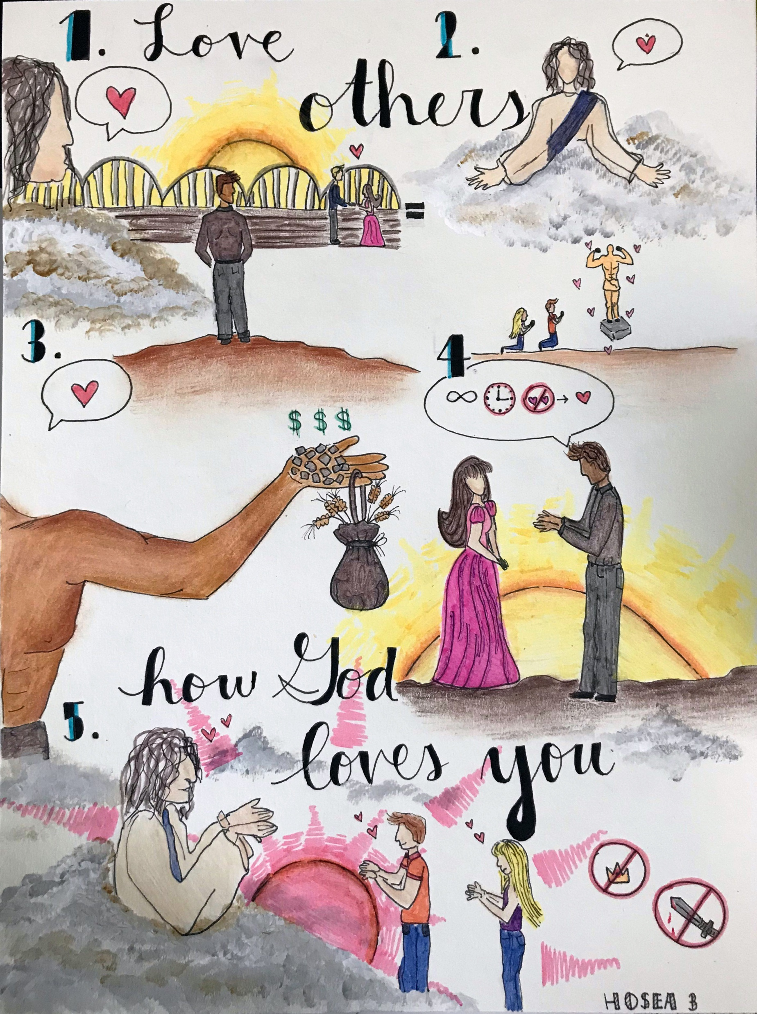
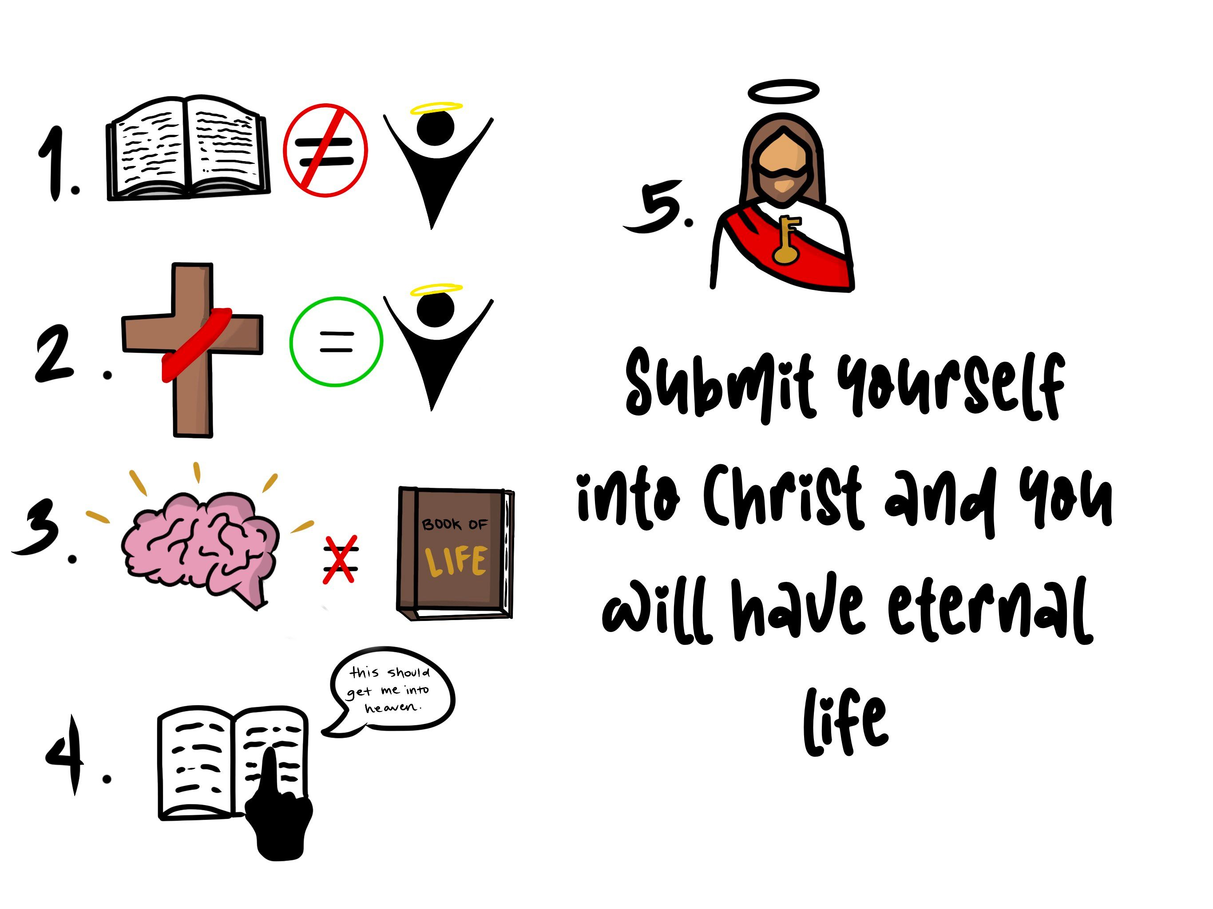
Notes:
7

Slide 8

Why are we different (how did we come to be that way)?
Did God intend us to be so different?
If God intended us to be so different, what are we supposed to learn from that (what was the purpose)?
How can i learn to appreciate someone else’s differences if they IRRITATE me so much?
If CHRIST could handle such differences (HEB 12:3) and still wash the feet of His enemy, how DID He do it? And how am i supposed to do that?
Notes:
8

Slide 9

Notes:
9

Slide 10
The purpose of MI:
What difference will you make?
Notes:
10

Slide 11
Online Learning modality assessment
Notes:
11

Slide 12
HOMEWORK TONIGHT!
Do online exam (get screen shot)
Finish Hand Out exam
Notes:
12

Slide 13
3
4
4
5
Written Eval 2
1
3
4
…
3
4
4
11
Notes:
13

Slide 14

3
1’s = Linguistic
5
2’s = Logical-Mathematical
Panda Test
4
3’s = INTRApersonal
5
4’s = Spatial
Add up all the values OF a number. For example: add up how MANY 1’s you got, then how MANY 2’s you got, etc
4
5’s = Musical
1
6’s = Bodily-Kinesthetic
2
7’s = INTERpersonal
There are no values for Naturalist
Notes:
14

Slide 15
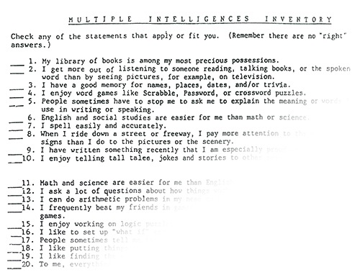
4
Section 1 = Linguistic
4
Section 2 = Logical-Mathematical
Written Eval 1
6
Section 3 = Spatial
1
Section 4 = Bodily-Kinesthetic
Total up all the values in EACH section separately. For example: add up how MANY √’s you got and put that number on the side
5
Section 5 = Musical
2
Section 6 = INTERpersonal
3
Section 7 = INTRApersonal
There are no values for Naturalist
Notes:
15

Slide 16








Online test
Section 1 = Linguistic
Find the number that you got with a particular category, then double it, then round it to the nearest whole number. FOR EXAMPLE: say you got a 3.52 on the Logical-Mathematical score. Double that would be 7.04. The nearest whole number is 7. Do that for each category.
Section 2 = Logical-Mathematical
Section 3 = Spatial
Section 4 = Bodily-Kinesthetic
Section 5 = Musical
Section 6 = INTERpersonal
Section 7 = INTRApersonal
Section 8 = Naturalist
Notes:
16

Slide 17
Panda
test
Written eval 1
Written eval 2
Online test
Total
Linguistic
3
4
15
5
27
Logical-Mathematical
5
4
8
7
24
Spatial
5
6
10
8
29
Musical
4
5
9
9
27
Bodily-Kinesthetic
1
1
7
1
10
Interpersonal
2
2
6
3
13
Intrapersonal
4
3
8
7
22
Naturalist
--
--
8
9
17

Slide 18
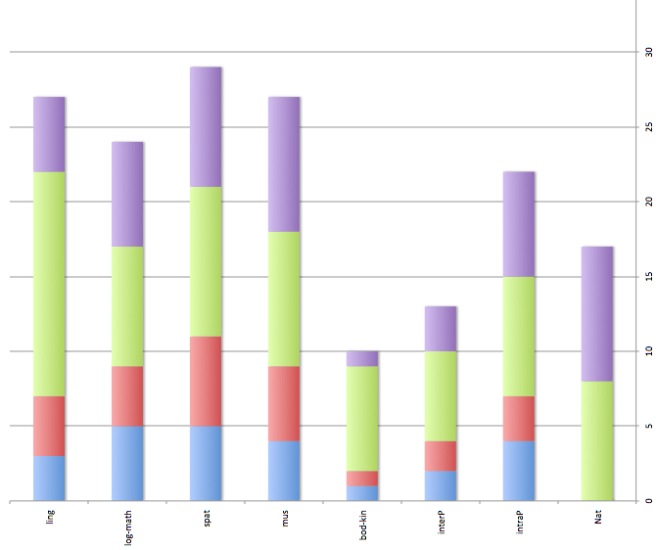
Interest/aptitude

Slide 19
Notes:
19

Slide 20
God Loves You
Notes:
20

Slide 21
Marked diversities of disposition and character frequently exist in the same family, for it is in the order of God that persons of varied temperament should associate together. When this is the case, each member of the household should sacredly regard the feelings and respect the right of the others. By this means mutual consideration and forbearance will be cultivated, prejudices will be softened, and rough points of character smoothed. Harmony may be secured, and the blending of the varied temperaments may be a benefit to each
Ellen White

Slide 22
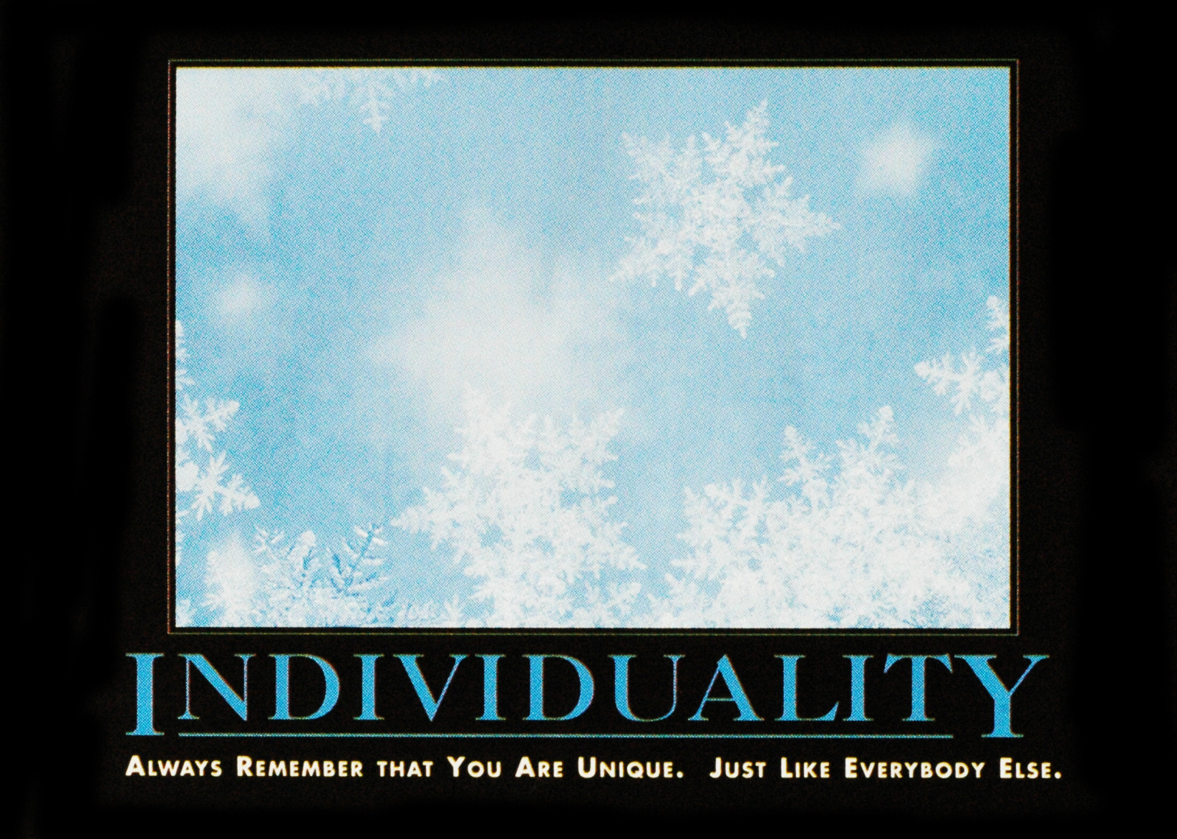
Notes:
22

Slide 23

Journaling
Compare your chart with at least 2 other people. What are the differences? What are the similarities?
Choose a biblical character’s personality and learning style. What do you think s/he was like? Describe someone you think might have been like you.
How might understanding learning modalities help us understand others (friends, colleagues, partners)?
Notes:
23

Slide 24
What it means
Notes:
24

Slide 25
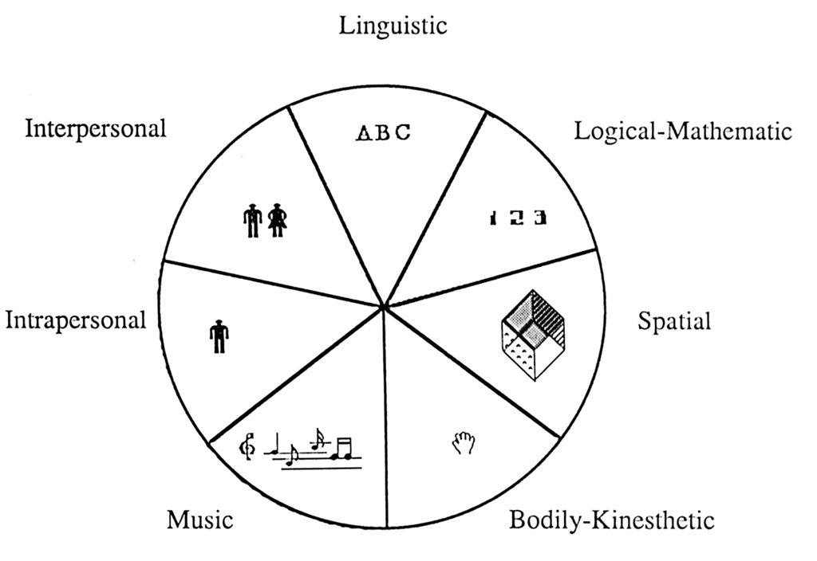
1
Notes:
25

Slide 26
Reading
Doing crossword puzzles
Playing word games (scrabble)
Playing trivia games
Writing stories, poetry
Listening to books on tape
Listening to public radio
Joining Toastmasters or similar group
Enjoying word processing software programs
Informal discussions with others
Self-talk
Notes:
26

Slide 27
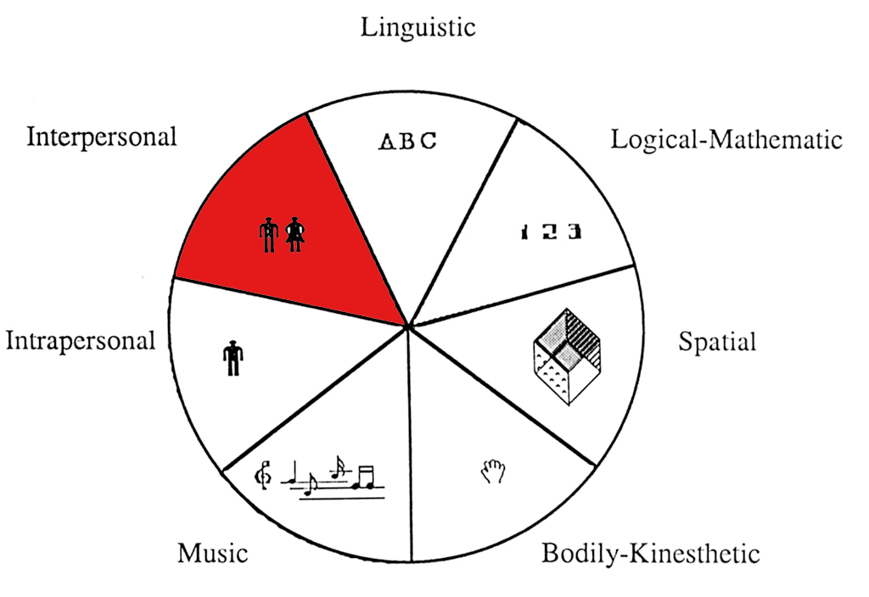
1
7
Notes:
27

Slide 28
Joining social clubs or groups
Going to parties (to meet with people!)
Being in discussion groups
Playing group games
Being on committees
Volunteering with organizations
Being a mentor to another person
Teaching others
Notes:
28

Slide 29
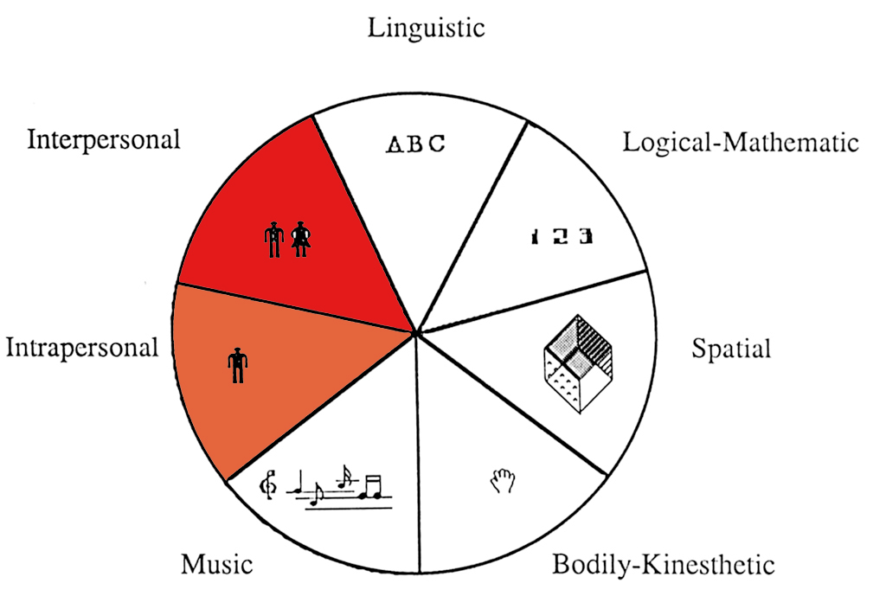
1
7
3
Notes:
29

Slide 30
Meditating
Keeping a journal
Working with dreams
Engaging in solo hobbies
Carrying out special projects
Going for long walks alone
Going on retreats
Studying a psychological tradition
Studying a spiritual tradition
Notes:
30

Slide 31
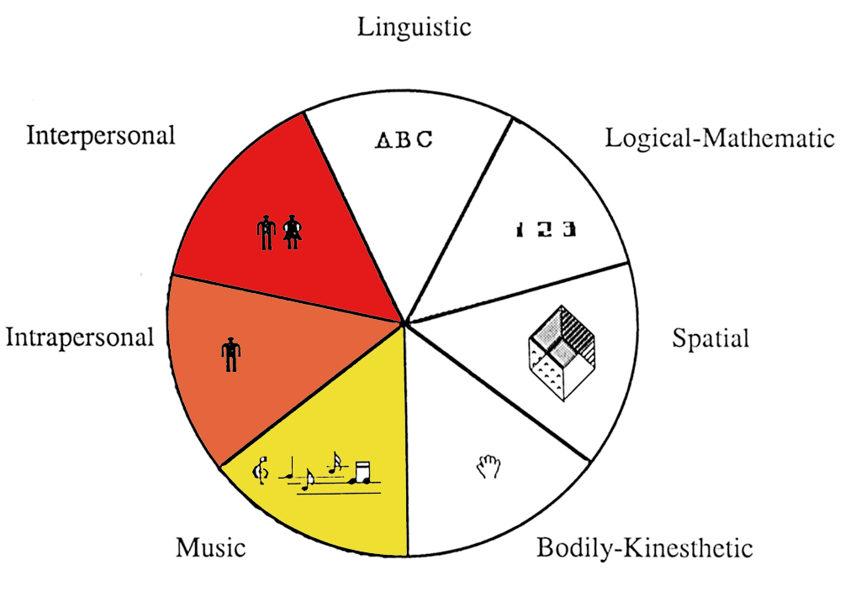
1
7
3
5
Notes:
31

Slide 32
Listening to music (for intricacies)
Playing a musical instrument
Being in a chorus
Writing songs
Going to musical concerts
Enjoying computer music software
Singing informally with friends
Collecting records, CDs, tapes (many genres)
Notes:
32

Slide 33
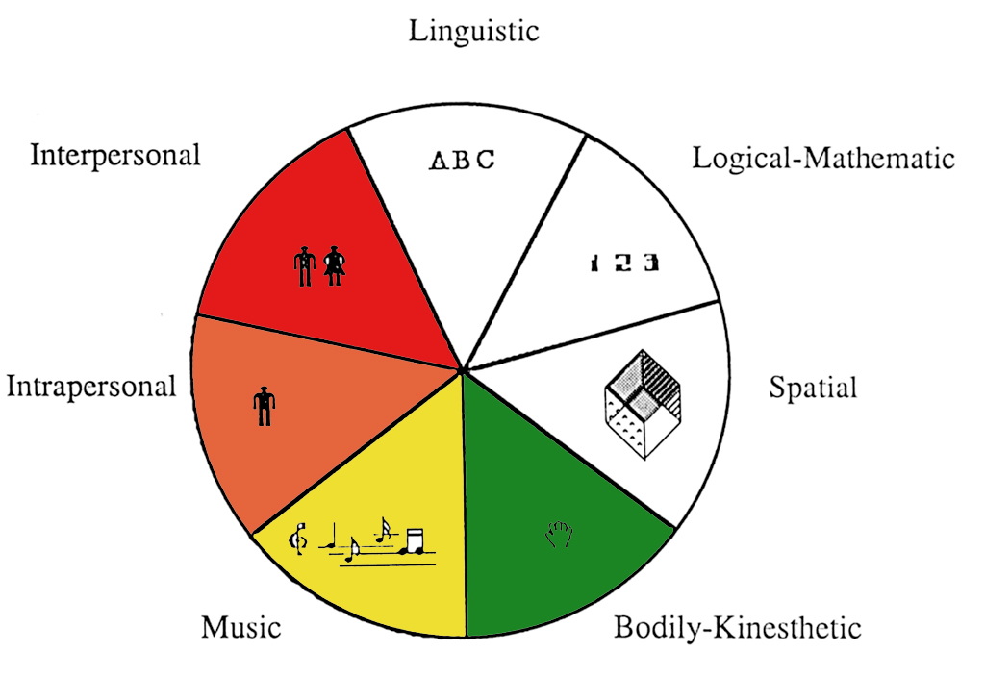
1
7
3
5
6
Notes:
33

Slide 34
Engaging in a solo/team sport
Spending time out in nature
Crafts (carpentry, sewing, carving, etc)
Working with mechanical objects (repair, etc)
Going out dancing (for the movement)
Acting in a community theatre
Going to amusement parks
Notes:
34

Slide 35
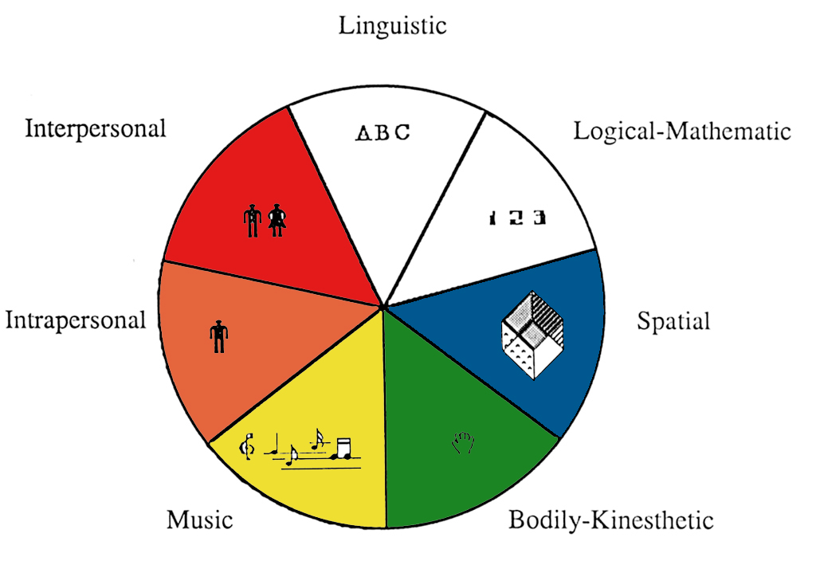
1
7
4
3
5
6
Notes:
35

Slide 36
Drawing, doodling, or painting
Photography or video
Going to museums
Taking art classes
Engaging in interior design
Fantasizing/visualizing/daydreaming
Working on jig-saw puzzles
Looking at picture books/magazines
Enjoying computer graphic software
Enjoy maze like puzzles/games
Notes:
36

Slide 37
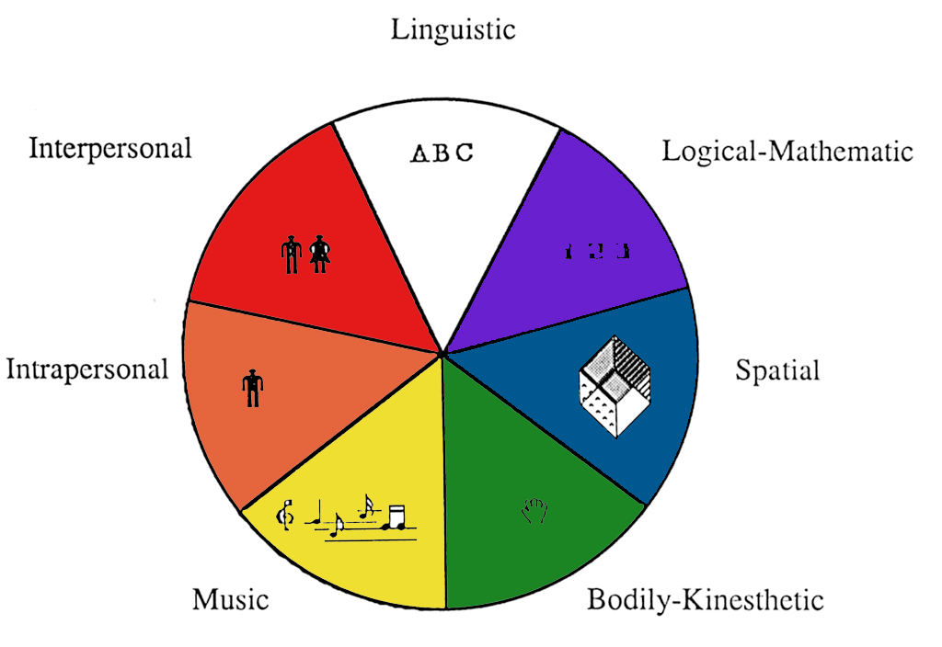
1
7
2
4
3
5
6
Notes:
37

Slide 38
Solving brainteasers
Playing with logic puzzles like a Rubik’s cube
Playing strategy games like Chess and Go
Enjoying computer programming software
Tinkering around with science kits/experiments
Watching science documentaries
Reading books about science or mathematics
Joining a computer club
Notes:
38

Slide 39
What characterizes a inter-personal learner?
a) Learns best by working alone
b) Learns best by working with others
c) Learns best by working with music in background
What characterizes a bodily-kinesthetic learner?
a) Learns best by doing/practicing
b) Learns best by watching/seeing
c) Learns best by listening/reading
What characterizes a musical learner?
a) Learns best by solitude
b) Learns best by group discussion
c) Learns best by rhyming language

Slide 40
Online testing
Keep working and save / print your work
Put into binder

Slide 41
Notes:
41

Slide 42
God Loves You
Notes:
42

Slide 43




Shorthand for learning
K
Knowledge. This is the basic collection of facts and data that a lesson or discipline needs or provides
Understanding (this is comprehension. Sometimes in part or whole). This is where understanding temperaments and learning modalities comes into play
U
D
O
The “do’s” or actions desired that reflect you have processed and acquired the knowledge
Notes:
43

Slide 44

Notes:
44

Slide 45
LARGE caveats:
Simplified
Not as diverse as MI
Pattern recognition emphasis
Not creative/generative measure
—> handout
Notes:
45

Slide 46
Notes:
46

Slide 47
God Loves You

Slide 48
Notes:
48

