Slide 1
God Loves You
Notes:
1

Slide 2
“You are not in competition with anybody except yourself; plan to outdo your past not other people.”
Jaachynma N. E. Agu

Slide 3
Though I speak with the tongues of men and of angels, and have not charity, I am become as sounding brass, or a tinkling cymbal. And though I have the gift of prophecy, and understand all mysteries, and all knowledge; and though I have all faith, so that I could remove mountains, and have not charity, I am nothing. And though I bestow all my goods to feed the poor, and though I give my body to be burned, and have not charity, it profiteth me nothing.
I Corinthians 13:1-3 (KJV)

Slide 4
If I speak in the tongues of men or of angels, but do not have love, I am only a resounding gong or a clanging cymbal. If I have the gift of prophecy and can fathom all mysteries and all knowledge, and if I have a faith that can move mountains, but do not have love, I am nothing. If I give all I possess to the poor and give over my body to hardship that I may boast, but do not have love, I gain nothing.
I Corinthians 13:1-3 (NIV)

Slide 5
This week MV submission: Media
A multimedia presentation of the verse. Examples could be an animated PPT with voice over and sound. Short movie with music and paraphrased text. Possibilities are nearly endless!

Slide 6
Examples
Notes:
6

Slide 7
Read chapters 6 & 8 this week. Be ready to discuss Monday in class. Discussion points!
Chapter 6: Engagement, Wedding, & Honeymoon

Slide 8
reading
Pgs 66-75
Notes:
8

Slide 9




Shorthand for learning
K
Knowledge. This is the basic collection of facts and data that a lesson or discipline needs or provides
Understanding (this is comprehension. Sometimes in part or whole). This is where understanding temperaments and learning modalities comes into play
U
D
O
The “do’s” or actions desired that reflect you have processed and acquired the knowledge
Notes:
9

Slide 10
Online testing
Keep working and save / print your work
Put into binder

Slide 11
LARGE caveats:
Simplified
Not as diverse as MI
Pattern recognition emphasis
Not creative/generative measure
—> handout
Notes:
11

Slide 12
How can i get
HELP?!
daniel e gregory site
http://www.danielegregory.info
Notes:
12

Slide 13
Notes:
13

Slide 14
God Loves You
Notes:
14

Slide 15
Though I speak with the tongues of men and of angels, and have not charity, I am become as sounding brass, or a tinkling cymbal. And though I have the gift of prophecy, and understand all mysteries, and all knowledge; and though I have all faith, so that I could remove mountains, and have not charity, I am nothing. And though I bestow all my goods to feed the poor, and though I give my body to be burned, and have not charity, it profiteth me nothing.
I Corinthians 13:1-3 (KJV)

Slide 16
If I speak in the tongues of men or of angels, but do not have love, I am only a resounding gong or a clanging cymbal. If I have the gift of prophecy and can fathom all mysteries and all knowledge, and if I have a faith that can move mountains, but do not have love, I am nothing. If I give all I possess to the poor and give over my body to hardship that I may boast, but do not have love, I gain nothing.
I Corinthians 13:1-3 (NIV)

Slide 17
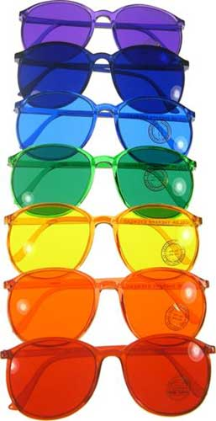
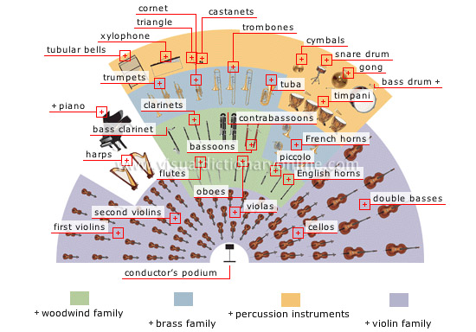
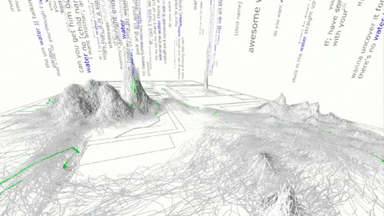
Metaphors
Notes:
17

Slide 18

Journaling
Compare and contrast the 3 metaphors we’ve covered so far in regards to understanding relationships. How is each one effective or how does each one fail in communicating the complexity of relationships? What might be advantages of having simpler models? Or more complex ones? Which metaphor works best for you? Why? Give details of each (glasses, music, language acquisition)
In what ways has the various tests been beneficial to you? Have you learned anything new (about yourself or others)? Like what?
Notes:
18

Slide 19
Personality demonstration
Notes:
19

Slide 20
Personality demonstration 2
Notes:
20

Slide 21
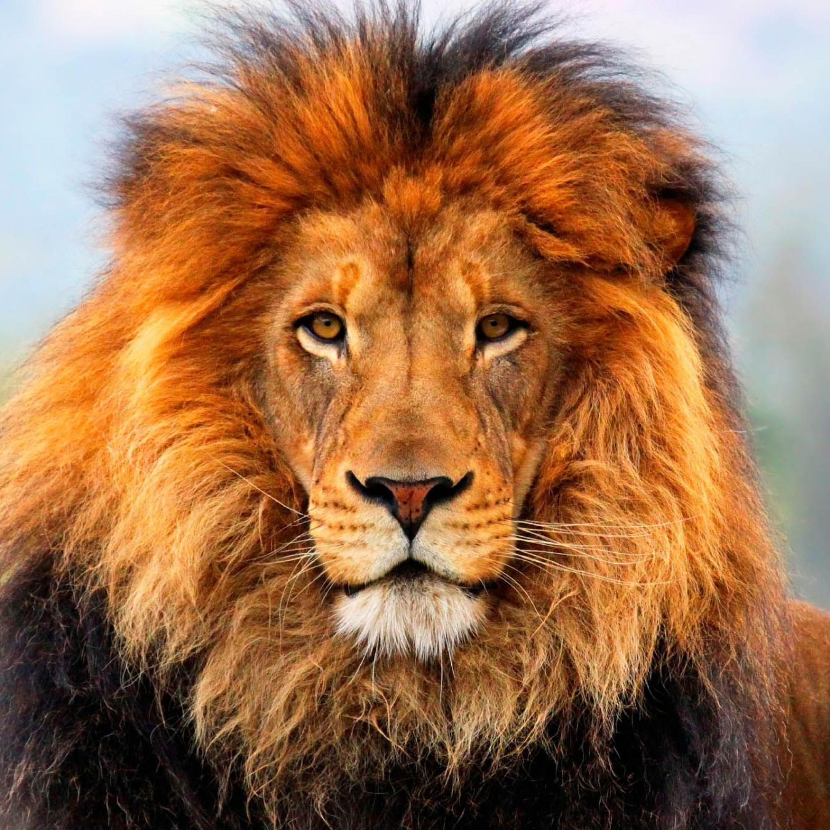
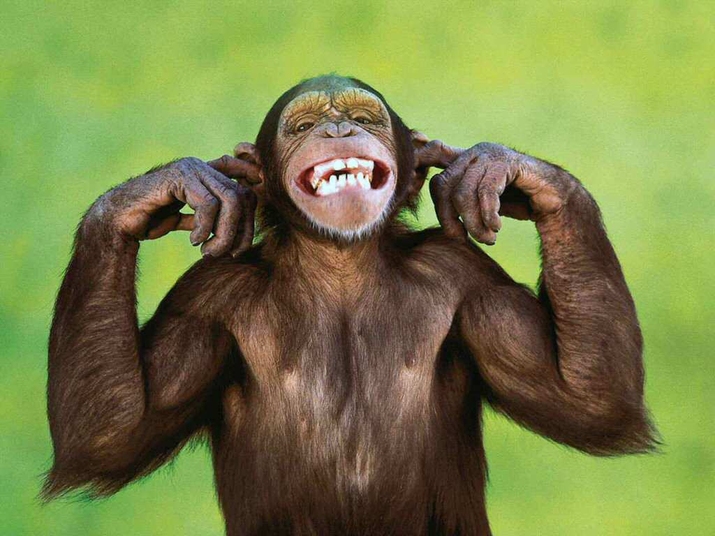
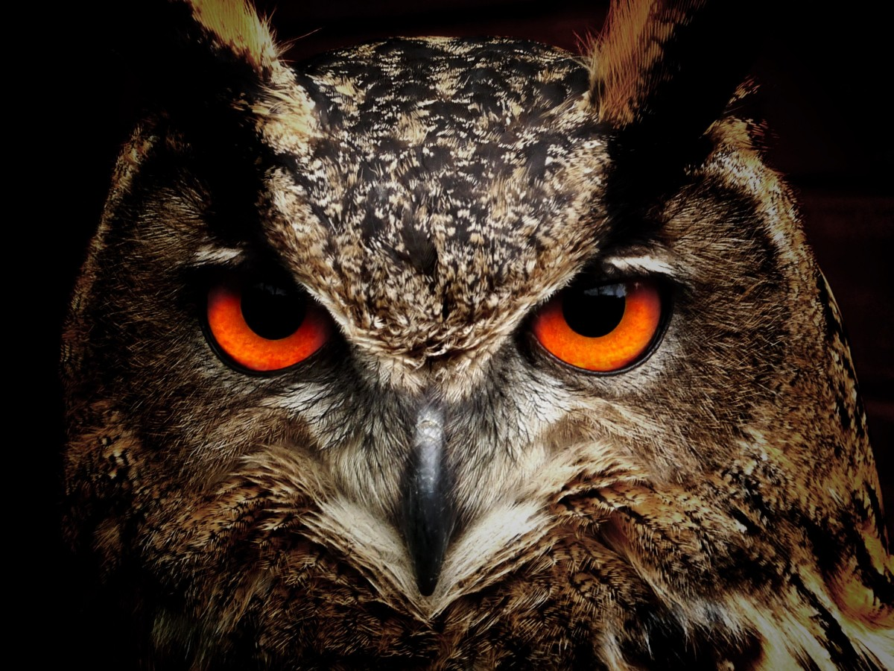
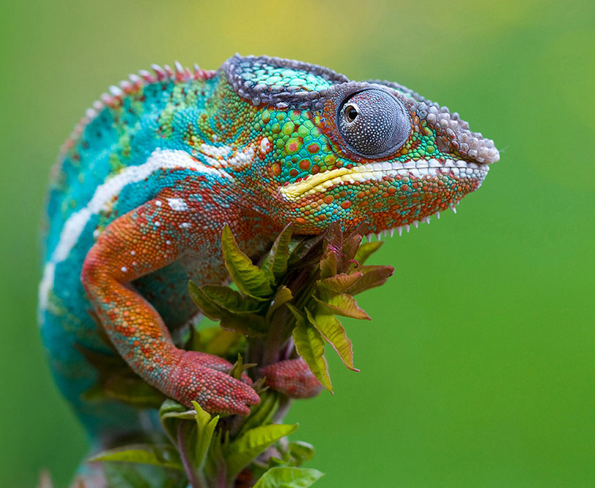
Notes:
21

Slide 22
Online testing
Keep working and save / print your work
Put into binder

Slide 23
Notes:
23

Slide 24
God Loves You
Notes:
24

Slide 25
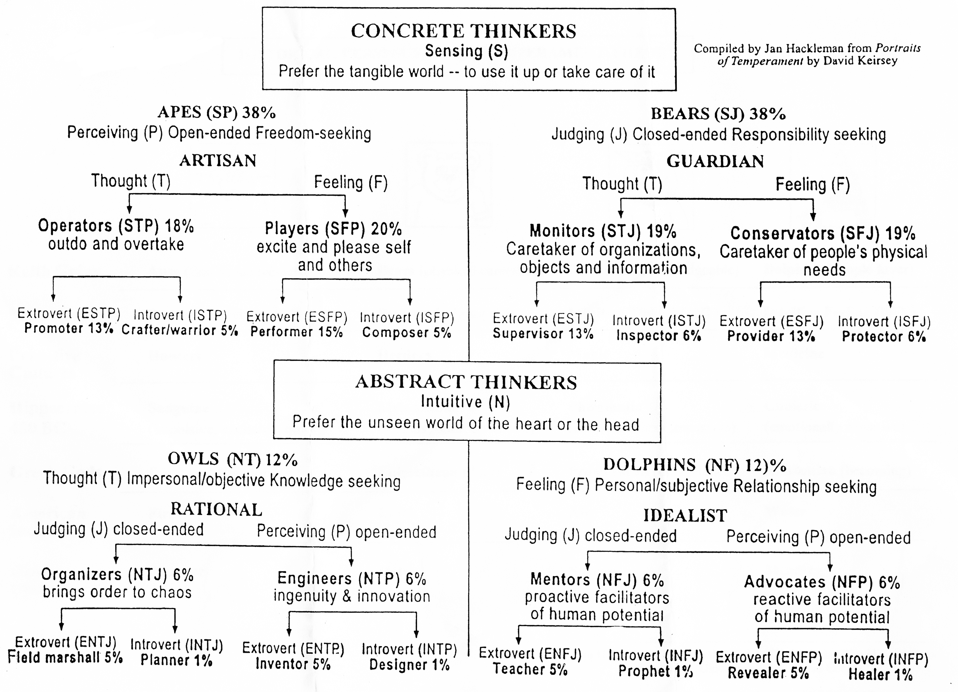
A visual breakdown of personality connectedness
Notes:
25

Slide 26
Communication is a good place to start with understanding. Speaking the correct love language

Slide 27
Love is not possible without risk
Notes:
27

Slide 28
Notes:
28

Slide 29
God Loves You

Slide 30

Journaling
What are the risks inherent in any relationship with regards to love/control/freedom of choice?
What are some practical suggestions for communicating with someone involving MBJT and Love Language?
Survey several couples in regards to how they regularly communicate with each other. Time point scale applies.
Notes:
30

Slide 31
Notes:
31

