Slide 1
God Loves You
Notes:
1

Slide 2
“Seek to laugh together more than cry.”
Lou Venden

Slide 3
“No one can so effectually ruin a woman’s happiness and usefulness, and make life a heartsickening burden, as her own husband; and no one can do one hundredth part as much to chill the hopes and aspirations of a man, to paralyze his energies and ruin his influence and prospects, as his own wife.”
– Review & Herald, 2/2/1886

Slide 4
“He [satan] is busily engaged in influencing those who are wholly unsuited to each other to unite their interests. He exults in this work, for by it he can produce more misery and hopeless woe to the human family than by exercising his skill in any other direction.”
– pg 248:2, 2Testimonies, pub. 1870

Slide 5
Read chapters 1, 4, 7 before Thursday. Be ready to discuss in class. Discussion points!
Chapter 1: God’s Design for Love
Chapter 4: Qualities of a Great Mate
Chapter 7: Dealing with the Differences

Slide 6
reading
Pgs 42-53
Pgs 76-89
Pgs 7-13
Notes:
6

Slide 7
marriage isn’t as much about finding the right someone as it is becoming someone right
Notes:
7

Slide 8
The pursuit of perfection . . . ?
Notes:
8

Slide 9


Number 12
end
Notes:
9

Slide 10

Journaling
What features would you change of yourself if you could? Make a list of your favourite features.
How is the TZ “vision” different or alike the Christian view of heaven?
Think back upon the time you wrote about feeling loved/secure (earlier JQ). Would you alter anything about that time? If so what?
What would you say to someone (imagine a friend—or a future child) who is terribly upset about their looks/height/skin color/hair/etc?
Notes:
10

Slide 11
Online testing
Keep working and save / print your work
Put into binder

Slide 12
Notes:
12

Slide 13
God Loves You
Notes:
13

Slide 14
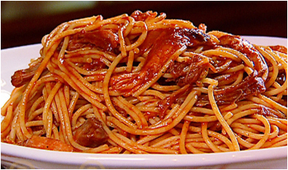
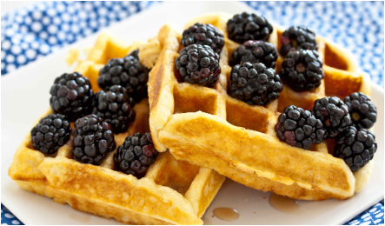
WOMEN:
MEN:

Slide 15
Communication patterns - humor
Notes:
15

Slide 16
Communication patterns – implications for intimacy
Notes:
16

Slide 17
Men and women just think/see things differently. Humor helps!
Notes:
17

Slide 18
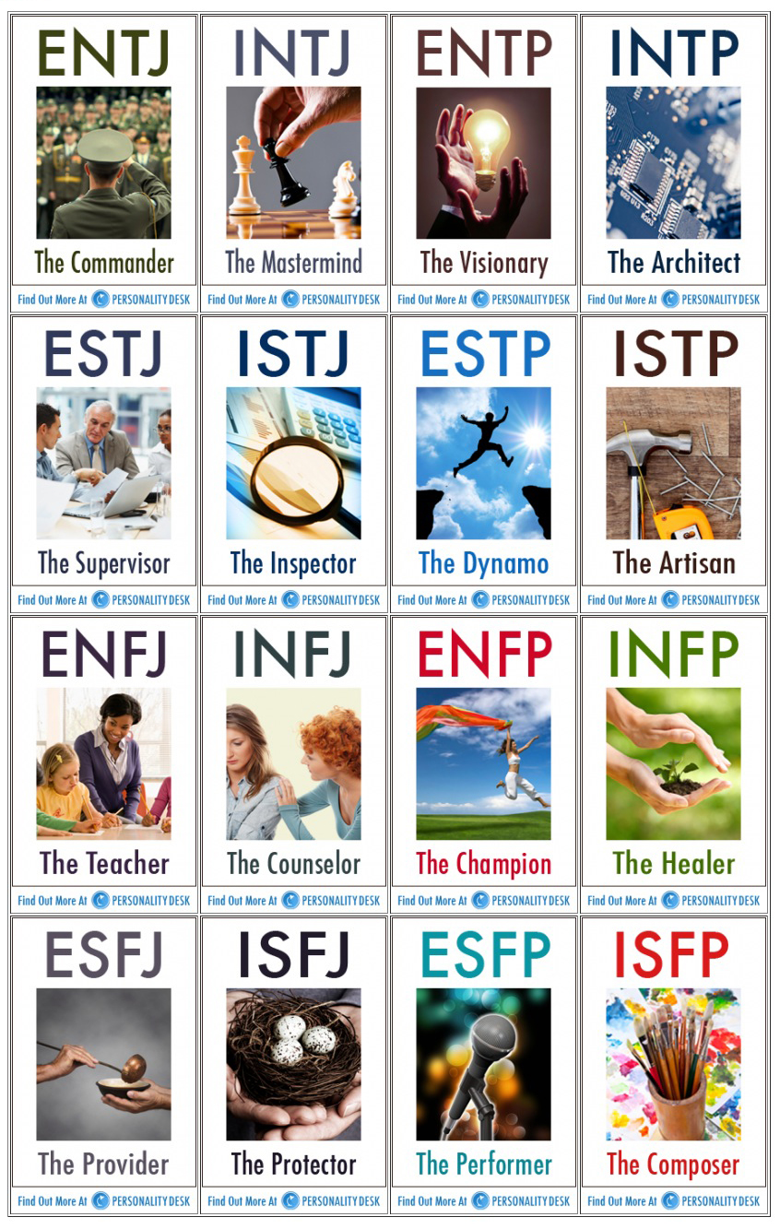
Group yourselves:
Question 1:
If you could, would you rather live in a boat or a tree house?
Question 2:
What are the best ways for parents to show their children they love them?
Question 3:
What’s the hardest thing you’ve ever done?
Question 4:
What personality trait has gotten you in the most trouble?

Slide 19
Read chapters 1, 4, 7 before Thursday. Be ready to discuss in class. Discussion points!
Chapter 1: God’s Design for Love
Chapter 4: Qualities of a Great Mate
Chapter 7: Dealing with the Differences

Slide 20
reading
Pgs 42-53
Pgs 76-89
Pgs 7-13
Notes:
20

Slide 21
Notes:
21

Slide 22
God Loves You
Notes:
22

Slide 23


Community Service
Change your world!
Notes:
23

Slide 24
Notes:
24

Slide 25
God Loves You

Slide 26
5 Love Language Needs
Notes:
26

Slide 27
Don’t forget to check here:
More info
daniel e gregory site
http://www.danielegregory.info
Notes:
27

Slide 28

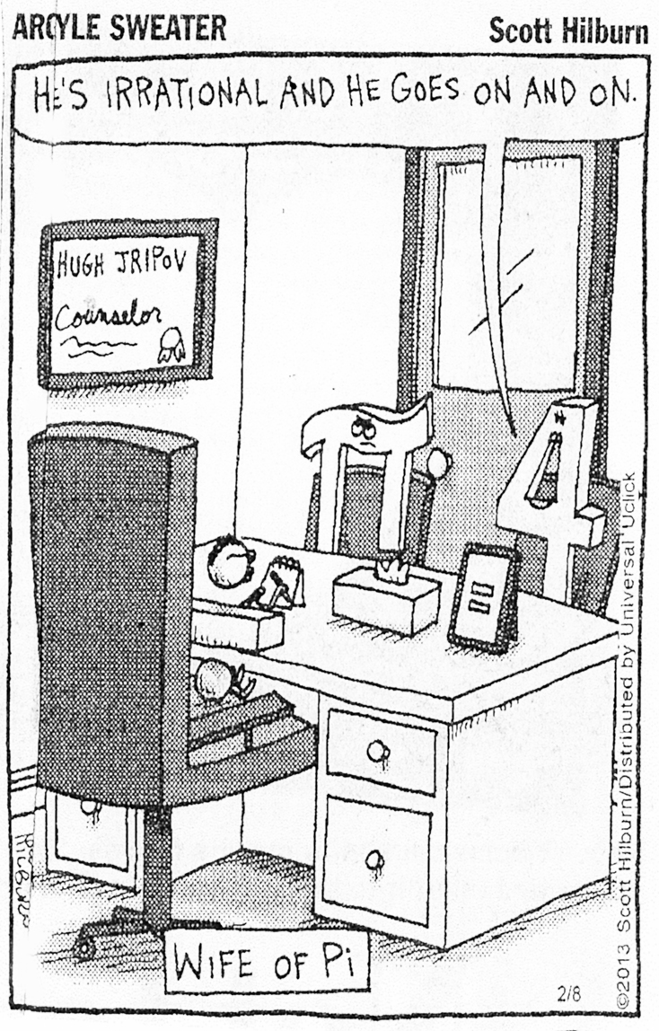
Notes:
28

Slide 29

Journaling
Research “relationship ratios” (start with the 4 articles i provide) and provide a summary/reflection of the information.
EXAMPLE: what is the basic info. What implications for relationships (note that this includes business, casual, etc) can be learned. What habits might you need to begin practicing? What communication patterns do you already do? Other insights . . .
Notes:
29

Slide 30
Relationships start with seeking to understand, which must begin with really listening which has to assume a basis of care which can only happen with trust in the other person’s intentions for good
Notes:
30

Slide 31
Faith in the other person makes a difference
Notes:
31

Slide 32
Unity is just that:
U n I Together?: Yes!
Notes:
32

Slide 33
Problems get solved when everyone acknowledges and uses their gifts for the benefit of all
Notes:
33

Slide 34
Journaling
Using the material in your textbook as a guide, what rules for communication were either followed or broken in the clips we saw? What patterns of communication have you seen modelled in your own home? What might you plan to differently in your future home?
Write a reaction/process/summary of the communication patterns needed for temperaments, MBJT, 5LL and others.
Notes:
34

Slide 35
Group yourselves:
Question 1:
If you could, would you rather live in a boat or a tree house?
Question 2:
What are the best ways for parents to show their children they love them?
Question 3:
What’s the hardest thing you’ve ever done?
Question 4:
What personality trait has gotten you in the most trouble?

Slide 36
Notes:
36

Slide 37
God Loves You
Notes:
37

Slide 38
“When you love someone, truly love them, you lay your heart open to them. You give them a part of yourself that you give to no one else, and you let them inside a part of you that only they can hurt-you literally hand them the razor with a map of where to cut deepest and most painfully on your heart and soul. And when they do strike, it’s crippling-like having your heart carved out.”
Sherrilyn Kenyon

Slide 39
Penny for your thoughts
end
Notes:
39

Slide 40
Journaling
What might be the PROS of being able to read someone’s mind?
What might be the PROS of someone else being able to read YOUR mind?
What might be the CONS of being able to read someone’s mind?
What might be the CONS of someone being able to read YOUR mind?
Notes:
40

Slide 41
Notes:
41

