Slide 1
God Loves You
Notes:
1

Slide 2
Charity suffereth long, and is kind; charity envieth not; charity vaunteth not itself, is not puffed up, Doth not behave itself unseemly, seeketh not her own, is not easily provoked, thinketh no evil; Rejoiceth not in iniquity, but rejoiceth in the truth; Beareth all things, believeth all things, hopeth all things, endureth all things. Charity never faileth:
I Corinthians 13:4-8a (KJV)

Slide 3
Love is patient, love is kind. It does not envy, it does not boast, it is not proud. It does not dishonor others, it is not self-seeking, it is not easily angered, it keeps no record of wrongs. Love does not delight in evil but rejoices with the truth. It always protects, always trusts, always hopes, always perseveres. Love never fails.
I Corinthians 13:4-8a (NIV)

Slide 4
This week MV submission: Puzzle
Crossword, Wordsearch, Rhebus

Slide 5
Examples
Notes:
5

Slide 6
marriage isn’t as much about finding the right someone as it is becoming someone right
Notes:
6

Slide 7


The Camera
end
Notes:
7

Slide 8

Journaling
1. If you had a gift that you could change/predict the future, would you use it?
2. The characters vacillate between doing what’s right and what is wrong. Each step leads them farther into the darkness. What lessons about moral boundaries are there?
3. The choices we make today are perched on the choices we made yesterday. What choice can you make today to prepare for who you want to be tomorrow?
Notes:
8

Slide 9
Read chapter 9 before Wednesday. Be ready to discuss in class the rest of the week. Discussion points!
Chapter 8: Money Management & Career Choices

Slide 10
reading
Pgs 90-101
Notes:
10

Slide 11
Notes:
11

Slide 12
God Loves You

Slide 13
Map testing
Notes:
13

Slide 14
Notes:
14

Slide 15
God Loves You

Slide 16
Trying to hold on to the past
Notes:
16

Slide 17
A Long Walk Home
end
Notes:
17

Slide 18
Journaling
1. If you could relive one day (or event) from your past, would you? What would it be? Why would you choose that?
2. The TZ episode is a metaphor for reliving the past. Time is a boundary we don’t have the luxury of recrossing. There are other “boundaries” or “guardrails” in our lives that might have disastrous consequences if we crossed. What areas might need to be protected so you can’t “get there”?
Notes:
18

Slide 19
“Because that’s what intimacy is: it’s a willingness to be vulnerable, a willingness to bite my tongue and a willingness to set an example of what I believe in.”
Diane Lane

Slide 20
Relationship Point Scale
Dating = 3 pts
Engaged = 7 pts
Married (1-4) = 10 pts
Married (5-10) = 15 pts
. . .
(each 5 years adds 5 pts; marriage status must be currently married)

Slide 21
God Loves You

Slide 22
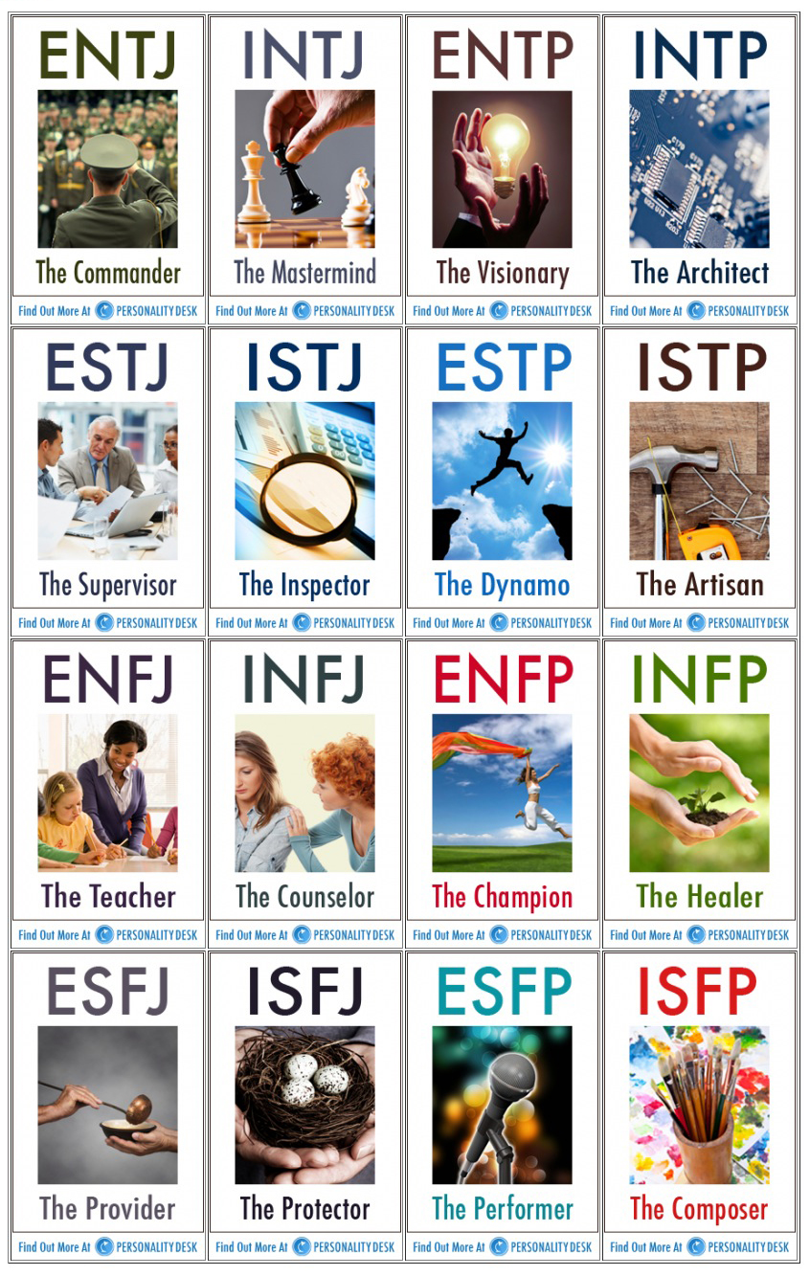
Group yourselves:
Question 1:
If you could, would you rather live in a boat or a tree house?
Question 2:
What are the best ways for parents to show their children they love them?
Question 3:
What’s the hardest thing you’ve ever done?
Question 4:
What personality trait has gotten you in the most trouble?

Slide 23
Boundaries of pride can damage ourselves
Notes:
23

Slide 24
Notes:
24

Slide 25
God Loves You
Notes:
25

Slide 26
Notes:
26

