Slide 1
God Loves You

Slide 2
but whether there be prophecies, they shall fail; whether there be tongues, they shall cease; whether there be knowledge, it shall vanish away. For we know in part, and we prophesy in part. But when that which is perfect is come, then that which is in part shall be done away. When I was a child, I spake as a child, I understood as a child, I thought as a child: but when I became a man, I put away childish things. For now we see through a glass, darkly; but then face to face: now I know in part; but then shall I know even as also I am known. And now abideth faith, hope, charity, these three; but the greatest of these is charity.
I Corinthians 13:8b-13 (KJV)

Slide 3
But where there are prophecies, they will cease; where there are tongues, they will be stilled; where there is knowledge, it will pass away. For we know in part and we prophesy in part, but when completeness comes, what is in part disappears. When I was a child, I talked like a child, I thought like a child, I reasoned like a child. When I became a man, I put the ways of childhood behind me. For now we see only a reflection as in a mirror; then we shall see face to face. Now I know in part; then I shall know fully, even as I am fully known. And now these three remain: faith, hope and love. But the greatest of these is love.
I Corinthians 13:8b-13 (NIV)

Slide 4
Read chapter 9 before Wednesday. Be ready to discuss in class the rest of the week. Discussion points!
Chapter 9: Caring Enough to Communicate

Slide 5
reading
Pgs 102-115
Notes:
5

Slide 6
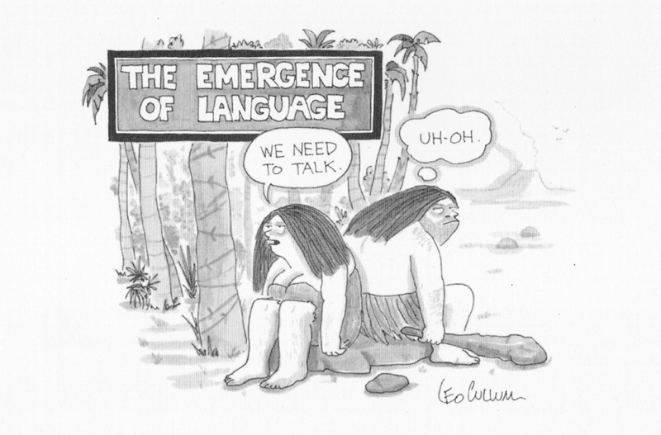
Communication

Slide 7
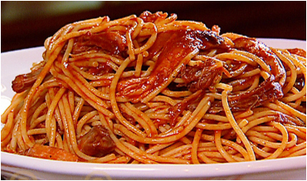
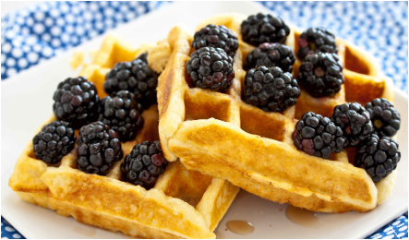
WOMEN:
MEN:

Slide 8
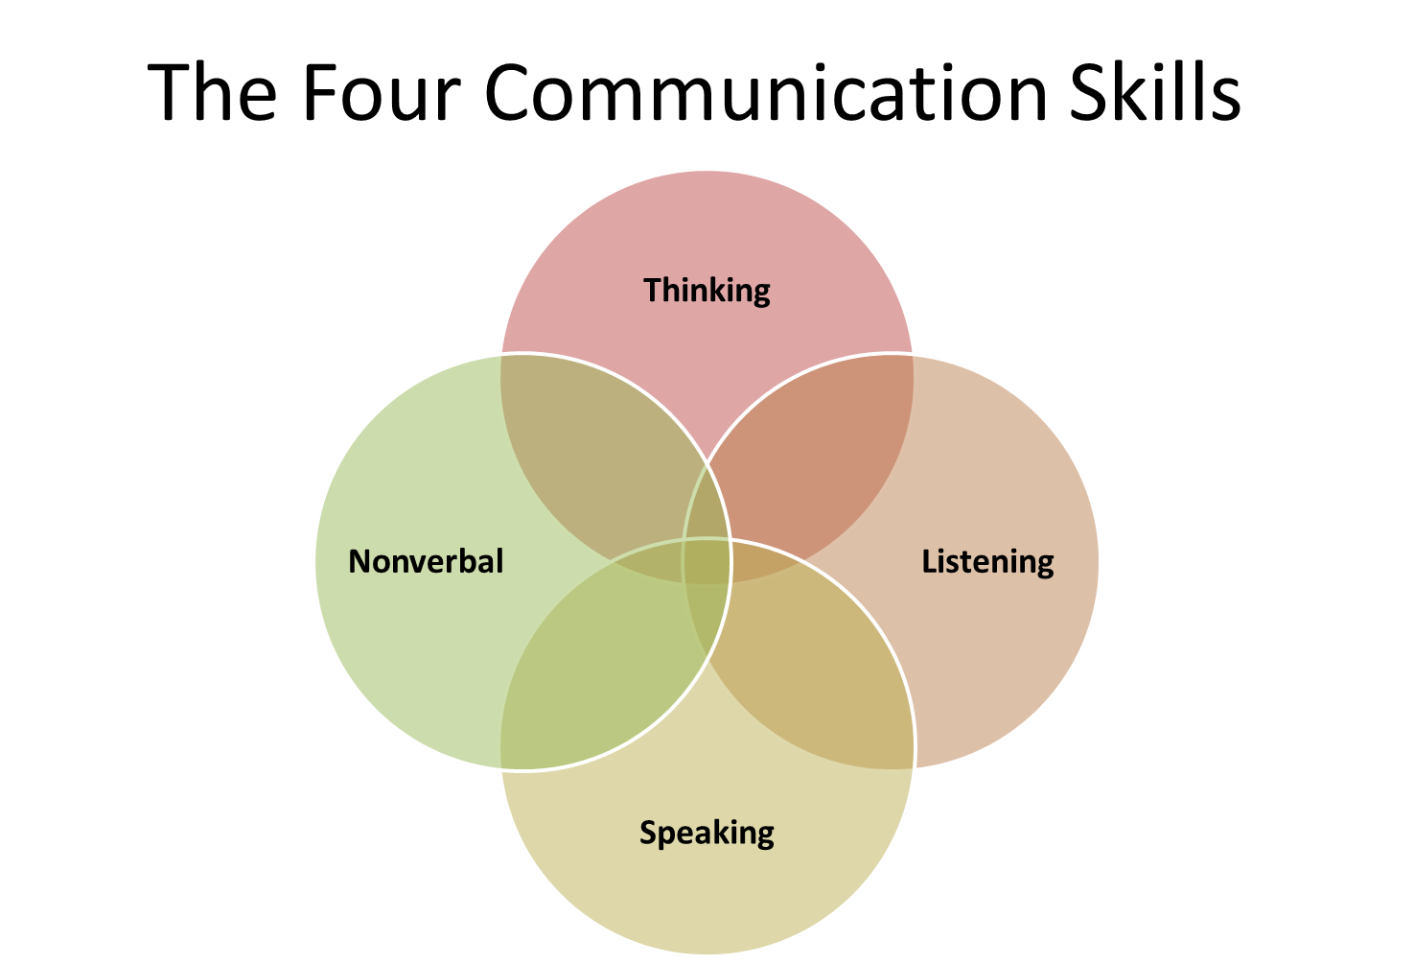

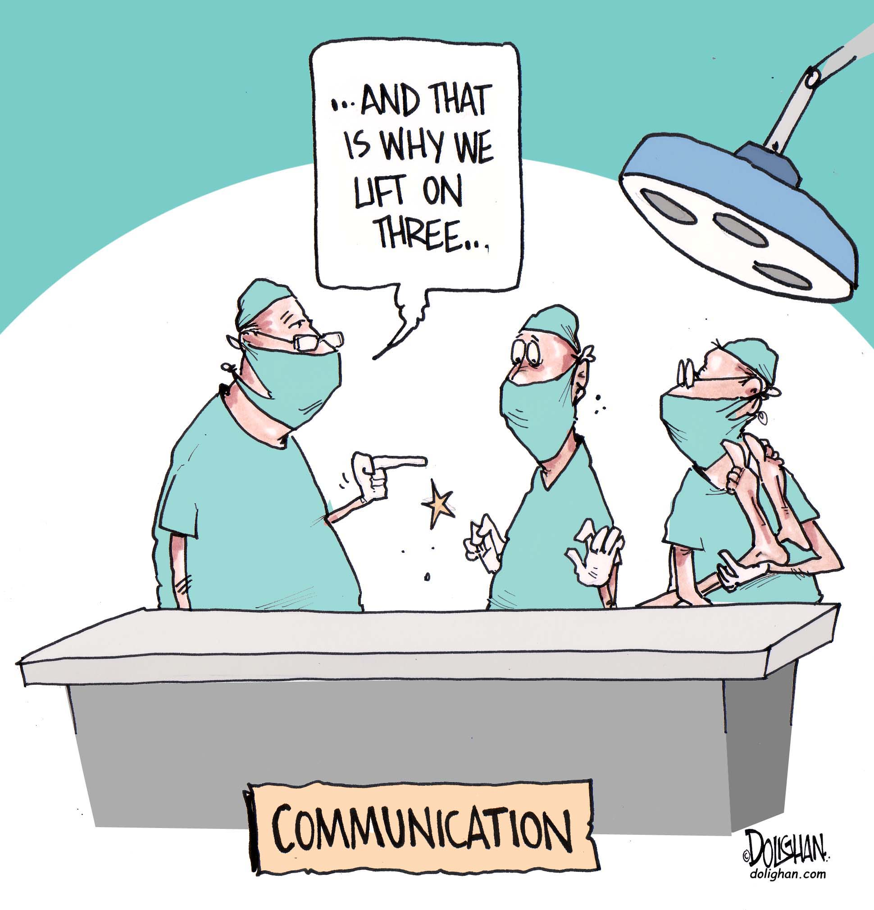
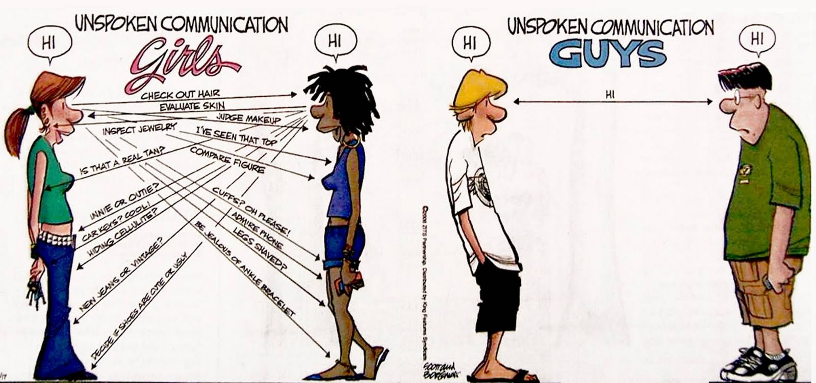

Notes:
8

Slide 9
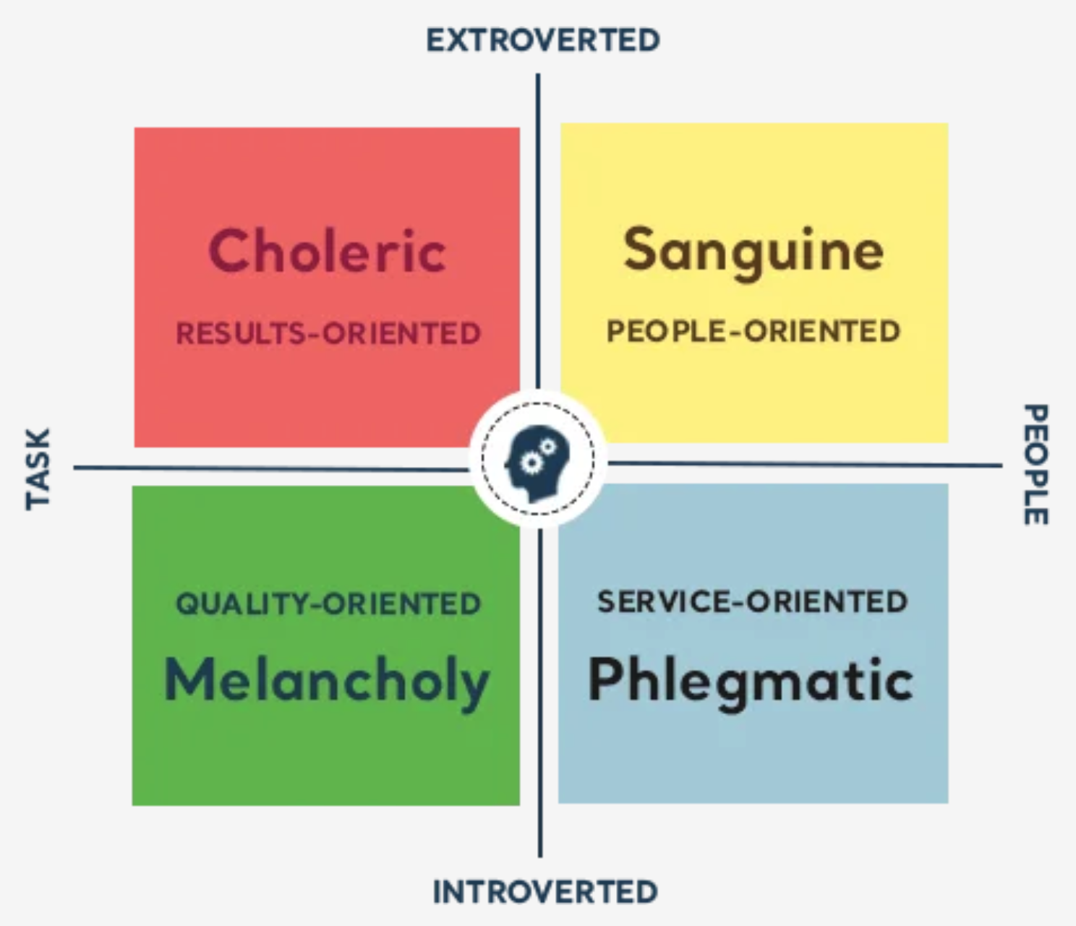
4 Temperament Needs
Notes:
9

Slide 10
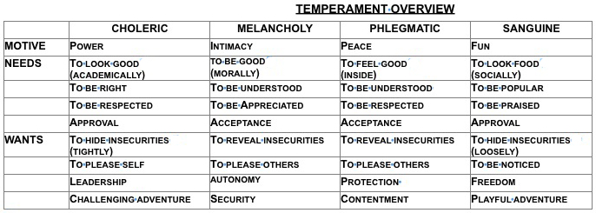

4 Temperament Needs
Notes:
10

Slide 11
God Loves You

Slide 12
“Because that’s what intimacy is: it’s a willingness to be vulnerable, a willingness to bite my tongue and a willingness to set an example of what I believe in.”
Diane Lane

Slide 13
Vulnerability is not a weakness
Notes:
13

Slide 14
What are the questions Dr. Brown suggests are the 2 most dangerous questions?
a) Who is at fault?
b) What should i fear?
c) What will i do with my life?
What is a mentality of “scarcity” culture?
a) Never EXTRAORDINARY enough
b) Never HAPPY enough
c) Never GOOD enough
What are the “normal” ways we cope with scarcity?
a) Armor up
b) Drugs & alcohol
c) Surrender (to a higher power)

Slide 15
Empathy . . .
a) Fuels connection
b) Is feeling for someone
c) Is feeling with someone
Sympathy . . .
a) Is where you connect with someone
b) Drives dis-connection
c) Is feeling for someone
Dr. Brown’s definition of blame?
a) Holding someone accountable for what has happened
b) Discharging of discomfort and pain (anger)
c) Gives the ILLUSION of control

Slide 16
What one response is NOT a helpful response
a) “at least . . .”
b) “wow, that must be . . .”
c) “———” (nothing)
Describe her distinction of empathy vs sympathy in the “well” example
How might these insights be integrated with what you know about personalities/temperaments/gender roles?

Slide 17
Notes:
17

Slide 18
God Loves You

Slide 19
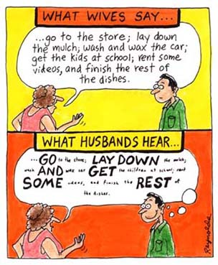
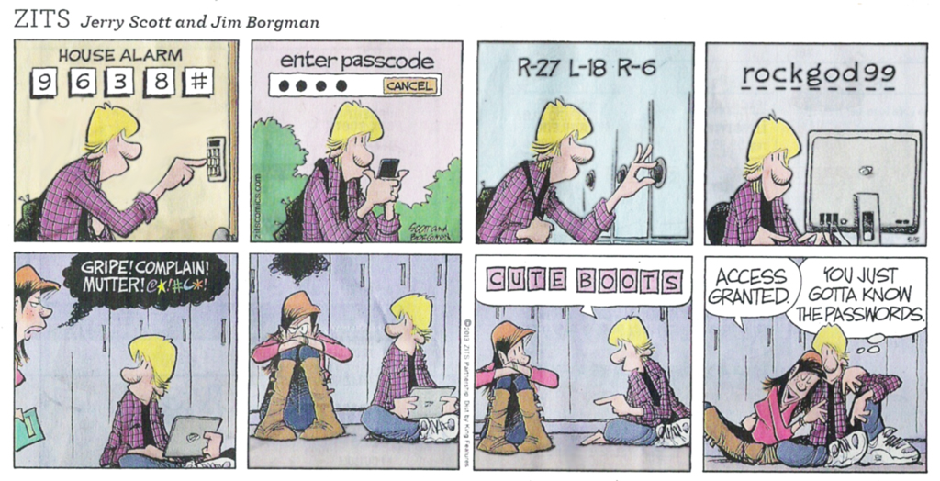
Communication is a good place to start with understanding. Clarify the terms

Slide 20
Notes:
20

Slide 21
God Loves You

Slide 22
God Loves You
Notes:
22

Slide 23
Notes:
23

