Slide 1
God Loves You

Slide 2
Except the Lord build the house, they labour in vain that build it: except the Lord keep the city, the watchman waketh but in vain.
Psalm 127:1 (KJV)

Slide 3
Unless the Lord builds the house, the builders labor in vain. Unless the Lord watches over the city, the guards stand watch in vain.
Psalm 127:1 (NIV)

Slide 4

Group yourselves in pairs with an opposite Example: sanguine with melancholy or choleric with phlegmatic. Or ENTJ and ISFP
2) draw Jimney Cricket

Slide 5
Read chapter 10 pages 117-120 before Tomorrow (Tuesday!). Be ready to discuss in class the rest of the week. Discussion points!
Chapter 10: Keeping Between the Lines

Slide 6
reading
Pgs 116-127
Notes:
6

Slide 7

What might be some emotional “guardrails” for you? What are some boundaries you might need to set for yourself?
What are boundaries issues you HAVE set (or need to?) on relationship issues against you?
What are some practical suggestions for maintaining your own integrity? (buddy call, random checks, software protection)
What is your plan for your relationship when you get into a mess? How will you know when you are in a mess?
What are other boundary issues in relationships?
Notes:
7

Slide 8
Notes:
8

Slide 9
God Loves You
Notes:
9

Slide 10
“If you age with somebody, you go through so many roles - you're lovers, friends, enemies, colleagues, strangers; you're brother and sister. That's what intimacy is, if you're with your soulmate.”
Cate Blanchett

Slide 11
Boundaries of pride can damage ourselves
Notes:
11

Slide 12
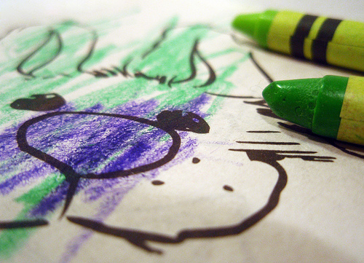
Drawing on our line illustration (pun!)

Slide 13
What areas of life does the book suggest we need boundaries for?
a) physical
b) emotional
c) financial
Some personalities need more boundaries than others
a) False
b) True
c) Don’t know
What were some lessons learned with the drawing?
a) Lines are important guides
b) Some personalities are better at drawing than others
c) Having a model to aim for is helpful

Slide 14
reading
Pgs 116-127
Notes:
14

Slide 15
Notes:
15

Slide 16
God Loves You
Notes:
16

Slide 17
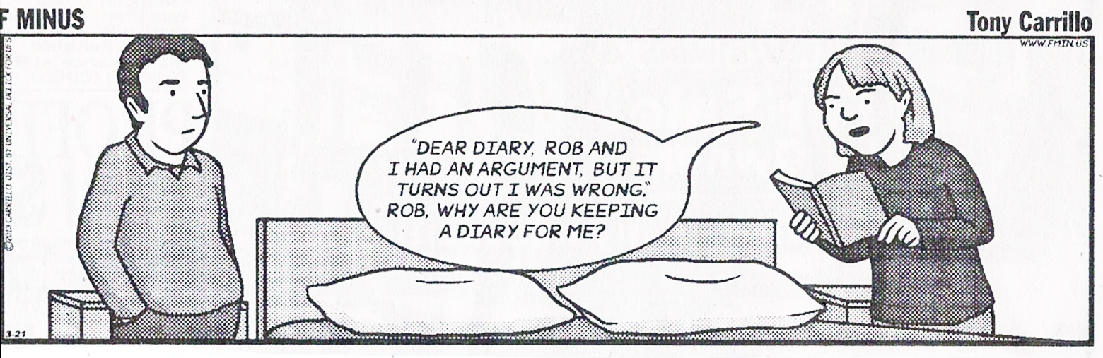
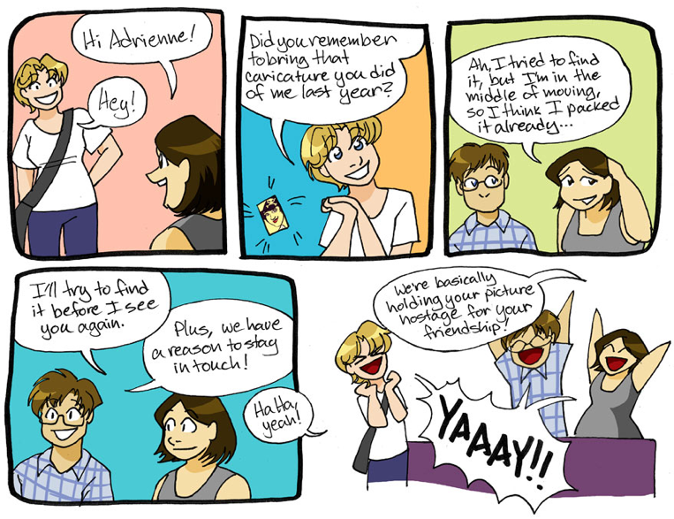
Boundaries . . .

Slide 18
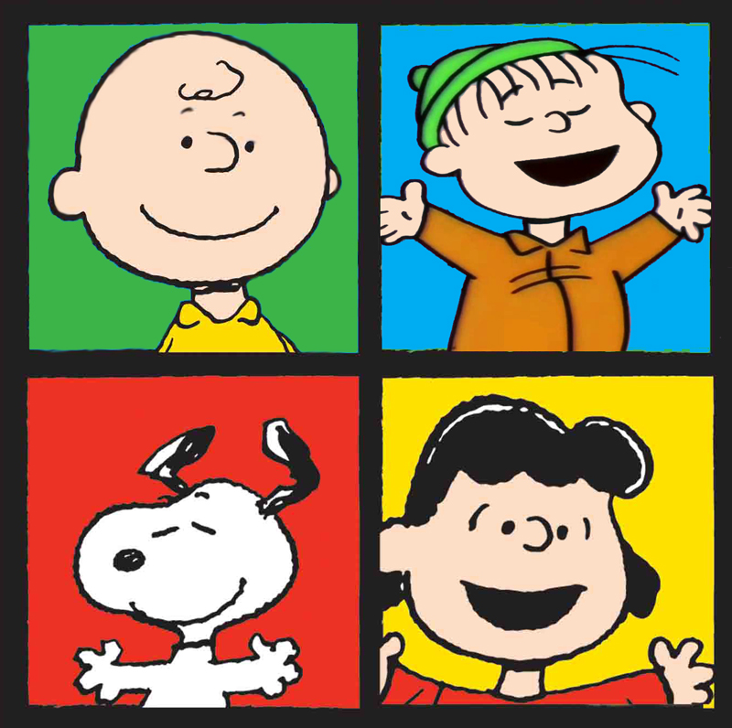
Group yourselves:
Question 1:
What was your favorite family vacation?
Question 2:
What’s one thing you’ve done that you’d like to erase?
Question 3:
What would you like to be famous for someday?
Question 4:
Would you keep a secret if you know someone would get hurt if you did?
Phlegmatic
Melancholy
Sanguine
Choleric

Slide 19
Notes:
19

Slide 20
God Loves You

Slide 21
Notes:
21

Slide 22
God Loves You
Notes:
22

Slide 23
Notes:
23

