Slide 1
God Loves You

Slide 2
And Jesus answered him, The first of all the commandments is, Hear, O Israel; The Lord our God is one Lord: And thou shalt love the Lord thy God with all thy heart, and with all thy soul, and with all thy mind, and with all thy strength: this is the first commandment. And the second is like, namely this, Thou shalt love thy neighbour as thyself. There is none other commandment greater than these. And the scribe said unto him, Well, Master, thou hast said the truth: for there is one God; and there is none other but he: And to love him with all the heart, and with all the understanding, and with all the soul, and with all the strength, and to love his neighbour as himself, is more than all whole burnt offerings and sacrifices.
Mark 12:29-33 (KJV)

Slide 3
The most important one,” answered Jesus, “is this: ‘Hear, O Israel: The Lord our God, the Lord is one. Love the Lord your God with all your heart and with all your soul and with all your mind and with all your strength.’ The second is this: ‘Love your neighbor as yourself.’ There is no commandment greater than these.” “Well said, teacher,” the man replied. “You are right in saying that God is one and there is no other but him. To love him with all your heart, with all your understanding and with all your strength, and to love your neighbor as yourself is more important than all burnt offerings and sacrifices.”
Mark 12:29-33 (NIV)

Slide 4
This week MV submission: Comic
Minimum of 8 panels telling or illustrating the passage!

Slide 5
Examples
Notes:
5

Slide 6
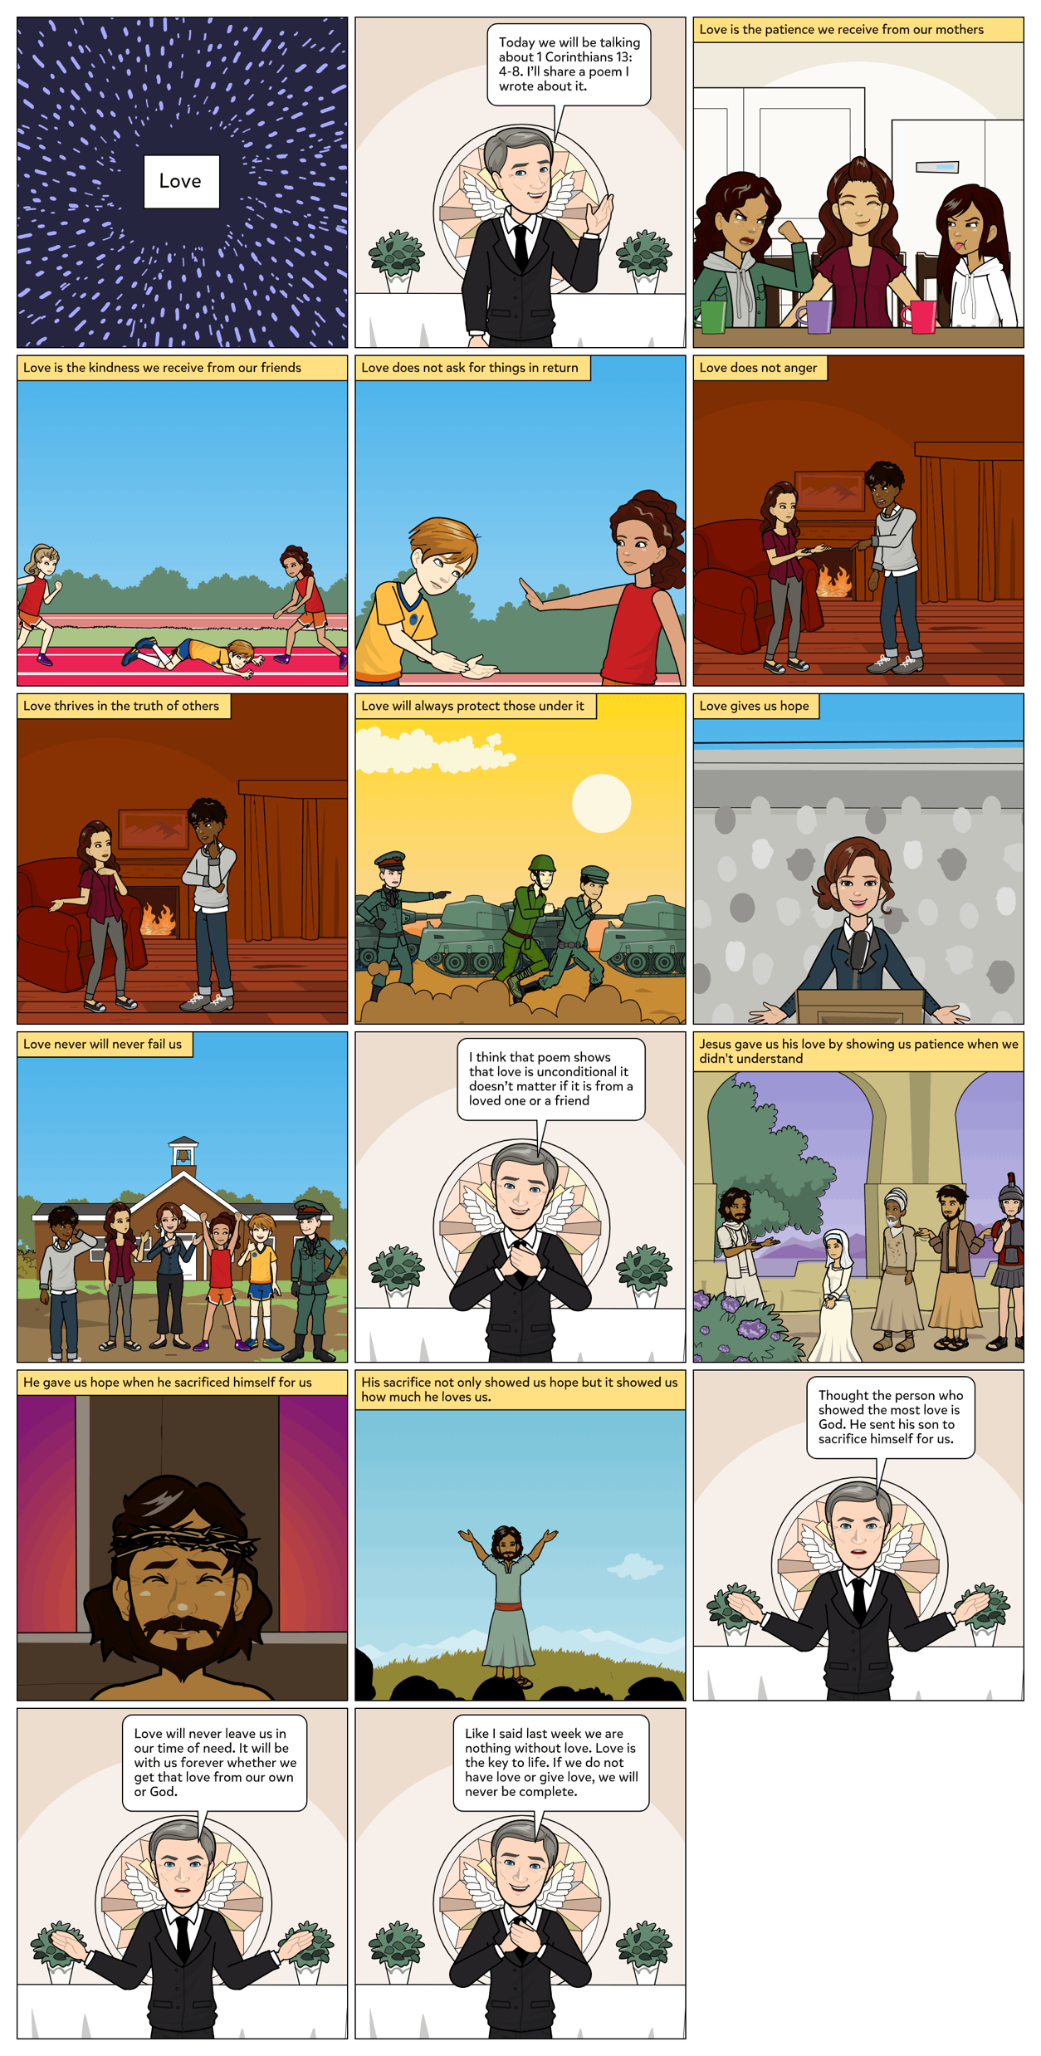
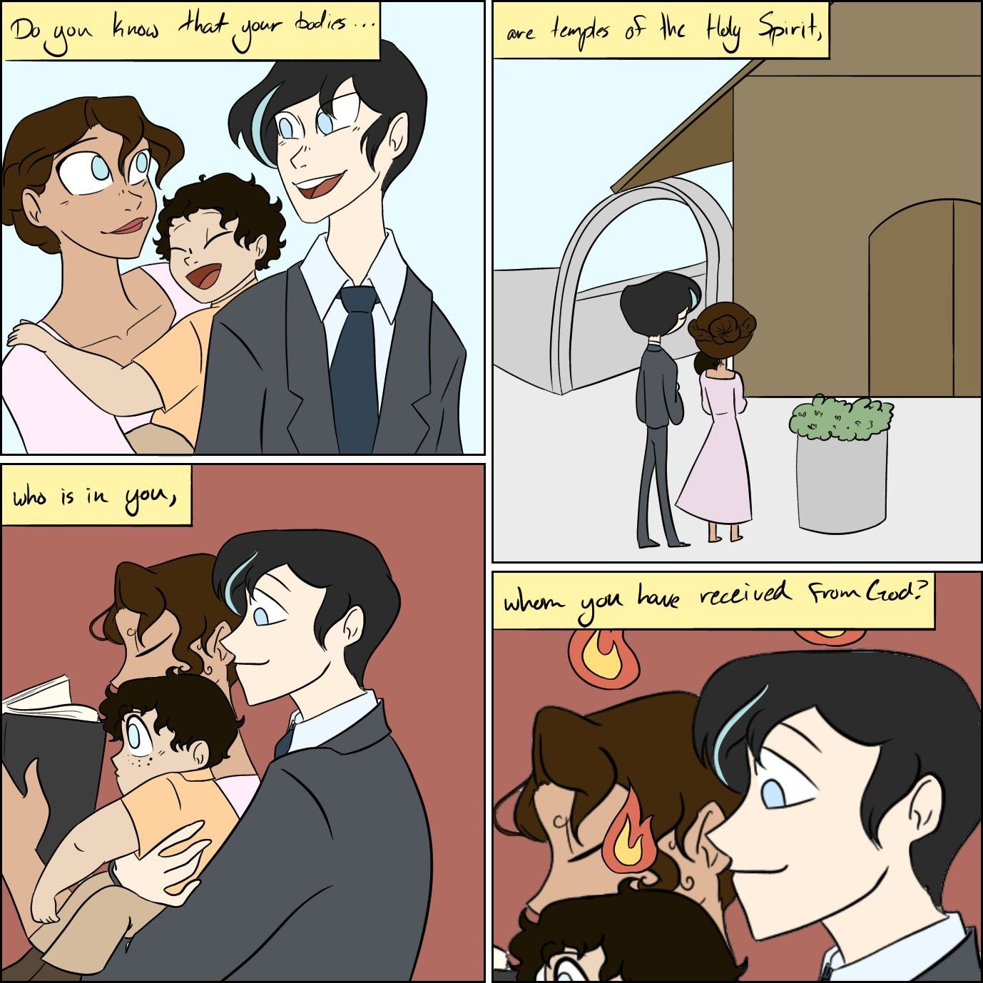
Notes:
6

Slide 7

What does it mean “obedience is love in action”?
What are some limits we should put on our compassion, friendships, love?
What is something you can do for someone this week (that they don’t have to know about)
How does it feel when someone does something unexpected for you?
How (give examples) is Christ right when saying what we do is more important than how we worship?
Notes:
7

Slide 8


Activity
Service project
Notes:
8

Slide 9


A Man Called Norman
25 min
Notes:
9

Slide 10
Notes:
10

Slide 11
God Loves You
Notes:
11

Slide 12
Activity
Service project
Notes:
12

Slide 13
A Man Called Norman
25 min
Notes:
13

Slide 14
Notes:
14

Slide 15
God Loves You
Notes:
15

Slide 16
A Man Called Norman
end
Notes:
16

Slide 17

Journaling
Norman is different from others and that is perhaps why they shun him. Have you ever felt like an “outsider” and experienced being treated like Norman? Where/when/how? Detail situation.
Have you ever been like Mike and treated someone different as a friend when others rejected them? Detail situation.
Choose someone to befriend outside of your regular circle of friends for an event. Report on situation.
Notes:
17

Slide 18
Notes:
18

Slide 19
God Loves You

Slide 20
Good Afternoon
Guided Learning Exercise
Finish Notes for Week
Notes:
20

Slide 21
Notes:
21

