Slide 1
God Loves You
Notes:
1

Slide 2
“When a boy turns 13, seal him in a barrel and feed him through a knot hole.
When he turns 16, plug up the hole.”
Samuel Clemens

Slide 3
A word fitly spoken is like apples of gold in pictures of silver.
Proverbs 25:11 (KJV)
Pleasant words are as an honeycomb, sweet to the soul, and health to the bones.
Proverbs 16:24 (KJV)

Slide 4
Like apples of gold in settings of silver is a ruling rightly given.
Proverbs 25:11 (NIV)
Gracious words are a honeycomb, sweet to the soul and healing to the bones.
Proverbs 16:24 (NIV)

Slide 5
This week MV submission: Memory
Write passage from memory on blank paper

Slide 6
Read chapters 13 & 14 This week. Chapter 13 by tomorrow (Tuesday!) and chapter 14 by Thursday. Be ready to discuss in class the rest of the week. Discussion points!
Chapter 13: Parenting Styles and Discipline
Chapter 14: Parenting Success Strategies

Slide 7
reading
Pgs 156-165
Pgs 166-175
Notes:
7

Slide 8
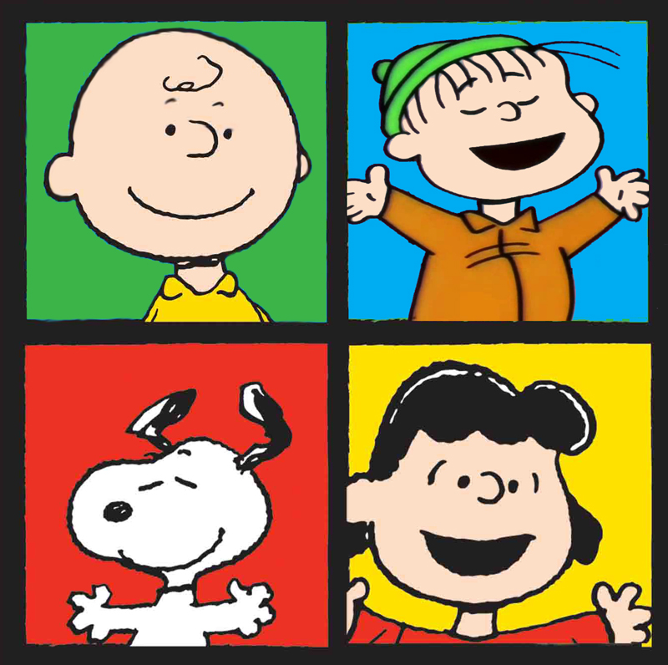
Group yourselves:
Question 1:
Favorite (or very positive) memory of just you and your parents (or parent). No siblings, or others.
Question 2:
Favorite (or very positive) memory of just you and your siblings (or cousins if no siblings). No parents.
Question 3:
Metacognition: WHAT prompted you (do you think) to remember these particular memories? What made them special enough to recall?
Phlegmatic
Melancholy
Sanguine
Choleric

Slide 9
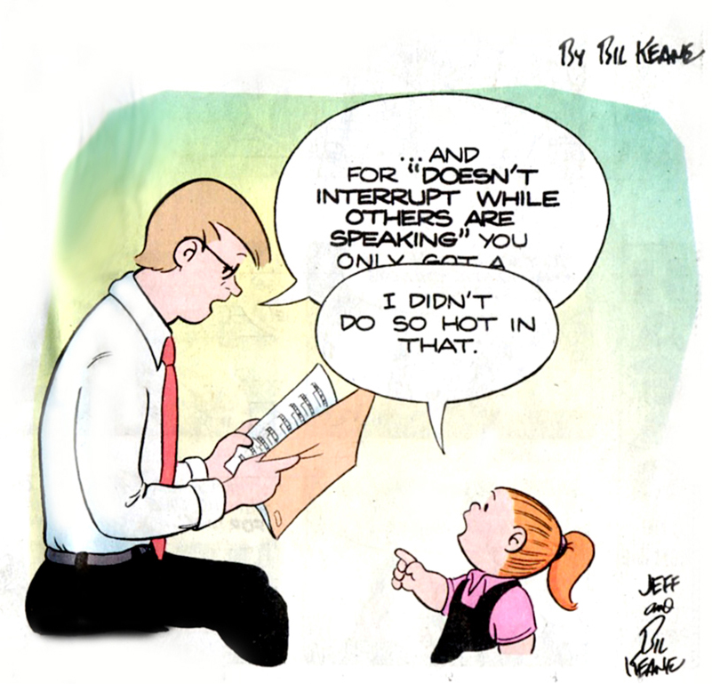
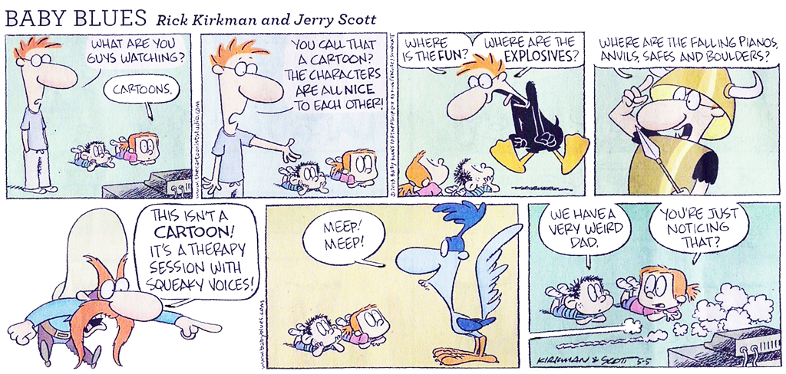
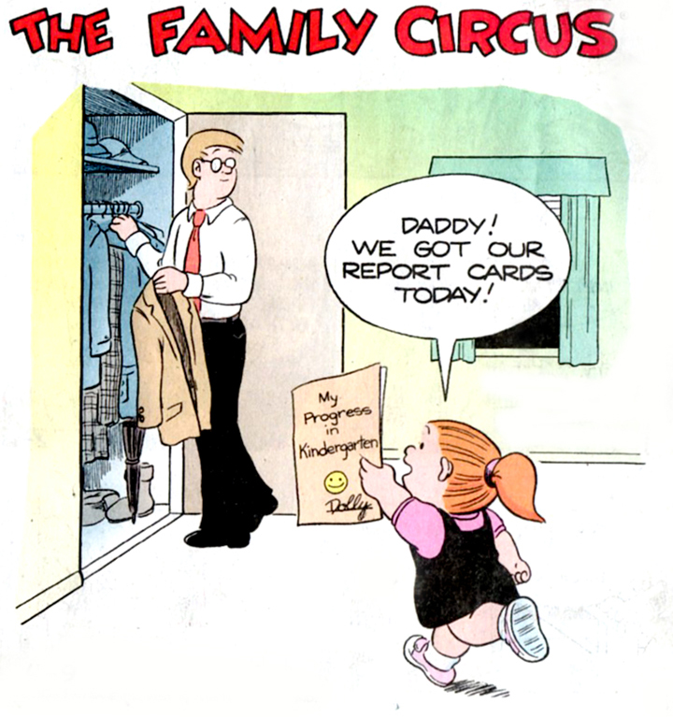
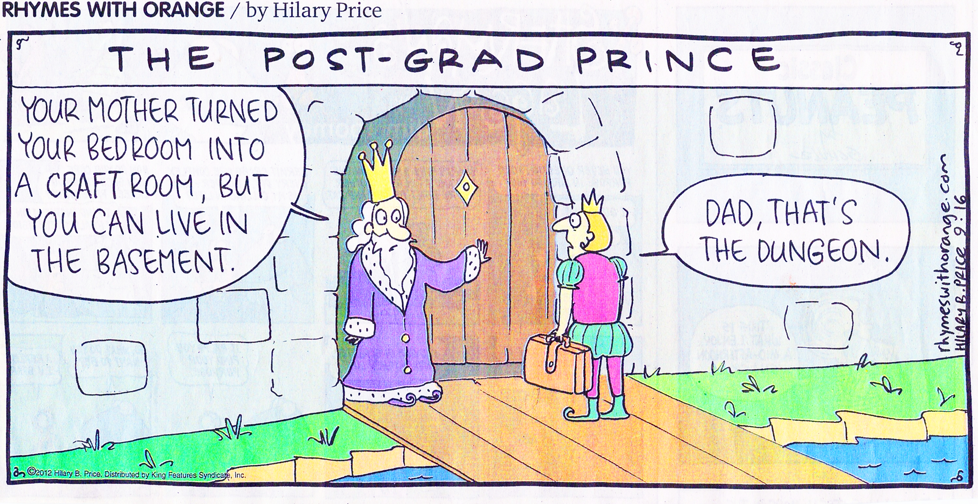
Cartoons with a message

Slide 10
A humorous insight into raising children
Notes:
10

Slide 11
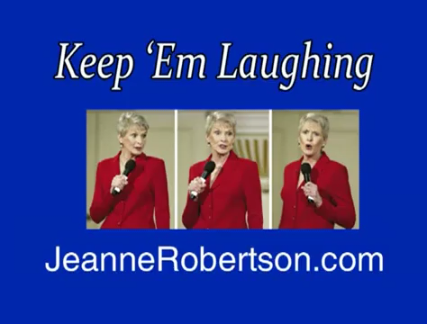
Parenting tips by listening to others . . .
Notes:
11

Slide 12

What might be some emotional “guardrails” for you? What are some boundaries you might need to set for yourself?
What might be boundaries you will need to set for your children (or those in your care)?
What are some practical suggestions for dealing with conflict (avoiding ahead of time, timeouts, etc)
What is your plan for your children when they get into a mess?
What ways (practical) can you deal with “love cup” issues and love language?
Notes:
12

Slide 13
Notes:
13

Slide 14
God Loves You
Notes:
14

Slide 15
“When I was a boy of fourteen, my father was so ignorant I could hardly stand to have the old man around. But when I got to be twenty-one, I was astonished at how much he had learned in seven years.”
attributed to Samuel Clemens

Slide 16
This week MV submission: Memory
Write passage from memory on blank paper

Slide 17
Group yourselves:
Get with an OPPOSITE:
Grab a blindfold. Go for a 10 minute walk. Switch. Take them where ever you wish (try to be considerate of their condition). When blindfolded, resist the temptation to try and look. Work hard at trusting your partner.
Phlegmatic
Melancholy
Sanguine
Choleric

Slide 18
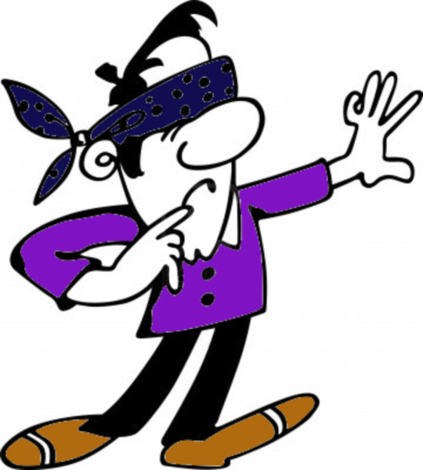
Lessons learned:
As a leader:
You have to remember their weakness (they can’t see, they take smaller steps, verbal directions are somewhat unclear).
As a leader:
What style you use needs to adapt to the person you are leading and can change. You need to be hyper-observant about the surroundings.
As a follower:
You have to listen carefully to the instructions of your guide.
As a follower:
Trust is difficult at first. It can get easier if kept safe. If trust is broken the follower will begin to self-protect.

Slide 19
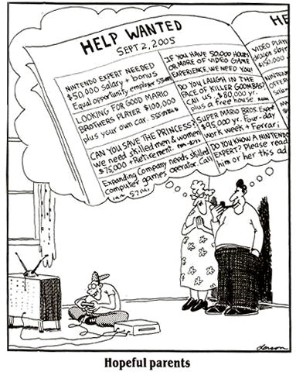
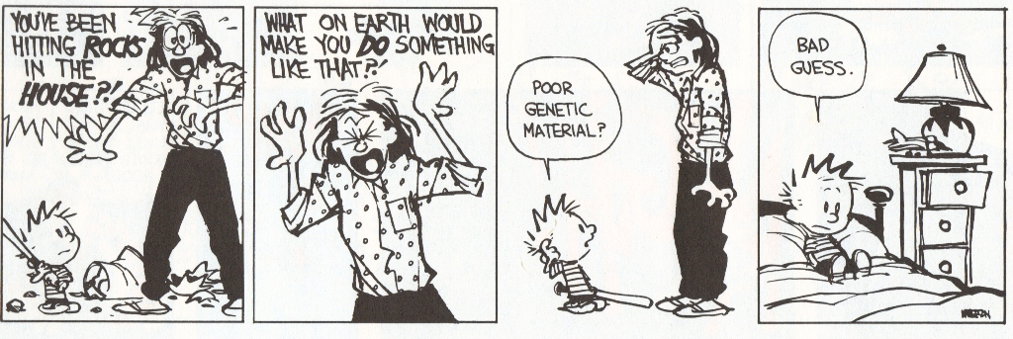
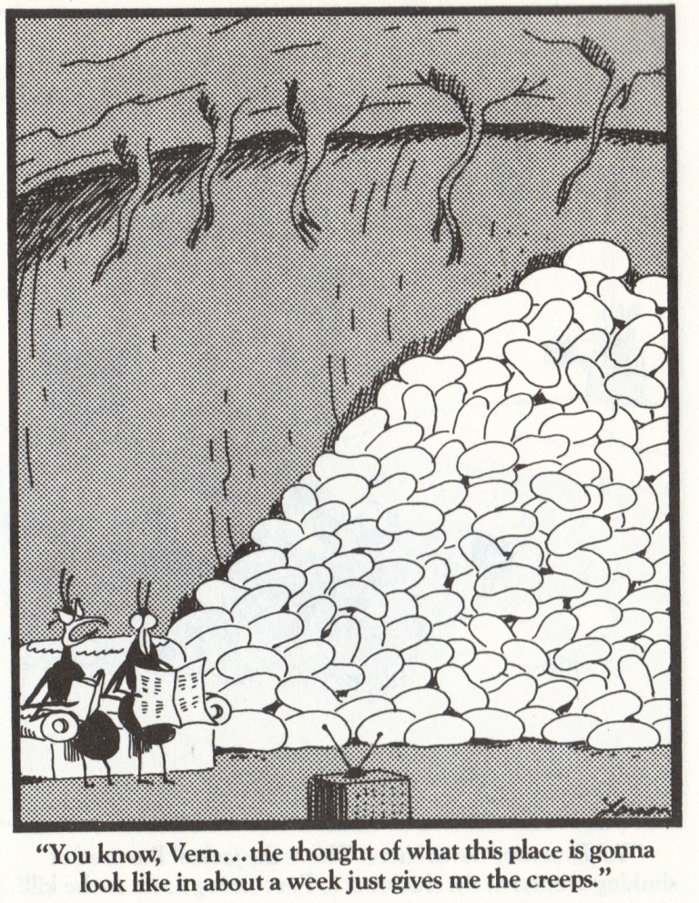
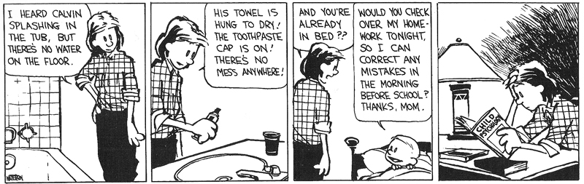
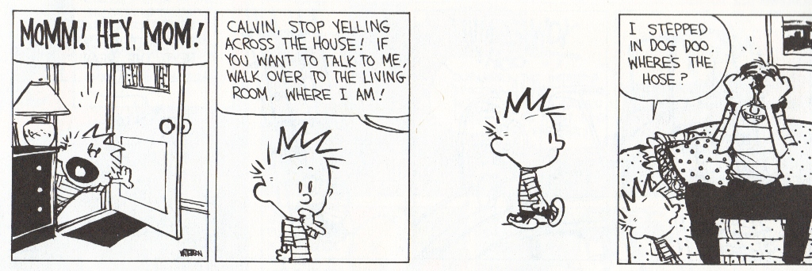
Cartoons with a message

Slide 20
Boundaries are taught in parenting (modeled)
Notes:
20

Slide 21
What is the child’s initial reaction to his father’s venom
a) confused
b) excited
c) disgust
The child begins to copy his dad
a) False
b) True
c) Don’t know
What happens when “peewee” Reese comes over to Jackie Robinson (#42)
a) The crowd mood changes for a more positive
b) The boy only gets louder
c) The boy stops and reassess his father

Slide 22
Read chapters 13 & 14 This week. Chapter 13 discussion today! Discussion points.
Chapter 13: Parenting Styles and Discipline
Chapter 14: Parenting Success Strategies

Slide 23
reading
Pgs 156-165
Pgs 166-175
Notes:
23

Slide 24
Notes:
24

Slide 25
God Loves You
Notes:
25

Slide 26
“The most important thing a father can do for his children is to love their mother.”
Theodore Hesburgh

Slide 27
“The object of discipline is the training of the child for self-government. He should be taught self-reliance and self-control.”
Ellen G. White, EDUCATION, chp 34

Slide 28
A word fitly spoken is like apples of gold in pictures of silver.
Proverbs 25:11 (KJV)
Pleasant words are as an honeycomb, sweet to the soul, and health to the bones.
Proverbs 16:24 (KJV)

Slide 29
Like apples of gold in settings of silver is a ruling rightly given.
Proverbs 25:11 (NIV)
Gracious words are a honeycomb, sweet to the soul and healing to the bones.
Proverbs 16:24 (NIV)

Slide 30
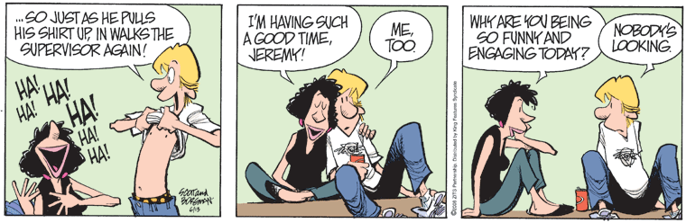
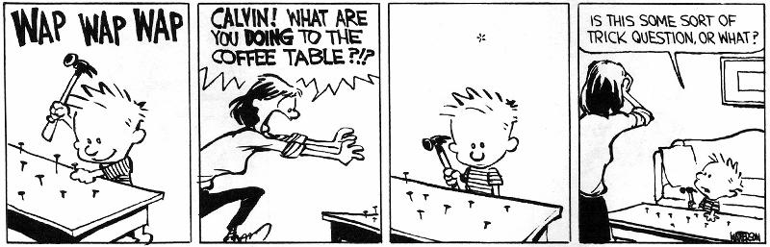
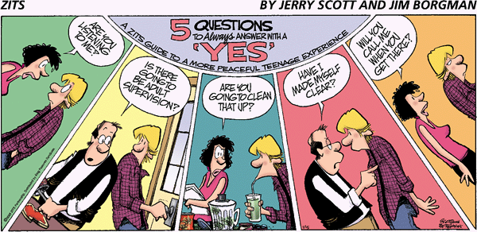
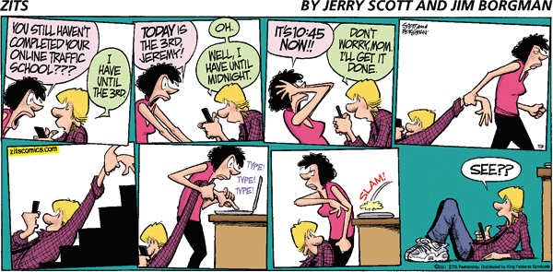
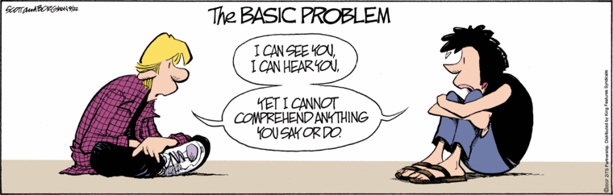
Cartoons with a message

Slide 31
Following your passion—including them
Notes:
31

Slide 32
A little humorous look at the generational differences
Notes:
32

Slide 33

Journaling
1. Read the EGW excerpt (link on website) regarding discipline. Give a one page reaction. What you noticed. What you liked/unsure of. Keep in mind this is written to teachers regarding classroom management, but what principles might apply to parenting as well?
Notes:
33

Slide 34
Group yourselves with a buddy:
Work on questionnaire

Slide 35
Notes:
35

Slide 36
God Loves You

Slide 37
“Since the surrender of the will is so much more difficult for some [children] than for others, the [parent] should make obedience to his requirements as easy as possible . . . The will should be guided and moulded, but not ignored or crushed. Save the strength of the will; in the battle of life it will be needed.”
Ellen G. White, EDUCATION, chp 34

Slide 38

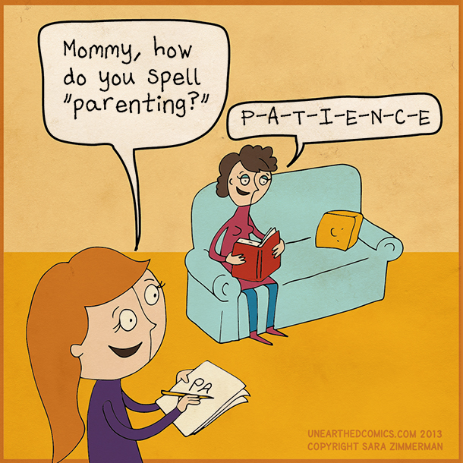
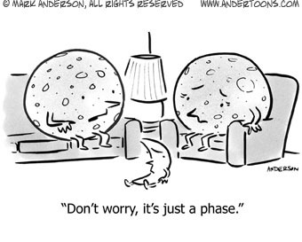
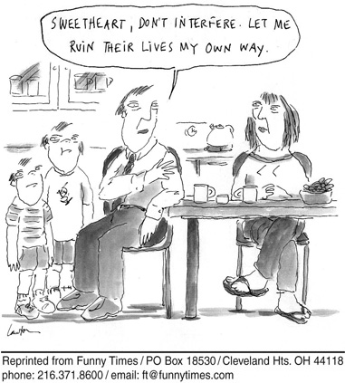
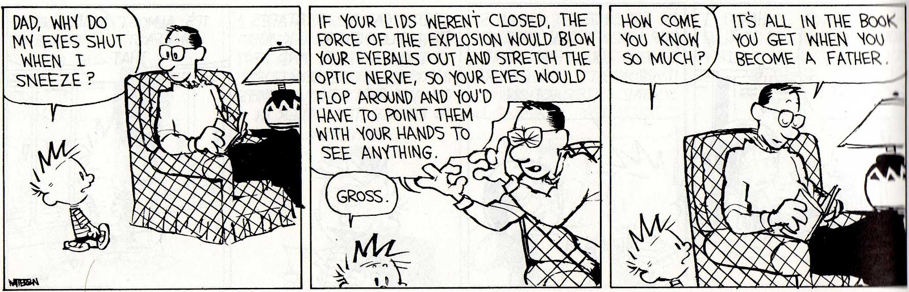
Cartoons with a message

Slide 39
Notes:
39

Slide 40
God Loves You
Notes:
40

Slide 41
Notes:
41

