Slide 1
God Loves You
Notes:
1

Slide 2
“Everyone knows what falling in love is like but being in love is what people have lost.”
Mark Polish

Slide 3
And grieve not the holy Spirit of God, whereby ye are sealed unto the day of redemption. Let all bitterness, and wrath, and anger, and clamour, and evil speaking, be put away from you, with all malice: And be ye kind one to another, tenderhearted, forgiving one another, even as God for Christ's sake hath forgiven you.
Ephesians 4:30-32 (KJV)

Slide 4
And do not grieve the Holy Spirit of God, with whom you were sealed for the day of redemption. Get rid of all bitterness, rage and anger, brawling and slander, along with every form of malice. Be kind and compassionate to one another, forgiving each other, just as in Christ God forgave you.
Ephesians 4:30-32 (NIV)

Slide 5
Word choices
Grieve
Sealed
Slander
Compassionate
Notes:
5

Slide 6
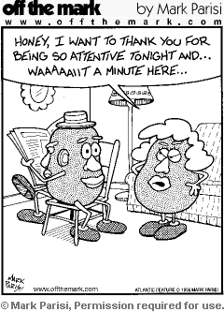
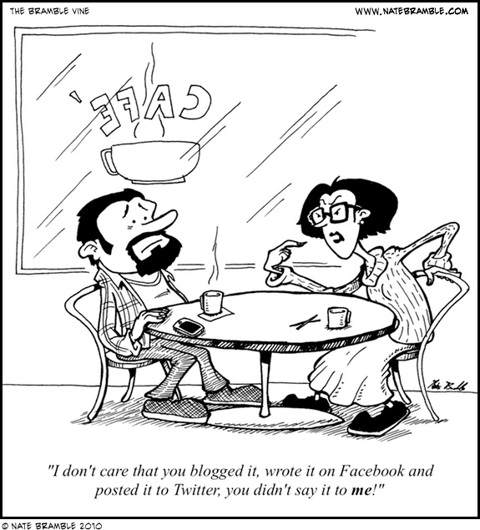
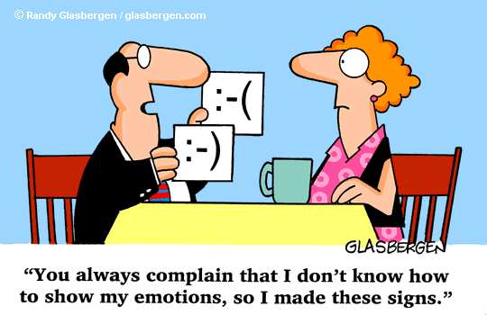
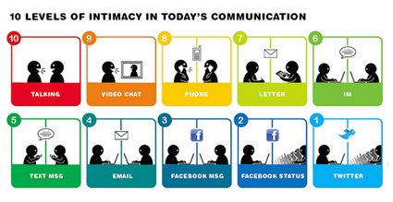
Real intimacy starts before the bedroom

Slide 7
Read chapter 3 this week. Chapter 3--first half-by tomorrow (Tuesday!) and the rest by Thursday. Be ready to discuss in class the rest of the week. Discussion points!
Chapter 3: The Sex Trap

Slide 8
reading
Pgs 28-41
Notes:
8

Slide 9

When is a rose a rose?
Notes:
9

Slide 10
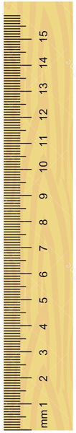
Outside experiment

Slide 11



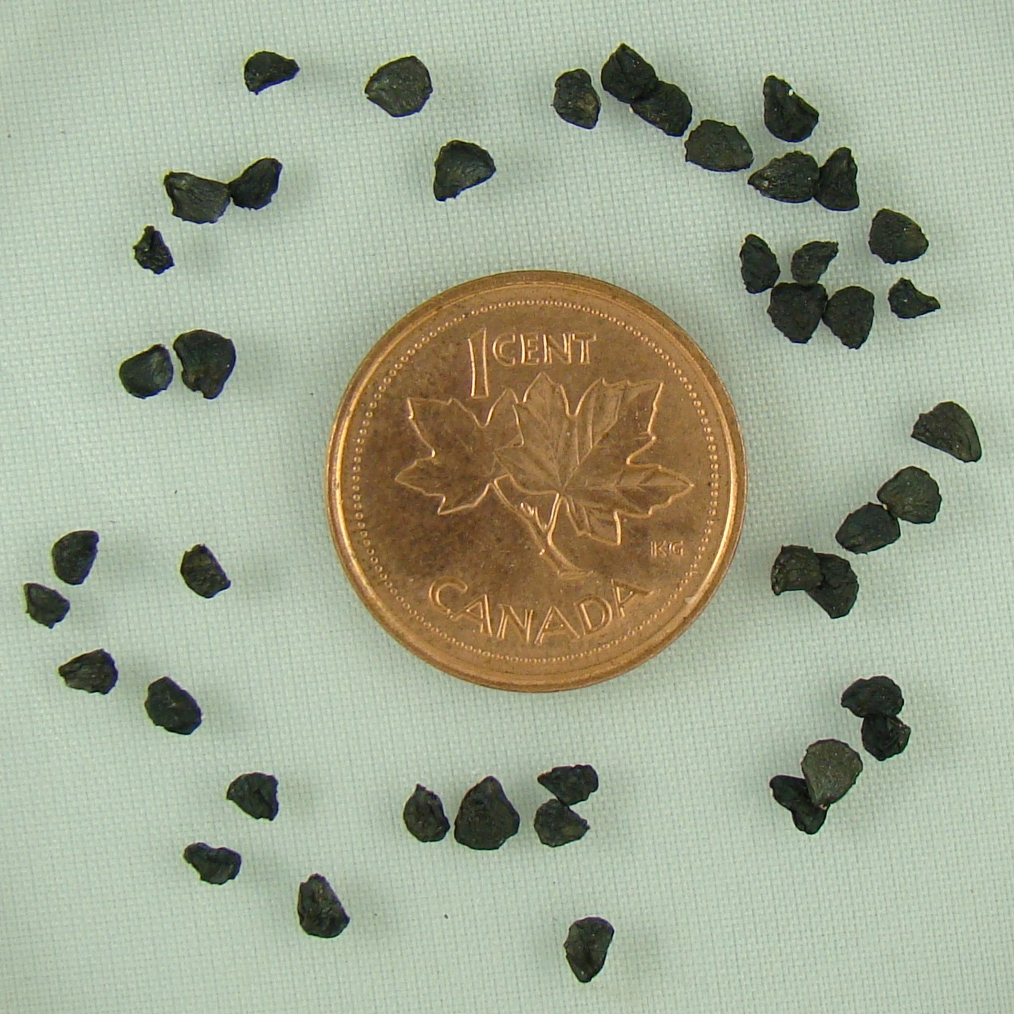
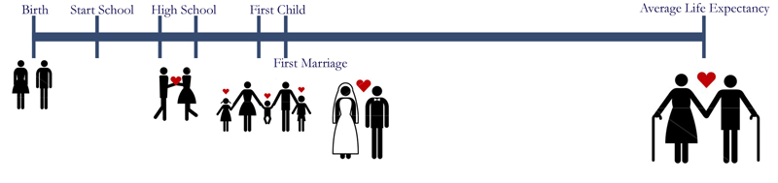
Notes:
11

Slide 12
Timeline Lessons learned:
Time is key:
Relationships take time. There is no instant cure.
Life need not be rushed:
You are “not missing the boat” or “being left behind.” There has never been a YOU before.
Decisions last:
The consequences of decisions are forever. That’s a long time.
Remember the scale:
Try to visualize where you are relative to the real size of life-even here on this planet.

Slide 13
Notes:
13

Slide 14
God Loves You
Notes:
14

Slide 15
“Intimacy, as I am using it, is sharing my reality with you.”
Keith Miller

Slide 16
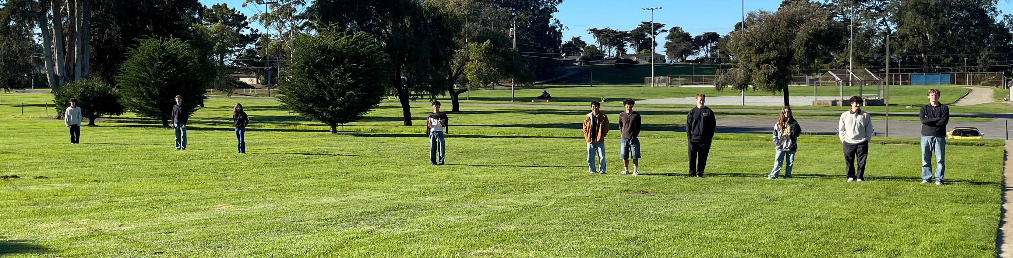
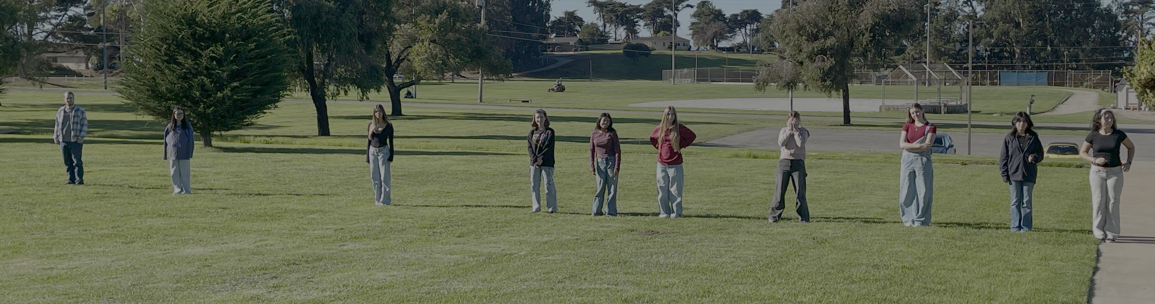
Outside experiment

Slide 17
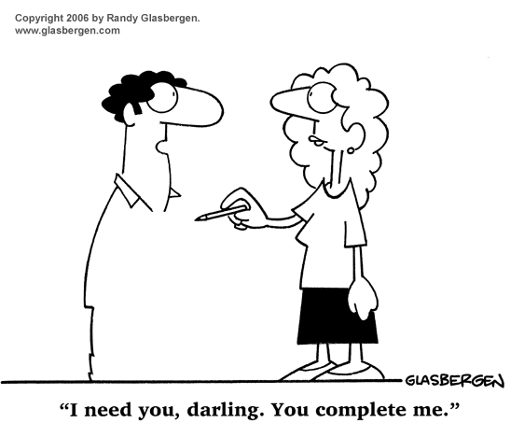

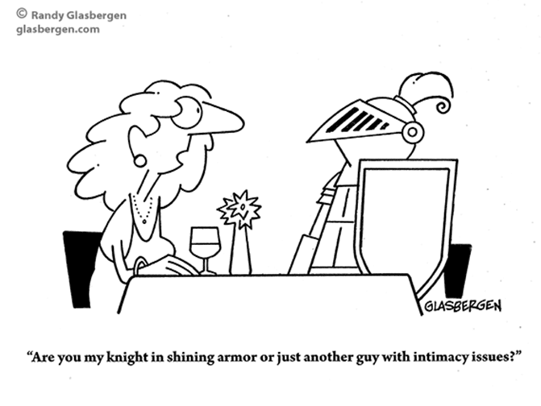
Real intimacy is built on something substantial

Slide 18
True love, waits, is long-suffering and never fails
Notes:
18

Slide 19
Read chapter 3 this week. Chapter 3--first half-by tomorrow (Tuesday!) and the rest by Thursday. Be ready to discuss in class the rest of the week. Discussion points!
Chapter 3: The Sex Trap

Slide 20
reading
Pgs 28-41
Notes:
20

Slide 21


Group in sets of four, if possible 2 boys & 2 girls:
male
Q1 / D1:
Read: MM, Dirty Little Secrets (near bottom). What are your reactions? Blasé? Disbelief? What might the implications be for a marriage relationship if this has been the experience of the people?
Q2 / D2:
Read: Sex and Meat Loaf (near top). What are your reactions? Blasé? Disbelief? What insights did you gain from the research reported? What are some PRACTICAL suggestions for people who want to wait?
female

Slide 22
Notes:
22

Slide 23
God Loves You
Notes:
23

Slide 24
“Among men, sex sometimes results in intimacy; among women, intimacy sometimes results in sex.”
Barbara Cartland

Slide 25
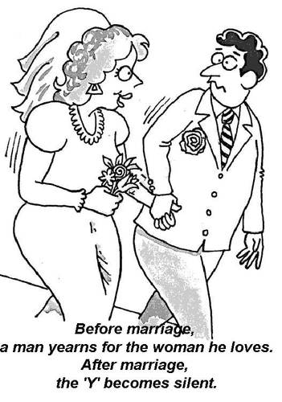

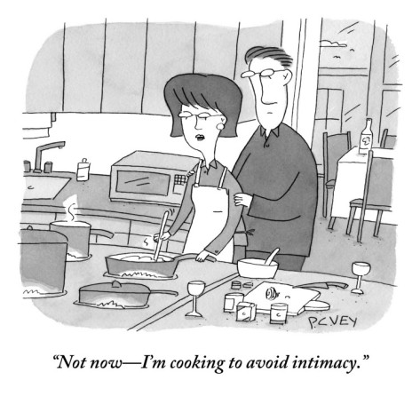
Beware what supplants real intimacy

Slide 26
Intimacy depends on relational context
Notes:
26

Slide 27
Real intimacy cannot happen when the relationship does not exist
Notes:
27

Slide 28
Intimacy must consider all aspects of a person-ality
Notes:
28

Slide 29

Journaling
1. Read and react to several of the articles posted on marriage, sexuality, dating, and divorce posted on my site for you to read.
Notes:
29

Slide 30
Notes:
30

Slide 31
God Loves You

Slide 32
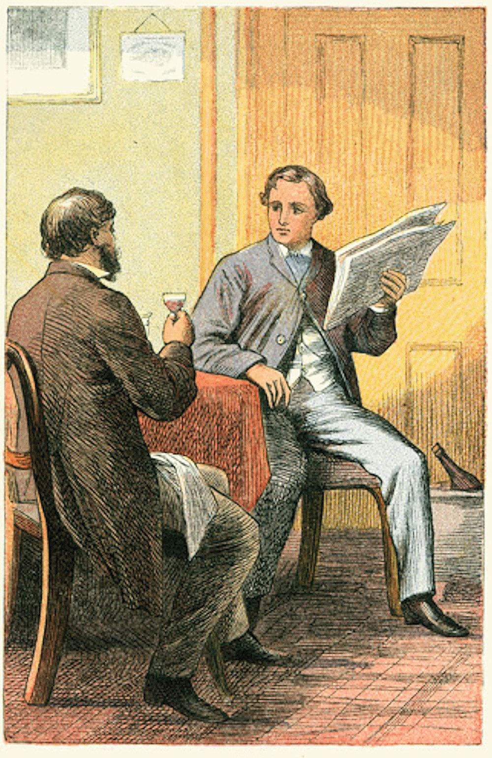
Discussion
Questions/answers/meanderings . . .
Notes:
32

Slide 33
Notes:
33

Slide 34
God Loves You
Notes:
34

Slide 35
Discussion
Questions/answers/meanderings . . .
Notes:
35

Slide 36
Notes:
36

