Slide 1
God Loves You
Notes:
1

Slide 2
“Most people are slow to champion love because they fear the transformation it brings into their lives. And make no mistake about it: love does take over and transform the schemes and operations of our egos in a very mighty way.”
Aberjhani

Slide 3
Wherefore be ye not unwise, but understanding what the will of the Lord is. And be not drunk with wine, wherein is excess; but be filled with the Spirit; Speaking to yourselves in psalms and hymns and spiritual songs, singing and making melody in your heart to the Lord; Giving thanks always for all things unto God and the Father in the name of our Lord Jesus Christ; Submitting yourselves one to another in the fear of God.
Ephesians 5:17-21 (KJV)

Slide 4
Therefore do not be foolish, but understand what the Lord’s will is. Do not get drunk on wine, which leads to debauchery. Instead, be filled with the Spirit, speaking to one another with psalms, hymns, and songs from the Spirit. Sing and make music from your heart to the Lord, always giving thanks to God the Father for everything, in the name of our Lord Jesus Christ. Submit to one another out of reverence for Christ.
Ephesians 5:17-21 (NIV)

Slide 5
For, brethren, ye have been called unto liberty; only use not liberty for an occasion to the flesh, but by love serve one another. For all the law is fulfilled in one word, even in this; Thou shalt love thy neighbour as thyself but if ye bite and devour one another, take heed that ye be not consumed one of another . . . But the fruit of the Spirit is love, joy, peace, longsuffering, gentleness, goodness, faith, Meekness, temperance: against such there is no law.
Galatians 5:13-15, 22-23 (KJV)

Slide 6
You, my brothers and sisters, were called to be free. But do not use your freedom to indulge the flesh; rather, serve one another humbly in love. For the entire law is fulfilled in keeping this one command: “Love your neighbor as yourself.” If you bite and devour each other, watch out or you will be destroyed by each other . . . But the fruit of the Spirit is love, joy, peace, forbearance, kindness, goodness, faithfulness, gentleness and self-control. Against such things there is no law.
Galatians 5:13-15, 22-23 (NIV)

Slide 7
Read chapter 5 this week. Be ready to discuss in class Thursday/Friday. Discussion points!
Chapter 5: Sex: God’s Gift

Slide 8
reading
Pgs 54-65
Notes:
8

Slide 9


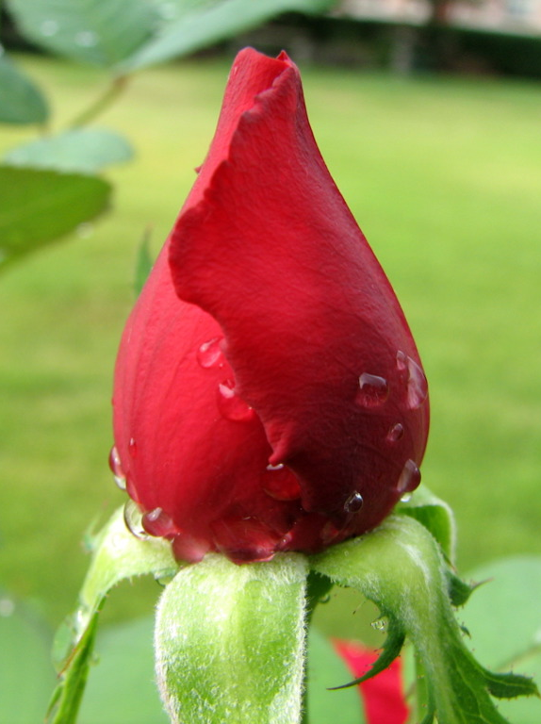
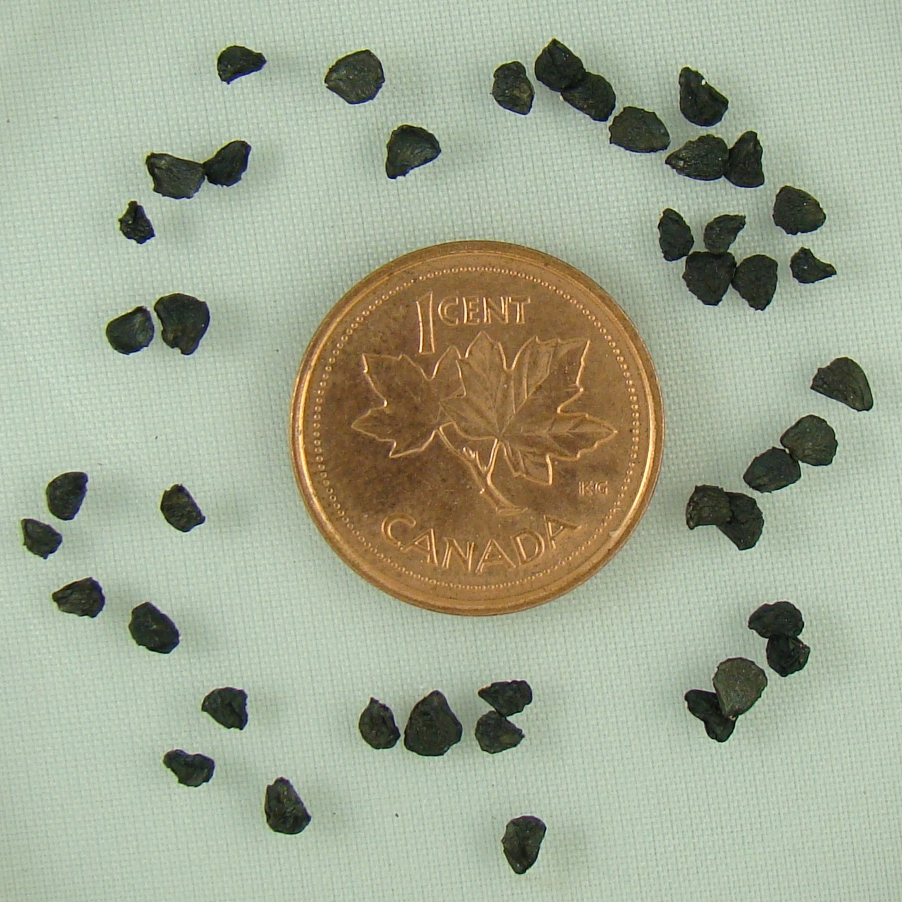
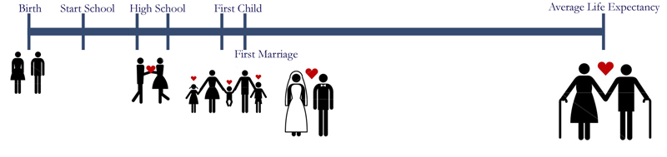
Notes:
9

Slide 10
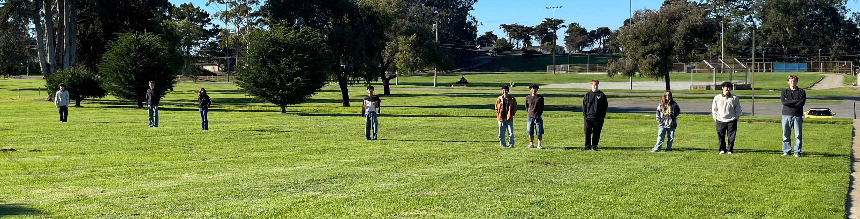
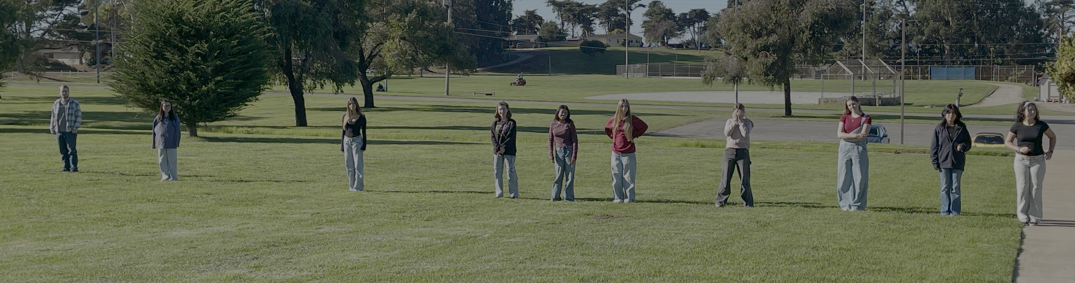
Outside experiment

Slide 11
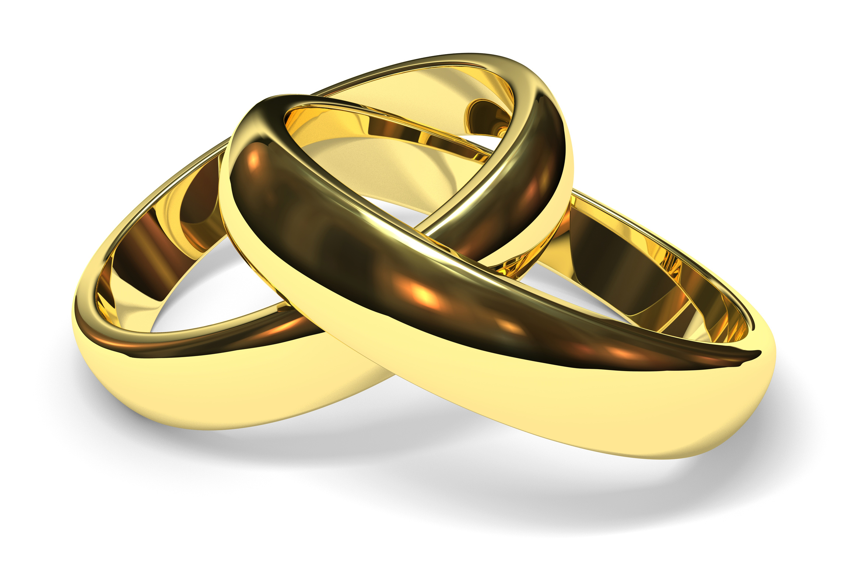
Texts to read
Ephesians 5:21-33:
Note what Paul says is due (owed/offered) to the husband and what is due (owed/offered) to the wife.
SOS chp1-5:
Read with an ear to the poetry of the profound.
SOS PDF interpretation:
Compare to translation.

Slide 12
Articles to read
9 Facts:
Note stats on childbirth related research.
Advice from Divorce Lawyers:
Note what they say they see a lot of (as in causes problems).
Life Partner Attraction:
What do people ACTUALLY settle into?
PDF of 3-Way Marriage:
What are some suggested Biblical models for a successful long-term marriage?

Slide 13
Notes:
13

Slide 14
God Loves You
Notes:
14

Slide 15
“My friends tell me I have an intimacy problem. But they don't really know me.”
Gary Shandling

Slide 16

Journaling
Answer Pg 65:C as a 1 page journal question. Describe in detail. Imagine!
How are you going to keep this dream that you’ve described saved and alive for marriage. You only get one chance . . .
Notes:
16

Slide 17
Notes:
17

Slide 18
God Loves You
Notes:
18

Slide 19
“I'm amazed and disheartened at how quickly adolescents lose their innocence nowadays. Everyone is in such a rush to give themselves over to someone physically without truly knowing the person to whom they are entrusting with their body and emotions.”
Karen Amanda Hooper

Slide 20
Recommended Viewing
Mark Gungor — a tale of two brains

Slide 21
Discussion points!
Ephesians 5:21-33
Chapter 5: Sex: God’s Gift
Song of Songs chps 1-5

Slide 22
Notes:
22

Slide 23
God Loves You

Slide 24
Notes:
24

Slide 25
God Loves You
Notes:
25

Slide 26
Notes:
26

