Slide 1
God Loves You
Notes:
1

Slide 2
“By three methods we may learn wisdom: First, by reflection, which is noblest; Second, by imitation, which is easiest; and third by experience, which is the bitterest.”
Confucius

Slide 3
And God said, Let us make man in our image, after our likeness: and let them have dominion over the fish of the sea, and over the fowl of the air, and over the cattle, and over all the earth, and over every creeping thing that creepeth upon the earth. So God created man in his own image, in the image of God created he him; male and female created he them.
Genesis 1:26-27 (KJV)

Slide 4
Then God said, “Let us make mankind in our image, in our likeness, so that they may rule over the fish in the sea and the birds in the sky, over the livestock and all the wild animals, and over all the creatures that move along the ground.” So God created mankind in his own image, in the image of God he created them; male and female he created them.
Genesis 1:26-27 (NIV)

Slide 5
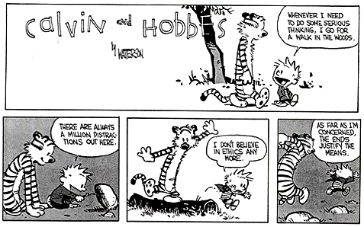
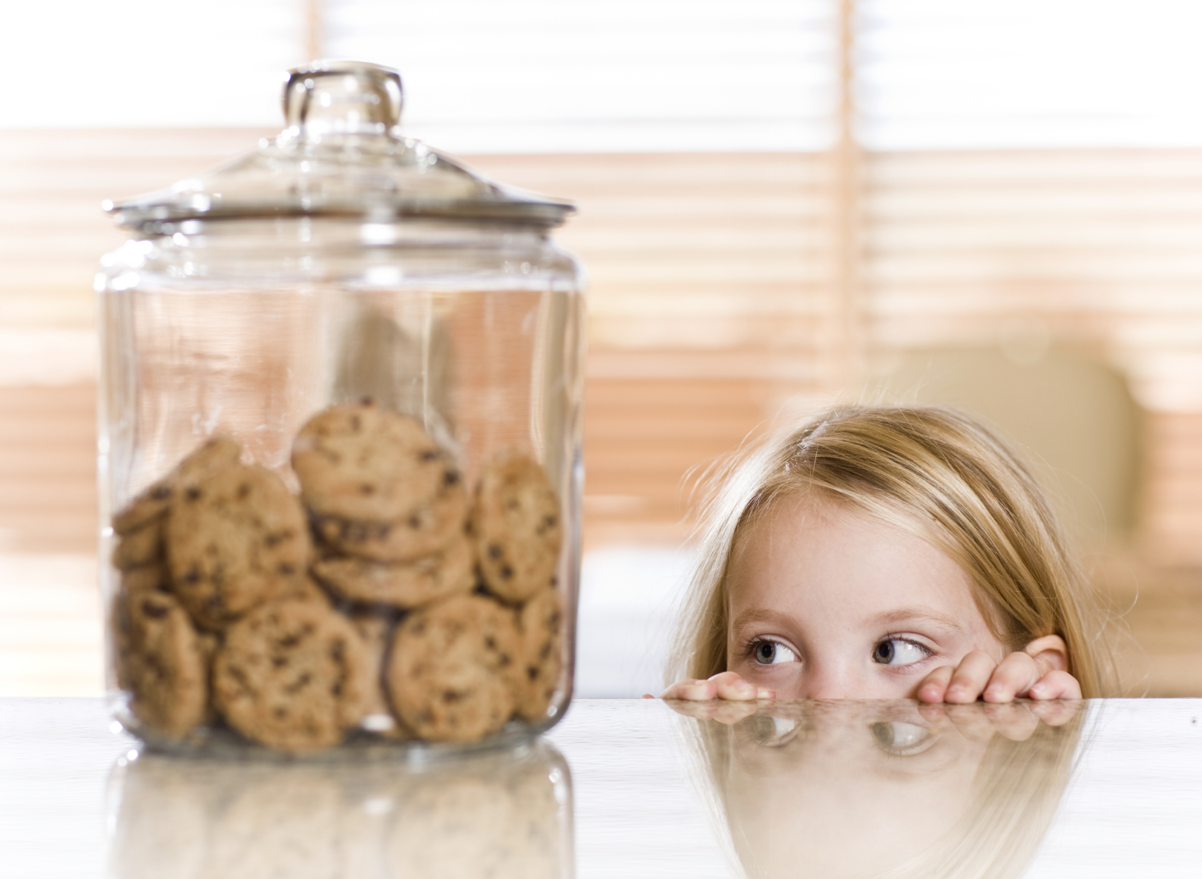
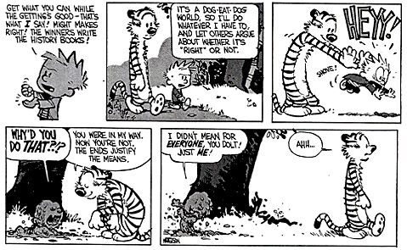
ethics:

Slide 6
What is your worldview?
Notes:
6

Slide 7

Journaling
Read about, describe, and react to the 6 suggested moral paradigms:
a) materialism/atheism
b) pantheism
c) appeasement theism
d) deterministic theism
e) deism
f) benevolent theism
Notes:
7

Slide 8
Read chapters 1, 2 this week. Read/listen to “Mere Christianity” CHP 1. Be familiar with Kohlberg's Moral Development model. All by Thursday. Be ready to discuss in class the rest of the week. Discussion points!
Chapter 2: Created in God’s Image

Slide 9
reading
Pgs 14-19
Notes:
9

Slide 10
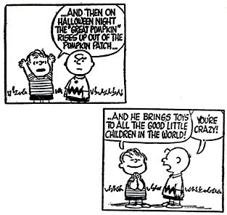
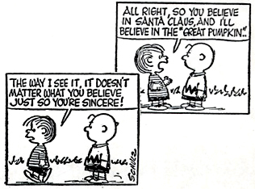
ethics:
A study and application of systems that make it ever increasingly likely to respond in ways nurturing to one’s self, others, and the environment with a view to long-term benefits over short-term gains.
Decisions that are “right” are seen to be so by the overall outcome that best aids all of these goals

Slide 11
Notes:
11

Slide 12
God Loves You
Notes:
12

Slide 13
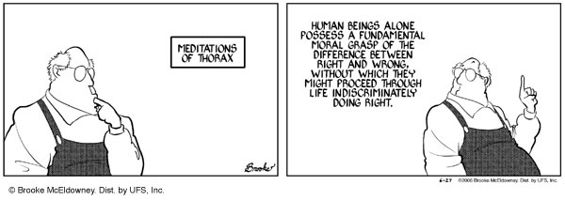
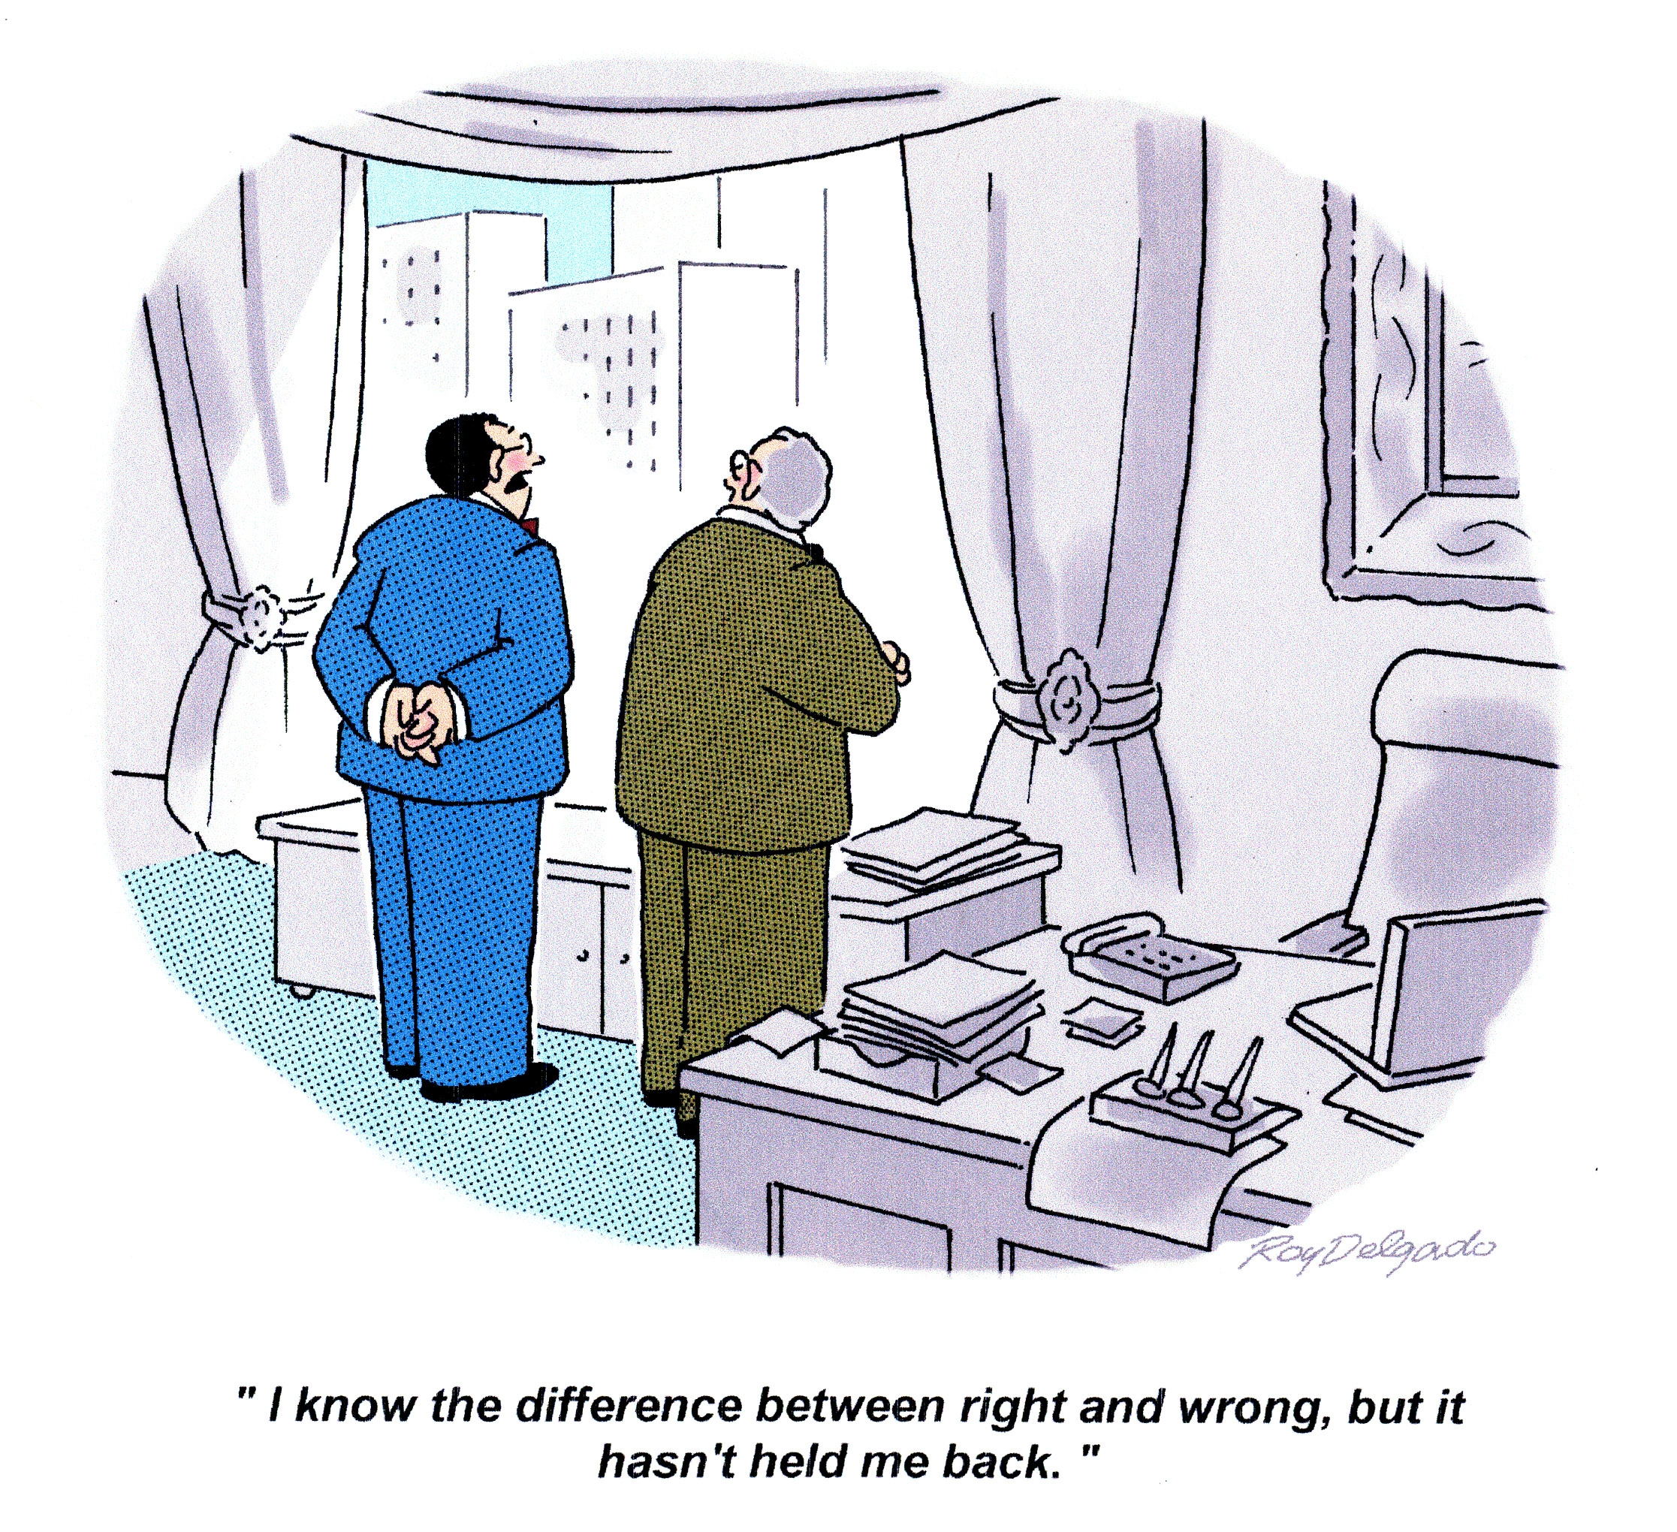
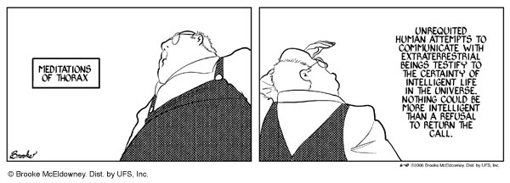
ethics:

Slide 14
Value of compassion in a ethical framework
Notes:
14

Slide 15
Notes:
15

Slide 16
God Loves You
Notes:
16

Slide 17
“Compassion, in which all ethics must take root, can only attain its full breadth and depth if it embraces all living creatures and does not limit itself to mankind.”
Albert Schweitzer

Slide 18
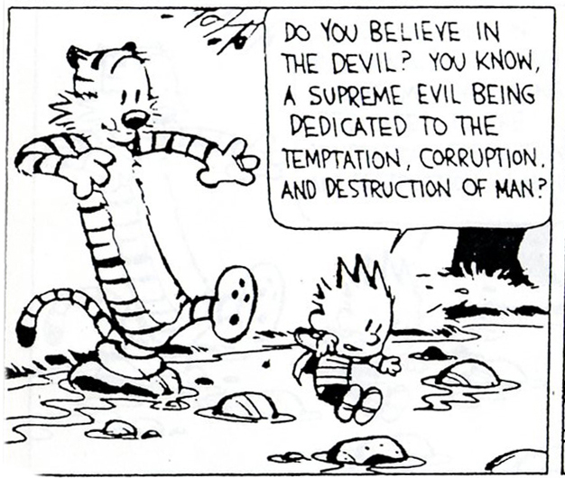
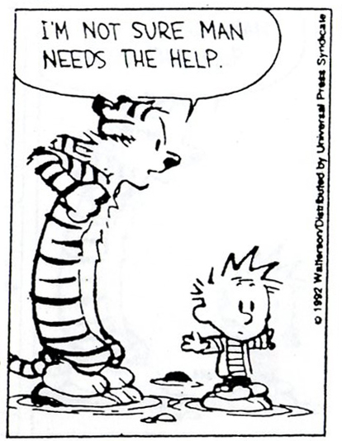
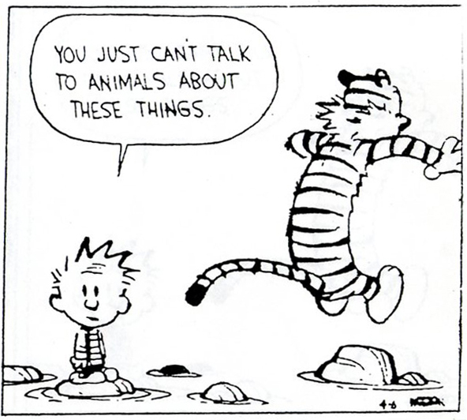
ethics:

Slide 19
Self-sacrifice as a key component in an ethical world-view
Notes:
19

Slide 20

Imago Dei (image of God)
Observed Characteristics
Orderly
Reflective
Communal
Purposeful
Creative
Appreciative
Patient
Invested
Delegator
Mathematical
Artistic
Aesthetic
Powerful
Intimate
Diverse

Slide 21
Notes:
21

Slide 22
God Loves You

Slide 23
“Ethics is knowing the difference between what you have a right to do and what is right to do.”
Potter Stewart

Slide 24
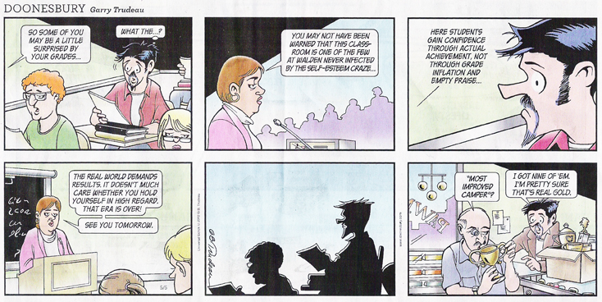
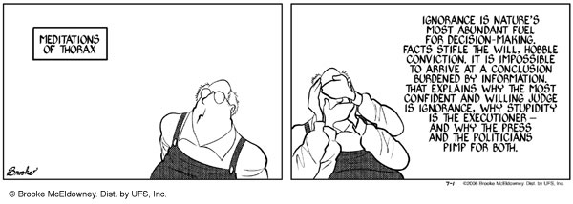
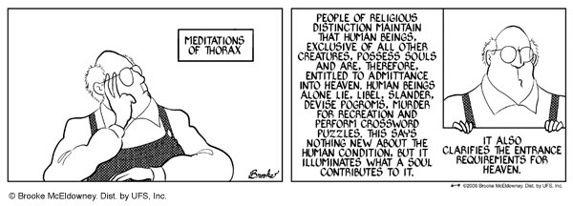
ethics:

Slide 25
Ethics considers the perspective/needs of others
Notes:
25

Slide 26
Discussion
Chapter 2
What?
LA Times article
What?
Genesis 1
What?
3 Deistic Paradigms
What?

Slide 27
Notes:
27

Slide 28
God Loves You
Notes:
28

Slide 29
Notes:
29

