Slide 1
God Loves You
Notes:
1

Slide 2
“I do not believe in immortality of the individual, and I consider ethics to be an exclusively human concern with no superhuman authority behind it.”
Albert Einstein

Slide 3
Remember the sabbath day, to keep it holy. Six days shalt thou labour, and do all thy work: but the seventh day is the sabbath of the Lord thy God: in it thou shalt not do any work, thou, nor thy son, nor thy daughter, thy manservant, nor thy maidservant, nor thy cattle, nor thy stranger that is within thy gates: for in six days the Lord made heaven and earth, the sea, and all that in them is, and rested the seventh day: wherefore the Lord blessed the sabbath day, and hallowed it.
Exodus 20:8-11 (KJV)

Slide 4
Remember the Sabbath day by keeping it holy. Six days you shall labor and do all your work, but the seventh day is a sabbath to the Lord your God. On it you shall not do any work, neither you, nor your son or daughter, nor your male or female servant, nor your animals, nor any foreigner residing in your towns. For in six days the Lord made the heavens and the earth, the sea, and all that is in them, but he rested on the seventh day. Therefore the Lord blessed the Sabbath day and made it holy.
Exodus 20:8-11 (NIV)

Slide 5
Now the Lord is that Spirit: and where the Spirit of the Lord is, there is liberty. But we all, with open face beholding as in a glass the glory of the Lord, are changed into the same image from glory to glory, even as by the Spirit of the Lord.
II Corinthians 3:17-18 (KJV)

Slide 6
Now the Lord is the Spirit, and where the Spirit of the Lord is, there is freedom. And we all, who with unveiled faces contemplate the Lord’s glory, are being transformed into his image with ever-increasing glory, which comes from the Lord, who is the Spirit.
II Corinthians 3:17-18 (NIV)

Slide 7
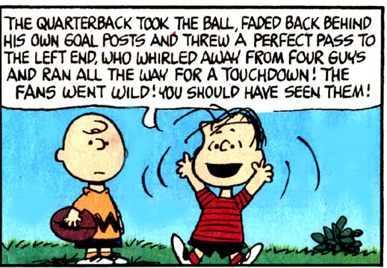
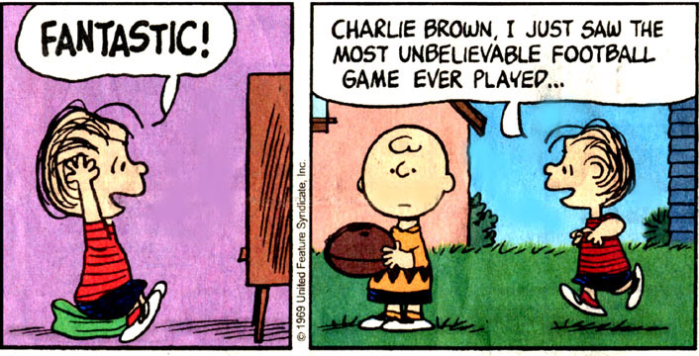
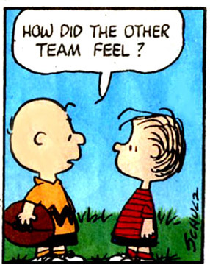
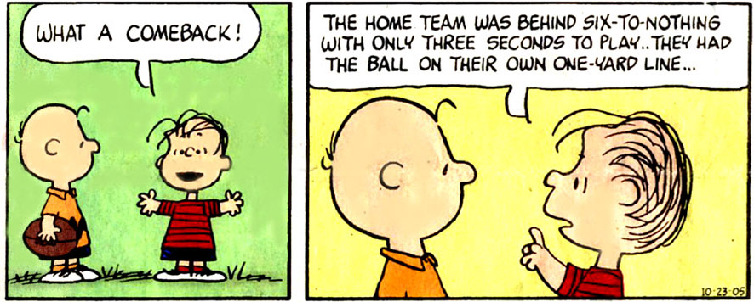
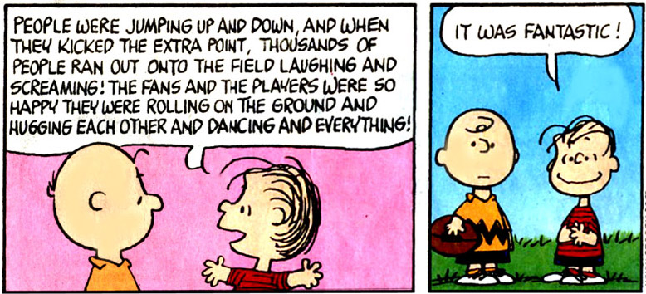
ethics:

Slide 8
Developing inclusive worldviews
Notes:
8

Slide 9
What about criminally insane?
Notes:
9

Slide 10
What about serial killers?
Notes:
10

Slide 11

Journaling
What are your views on those:
a) criminally insane
b) bent on hurting others rationally
c) power delusional
How do you handle them? Long-term imprisonment? Psychiatric care? Death-penalty? What are recidivism rates in America? How effective are social reforms? Could those have prevented Hitler, Mussolini, or Stalin?
Notes:
11

Slide 12
ethics:
A study and application of systems that make it ever increasingly likely to respond in ways nurturing to one’s self, others, and the environment with a view to long-term benefits over short-term gains.
Decisions that are “right” are seen to be so by the overall outcome that best aids all of these goals

Slide 13
Statements that might help you “crystallize” your viewpoint (ethical stance)
What obligations for testing a product does a pharmaceutical company have?
What opportunities for the disenfranchised (poor) should there be ? (free education? Free health care? Free housing?)
What solutions do you suggest for dealing with deviant behavior? What is permissible?
What rights does the state have on the individual? (military draft? Allegiance to country?)

Slide 14
Notes:
14

Slide 15
God Loves You
Notes:
15

Slide 16
“Ethics is nothing else than reverence for life.”
Albert Schweitzer

Slide 17
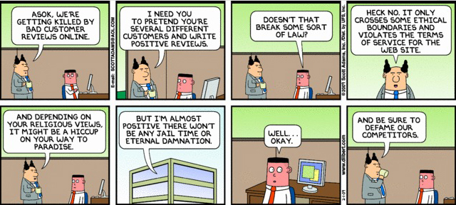
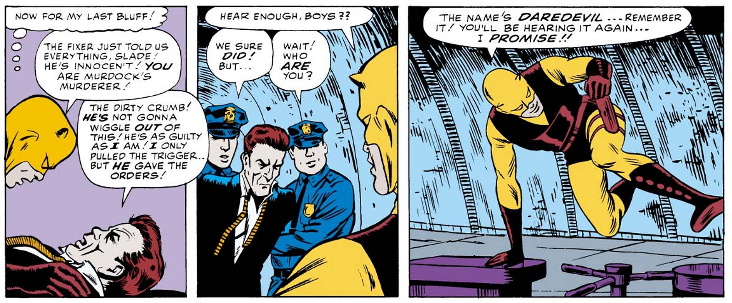
ethics:

Slide 18
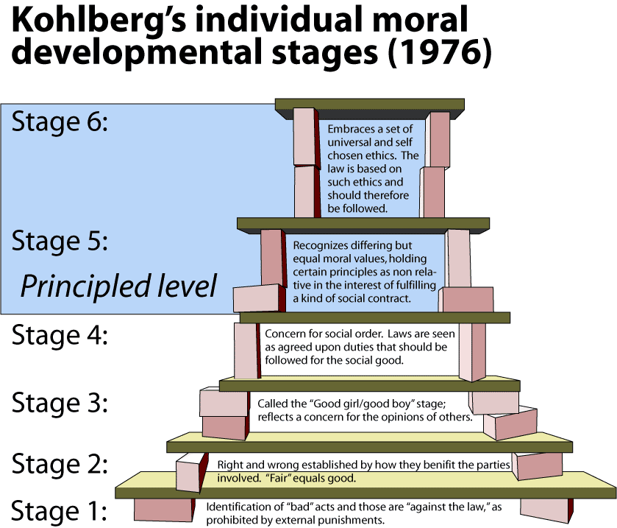
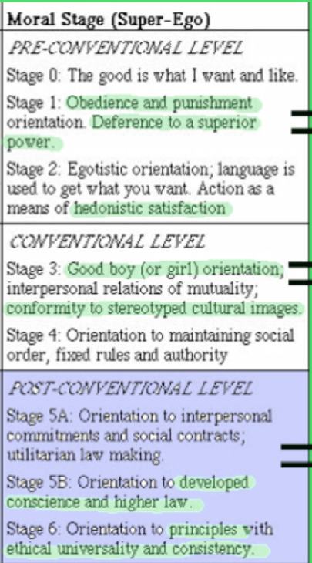
Ethical moral development:
Egocentric
Ethnocentric
Worldcentric
Kholberg’s Moral Development
Kosmocentric

Slide 19
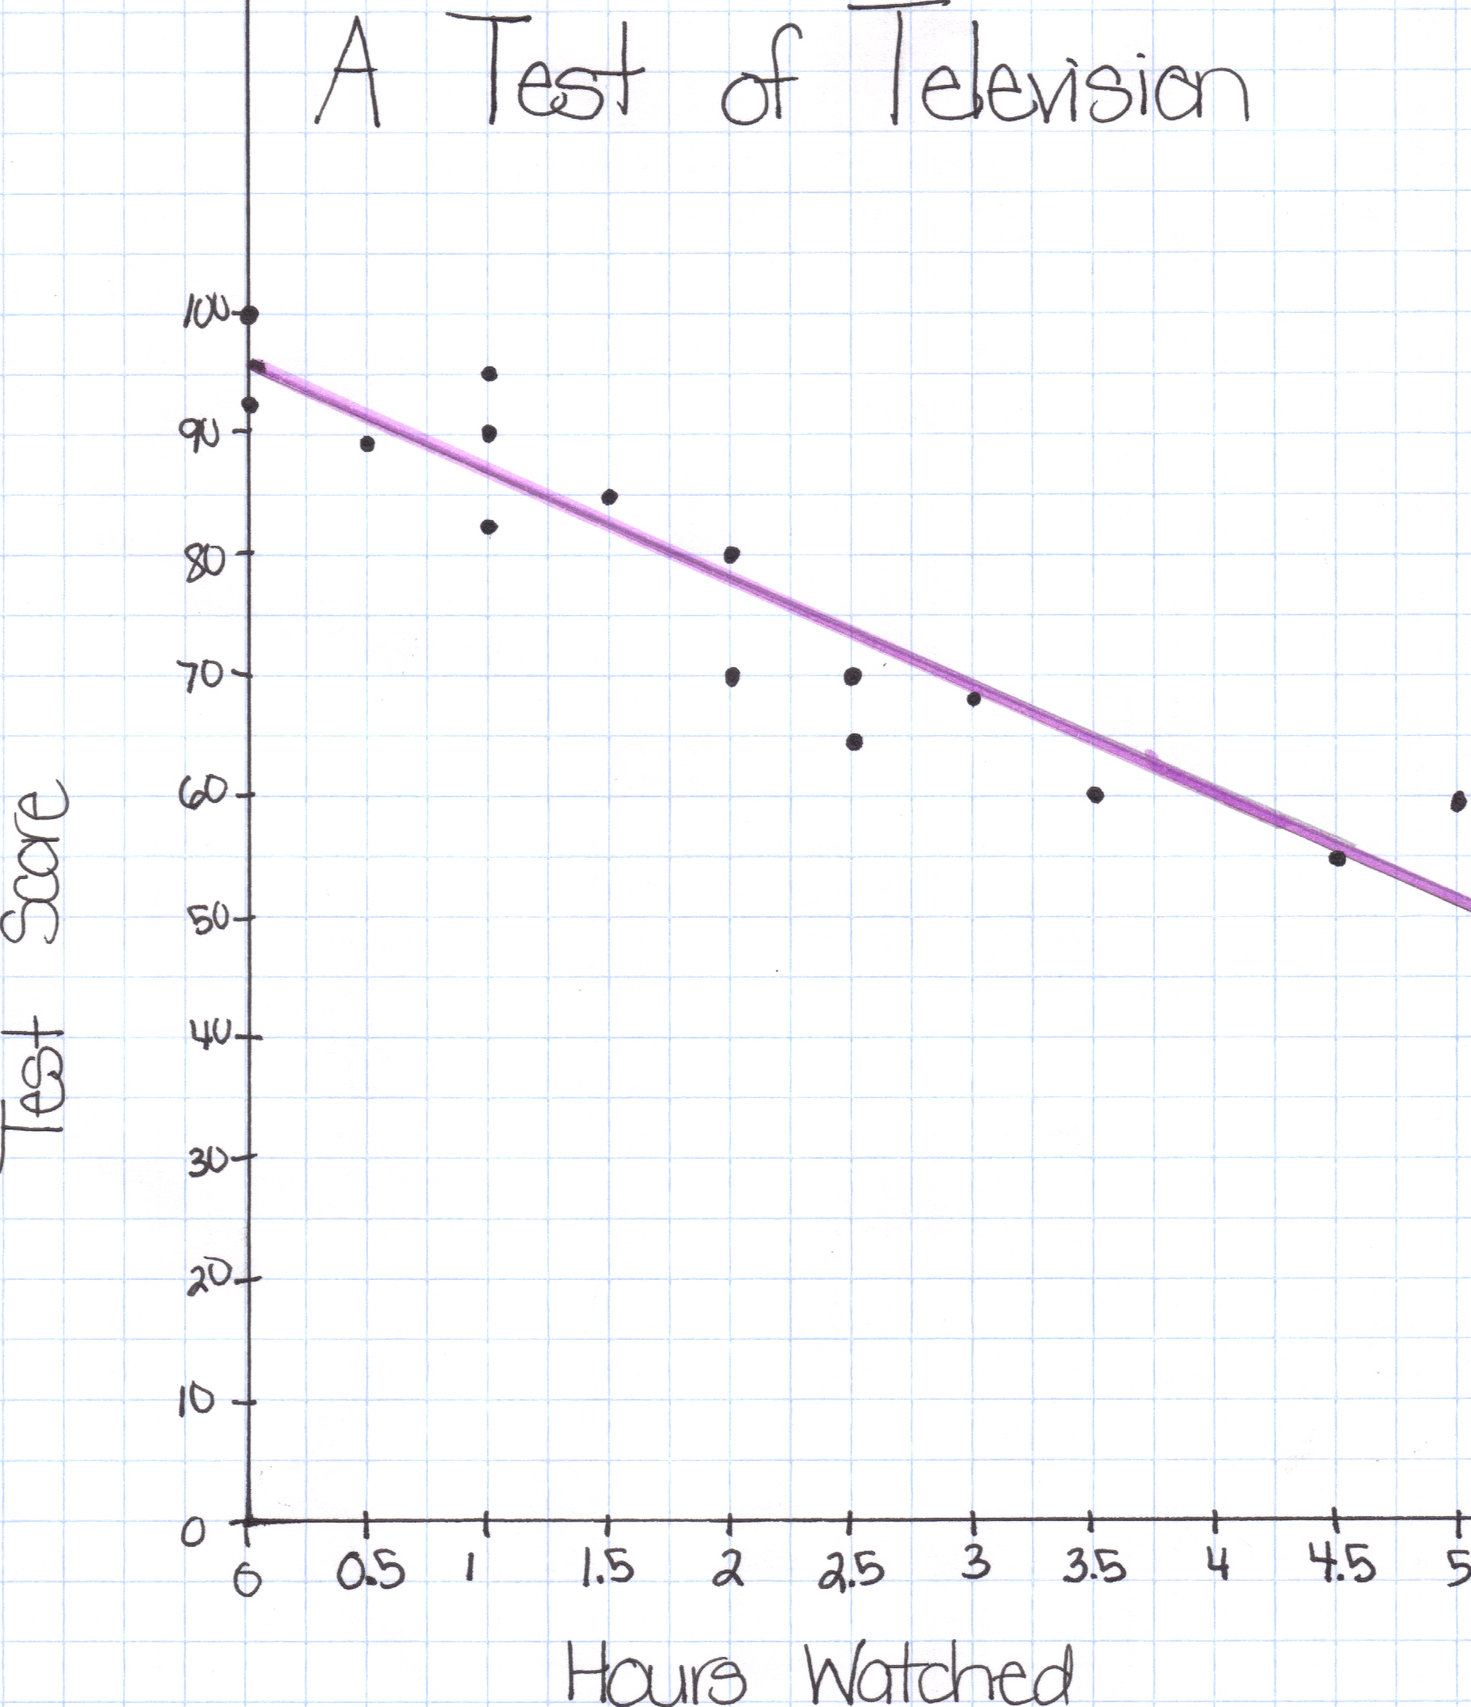
Developing a ethical framework model:
Write down (brief: bullet point) views of right wrong on several key issues:
Environment
Life/Death
Animal rights/cruelty
Health care issues
Then see what emerges and synthesize your viewpoints (aka scatter-plot diagram)

Slide 20
Relationship Point Scale
Dating = 3 pts
Engaged = 7 pts
Married (1-4) = 10 pts
Married (5-10) = 15 pts
. . .
(each 5 years adds 5 pts; marriage status must be currently married)

Slide 21
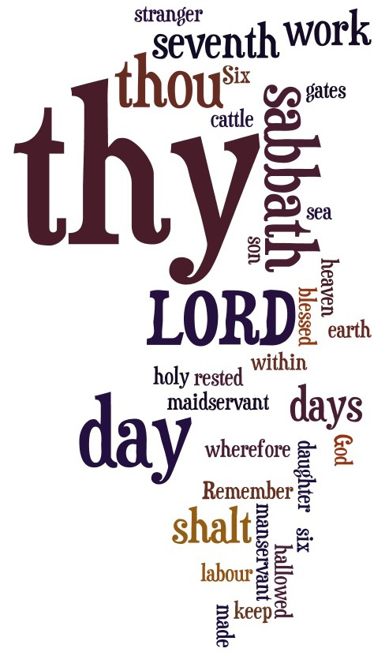
analysis:
www.wordle.net

Slide 22
Notes:
22

Slide 23
God Loves You
Notes:
23

Slide 24
“The word ‘good’ has many meanings. For example, if a man were to shoot his grandmother at a range of five hundred yards, I should call him a good shot, but not necessarily a good man.”
G. K. Chesterton

Slide 25
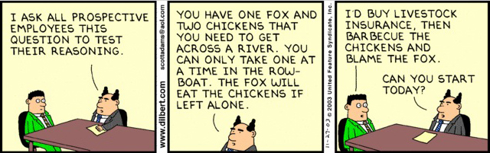
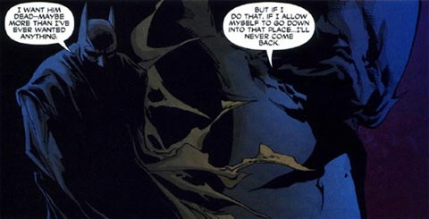
ethics:

Slide 26
Notes:
26

Slide 27
God Loves You

Slide 28
“Ethics is in origin the art of recommending to others the sacrifices required for cooperation with oneself.”
Bertrand Russel

Slide 29
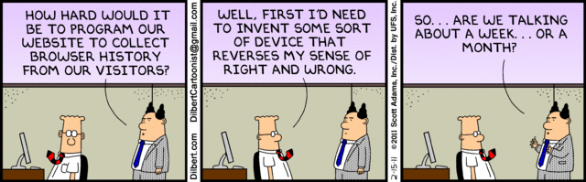
ethics:

Slide 30
Notes:
30

Slide 31
God Loves You
Notes:
31

Slide 32
Notes:
32

