Slide 1
God Loves You
Notes:
1

Slide 2
“Action indeed is the sole medium of expression for ethics.”
Jane Addams

Slide 3
Developing inclusive worldviews and practicing ethical applications
Notes:
3

Slide 4

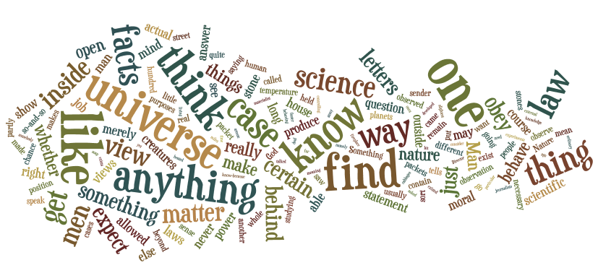
Mere Christianity
What is CS Lewis’ “footprint”?

Slide 5
Notes:
5

Slide 6
God Loves You
Notes:
6

Slide 7
“The first step in the evolution of ethics is a sense of solidarity with other human beings.”
Albert Schweitzer

Slide 8
And Jesus answered him, The first of all the commandments is, Hear, O Israel; The Lord our God is one Lord: And thou shalt love the Lord thy God with all thy heart, and with all thy soul, and with all thy mind, and with all thy strength: this is the first commandment. And the second is like, namely this, Thou shalt love thy neighbour as thyself. There is none other commandment greater than these.
Mark 12:29-31 (KJV)

Slide 9
“The most important one,” answered Jesus, “is this: ‘Hear, O Israel: The Lord our God, the Lord is one. Love the Lord your God with all your heart and with all your soul and with all your mind and with all your strength.’ The second is this: ‘Love your neighbor as yourself.’ There is no commandment greater than these.”
Mark 12:29-31 (NIV)

Slide 10
I beseech you therefore, brethren, by the mercies of God, that ye present your bodies a living sacrifice, holy, acceptable unto God, which is your reasonable service. And be not conformed to this world: but be ye transformed by the renewing of your mind, that ye may prove what is that good, and acceptable, and perfect, will of God.
Romans 12:1-2 (KJV)

Slide 11
Therefore, I urge you, brothers and sisters, in view of God’s mercy, to offer your bodies as a living sacrifice, holy and pleasing to God—this is your true and proper worship. Do not conform to the pattern of this world, but be transformed by the renewing of your mind. Then you will be able to test and approve what God’s will is—his good, pleasing and perfect will.
Romans 12:1-2 (NIV)

Slide 12
Read chapter 3 this week. All by Thursday. Be ready to discuss in class the rest of the week. Discussion points!
Chapter 8: God’s Call to Care
Chapter 15: Gender Justice

Slide 13
reading
Pgs 64-73
Pgs 132-137
Notes:
13

Slide 14
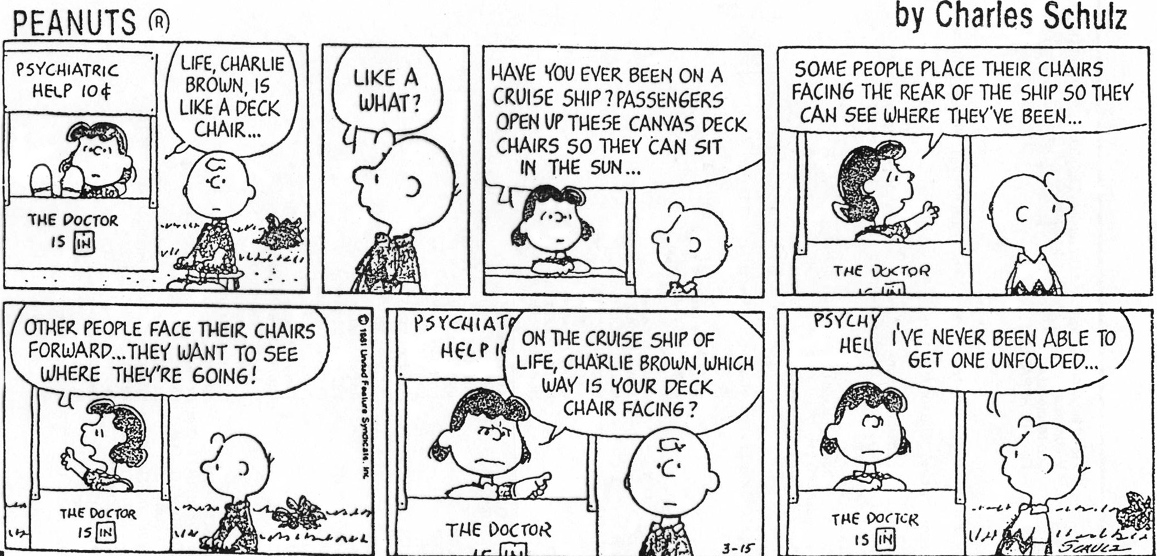
ethics:

Slide 15
ethics:
A study and application of systems that make it ever increasingly likely to respond in ways nurturing to one’s self, others, and the environment with a view to long-term benefits over short-term gains.
Decisions that are “right” are seen to be so by the overall outcome that best aids all of these goals

Slide 16
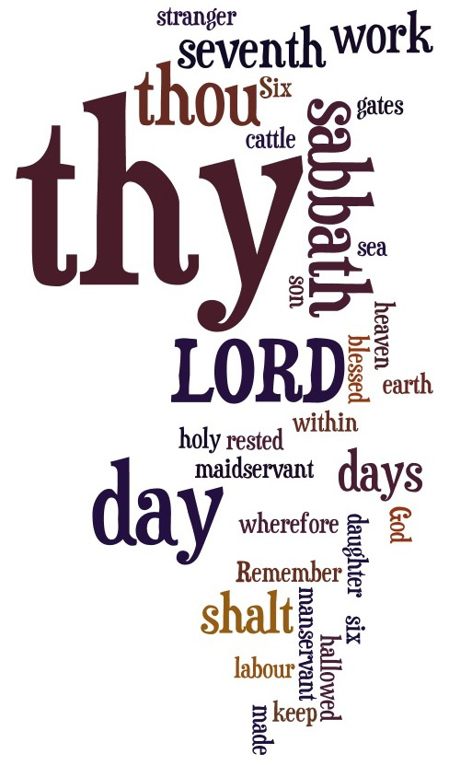
analysis:

Slide 17
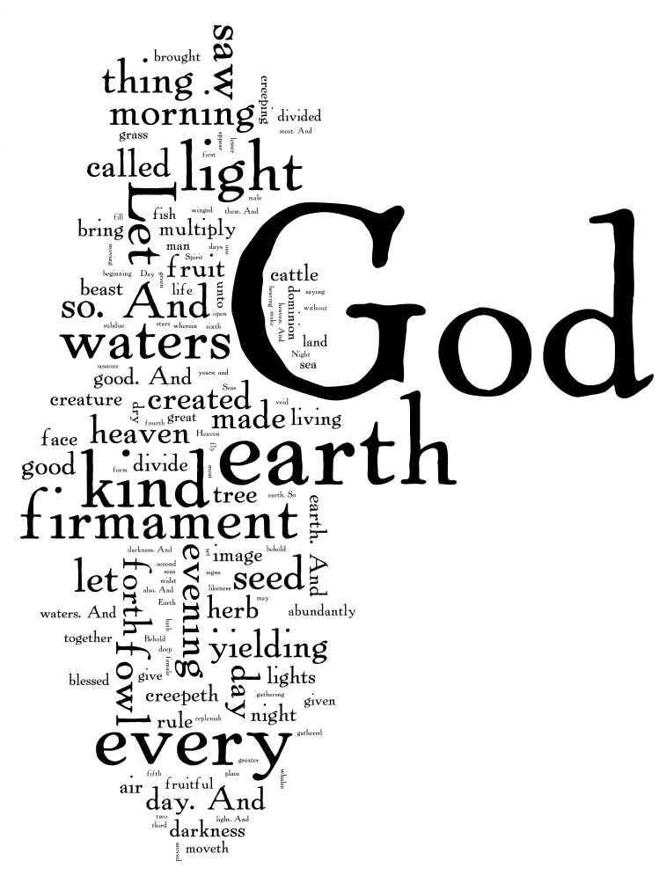
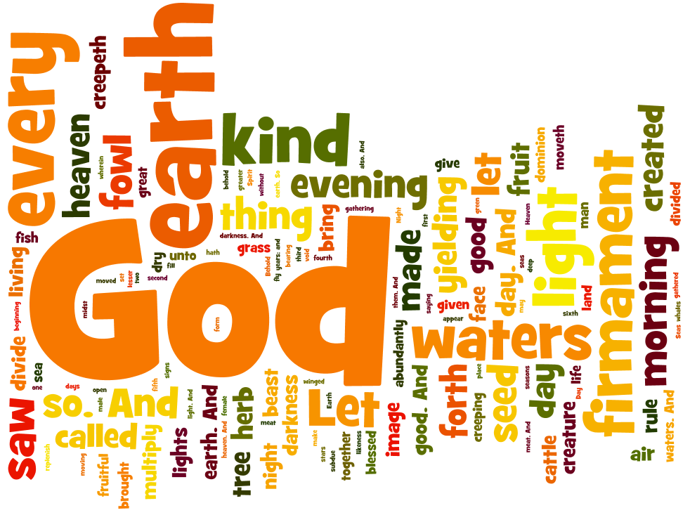
analysis:

Slide 18
Notes:
18

Slide 19
God Loves You
Notes:
19

Slide 20
“It is forbidden to kill; therefore all murderers are punished unless they kill in large numbers and to the sound of trumpets.”
Voltaire

Slide 21
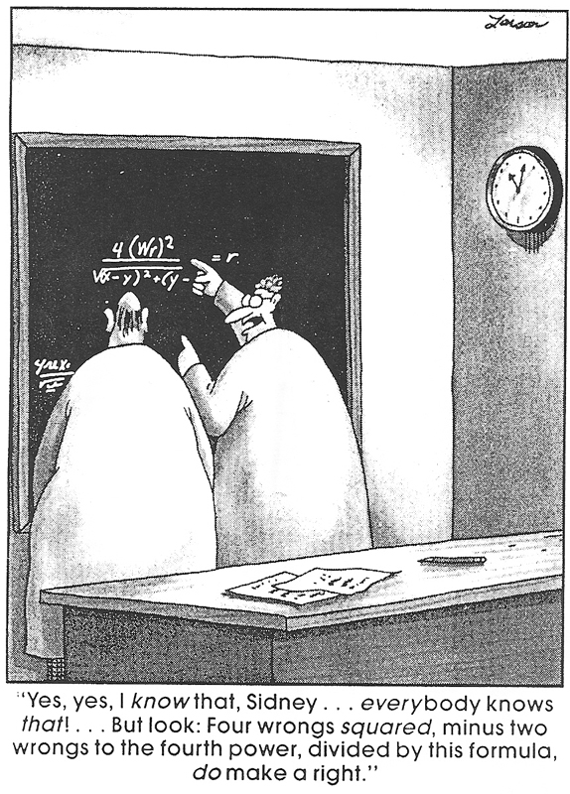
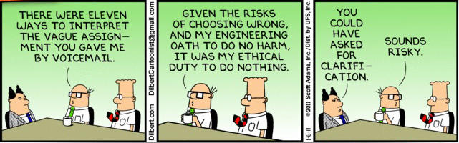
ethics:

Slide 22
Notes:
22

Slide 23
God Loves You

Slide 24
“Educating the mind without educating the heart is no education at all.”
Aristotle

Slide 25

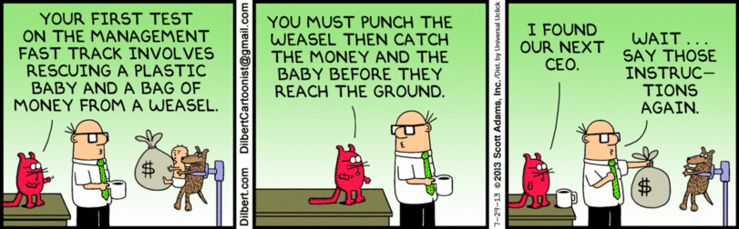
ethics:

Slide 26
Notes:
26

Slide 27
God Loves You
Notes:
27

Slide 28
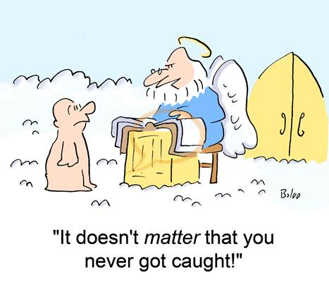
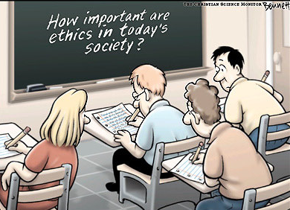
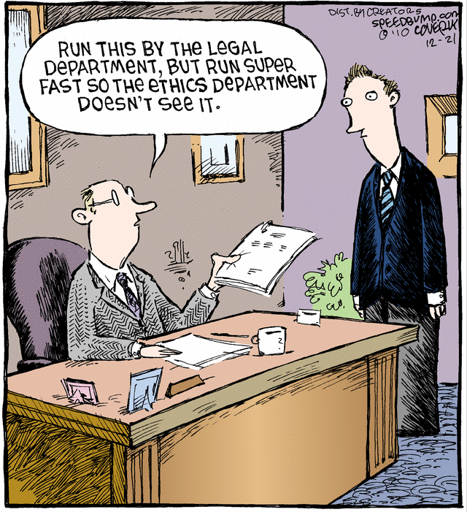
ethics:

Slide 29
Notes:
29

Slide 30


Resources:
Mere Christianity
Note his suggested basis for a divine overlord (CS Lewis himself suggests he is at this point a far cry from a notion of Christian Deity) begins with a view of ethics as observed
Section 4 (37:51)

Slide 31

Journaling
Thoughts/reactions to Lewis’ philosophy:
a) Observations on logic
b) Observations on fair use of examples
c) Questions that arise
d) Commentary on conclusions
Notes:
31

Slide 32
Resources:
Mere Christianity
Note his suggested basis for a divine overlord (CS Lewis himself suggests he is at this point a far cry from a notion of Christian Deity) begins with a view of ethics as observed
Section 1& 2 (18:56)

Slide 33
CS Lewis observes that arguing suggests . . .
a) There is moral code all people “know”
b) All cultures have the same ethical base
c) People don’t have rational impulse control
Lewis suggests that (an)other proof of an implied moral code is/are . . .
a) The taking of 4 wives
b) Exemplary behavior
c) Making excuses for behavior
In rebutting suggestions that ethics is relative, Lewis points out
a) Global constructs of behavioral codes are very consistent
b) Changes to applied behavior does NOT indicate ethical relativism
c) Ethics is more like math than driving preferences

Slide 34
Resources:
Mere Christianity
Note his suggested basis for a divine overlord (CS Lewis himself suggests he is at this point a far cry from a notion of Christian Deity) begins with a view of ethics as observed
Section 3 & 4 (37:38)

Slide 35
Lewis argues that the “Natural Law” differs from, say, the law of gravity by . . .
a) “Natural Law” can be known from the inside
b) The law of gravity is never broken
c) The consequences of each
What does “ought” and “is” mean in regards to ethics?
a) The “ought” = what we expect of others; the “is” = what we expect of ourselves
b) The “ought” = what others expect of us; the “is” = what we expect of ourselves
c) The “ought” = what should be; the “is” = what is readily observed
Lewis suggests that Humanity can understand “Natural Law” because
a) He is a human and can view it from the “inside”
b) “Natural Law” presses down upon our experience as humans (as opposed to, say, trees)
c) Actually we can’t really understand it. It simply imposes itself and we accept it

Slide 36
Resources:
Mere Christianity
Note his suggested basis for a divine overlord (CS Lewis himself suggests he is at this point a far cry from a notion of Christian Deity) begins with a view of ethics as observed
Section 5; 1 (6:39)

Slide 37
Materialistic viewpoint encompasses . . .
a) Atheism
b) Evolution
c) Existentialist philosophy
Lewis suggests that “Creationist Evolution” is
a) Wishful thinking
b) A logical conundrum
c) A pre-cursor to Intelligent Design
Lewis articulates that if there is an impartial Moral Law with a will-power . . .
a) It would be unrelenting / unforgiving to be absolutely fair
b) It would lead to repentance
c) This notion would give rise to a God we can trust

Slide 38
Discussion
Chapter 3
What?
Mere Christianity
What?

Slide 39
Resources:
Mere Christianity
Note his suggested basis for a divine overlord (CS Lewis himself suggests he is at this point a far cry from a notion of Christian Deity) begins with a view of ethics as observed
Section 2 & 3 (27:05)

