Slide 1
God Loves You
Notes:
1

Slide 2
“If you are a Christian you do not have to believe that all the other religions are simply wrong all through. If you are an atheist you do have to believe that the main point in all the religions of the whole world is simply one huge mistake.”
CS Lewis

Slide 3
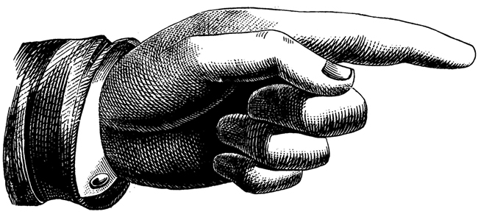
Outlining the Semester
Q3: Discover World Religions
Weekly reading & quizzes & notes
Daily discussion (pts for part)
Weekly Overview
Q4: Proclaim Christianity Project
Roles
Expectations
Weekly Overview
Weekly Progress
Questions
???
Notes:
3

Slide 4
Have we not all one father? Hath not one God created us? Why do we deal treacherously every man against his brother, by profaning the covenant of our fathers?
Malachi 2:10 (KJV)

Slide 5
Do we not all have one Father? Did not one God create us? Why do we profane the covenant of our ancestors by being unfaithful to one another?
Malachi 2:10 (NIV)

Slide 6
6 windows on the world of religious thought
Notes:
6

Slide 7

Journaling
Read about, describe, and react to the 6 suggested moral paradigms:
a) materialism/atheism
b) pantheism
c) appeasement theism
d) deterministic theism
e) deism
f) benevolent theism
Notes:
7

Slide 8

Reflect
Take test from link on website
Read and reflect on the chart (on my website) comparing the 3 ”branches” of religious thought. How does this compare/connect to Ty Gibson’s breaking things down to 6 philosophies or CS Lewis division of thought?
paradigms
Notes:
8

Slide 9
Notes:
9

Slide 10
God Loves You
Notes:
10

Slide 11
“Work out your own salvation. Do not depend on others.”
Buddha

Slide 12
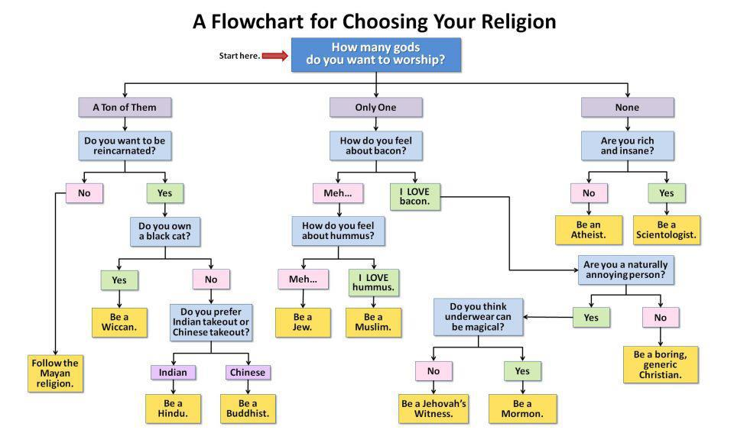

Slide 13
“Those whom Christ commends in the judgement may have known little of theology, but they have cherished His principles. Through the influence of the divine Spirit they have been a blessing to those about them. Even among the heathen are those who have cherished the spirit of kindness . . . among the heathen are those who worship God ignorantly . . . they have heard His voice speaking to them in nature, and have done the things that the law required. Their works are evidence that the Holy Spirit has touched their hearts, and they are recognized as the children of God.”
–pg 638, DA, pub. 1890

Slide 14
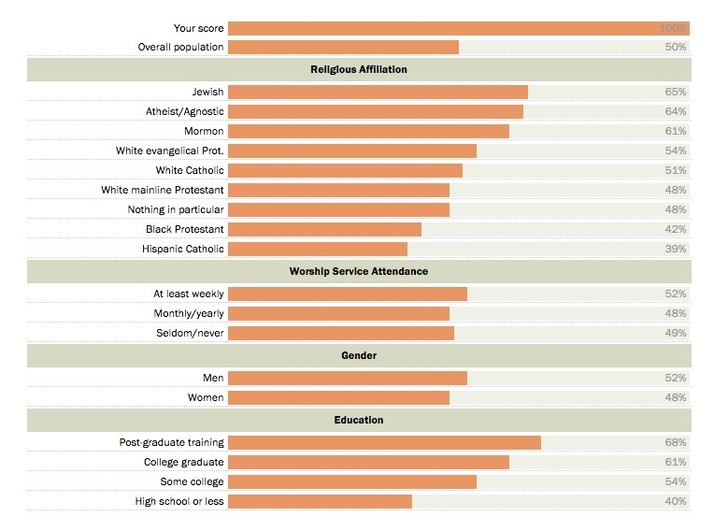
Quiz results . . .

Slide 15

Buddhism
Notes:
15

Slide 16

Taoism
Notes:
16

Slide 17
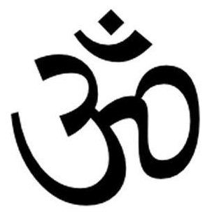
Hinduism (OHM)
Notes:
17

Slide 18

Christianity
Notes:
18

Slide 19
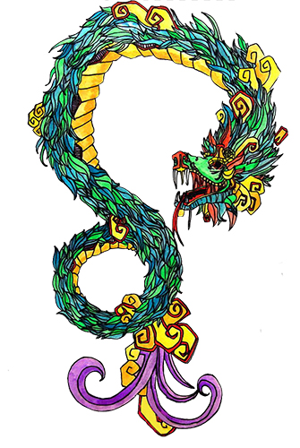
Mayan/Aztec
Notes:
19

Slide 20
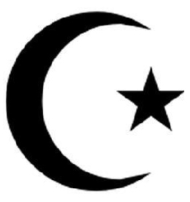
Islam
Notes:
20

Slide 21

Sikhism
Notes:
21

Slide 22
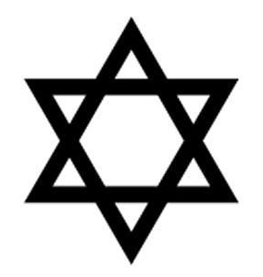
Judaism
Notes:
22

Slide 23
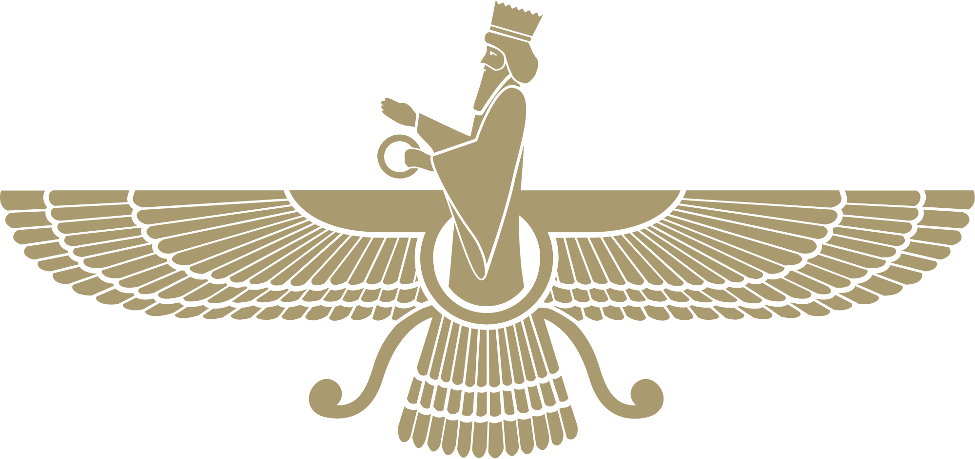
Zoroastrianism
Notes:
23

Slide 24

Shintoism
Notes:
24

Slide 25
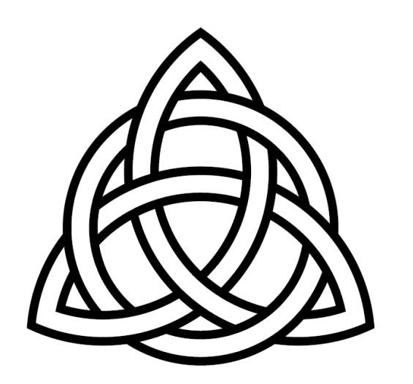


Druidism (celtic)
Notes:
25

Slide 26
Celtic Cross (an example of syncretism)
Notes:
26

Slide 27
Journaling
How are symbols (logos with religious value) used today? Why are they important to believers? How do people use these symbols for identity?
Some symbols that begin as non-religious take on a “sacred” tone amongst some who are very zealous in guarding them (for example those people get really upset if you desecrate their symbol). Name/draw/describe some in the world that you see.
Notes:
27

Slide 28

Discussion
Religious Quiz results
Pamphlet handout
Ty Gibson grouping
CS Lewis grouping
deg religion grouping
Thoughts? Reflections?
Notes:
28

Slide 29
Time to work
Journal pages
Reading
Notes
Homework
Anything else . . .
Work on stuff!
Notes:
29

Slide 30
Notes:
30

Slide 31
God Loves You

Slide 32
“For it is not by hearing the Law that people are put right with God, but by doing what the Law commands. The Gentiles do not have the Law; but whenever they do by instinct what the Law commands, they are their own law, even though they do not have the Law. Their conduct shows that what the Law commands is written in their hearts. Their consciences also show that this is true, since their thoughts sometimes accuse them and sometimes defend them.”
Paul the Apostle (ROM 2: GNT)

Slide 33
Notes:
33

Slide 34
God Loves You
Notes:
34

Slide 35
Notes:
35

