Slide 1
God Loves You
Notes:
1

Slide 2
Trust ye not in lying words, saying, The temple of the Lord, The temple of the Lord, The temple of the Lord, are these. For if ye thoroughly amend your ways and your doings; if ye thoroughly execute judgment between a man and his neighbour; If ye oppress not the stranger, the fatherless, and the widow, and shed not innocent blood in this place, neither walk after other gods to your hurt: Then will I cause you to dwell in this place, in the land that I gave to your fathers, for ever and ever.
Jeremiah 7:4-7 (KJV)

Slide 3
Do not trust in deceptive words and say, “This is the temple of the Lord, the temple of the Lord, the temple of the Lord!” If you really change your ways and your actions and deal with each other justly, if you do not oppress the foreigner, the fatherless or the widow and do not shed innocent blood in this place, and if you do not follow other gods to your own harm, then I will let you live in this place, in the land I gave your ancestors for ever and ever.
Jeremiah 7:4-7 (NIV)

Slide 4

Reading
Book 1:21-40
Book 2:232-238
Good overview
Notes:
4

Slide 5
The Dreamtime
Notes:
5

Slide 6
Aborigines come from what continent?
a) Australia
b) New Guinea
c) New Zealand
The creation happened during . . . ?
a) The Great Walkabout
b) The Big Bang
c) The Dreamtime
The creating being was . . . ?
a) The Rainbow Serpent
b) The Ancient Koala
c) The Bounding Wallaby

Slide 7
Sacred Places
Notes:
7

Slide 8
Primal religions have a reverence for . . .
a) Physical locations
b) Modern technology (seems like magic)
c) Animals & nature
The elders of a community provide . . . ?
a) The priesthood among the people
b) Wisdom of ancient ways
c) They guides for upcoming marriages

Slide 9
Notes:
9

Slide 10
God Loves You
Notes:
10

Slide 11
Sacred view of nature
Notes:
11

Slide 12
The purpose, power and place of ritual
Notes:
12

Slide 13
Why might a man NOT kill a fish?
a) He’s part fish
b) The fish is a relative
c) He shares the same spirit with the fish
Aboriginal tradition views life as . . . ?
a) Life that carries and life that is carried
b) Disconnected from the spiritual realm
c) Dual life forms co-existing
The purpose of ritual celebrations . . . ?
a) To honor the ancestors
b) To harness ancestral power
c) To learn new knowledge

Slide 14
Notes:
14

Slide 15
God Loves You
Notes:
15

Slide 16
The importance of oral traditions
Notes:
16

Slide 17

Journaling
The aboriginal (and most primal or proto-religion) culture is one based on oral traditions. That is, information: rituals and values are passed down by word of mouth—there is no written text. What might be any pros/cons of such a system. Compare that to a tradition that has a sacred text for example.
Notes:
17

Slide 18

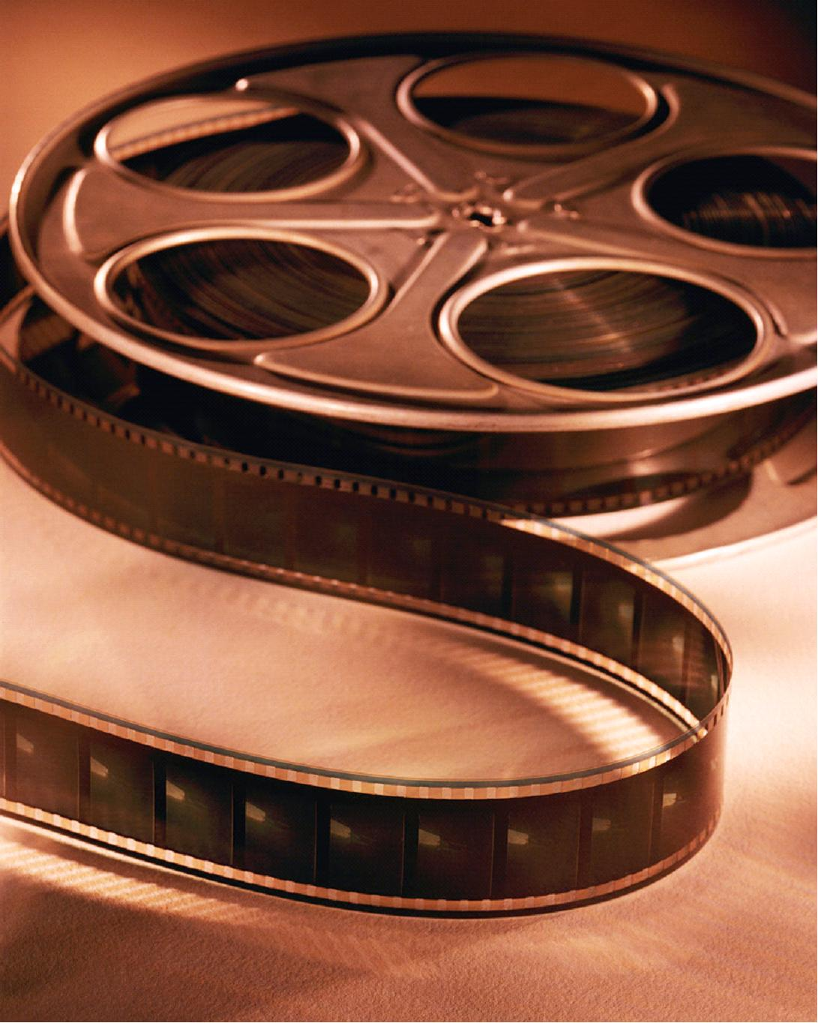
Star Trek: Quetzalcoatl
Notes:
18

Slide 19

Journaling
The message of the Great Controversy (a galactic fight of good vs. evil) is very prevalent in many media. Can you think of some other movies/cartoons, etc? Describe them. Tell the story.
i find it very interesting that the cartoon featured a winged serpent of mythology (there are many such creatures in the stories/myths of earth) who was trying to HELP humanity. Compare and contrast this with the Biblical account of the Great Controversy (similar/different)?
Notes:
19

Slide 20

Discussion
Questions from readings
Questions from videos
Thoughts? Reflections?
Notes:
20

Slide 21
Time to work
Journal pages
Reading
Notes
Homework
Anything else . . .
Work on stuff!
Notes:
21

Slide 22
Notes:
22

Slide 23
God Loves You

Slide 24
African Orisha Pantheon
Notes:
24

Slide 25
How differences/strife came to be . . .
Notes:
25

Slide 26
Who is the all-powerful original ”god”?
a) Orunmila
b) Eshu
c) Olorun
How did powers get disseminated?
a) Orunmila rained them from the sky
b) They (the orishas) were born that way
c) A competitional game determined who got what
Why did differences arise?
a) Everyone was the same and did not want that
b) Each orisha drew a number
c) Eshu passed out different abilities in the marketplace

Slide 27
Notes:
27

Slide 28
God Loves You
Notes:
28

Slide 29
Notes:
29

