Slide 1
God Loves You
Notes:
1

Slide 2
If a king is fair, he makes his country strong, but if he takes gifts dishonestly, he tears his country down.
Proverbs 29:4

Slide 3
Starting a quarrel is like breaching a dam; so drop the matter before a dispute breaks out.
Proverbs 17:14

Slide 4
Now to Abraham and his seed were the promises made. He saith not, And to seeds, as of many; but as of one, And to thy seed, which is Christ . . . For ye are all the children of God by faith in Christ Jesus. For as many of you as have been baptized into Christ have put on Christ. There is neither Jew nor Greek, there is neither bond nor free, there is neither male nor female: for ye are all one in Christ Jesus. And if ye be Christ's, then are ye Abraham's seed, and heirs according to the promise.
Galatians 3:16, 26-29 (KJV)

Slide 5
The promises were spoken to Abraham and to his seed. Scripture does not say “and to seeds,” meaning many people, but “and to your seed,” meaning one person, who is Christ . . . So in Christ Jesus you are all children of God through faith, for all of you who were baptized into Christ have clothed yourselves with Christ. There is neither Jew nor Gentile, neither slave nor free, nor is there male and female, for you are all one in Christ Jesus. If you belong to Christ, then you are Abraham’s seed, and heirs according to the promise.
Galatians 3:16, 26-29 (NIV)

Slide 6
The importance and meaning of Torah
Notes:
6

Slide 7
Key scripture passage?
a) Torah
b) Shema
c) Mezuzah
Key historical event?
a) Creation of mankind at eden
b) Beginning of the kingdom of David
c) Receiving the torah at sinai
Key aspects of judaism?
a) Love of YWHW
b) A land to freely worship in
c) The torah

Slide 8
Meaning in suffering
Notes:
8

Slide 9
The past living in the present (temple structure)
Notes:
9

Slide 10
The role of evil?
a) To grow OVER it (an obstacle to overcome)
b) To reinforce the notions of good vs evil
c) There is no role for evil in judaism
The wall is a archealogical relic from . . . ?
a) The time of David
b) The time of Saul
c) The time of Moses
Jerusalem is sacred to ?
a) Jew
b) Christian
c) Muslim

Slide 11

Reading
Book 1:211-232
Book 2:178-181, 185-187, 189-195, 198-201
Good overview
Notes:
11

Slide 12
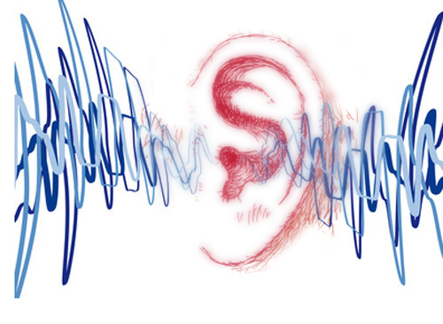
Listening
Genesis 1
Exodus 20
As it was delivered to them
Notes:
12

Slide 13
Notes:
13

Slide 14
God Loves You
Notes:
14

Slide 15
Do not correct those who make fun of wisdom, or they will hate you. But correct the wise, and they will love you.
Proverbs 9:8

Slide 16
One who has unreliable friends soon comes to ruin, but there is a friend who sticks closer than a brother.
Proverbs 18:24

Slide 17
Understanding Judaism through festivals
Notes:
17

Slide 18
Important facets (practical commandments) of jewish life?
a) Torah reading
b) Dietary laws
c) Sabbath keeping
Sacred days of awe begins with?
a) Yom kippur
b) Passover (pesach)
c) Rosh hoshana
Feast of Sukkot is similar to . . . ?
a) Communion service
b) Easter celebration
c) Campmeeting

Slide 19
Notes:
19

Slide 20
God Loves You
Notes:
20

Slide 21
Those who give false praise to their neighbors are setting a trap for them.
Proverbs 29:5

Slide 22
A gentle answer turns away wrath, but a harsh word stirs up anger . . . The soothing tongue is a tree of life, but a perverse tongue crushes the spirit.
Proverbs 15:1, 4

Slide 23
Notes:
23

Slide 24
God Loves You

Slide 25
Like a maniac shooting flaming arrows of death is one who deceives their neighbor and says, “I was only joking!”
Proverbs 26:18-19

Slide 26
A merry heart doeth good like a medicine: but a broken spirit drieth the bones.
Proverbs 17:22

Slide 27
Notes:
27

Slide 28
God Loves You
Notes:
28

Slide 29
Notes:
29

