Slide 1
God Loves You
Notes:
1

Slide 2
No one else holds or has held the place in the heart of the world which Jesus holds. Other gods have been as devoutly worshipped; no other man has been so devoutly loved.
John Knox

Slide 3
For God so loved the world, that he gave his only begotten Son, that whosoever believeth in him should not perish, but have everlasting life. For God sent not his Son into the world to condemn the world; but that the world through him might be saved. He that believeth on him is not condemned: but he that believeth not is condemned already, because he hath not believed in the name of the only begotten Son of God. And this is the condemnation, that light is come into the world, and men loved darkness rather than light, because their deeds were evil. For every one that doeth evil hateth the light, neither cometh to the light, lest his deeds should be reproved.
John 3:16-20 (KJV)

Slide 4
For God so loved the world that he gave his one and only Son, that whoever believes in him shall not perish but have eternal life. For God did not send his Son into the world to condemn the world, but to save the world through him. Whoever believes in him is not condemned, but whoever does not believe stands condemned already because they have not believed in the name of God’s one and only Son. This is the verdict: Light has come into the world, but people loved darkness instead of light because their deeds were evil. Everyone who does evil hates the light, and will not come into the light for fear that their deeds will be exposed.
John 3:16-20 (NIV)

Slide 5
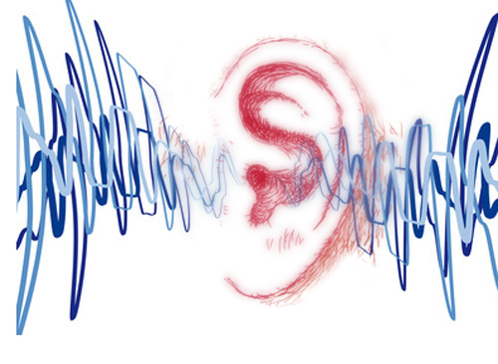
Listening
John 1
1 Corinthians 13
As it was delivered to them
Notes:
5

Slide 6
THE story: What is really going on
Notes:
6

Slide 7
A key concept of Christianity: the God of 2nd Chances
Notes:
7

Slide 8

Reading
Book 1:233-256
Good overview
Notes:
8

Slide 9
Notes:
9

Slide 10
God Loves You
Notes:
10

Slide 11
Love is patient, love is kind. It does not envy, it does not boast, it is not proud. It does not dishonor others, it is not self-seeking, it is not easily angered, it keeps no record of wrongs. Love does not delight in evil but rejoices with the truth. It always protects, always trusts, always hopes, always perseveres. Love never fails.
Apostle Paul

Slide 12
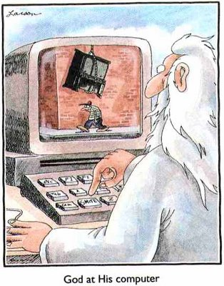
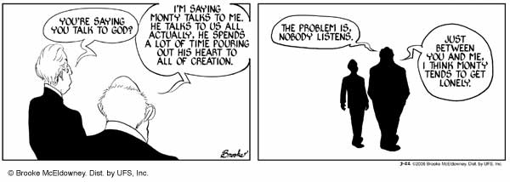
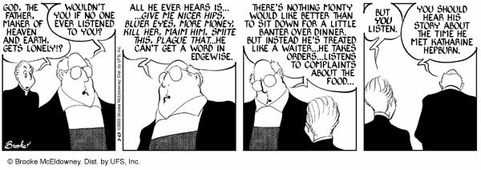
Notes:
12

Slide 13
Word Study
“without sin”; John 8:7
Notes:
13

Slide 14
Eternal Message in Chinese Language
Notes:
14

Slide 15

The Chinese Language
Is the oldest, continuous written language in the World
First written over 4,500 years ago
The inventors of the written language drew pictures to express words or ideas
Simple pictures were combined to make more complex thoughts

Slide 16





Simple pictures were combined to make more complex thoughts
For Example…..
=
+
OLDER BROTHER
MAN
MOUTH

Slide 17
Simple pictures were combined to make more complex thoughts
For Example…..
=
+
OLDER BROTHER
MAN
MOUTH
The family“mouth man” or “spokes person” was usually the oldest son or brother.

Slide 18
Long before Buddha, the Chinese people worshipped the same God described in the Bible!
The Proof is in the Ancient Chinese Characters
2500 B.C.
1400 B.C.
600 B.C.
30 A.D.
Chinese language first written
Buddha
Death of Jesus
Today
First five books of Bible written

Slide 19

“Shang Di” was the God of China before Buddha. He was the creator God and animal sacrifice was offered to him.
Shang Di
Buddha
2500 B.C.
1400 B.C.
600 B.C.
30 A.D.
Chinese language first written
First five books of Bible written
Buddha
Death of Jesus
Today

Slide 20
Now the whole earth had one language and one speech. And it came to pass, as they journeyed from the east, that they found a plain in the land of Shinar, and they dwelt there. Then they said to one another, “Come, let us make bricks and bake them thoroughly.” They had brick for stone, and they had asphalt for mortar. And they said, “Come, let us build ourselves a city, and a tower whose top is in the heavens; let us make a name for ourselves, lest we be scattered abroad over the face of the whole earth.”
Genesis 11:1-4

Slide 21
But the LORD came down to see the city and the tower which the sons of men had built. And the LORD said, “Indeed the people are one and they all have one language, and this is what they begin to do; now nothing that they propose to do will be withheld from them. Come, let Us go down and there confuse their language, that they may not understand one another’s speech.” So the LORD scattered them abroad from there over the face of all the earth, and they ceased building the city. Therefore its name is called Babel, because there the LORD confused the language of all the earth; and from there the LORD scattered them abroad over the face of all the earth. Genesis 11:5-9

Slide 22
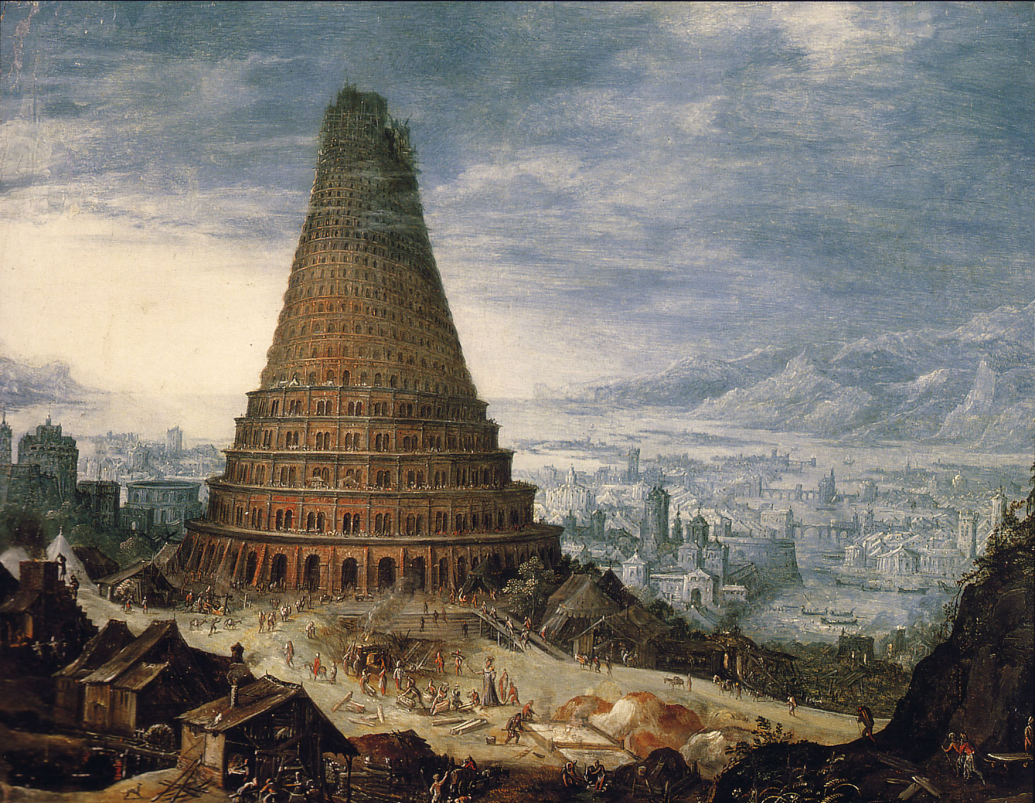
Notice the main points of this story in the Bible
Took place 5000 years ago
World’s oldest written language (Chinese) is more that 4500 years old
Languages were divided
People were scattered

Slide 23
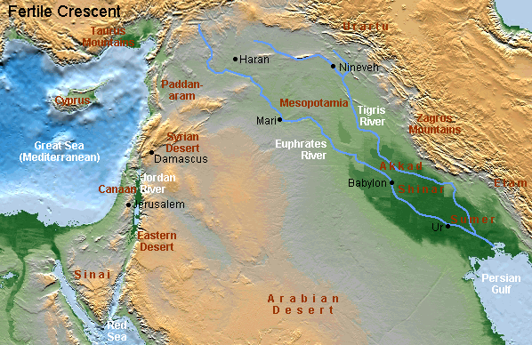
Location of the Tower of Babel
circa 3000BC
Today it is in Iraq

Slide 24
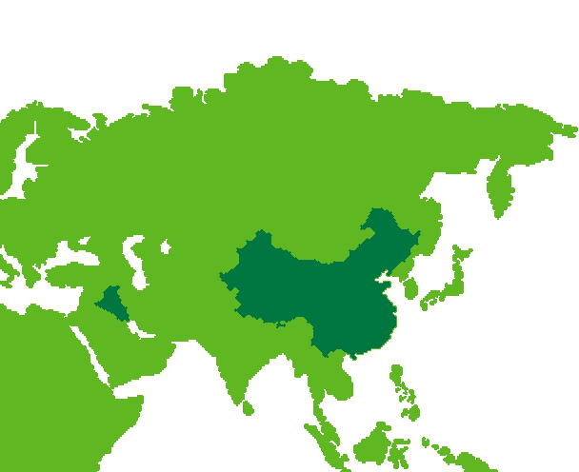






The Chinese would have migrated or walked from the west to China
ASIA
EUROPE
BABEL
CHINA
AFRICA
=
+
+
+
MIGRATE
GREAT
DIVISION
WEST
WALKING

Slide 25


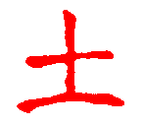

Then the LORD God formed man of dust from the ground, and breathed into his nostrils the breath of life; and man became a living being.
Genesis 2:7
=
+
TO CREATE
TO TALK
WALKING
TO TALK
=
+
+
DUST
BREATH
ALIVE

Slide 26

According to the Bible, the first man was a…
LIVING DUST MAN
+
+
=
ALIVE
DUST
MAN
FIRST
According to the Chinese Language, 4500 years ago this was also believed in China.

Slide 27



Happiness or Blessing
+
+
+
GOD
ONE
MAN
GARDEN
In the beginning God and the man had close fellowship; this leads to true happiness!

Slide 28
And God planted a garden eastward, in Eden; and there he put the man whom he had formed.
ASIA
East
for
Moses
EDEN
CHINA
West from China
=
+
+
WEST
ONE
MAN
ENCLOSURE

Slide 29
And the LORD God said, “It is not good that man should be alone; I will make him a helper comparable to him…” And the LORD God caused a deep sleep to fall on Adam, and he slept; and He took one of his ribs, and closed up the flesh in its place. Then the rib which the LORD God had taken from man He made into a woman, and He brought her to the man.
Genesis 2:18, 21, 22

Slide 30
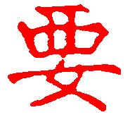
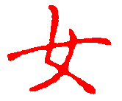

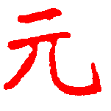
To Want,
Necessary
+
+
+
ONE
MAN
ENCLOSURE
WOMAN
+
=
TWO
PEOPLE
BEGINNING

Slide 31
The LORD God planted a garden eastward in Eden, and there He put the man whom He had formed. And out of the ground the LORD God made every tree grow that is pleasant to the sight and good for food. The tree of life was also in the midst of the garden, and the tree of the knowledge of good and evil. Genesis 2:8-9
How many special trees were in the middle of the garden?
TWO TREES

Slide 32
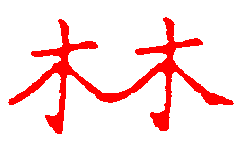
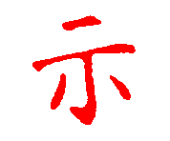

And the LORD God commanded the man, saying, “Of every tree of the garden you may freely eat; but of the tree of the knowledge of good and evil you shall not eat, for in the day that you eat of it you shall surely die.” Genesis 2:16-17
Man was forbidden to eat one of the two trees—if he ate the forbidden tree the other would be taken from him also.
+
=
TWO TREES
COMMAND
FORBIDDEN

Slide 33
Now the serpent … said to the woman, “Has God indeed said, ‘You shall not eat of every tree of the garden?” And the woman said to the serpent, “We may eat the fruit of the trees of the garden; but of the fruit of the tree which is in the midst of the garden, God has said, ‘You shall not eat it, nor shall you touch it, lest you die.’” Then the serpent said to the woman, “You will not surely die. For God knows that in the day you eat of it your eyes will be opened, and you will be like God, knowing good and evil.”
Genesis 3:1-4

Slide 34




The Chinese people 4500 years ago associated the devil with a garden and two trees.
+
+
+
=
DEVIL
LIFE
SECRET
GARDEN
MAN
DEVIL
+
+
=
TWO TREES
COVER
TEMPTER

Slide 35
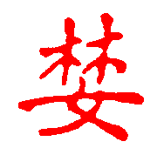
So when the woman saw that the tree was good for food, that it was pleasant to the eyes, and a tree desirable to make one wise, she took of its fruit and ate. She also gave to her husband with her, and he ate.
Genesis 3:6
+
=
WOMAN
TWO TREES
TO COVET, DESIRE

Slide 36



… she took of its fruit and ate. She also gave to her husband with her, and he ate. Then the eyes of both of them were opened, and they knew that they were naked; and they sewed fig leaves together and made themselves coverings.
Genesis 3:6-7
+
=
MAN
FRUIT
NAKED

Slide 37

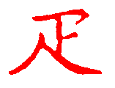
To the woman He said: “I will greatly multiply your sorrow and your conception; In pain you shall bring forth children; Your desire shall be for your husband, And he shall rule over you.”
Genesis 3:16
+
=
PIECE
TWO TREES
PAIN

Slide 38
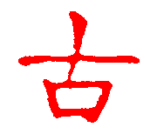
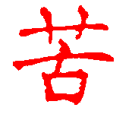
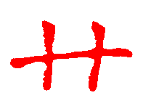
… cursed is the ground for thy sake; in sorrow shalt thou eat of it all the days of thy life; Thorns also and thistles shall it bring forth to thee; and thou shalt eat the herb of the field;
Genesis 3:17-18 KJV
+
=
ANCIENT
WEEDS
SORROW

Slide 39

Now Cain talked with Abel his brother; and it came to pass, when they were in the field, that Cain rose up against Abel his brother and killed him.
Genesis 4:8
Older
Brother
Both Are
Pronounced
“Shun”
Cruel,
Violent

Slide 40
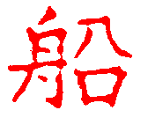

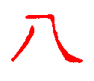
So Noah, with his sons, his wife, and his sons’ wives, went into the ark because of the waters of the flood.
Genesis 7:7
=
+
+
LARGE
SHIP
BOAT
EIGHT
PERSON

Slide 41
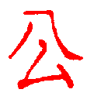
So Noah, with his sons, his wife, and his sons’ wives, went into the ark because of the waters of the flood.
Genesis 7:7
=
+
PUBLIC
EIGHT
SECRET

Slide 42
Then Noah built an altar to the LORD and he took of every clean animal and of every clean bird and offered burnt offerings on the altar.
Genesis 7:20

Slide 43





+
=
HAND
LANCE
ME
ME
+
=
SHEEP
RIGHTEOUSNESS

Slide 44
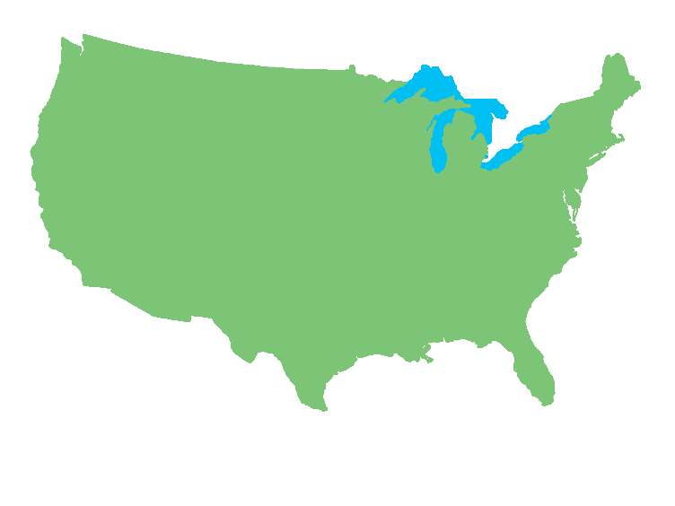
Stories of the Bible were know 4500 years ago in China but have long been forgotten…
Will they be forgotten
elsewhere?

Slide 45

Journaling
As the quarter wraps up; make a list of the similarities and differences between Christianity and other world religious traditions. How are they the same? What are some things that they DO NOT have in common? What image of God appears from the Christian tradition in contrast to others? What does a belief in the Christian God look like in how to treat others? What view of humanity emerges? Come up with a “selling slogan” for Christianity (think bumper-sticker)
Notes:
45

Slide 46
Reading
Book 1:233-256
Good overview
Notes:
46

Slide 47
Time to work
Journal pages
Reading
Notes
Homework
Anything else . . .
Work on stuff!
Notes:
47

Slide 48
Notes:
48

Slide 49
God Loves You
Notes:
49

Slide 50
Dear children, do not let anyone lead you astray. The one who does what is right is righteous, just as he is righteous.
Apostle John

Slide 51
God Loves You

Slide 52
My command is this: Love each other as I have loved you.
Jesus the Christ

Slide 53
Notes:
53

Slide 54
God Loves You
Notes:
54

Slide 55
Notes:
55

