Slide 1
God Loves You
Notes:
1

Slide 2
Thus saith the Lord the King of Israel, and his redeemer the Lord of hosts; I am the first, and I am the last; and beside me there is no God.
Isaiah 44:6 (KJV)

Slide 3
“This is what the Lord says— Israel’s King and Redeemer, the Lord Almighty: I am the first and I am the last; apart from me there is no God.”
Isaiah 44:6 (NIV)

Slide 4
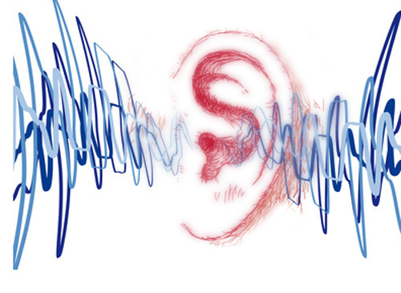
Listening
Isaiah 53
As it was delivered to them
Notes:
4

Slide 5
Isaiah 53 is unread. It is the story of Christ
Notes:
5

Slide 6
Why was/is reaching the Jews difficult?
Notes:
6

Slide 7

Outlining the Semester
Q4: Proclaim Christianity Project
Roles
Expectations
Weekly Overview
Weekly Progress
Questions
???
Notes:
7

Slide 8

Outline upcoming project
Administrator
Media Specialists
Fabricators
Researchers
Artists
Technology Experts
Thoughts? Reflections?
Notes:
8

Slide 9
Discussion
Begin to figure out who you are and who you will be . . .
Thoughts? Reflections?
Notes:
9

Slide 10
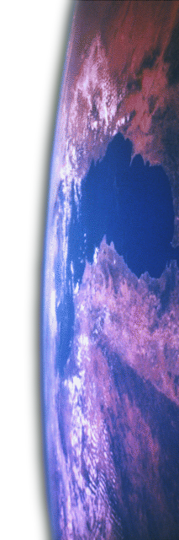

SDA details
Biblical roots: taking Scripture seriously
Notes:
10

Slide 11


Keep working!
Checkups during the week
Notes:
11

Slide 12
Notes:
12

Slide 13
God Loves You
Notes:
13

Slide 14
Preaching the GOSPEL!
Notes:
14

Slide 15
Notes:
15

Slide 16
God Loves You
Notes:
16

Slide 17
Notes:
17

Slide 18
God Loves You

Slide 19
Notes:
19

Slide 20
God Loves You
Notes:
20

Slide 21
Notes:
21

