Slide 1
God Loves You
Notes:
1

Slide 2
Who hath believed our report? and to whom is the arm of the Lord revealed? For he shall grow up before him as a tender plant, and as a root out of a dry ground: he hath no form nor comeliness; and when we shall see him, there is no beauty that we should desire him. He is despised and rejected of men; a man of sorrows, and acquainted with grief: and we hid as it were our faces from him; he was despised, and we esteemed him not. Surely he hath borne our griefs, and carried our sorrows: yet we did esteem him stricken, smitten of God, and afflicted. But he was wounded for our transgressions, he was bruised for our iniquities: the chastisement of our peace was upon him; and with his stripes we are healed. All we like sheep have gone astray; we have turned every one to his own way; and the Lord hath laid on him the iniquity of us all.
Isaiah 53:1-6 (KJV)

Slide 3
Who has believed our message and to whom has the arm of the Lord been revealed? He grew up before him like a tender shoot, and like a root out of dry ground. He had no beauty or majesty to attract us to him, nothing in his appearance that we should desire him. He was despised and rejected by mankind, a man of suffering, and familiar with pain. Like one from whom people hide their faces he was despised, and we held him in low esteem. Surely he took up our pain and bore our suffering, yet we considered him punished by God, stricken by him, and afflicted. But he was pierced for our transgressions, he was crushed for our iniquities; the punishment that brought us peace was on him, and by his wounds we are healed. We all, like sheep, have gone astray, each of us has turned to our own way; and the Lord has laid on him the iniquity of us all.
Isaiah 53:1-6 (NIV)

Slide 4
Does Jesus still reach out today?
Notes:
4

Slide 5
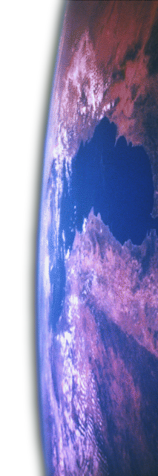

SDA details
Biblical roots: practical living
Notes:
5

Slide 6
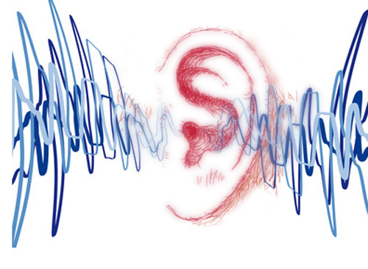
Listening
Isaiah 58
As it was delivered to them
Notes:
6

Slide 7
Notes:
7

Slide 8
God Loves You
Notes:
8

Slide 9


Keep working!
Checkups during the week
Notes:
9

Slide 10
Notes:
10

Slide 11
Notes:
11

Slide 12
God Loves You
Notes:
12

Slide 13
Notes:
13

Slide 14
God Loves You

Slide 15
Notes:
15

Slide 16
God Loves You
Notes:
16

Slide 17
Notes:
17

